Slide 1
Reading, Listening and Creating Kamishibai Stories
LOGOS FROM TURKEY
Sıdıka Akdemir Science and Art Center
İzmir-Turkey

Slide 2
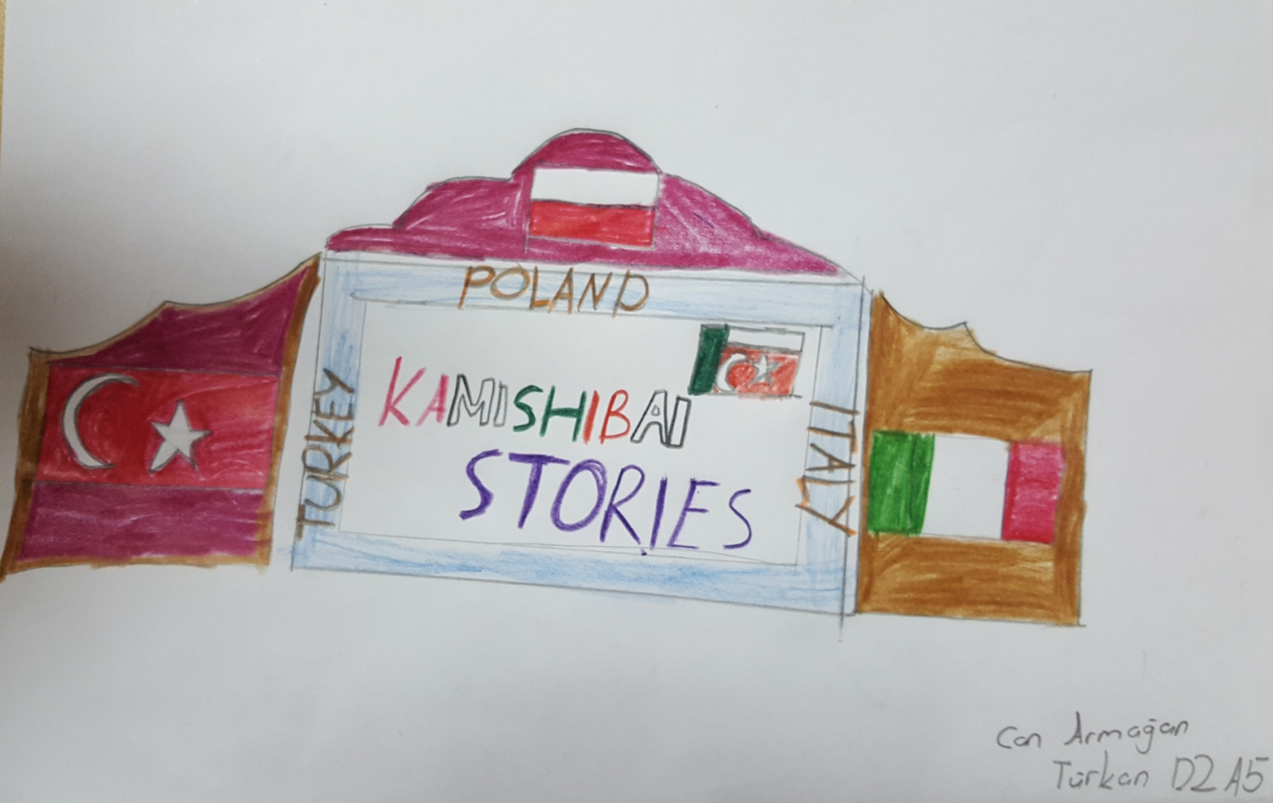
Can Armağan TÜRKKAN

Slide 3
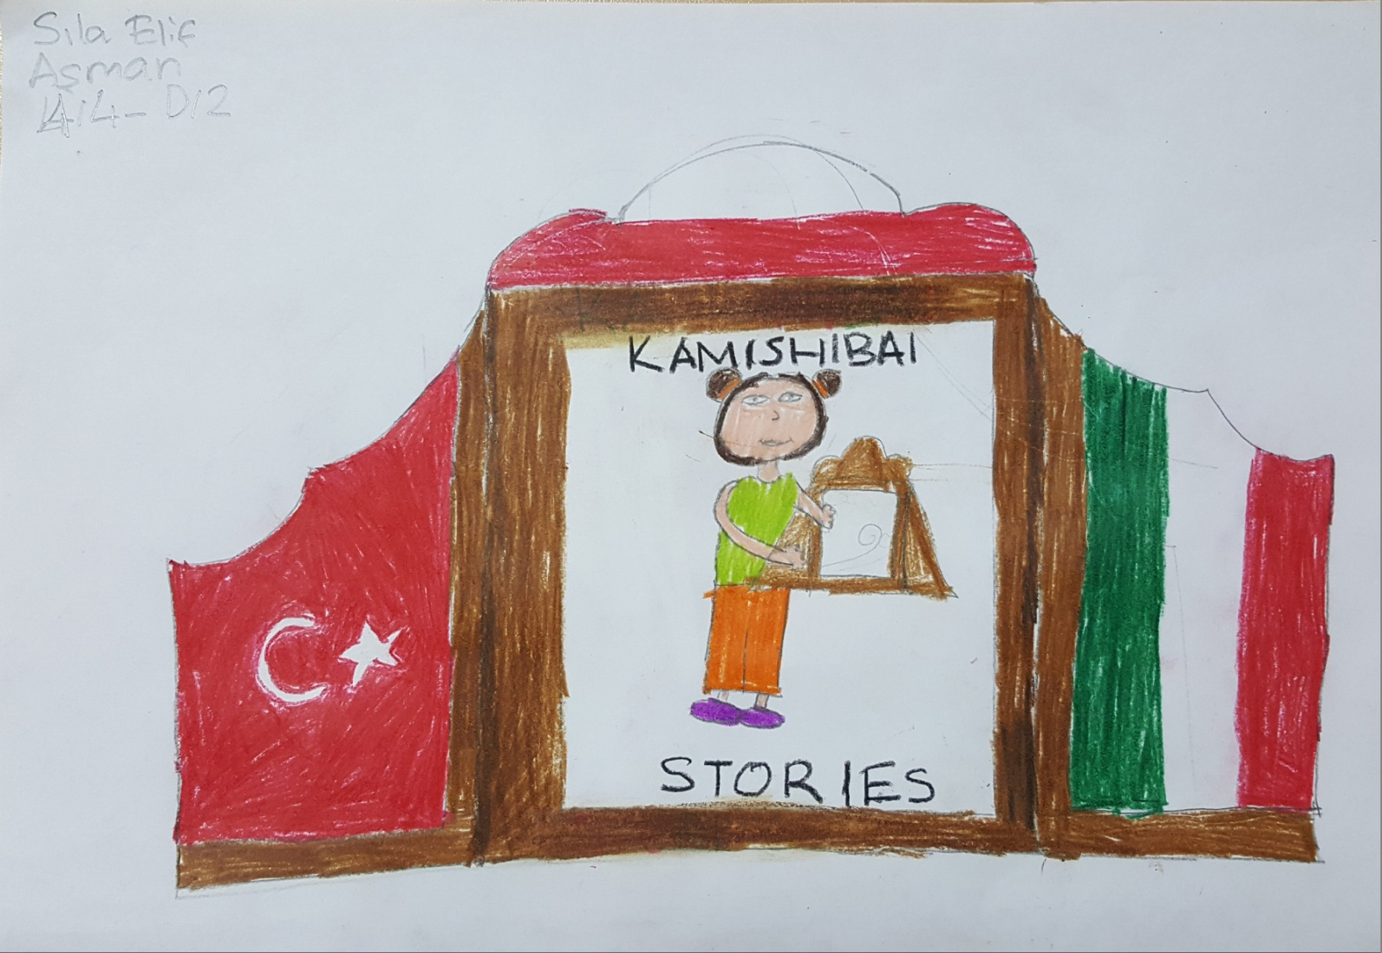
SIla Elİf AŞMAN

Slide 4
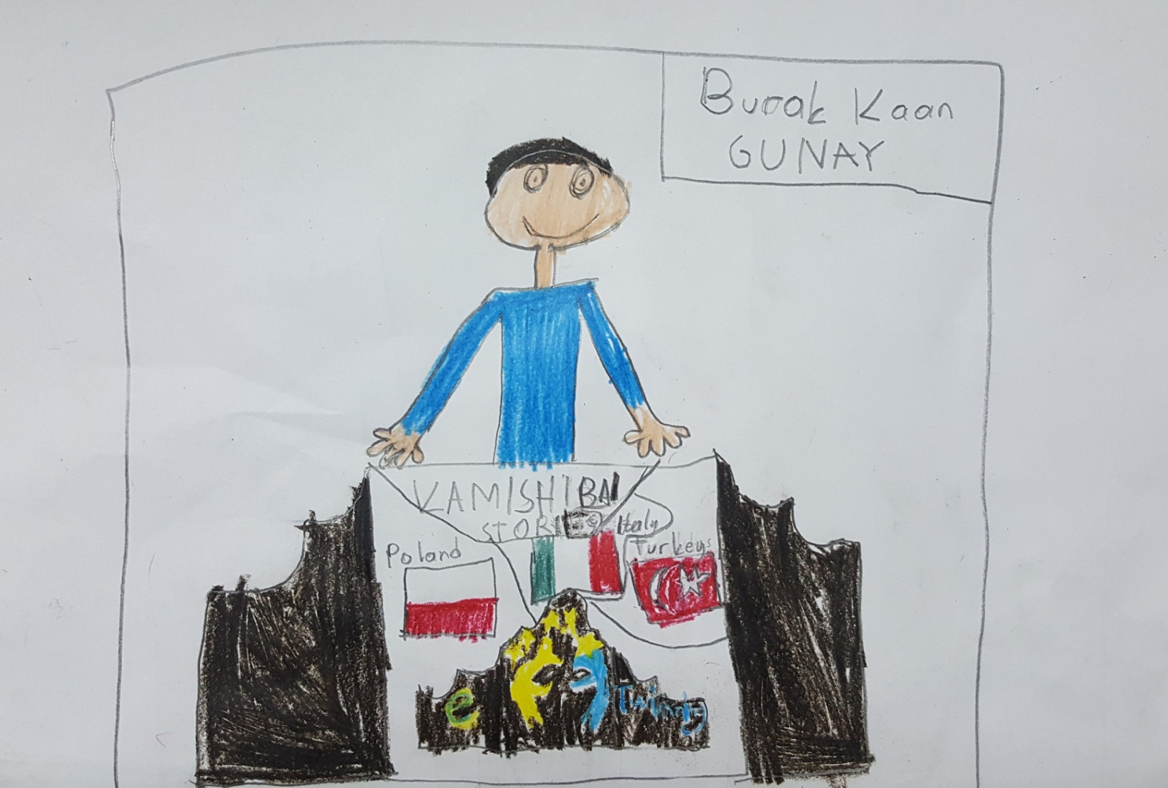
Burak Kaan GÜNAY

Slide 5
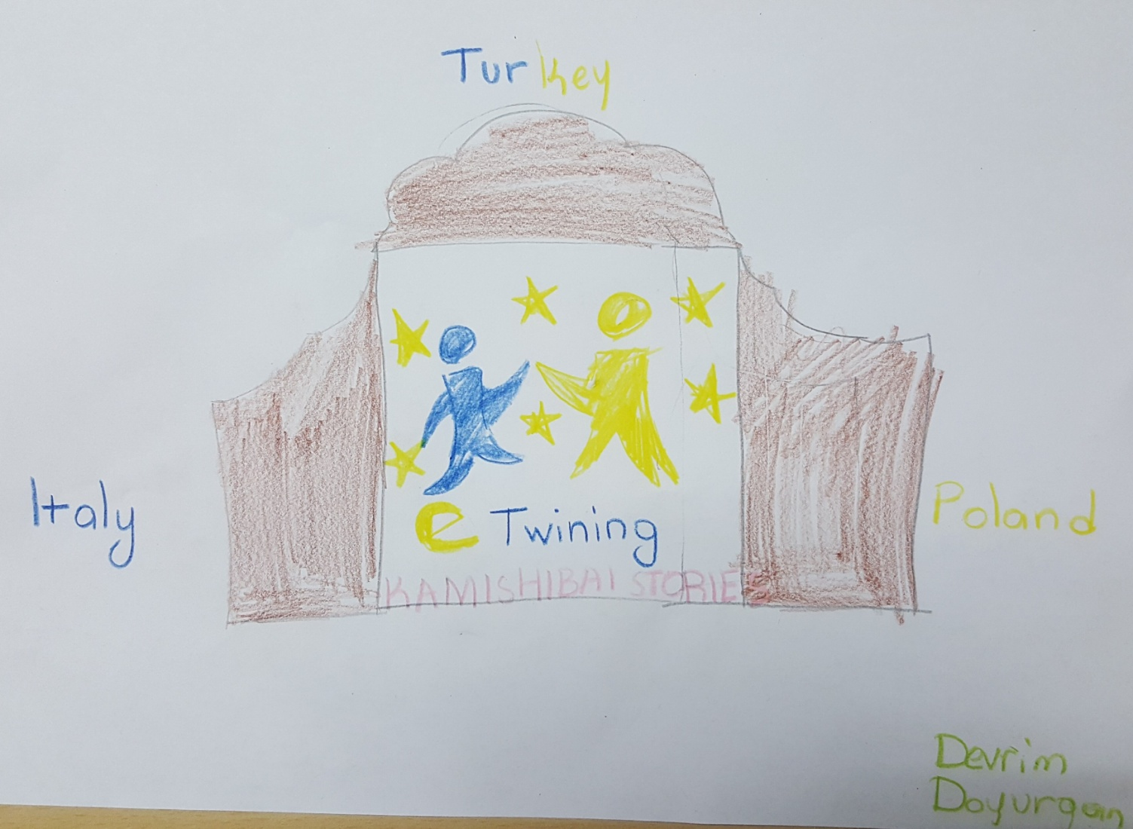
Devrİm DOYURGAN

Slide 6
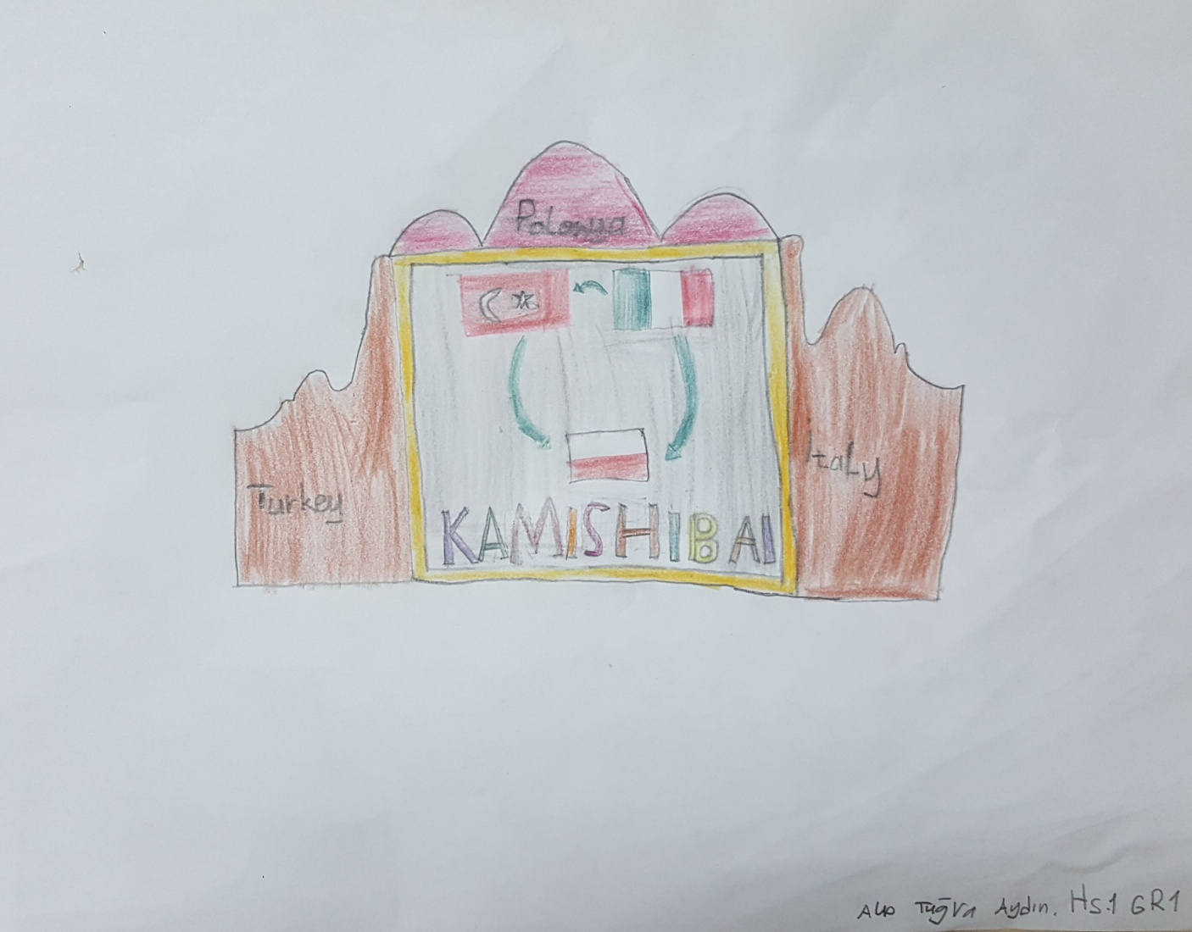
Alp Tuğra AYDIN

Slide 7
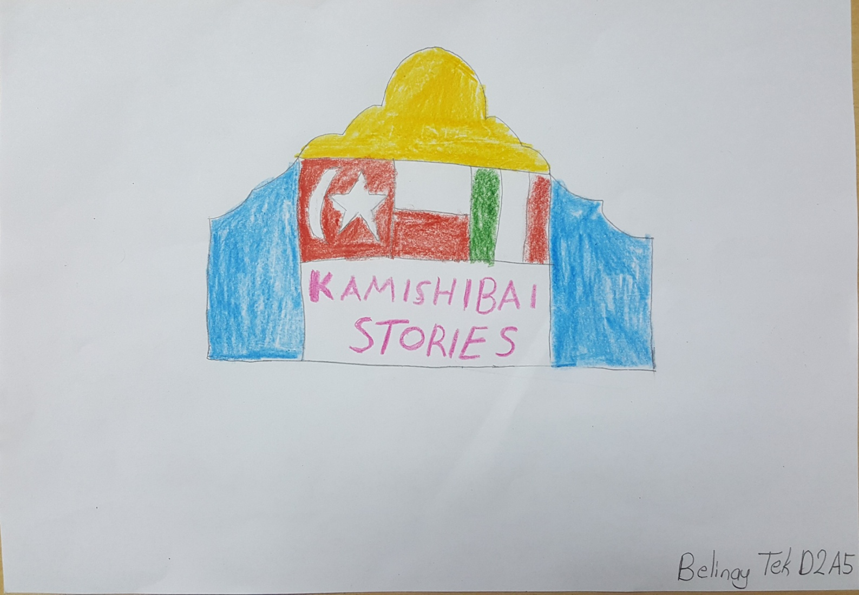
Belİnay TEK

Slide 8
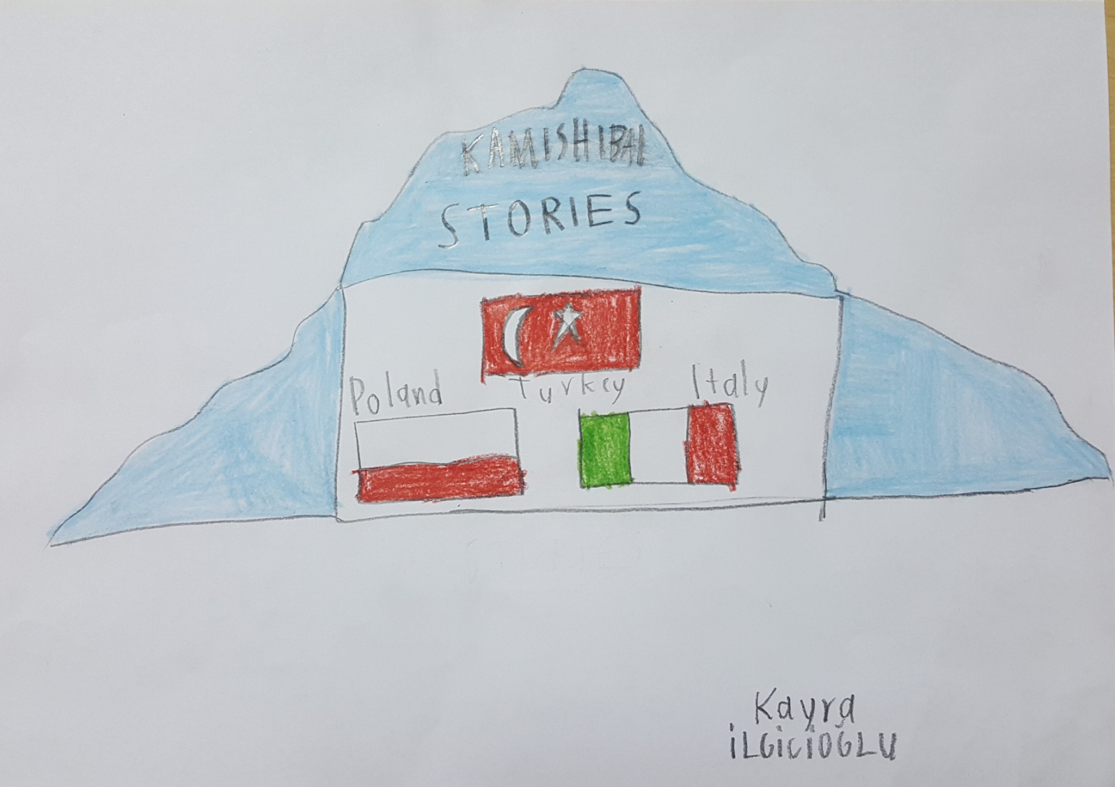
Kayra İLGİCİOĞLU

