Slide 1
The Earth Day 2021
PHOTOS FROM OUR NEIGHBOURHOOD

Slide 2
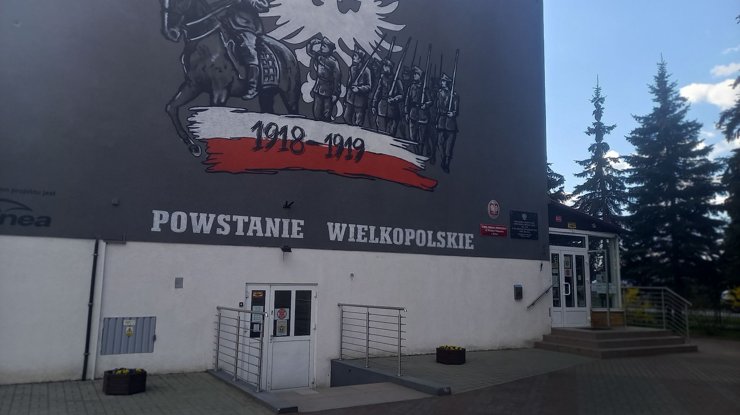
OUR SCHOOL

Slide 3
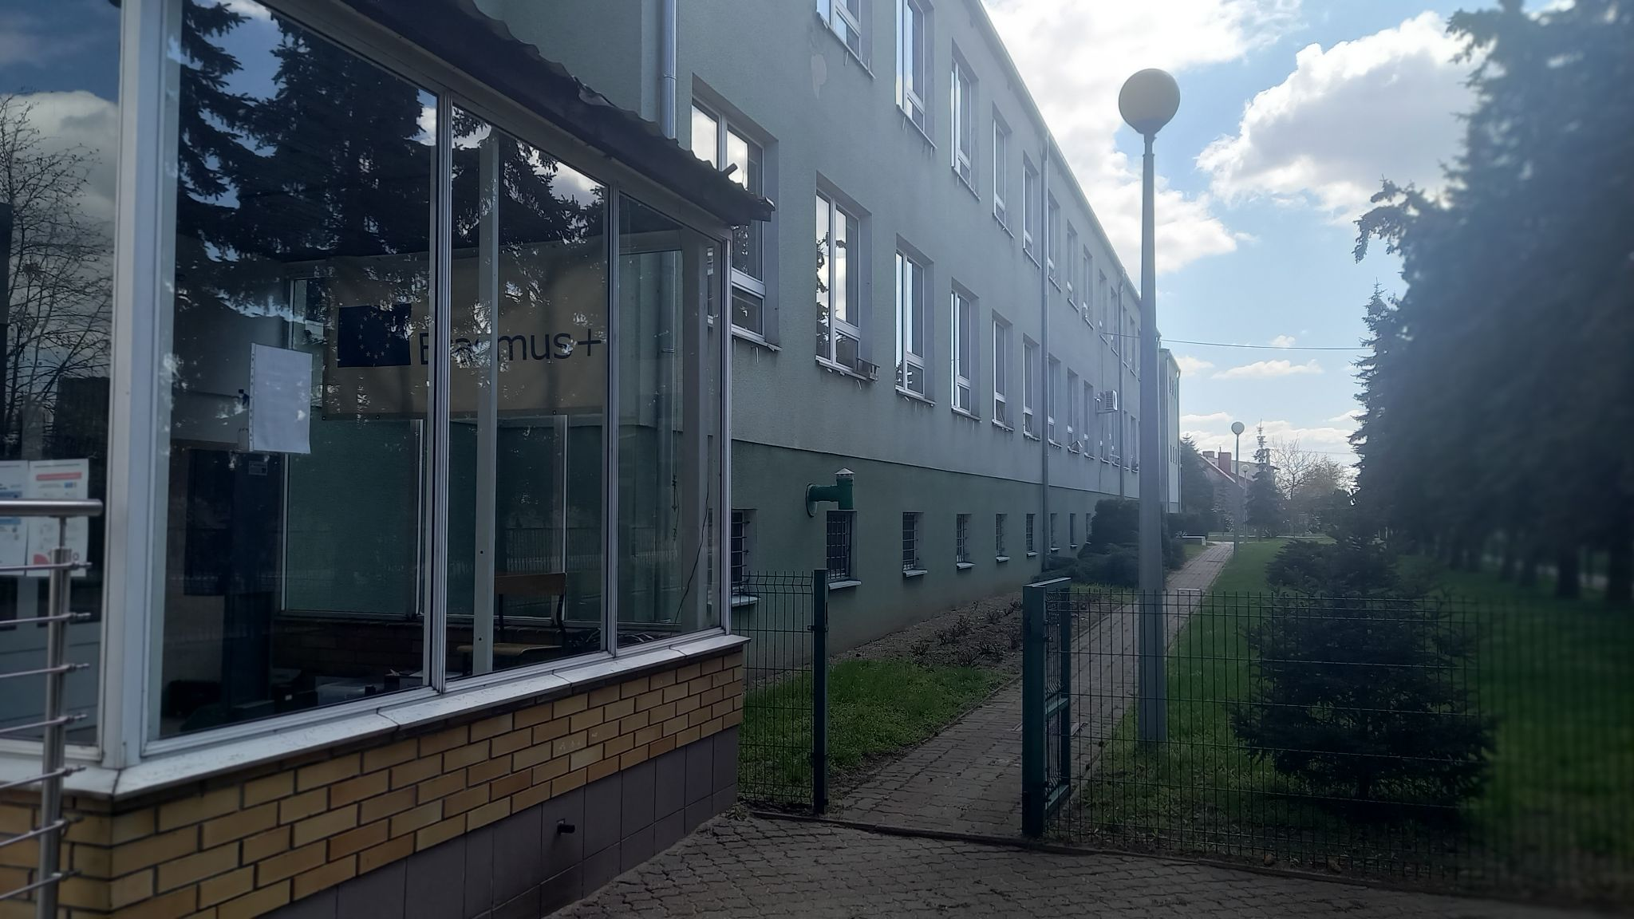

Slide 4
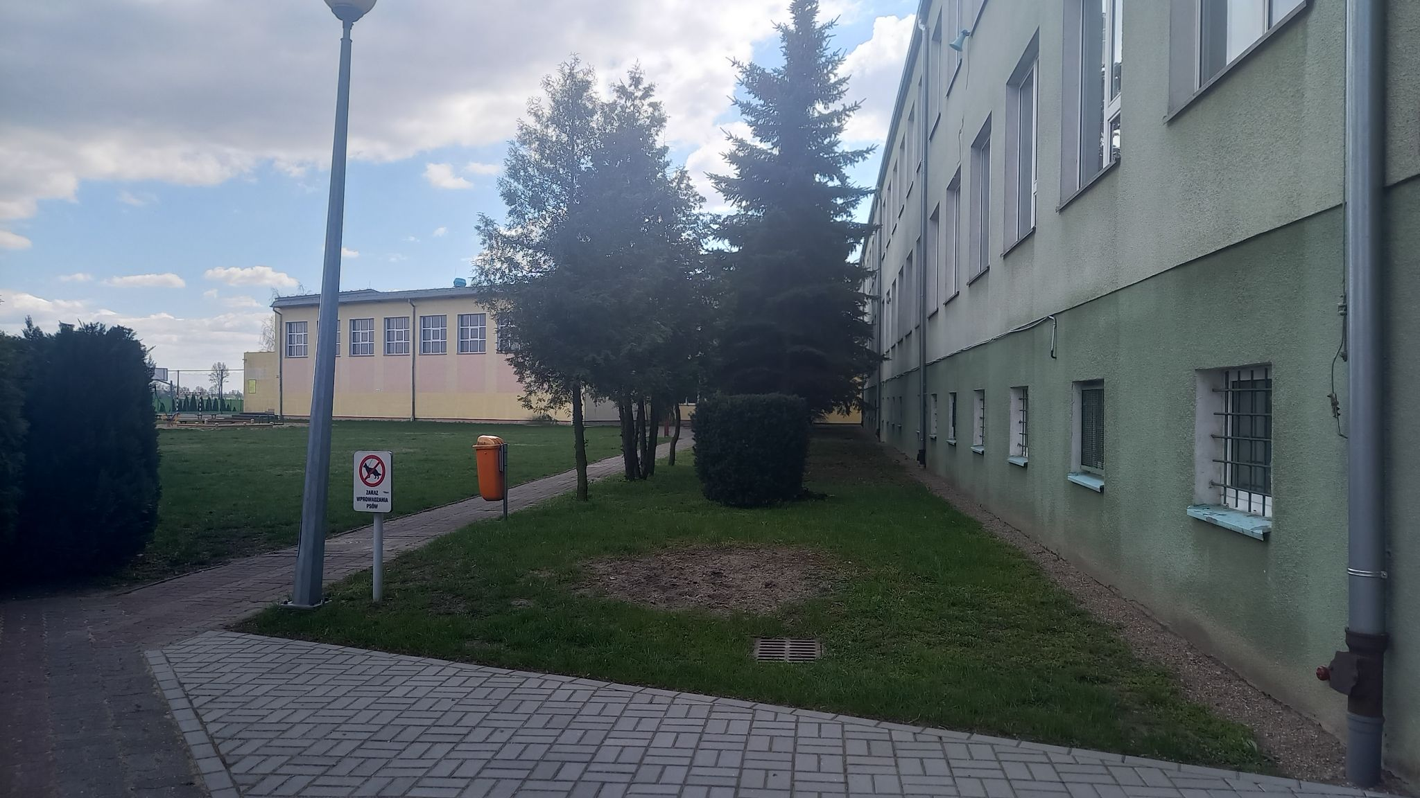

Slide 5
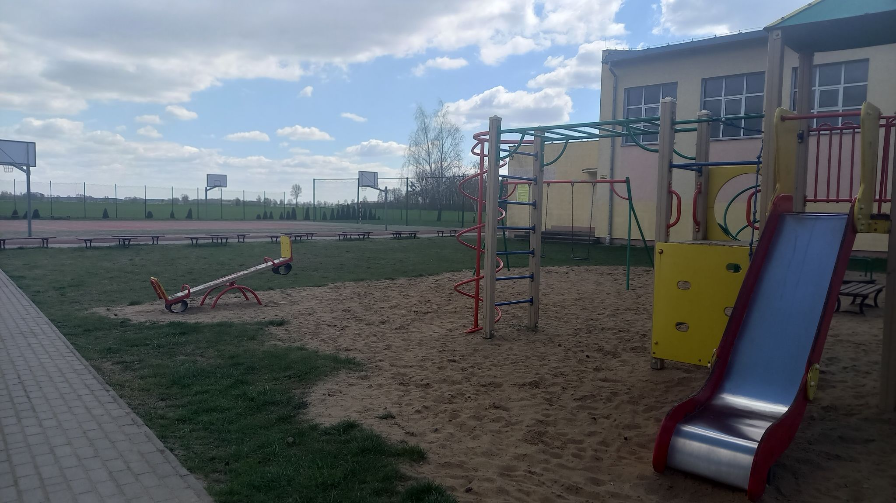
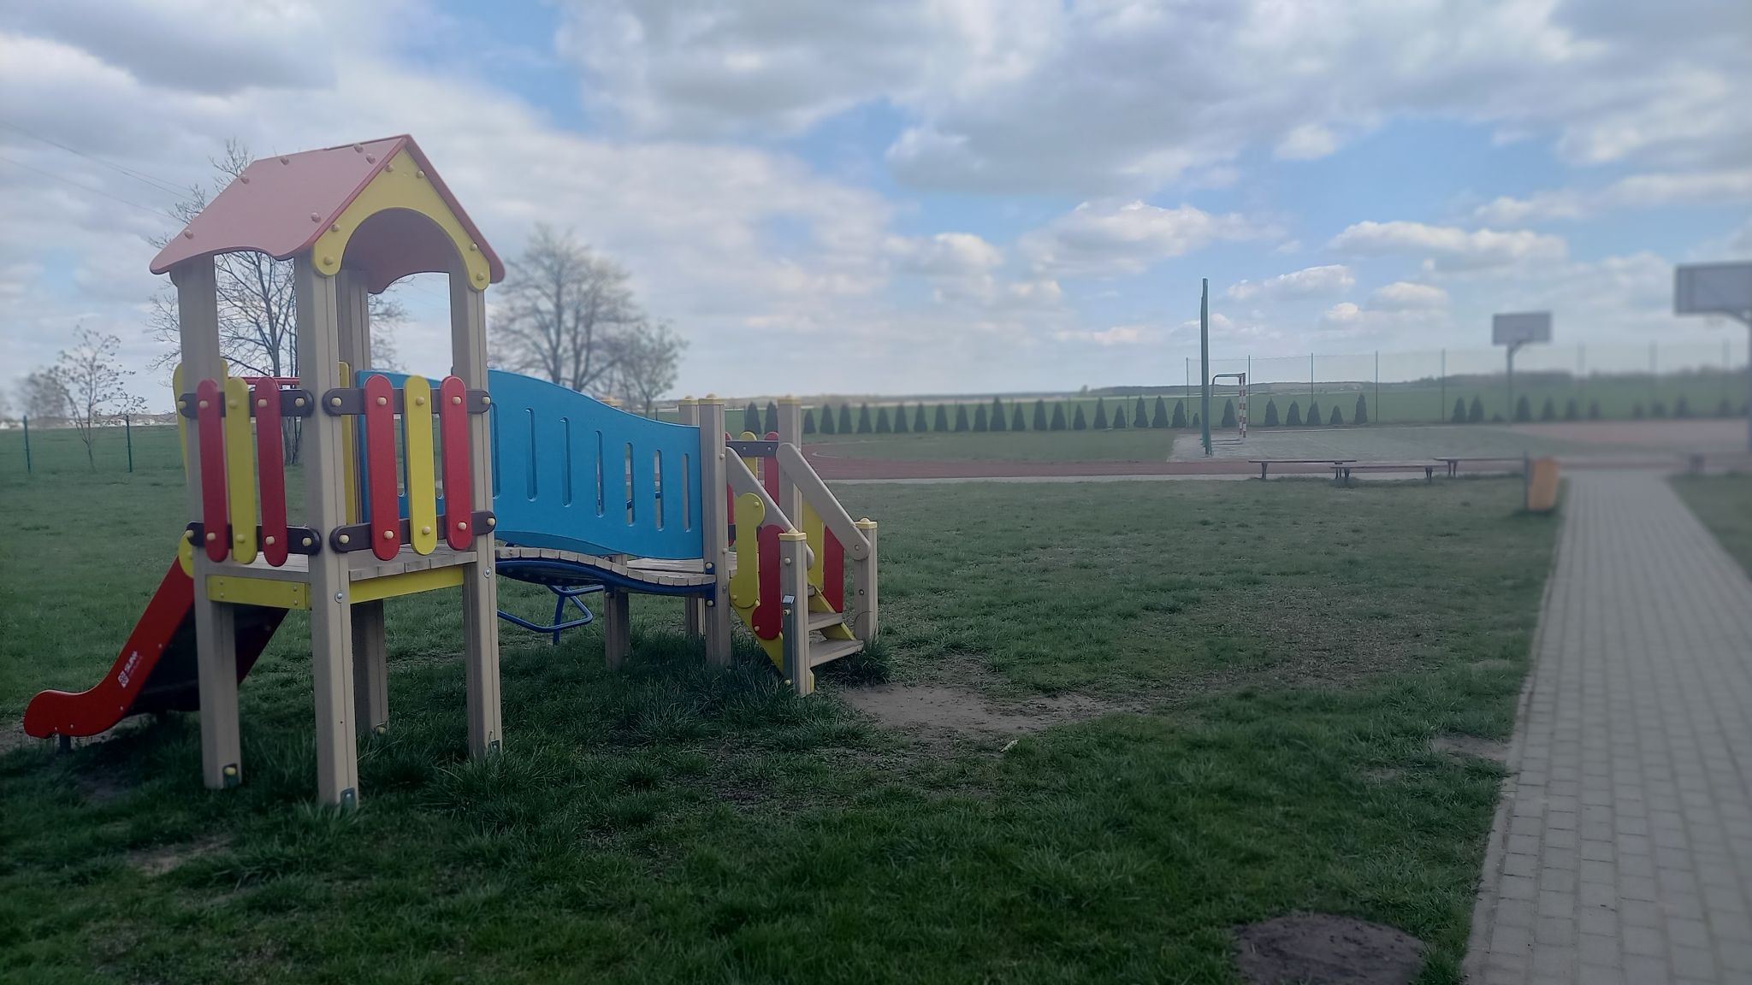
SCHOOL
PLAYGORUND

Slide 6
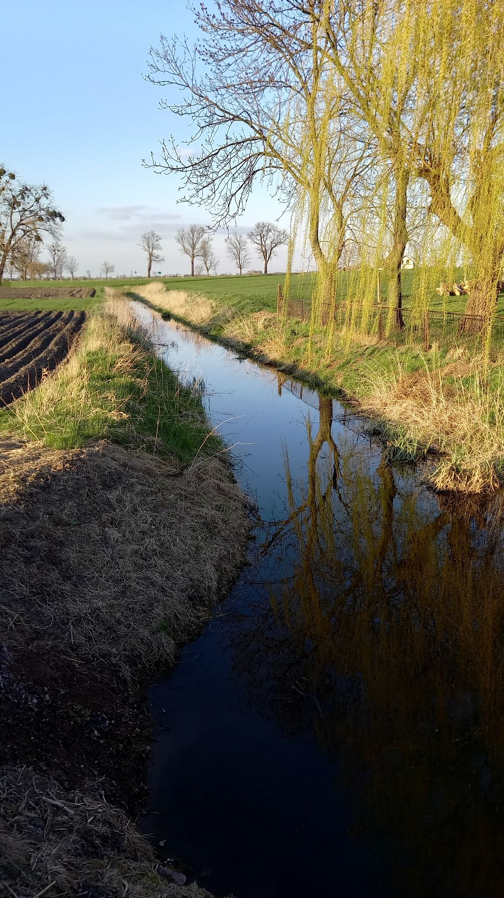
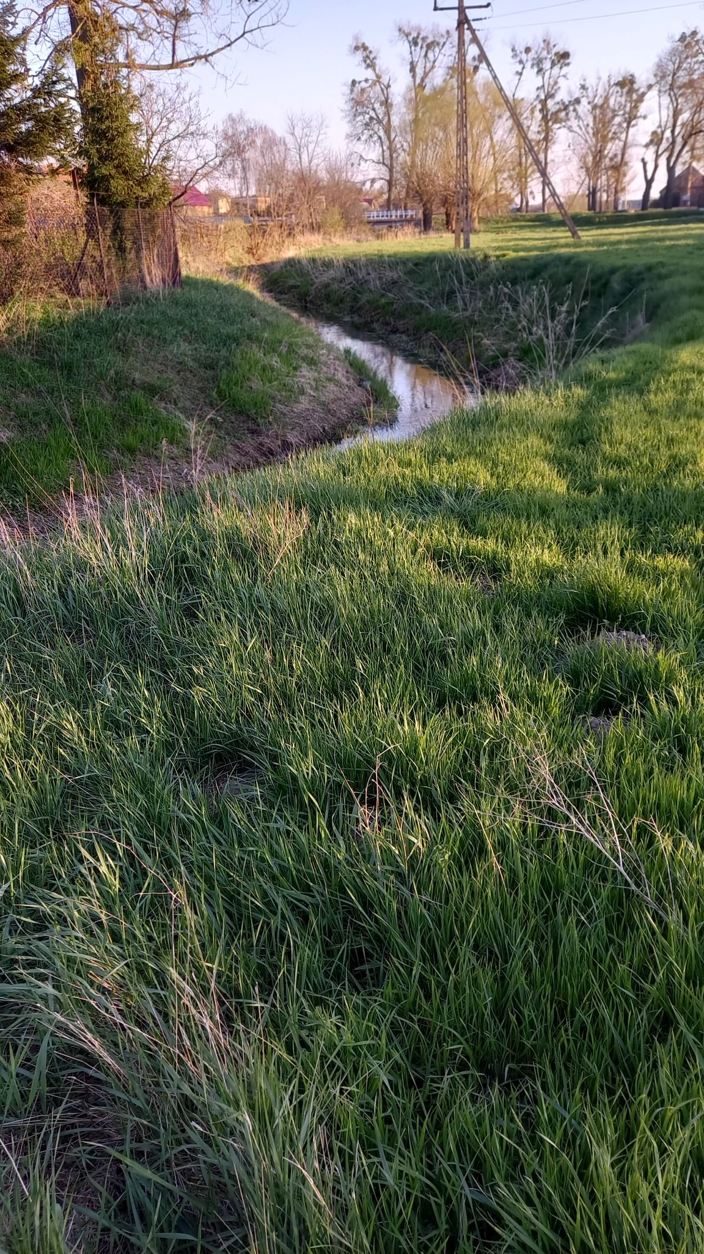
LOCAL RIVER

Slide 7
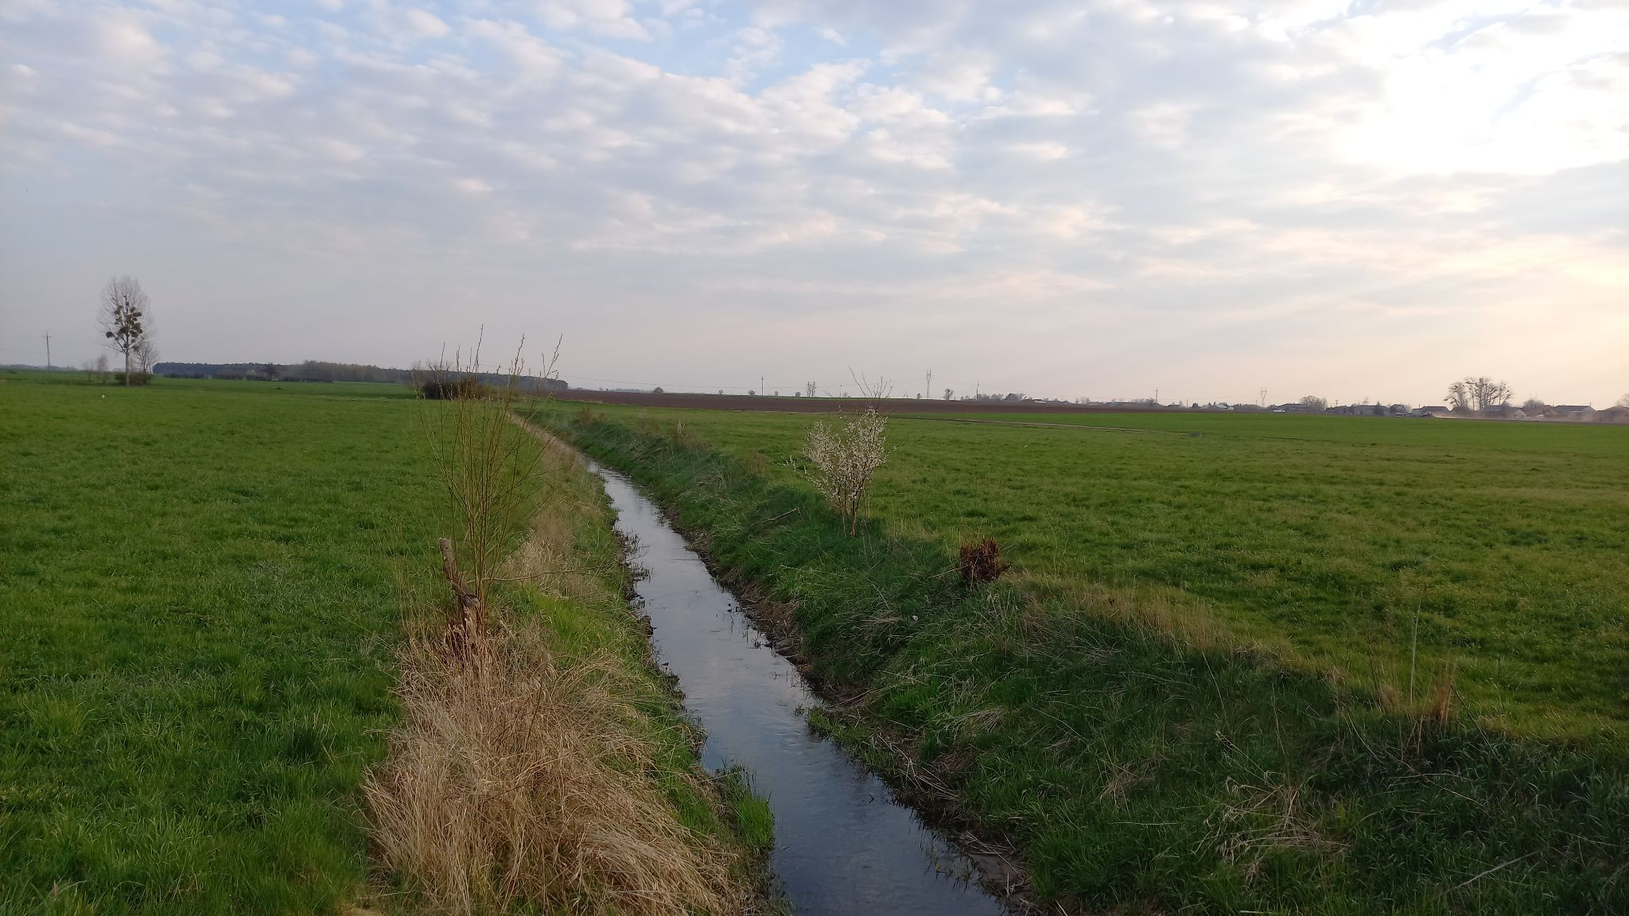

Slide 8
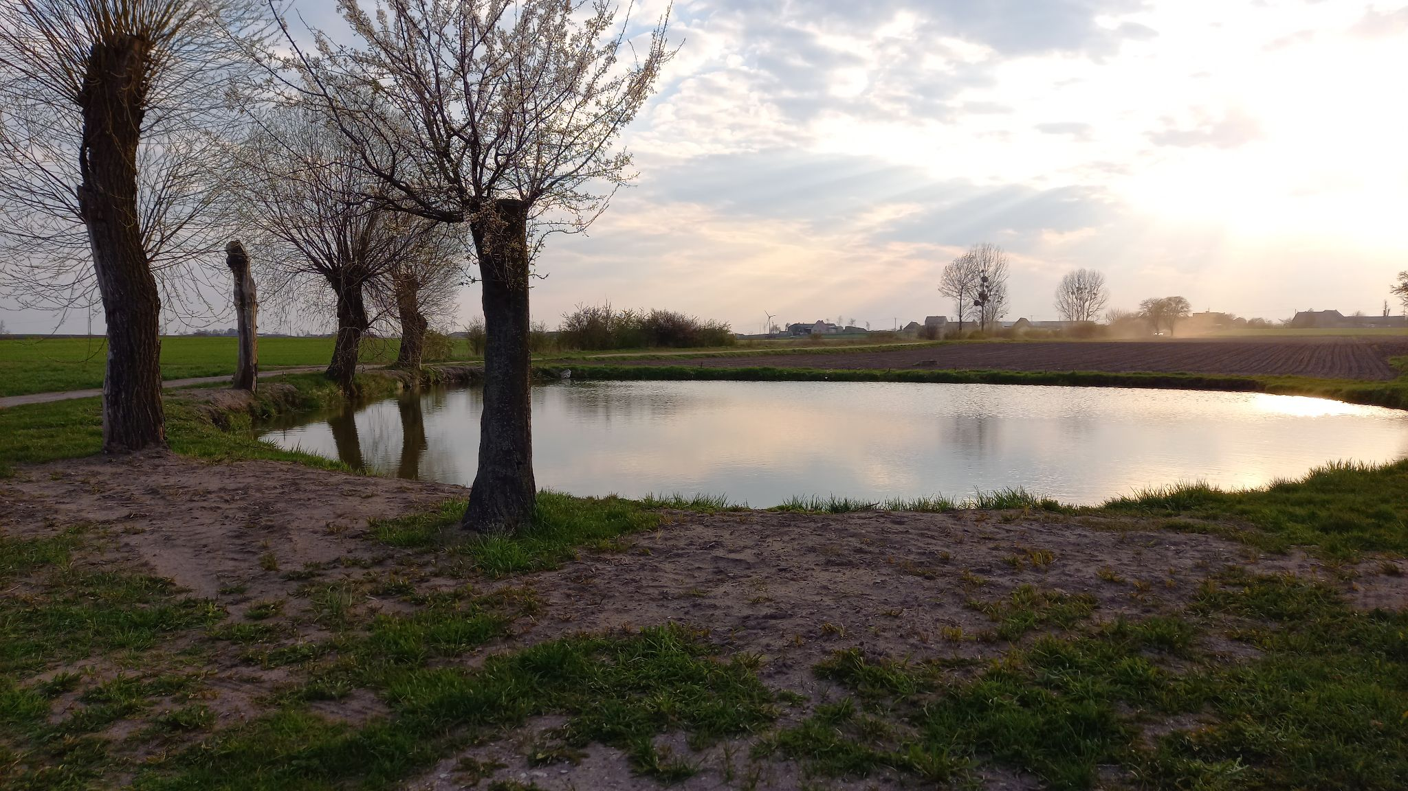
ONE OF OUR LOCAL PONDS

Slide 9
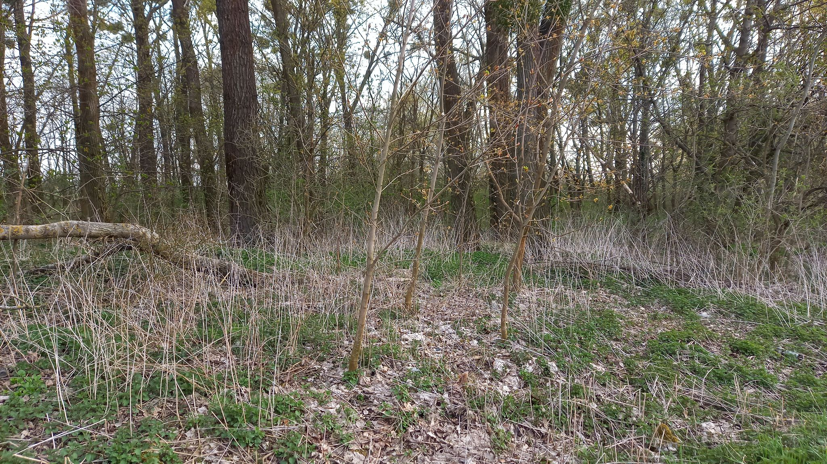
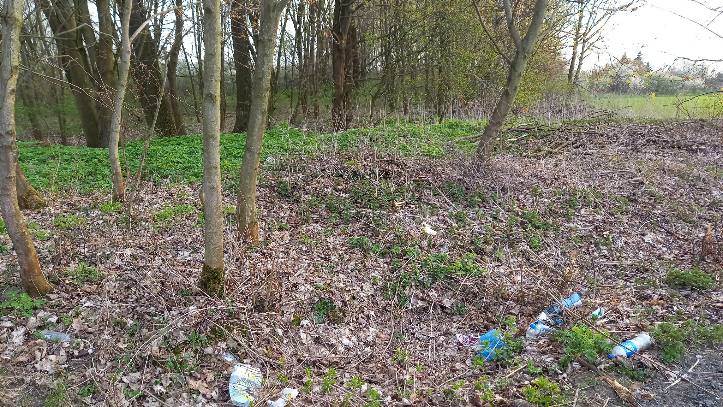
A SMALL FOREST
CLEAN VS. POLLUTED

Slide 10
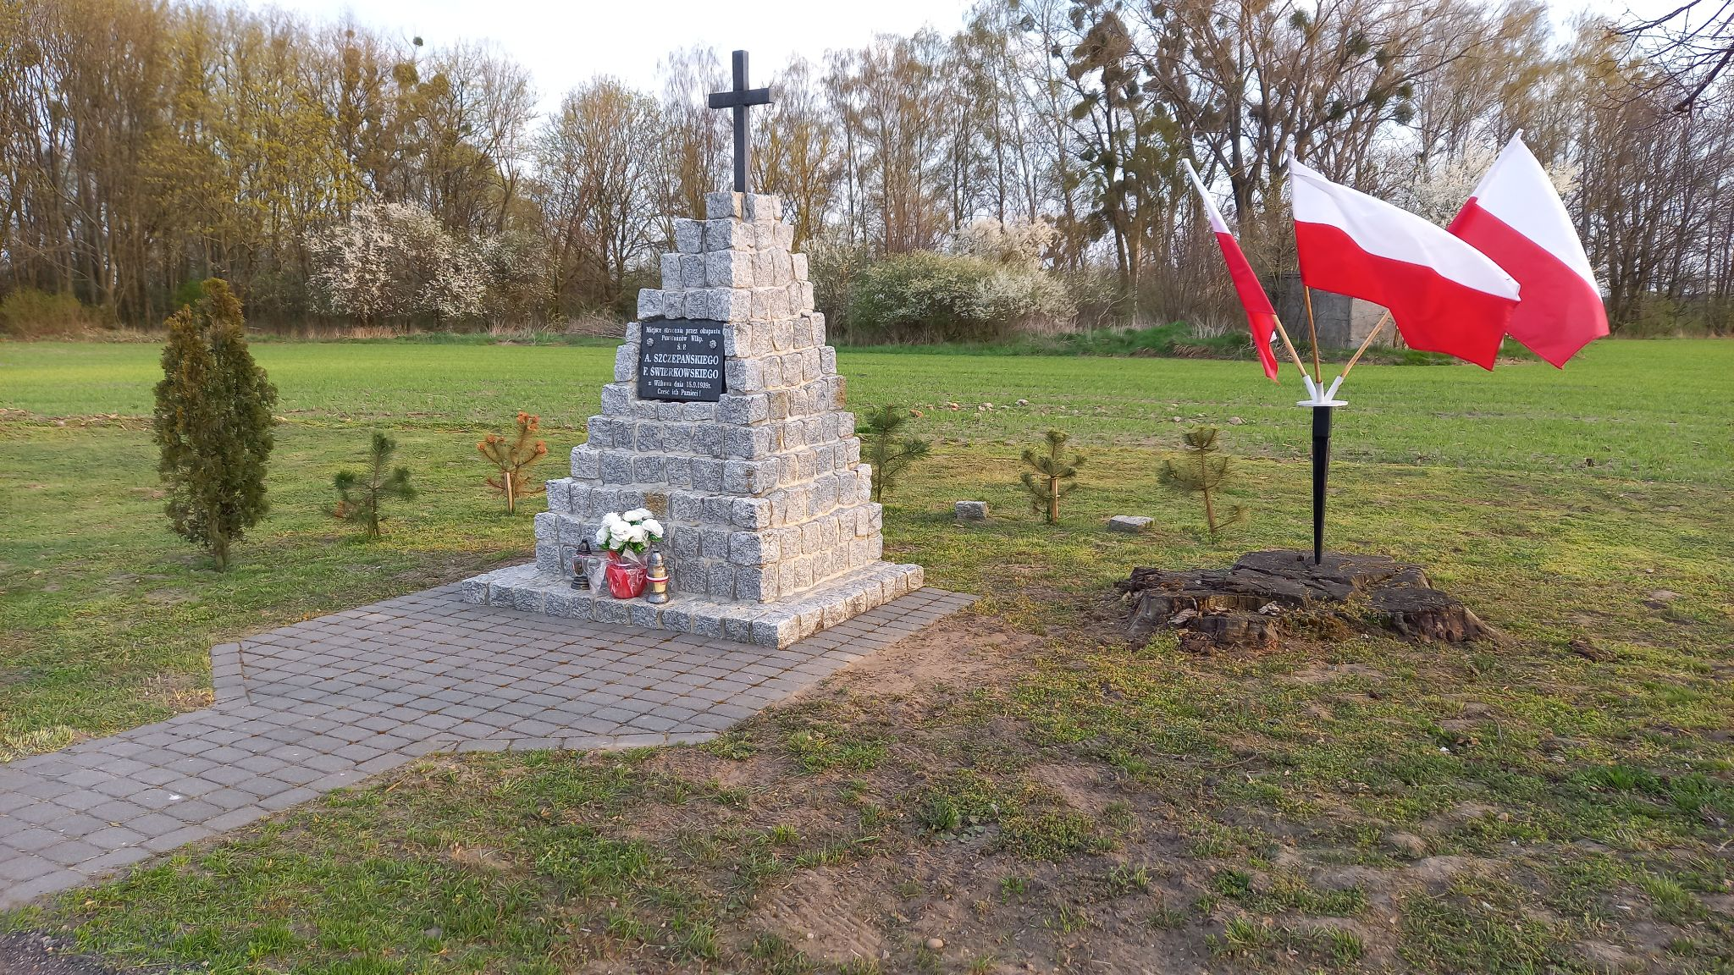
THE MONUMENT COMMEMORATING VICTIMS OF THE EXECUTION (TWO PARTICIPANTS OF THE GREATER POLAND UPRISING
WERE EXECUTED
HERE)

Slide 11
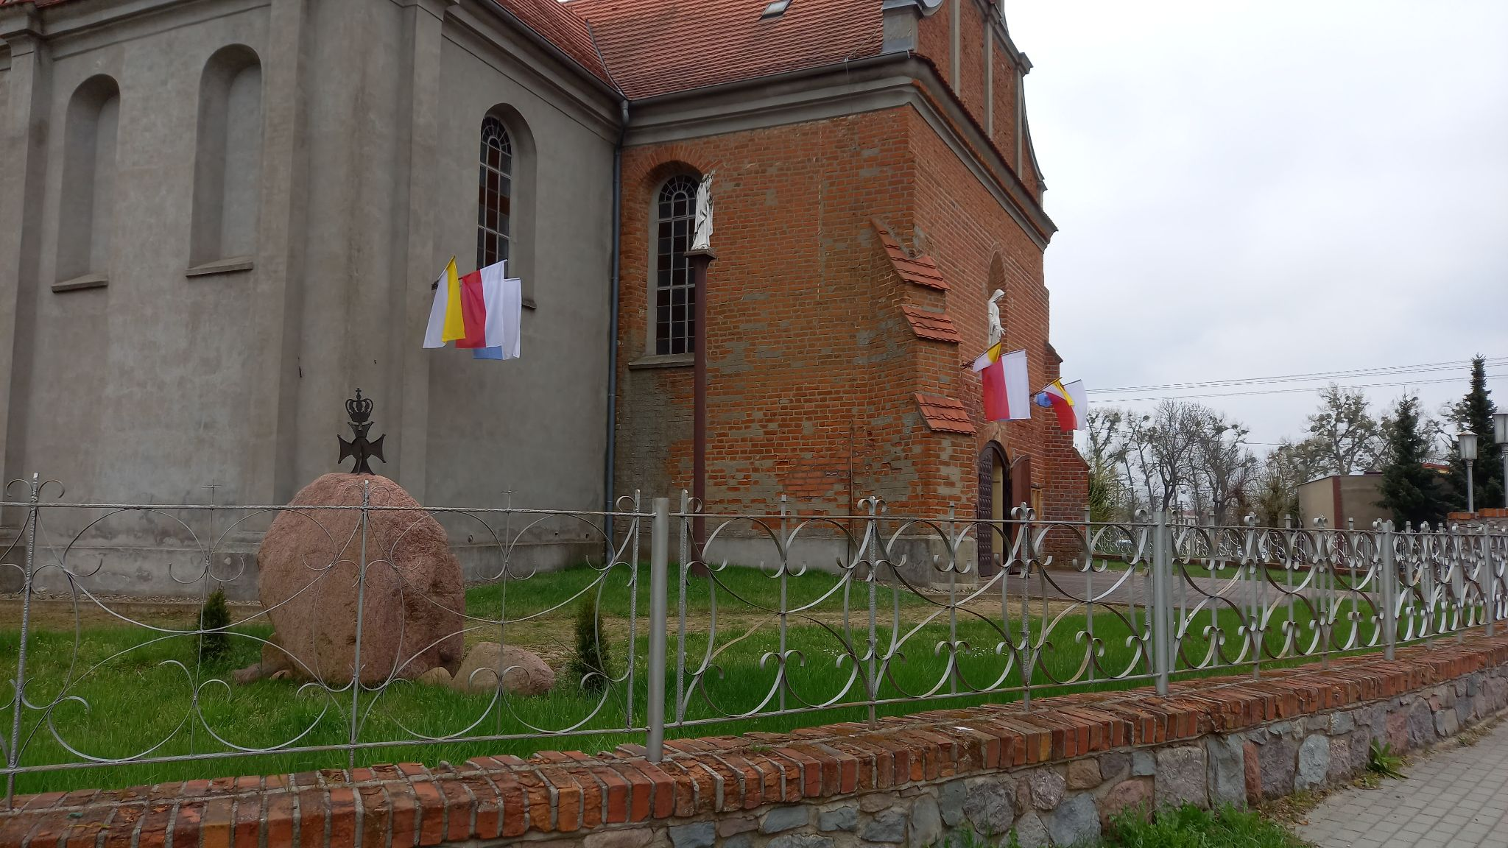
LOCAL CHURCH

Slide 12
You could see a few photos from our neighbourhood taken on the Earth Day 2021.
As you can see, we found only one place which is polluted.
We think nowadays people in our village really pay attention to their neighbourhood.
Photos were taken by Year 6 students
Presentation prepared under the supervision of Elwira Wasiewicz

Slide 13
The European Commission's support for the production of this publication does not constitute an endorsement of the contents, which reflect the views only of the authors, and the Commission cannot be held responsible for any use which may be made of the information contained therein.
Wsparcie Komisji Europejskiej dla produkcji tej publikacji nie stanowi poparcia dla treści, które odzwierciedlają jedynie poglądy autorów, a Komisja nie może zostać pociągnięta do odpowiedzialności za jakiekolwiek wykorzystanie informacji w niej zawartych.

