Slide 1
Erasmus + KA 229 – School exchange partnership
CLIL across the borders – enjoy and learn
2019-1-CZ01-KA229-061391_2
OS `DESPOT STEFAN VISOKI` - DESPOTOVAC - SERBIA

Slide 2
10 tips for saving energy
Made by:
MIHAJLO AND FILIP

Slide 3
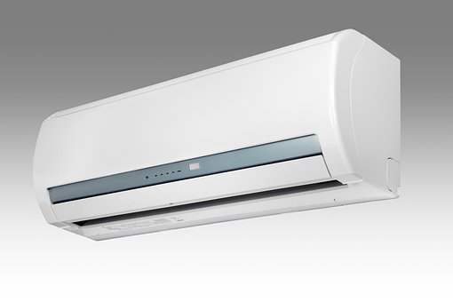
1. Service your air conditioner
Easy maintenance such as routinely replacing or cleaning air filters can lower your cooling system’s energy consumption by up to 15 percent. Also, the first day of spring could serve as a reminder to check your air conditioner’s evaporator coil, which should be cleaned annually to ensure the system is performing at optimal levels.

Slide 4
2. Open windows
Opening windows creates a cross-wise breeze, allowing you to naturally cool your home without switching on air conditioners. This is an ideal tactic in spring when temperatures are mild.

Slide 5
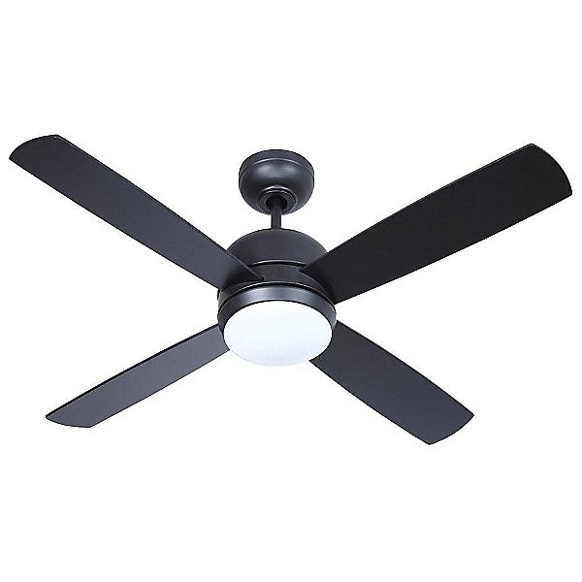
3. Use ceiling fans.
Cooling your home with ceiling fans will allow you to raise your thermostat four degrees. This can help lower your electricity bills without sacrificing overall comfort.

Slide 6
4. Cook outside.
On warmer spring days, keep the heat out of your home by using an outdoor grill instead of indoor ovens.

Slide 7
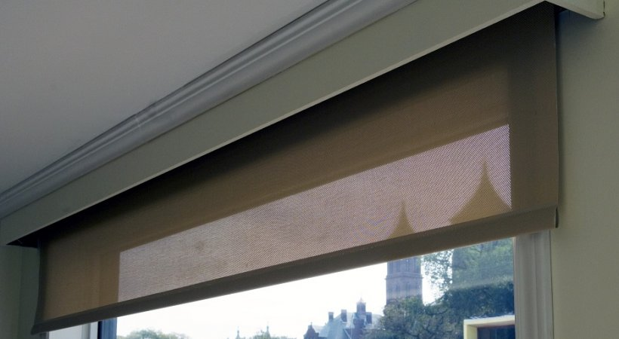
5. Install window treatments
Energy efficient window treatments or coverings such as blinds, shades and films can slash heat gain when temperatures rise. These devices not only improve the look of your home but also reduce energy costs.

Slide 8
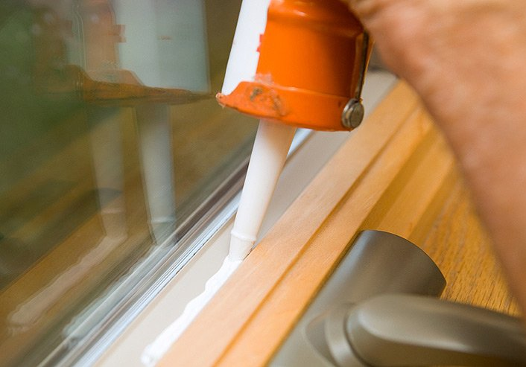
6. Caulk air leaks
Using low-cost caulk to seal cracks and openings in your home keeps warm air out - and cash in your wallet.

Slide 9
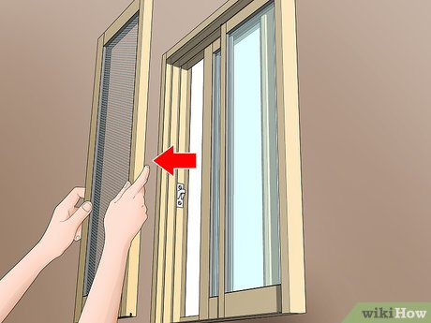
7.Bring in sunlight
During daylight hours, switch off artificial lights and use windows and skylights to brighten your home.

Slide 10
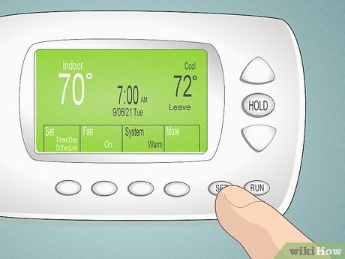
8. Set the thermostat.
On warm days, setting a programmable thermostat to a higher setting when you are not at home can help reduce your energy costs by approximately 10 percent.

Slide 11
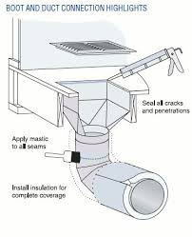
9. Seal ducts
Air loss through ducts can lead to high electricity costs, accounting for nearly 30 percent of a cooling system’s energy consumption. Sealing and insulating ducts can go a long way toward lowering your electricity bills.

Slide 12
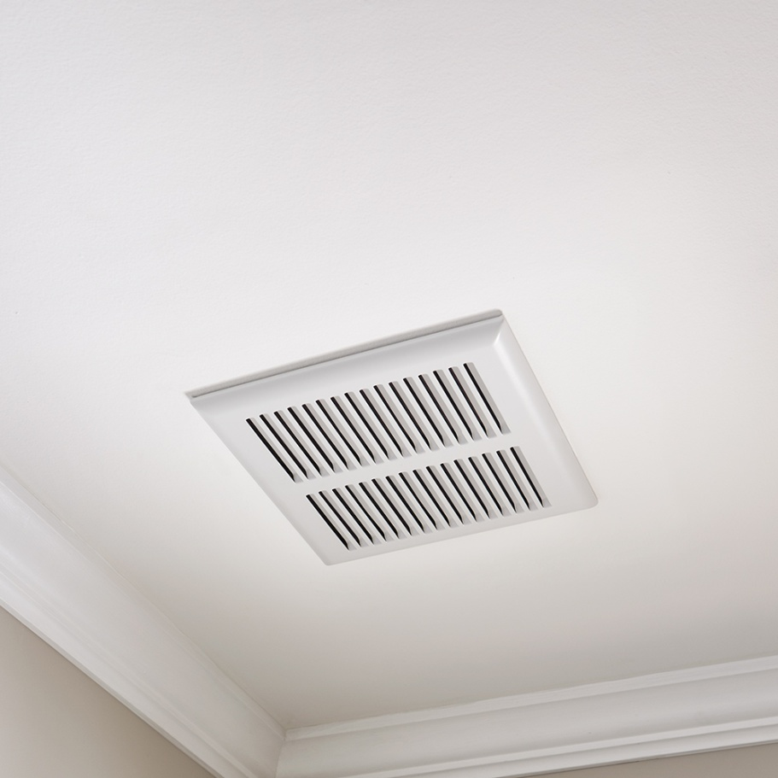
10. Switch on bathroom fans.
Bathroom fans suck out heat and humidity from your home, improving comfort.

Slide 13
Thanks for watching!

