Slide 1
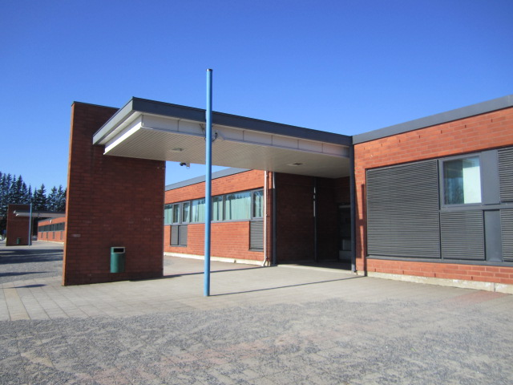
Pikkola school
Finland

Slide 2
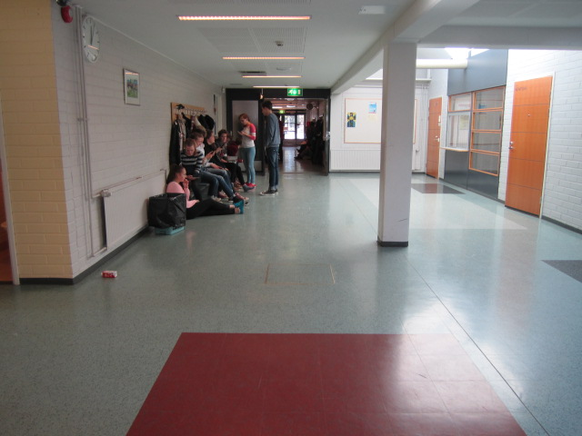
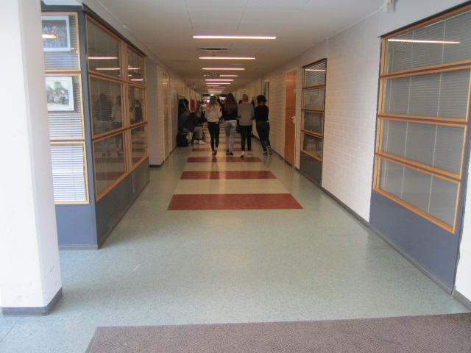
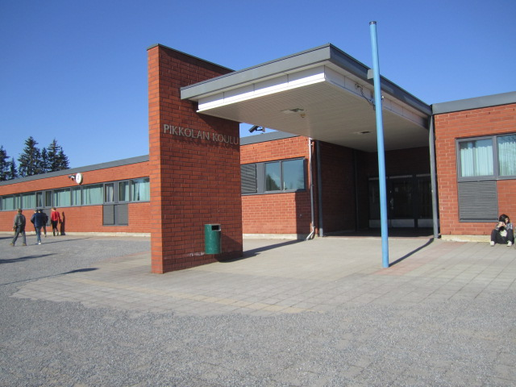
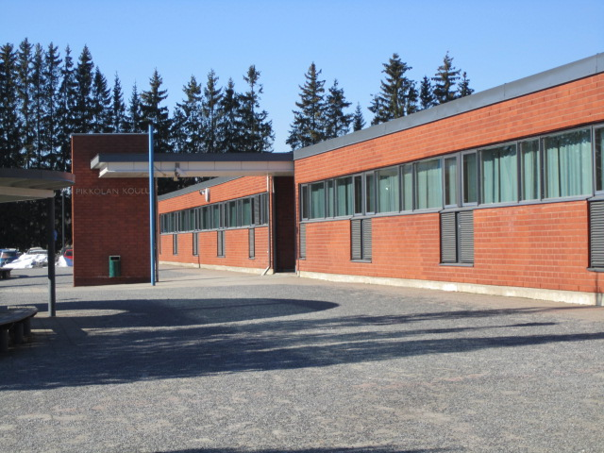
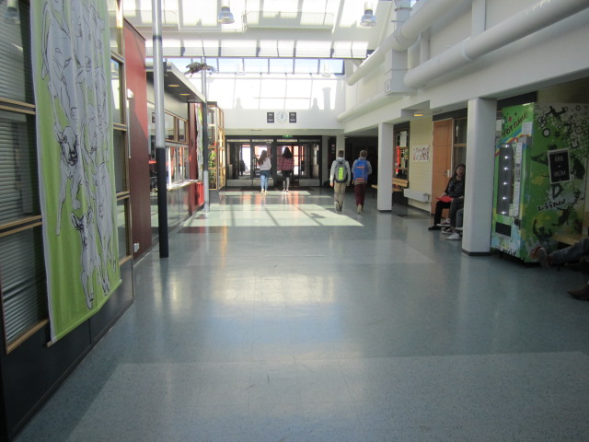
The buildings
Pictures of the main building

Slide 3
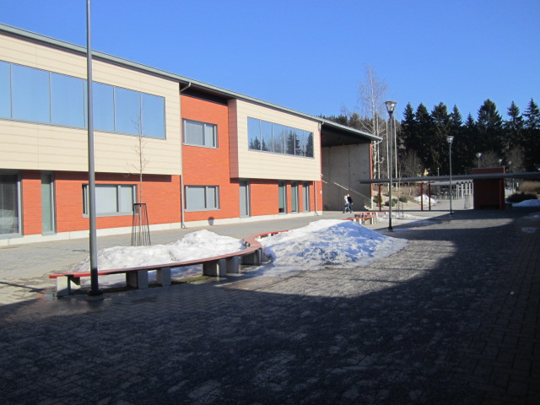
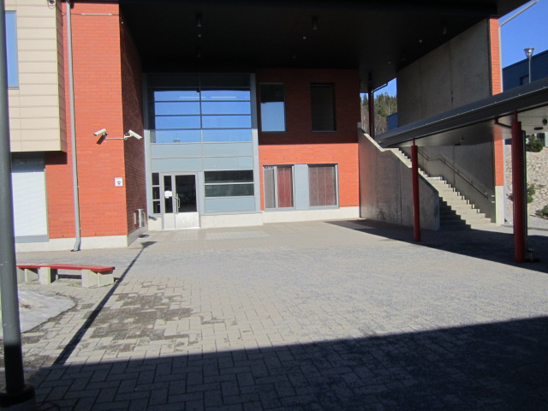
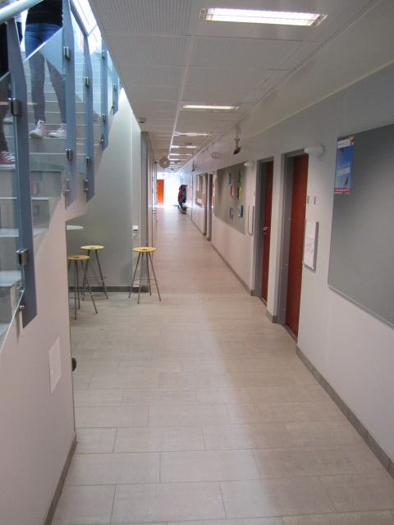
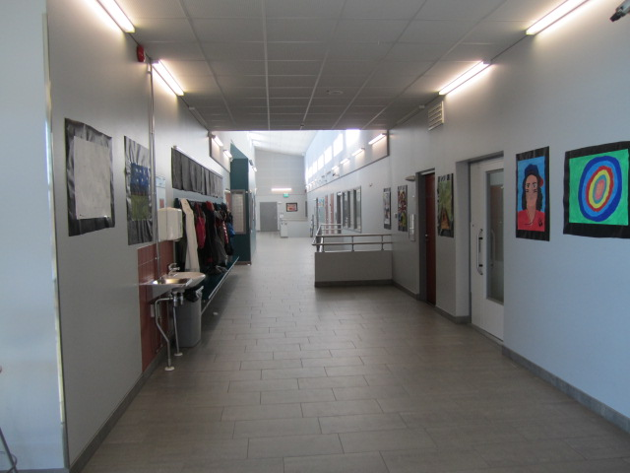
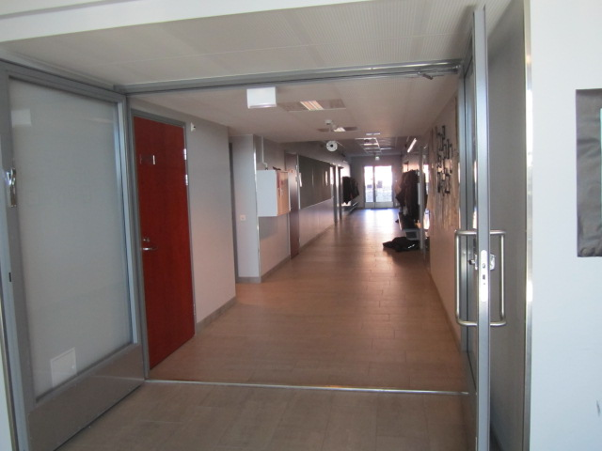
”taitotalo” = the House of Crafts

Slide 4
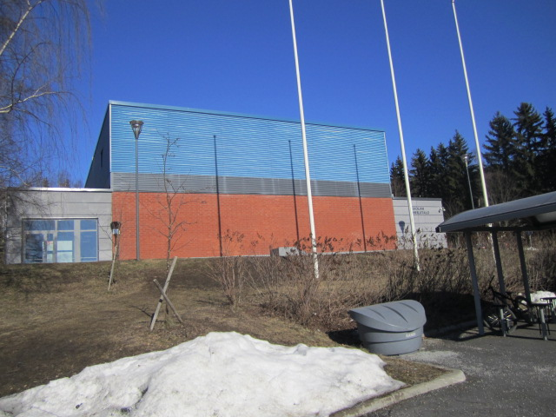
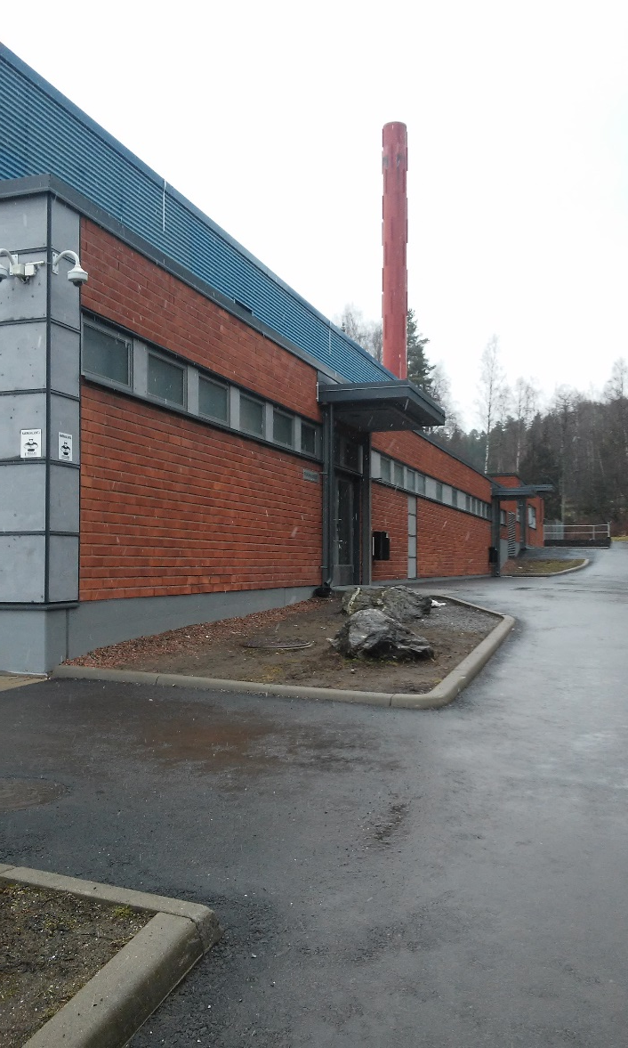
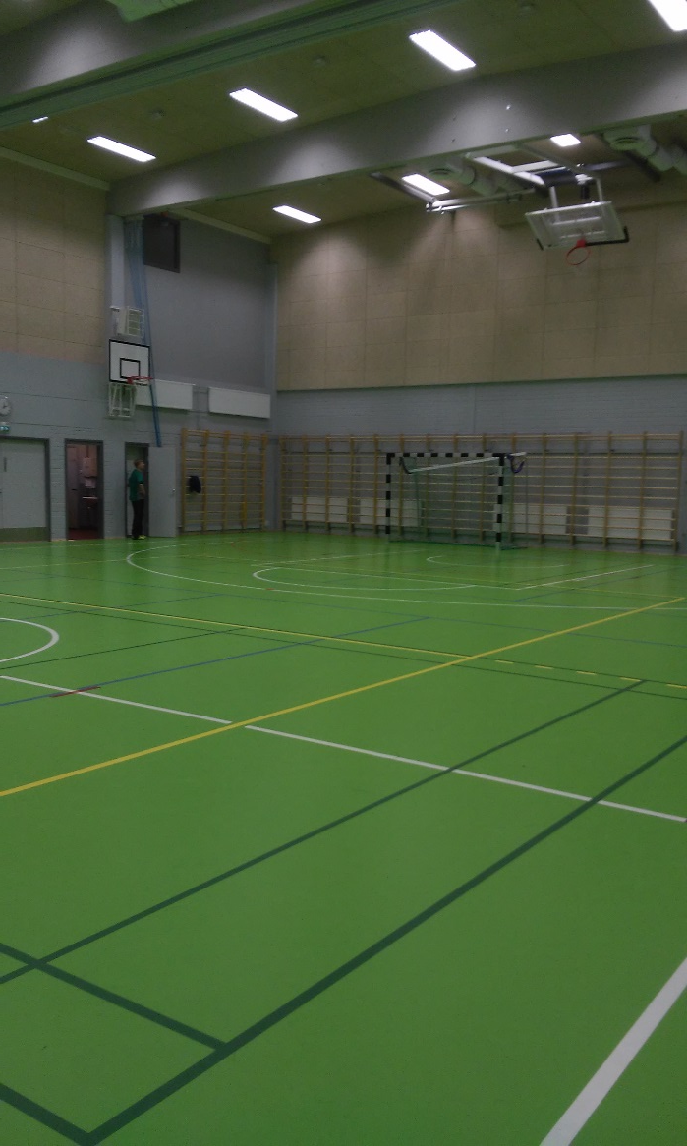
Sports hall

Slide 5
Library

Slide 6
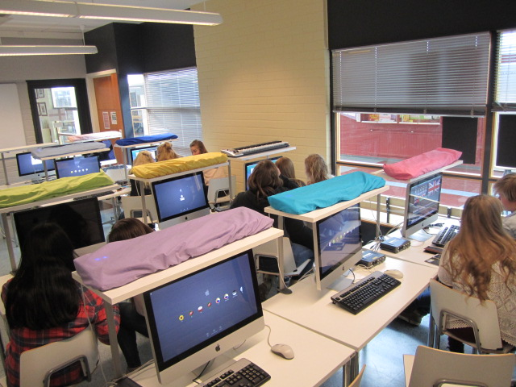
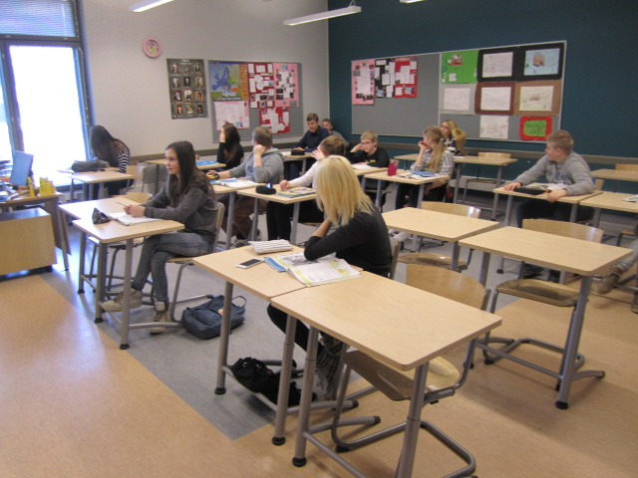
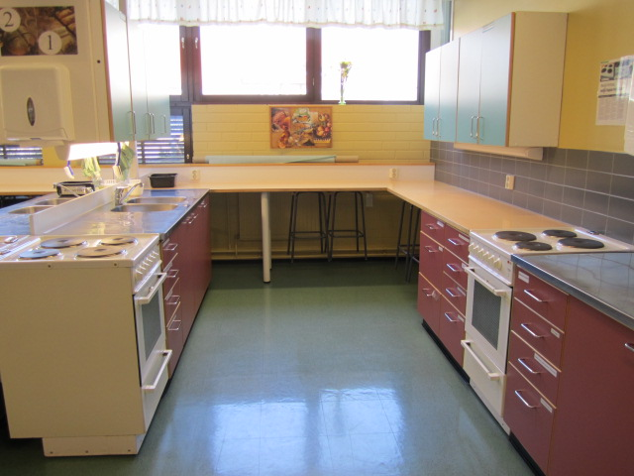
The classrooms

Slide 7
Subjects
Mathematics
Geography
Physics
Finnish
English
Swedish
Chemistry
Biology
Student counselling
Sports
Religion
History/social studies
Health education
In the 7th grade we study visual arts, crafts, music and home economics.
We can start German when we’re in the 4th grade.

Slide 8
Optional subjects
Band class
Pop singing
The basic course of music
Music technology
Home economics
Textile crafts
Technical crafts
Extra sports class to boys and girls
Media class
International class
Advanced special studies
English
Swedish
Mathematics
Drama
Creative writing
Conversation and investigation of history
On world’s pulse
German
French
Russian
Laboratory class
Health education
Short and long information technology
Visual arts
Comics class
Ceramic and sculpture

Slide 9
Schedule (for example)
klock | Monday | Tuesday | Wednesday | Thursday | Friday
8-8.45 am | Geography | English |  |  | Mathematics
9-9.55 am | Physics | Geography | Mathematics | English | Finnish
10-10.45 am | English | Mathematics | Sports | Textile crafts | Physics
11-11.45 am | International class | Finnish | Sports | Textile crafts | Swedish
12.15-1 am/pm | International class | Religion | Physics | Mathematics | Religion
1.15-2 pm | Student counselling | German | Swedish | History | History
2.15-3 pm |  | German |  | Finnish
The lunch is 10.45-11.15 or 11.45-12.15

Slide 10
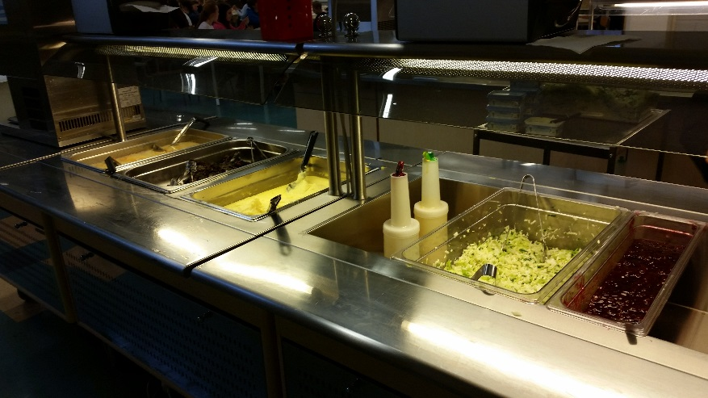
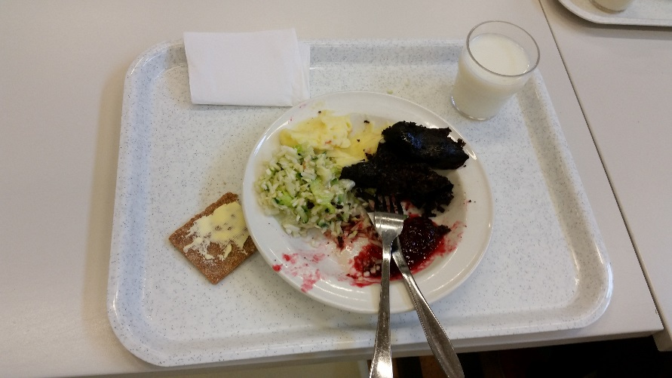
SCHOOL LUNCH
Soups (for example meat, pea, broiler and fish)
Potatoes, rice or pasta with sauce (mincedmeat, sausage and meatball)
Macaroni casserole
Porridge
Lasagne
Black sausage
And salads
The food is free for the students

Slide 11
There are 70 teachers in our school and over 600 students.
The principal’s name is Ville Vuorisalmi.
The teacher of international class is Jennika Lassila.
There are some pupil groups in our school. (for example)
Hobbarit= They keep sport activities for pupils when we have breaks. (sometimes)
Prefect= They tell about our school to new pupils and help them to get to know each other.
Students’ union= They represent pupils and decide some things.
Some of our pupils come to school by bus because they live so far. (about 5-20 kilometers) The bus is free to pupils.

Slide 12
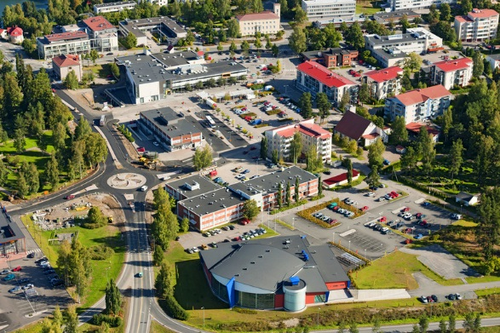
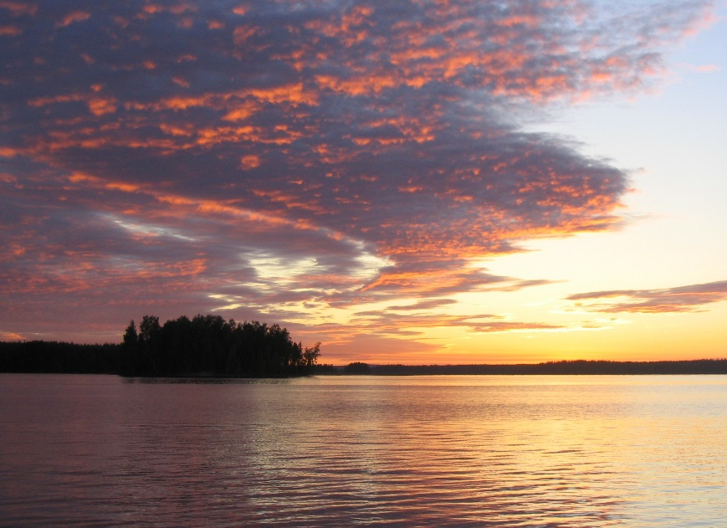
Location
It is about one kilometer from the center of Kangasala. And Kangasala is about twenty kilometers from Tampere.
Kangasala
Kangasala.fi
Aleksi Stenberg

