Slide 1
GÜLLÜK mountaIn (TERMESSOS) BIOLOGICAL DIVERSITY

Slide 2
Province: Antalya
District: Korkuteli
Area: 67 020 decares
Posted on: 1970 Long Term
Development Plan (UDGP) Approval date: 22.05.1971
Settlements: There are no settlements within the National Park area. However, Termessos Antique City, which gives its name to the national park, is located in the park area.

Slide 3
WELDING VALUES Geological Structure: The steep cliffs of Güllük Mountain and Mecine Canyon rising up to 600 m are the most important geological resource values.

Slide 4
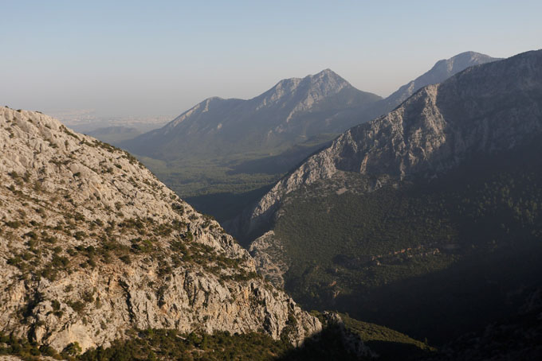

Slide 5
FAUNA
Mammals: Wild boar, fox, jackal, caracal, wildcat, badger, rabbit, marten, squirrel, hedgehog, roe deer, mountain goat, tree dormouse, bat, lynx are mammal species found in the National Park.

Slide 6
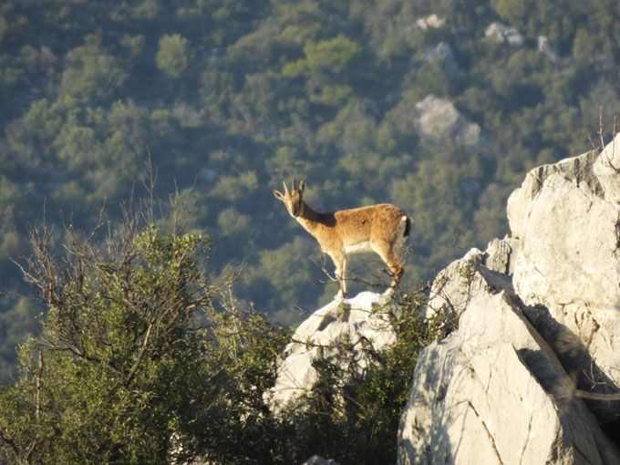

Slide 7
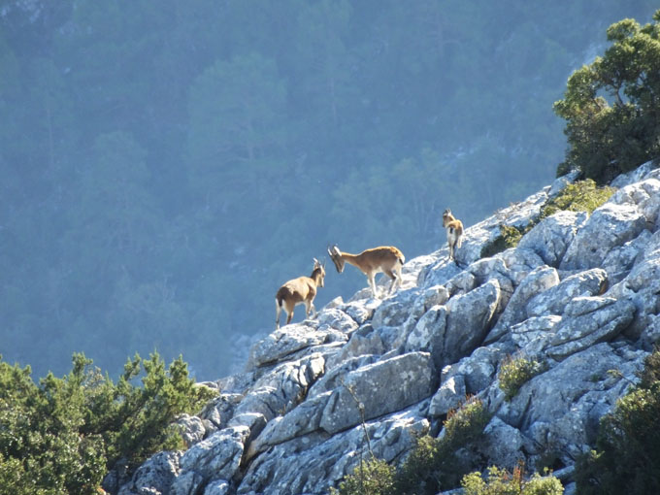

Slide 8
Birds: 113 of the 456 bird species found in Turkey is seen in this National Park. Karaca, Shah eagle quail, woodcock, freckle partridge, henna partridge and dove are the main species.
Reptiles: There are 20 reptile species living within the borders of the National Park. Turtle (Black Turtle), Spotted Turtle, Blind Lizard, Spiny Lizard, Half-Finger Keler, Slim Lizard, Spotted Lizard, Coin Snake and Banded Viper are the main ones.

Slide 9
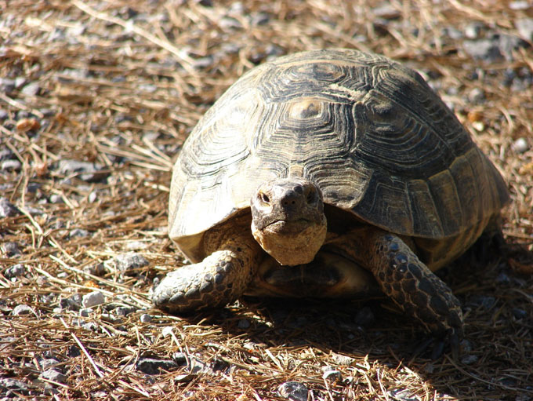

Slide 10
FLORA: 250-1665m elevation difference and different view feature of the national park with rich biodiversity, Mediterranean climate type exhibiting plant communities in the forest and scrub gum tree, wild olive, sandalwood, carob, laurel, rosary and so on. 680 plant species has been identified, 80 (11.76%) is defined as the number of endemic Turkey. Mountain Ecosystem; 250-1665m. Red pine forest, Mediterranean maquis vegetation and rocky areas

Slide 11
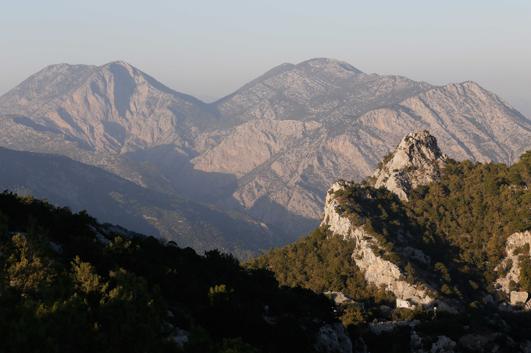
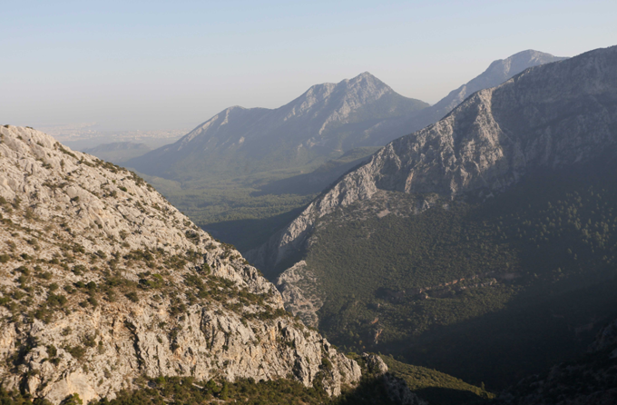
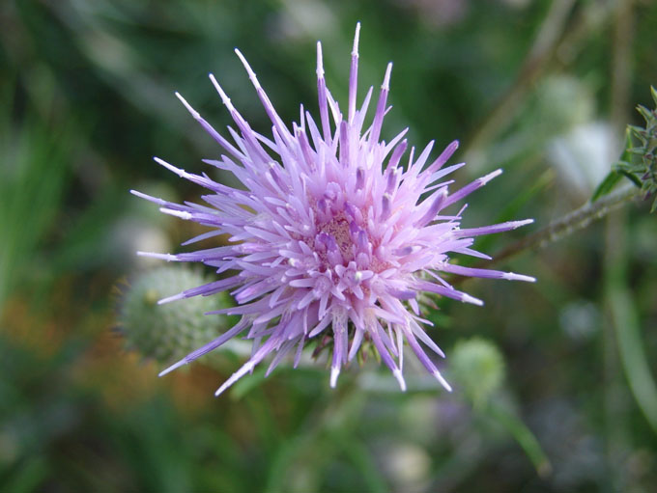
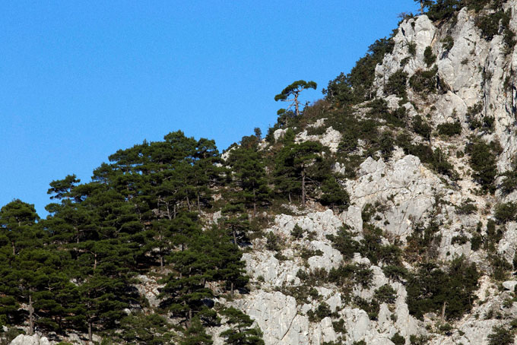
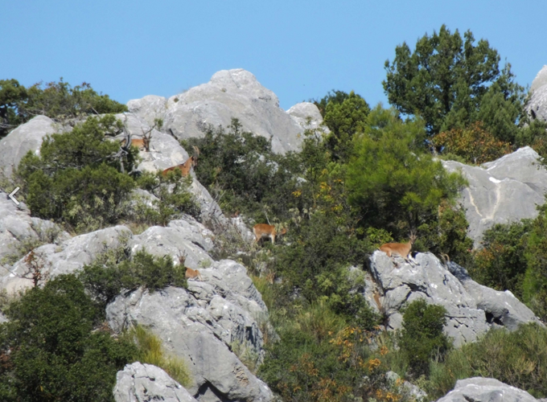

Slide 12
CULTURAL AND ARCHEOLOGICAL VALUES: Termessos, one of the best preserved ancient cities in terms of archaeological sites in Anatolia and giving its name to the national park, is located on the slopes of the Gulluk Mountain of the Taurus Mountains, 1050 m above sea level, rising after the travertine steps that make up wide plains in the north of Antalya. The city of Termessos was founded by the Solims, one of the indigenous peoples of Anatolia, known for their warrior character. The first information about Termessos and Solims is obtained from Homer's Epic of Iliad depending on Herodotus history and legend of Bellerofontes. Termessos’ rise to the stage of history BC. It begins with the date when Alexander was the only city in 334 that he could not get through the region.

Slide 13
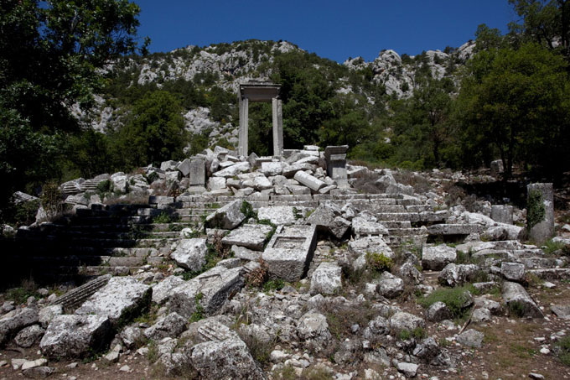
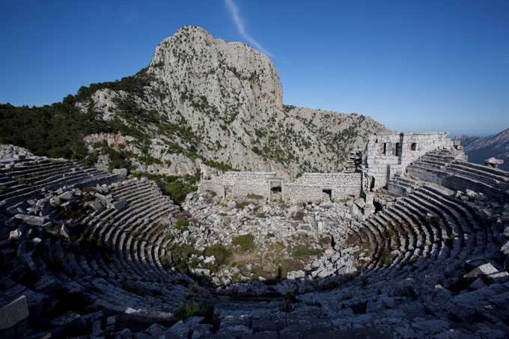
The oldest of the existing structures in Termessos are the graves belonging to the Hellenistic period. The other remains belong to the Roman period. It is estimated that the people of Termessos left their cities when the Roman influence in Asia Minor decreased. The city lived its brightest times during the Roman period, which developed in 3 sections as the lower city, city center and cemetery. The city walls, towers, the king's road, Hadrian's Gate, Gymnasium, Agora, Theater, Odeon, richly decorated tombs, cisterns providing water to the city and the drainage system are the ruins of the most magnificent buildings of Termessos.

Slide 14
AVAILABLE LAND USE: The Administration and Visitor Promotion Center within the National Park provides services to the visitors with all kinds of equipment to provide information about the park. As a Nature School, it is a field in which nature courses are practiced in cooperation with the General Directorate of National Parks and Hunting and Wildlife, universities and TUBITAK.

Slide 15
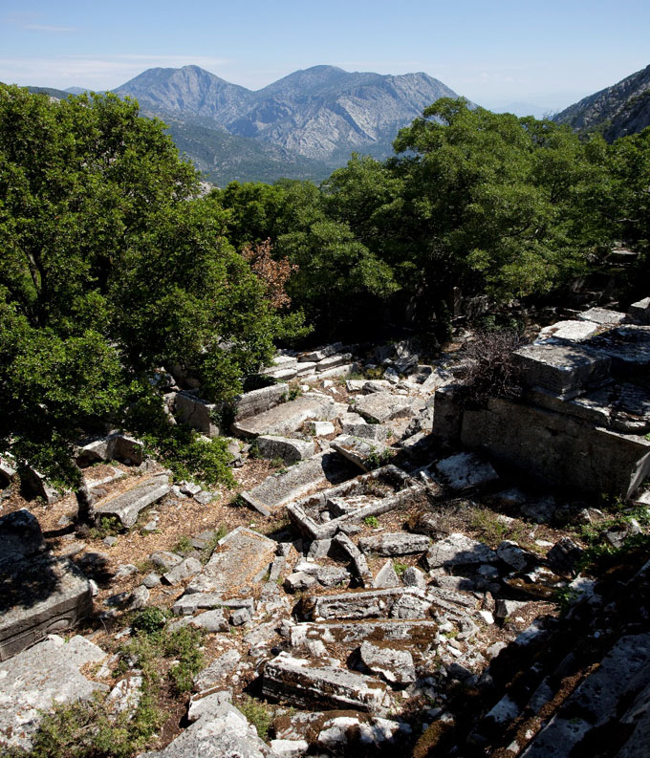
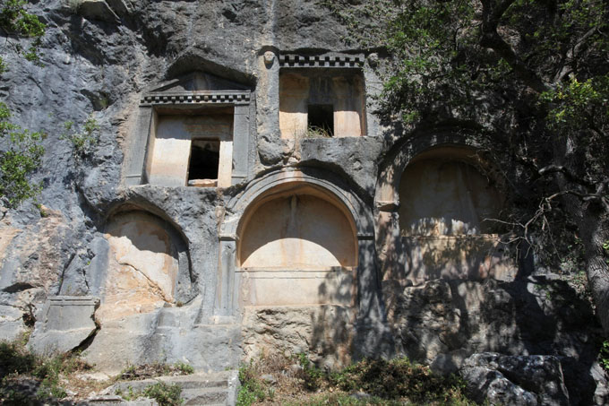
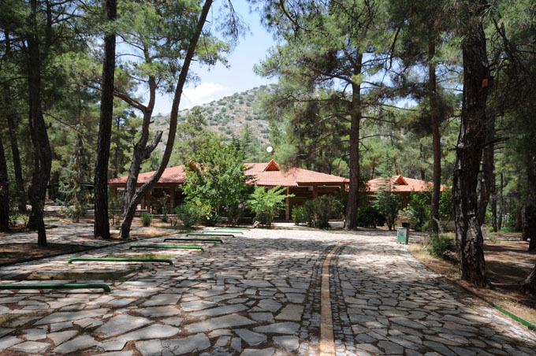

Slide 16
GÜLLÜK MOUNTAIN (TERMESSOS) NATIONAL PARK PLACES TO SEE:
Termessos Ancient City
Forest Ecosystem
Administration and Visitor Promotion Center
Daily Usage Area.

Slide 17
ACTIVITIES IN THE NATIONAL PARK OF GÜLLÜK MOUNTAIN (TERMESSOS):
Trip to Ancient City,
Rich Vegetation and Geological Structure Observation, Administration and Visitor Promotion Center Tour Hiking
Picnic
Photography
Cycling
Mountaineering
Opportunity

Slide 18
