Slide 1
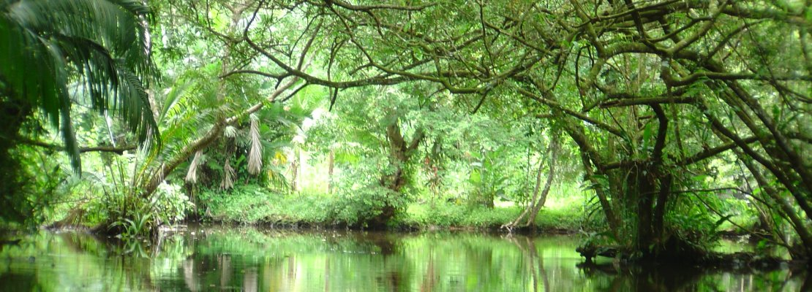
The
Endangered Species
Valle di Diano Parco Nazionale del Cilento Italy
I.P.S.A.S.R. ‘M. TULLIO CICERONE’
SALA CONSILINA (SA) - ITALY

Slide 2
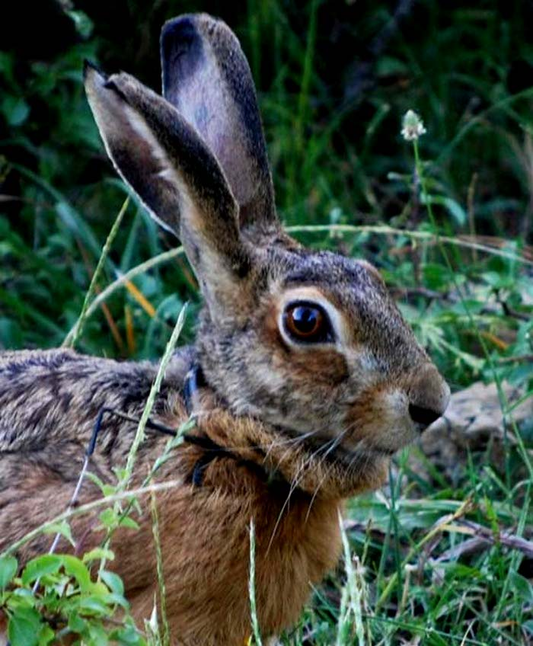
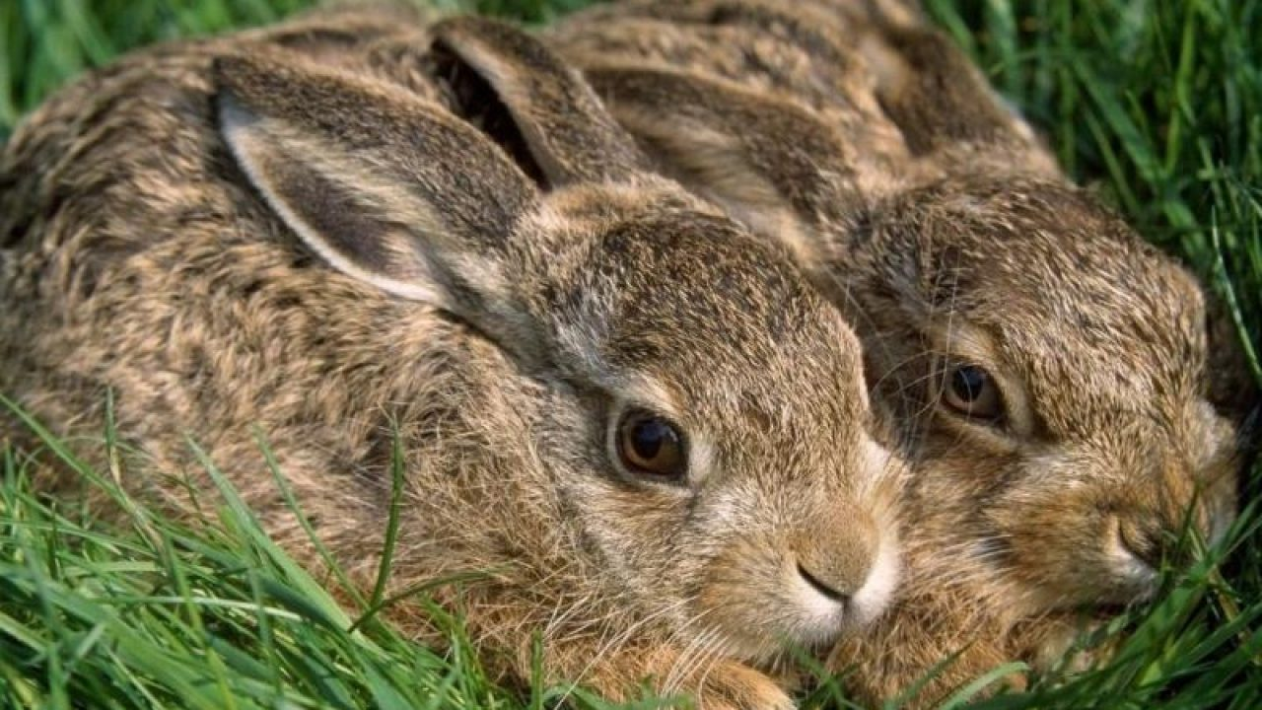
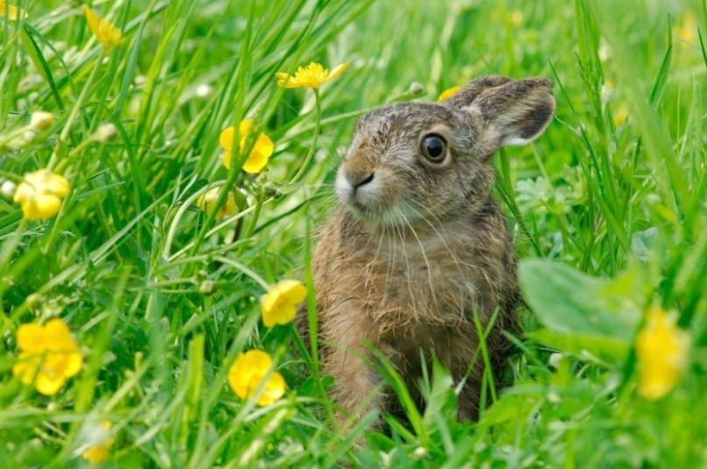
Lepus Corsicanus Italian Hare
It is similar to the European hare in appearance, being largely brown with a cream-coloured belly. It differs in having grey rather than white bases to the hairs of the underfur It is smaller on average than the European Hare with a head and body length of 44.1—61.2 cm, a tail length of 6.6—11.2 cm and a weight of 1.8—3.8 kg. The ears and hind legs are relatively longer, 9—12.6 cm and 11.4—13.5 cm respectively. Italian hare (also known as the Appenine or Corsican hares) are located throughout Southern Italy, from Umbria and Southern Tuscany to Cabria.
The first, historical pair of Italic hares was freed in the wildlife area created by the Campania Region in the state forest of Cerreta Cognole, within the Cilento, Vallo di Diano and Alburni National Park, in the Salerno area. It is a species of the central and southern Apennines, Italian endemic and discovered only in the early 2000s, when its difference with the most common "cousin", the European hare, was documented - thanks to a series of genetic studies. And it is precisely for this reason that the Ministry of the Environment is taking steps to extend its distribution in the territories where it is almost extinct. Just like in Cilento, where the first two specimens (lepus corsicanus the scientific name) - taken from Calabria and considered compatible with the populations already present in the new area - will find the ideal habitat for living and reproducing
Valle di Diano Parco Nazionale del Cilento Italy

Slide 3
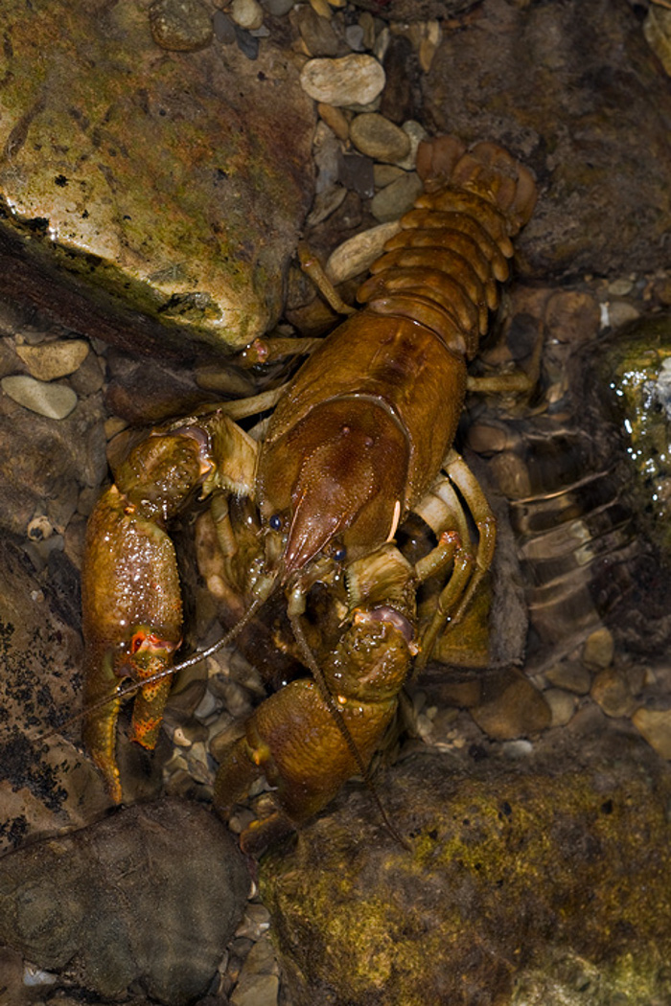
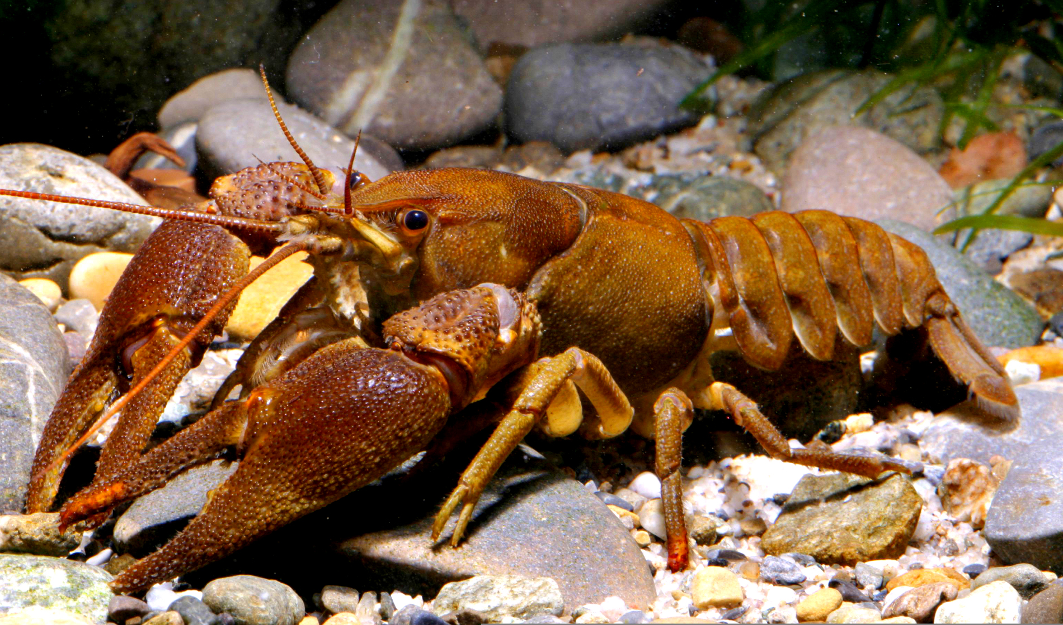
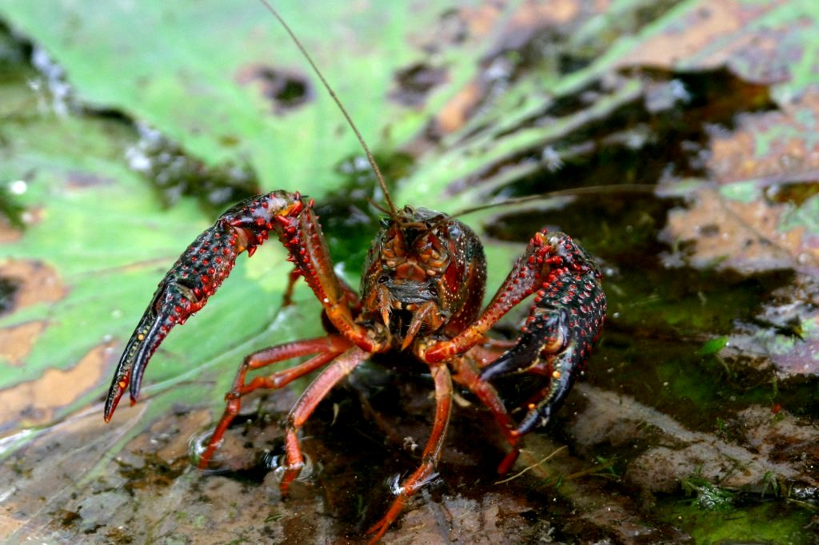
Valle di Diano Parco Nazionale del Cilento Italy
The Atlantic stream crayfish is a small freshwater crustacean of the Astacidae family.
It lives in oxygenated streams and rivers. It prefers gravelly or sandy beds but with the banks where there are shelters, often represented by branches of fallen trees or leaves, in order to hide and rest. In the National Park of Cilento and Vallo di Diano it was found in the basin of Bussento. In the past we have news of its presence also in Fuonti (fraction Pucara) in Tramonti.
A project of the Park of Cilento has proposed further study on its status in the river courses, aiming at planning the management and conservation of the species considered vulnerable according to the criteria of the IUCN red list.

Slide 4
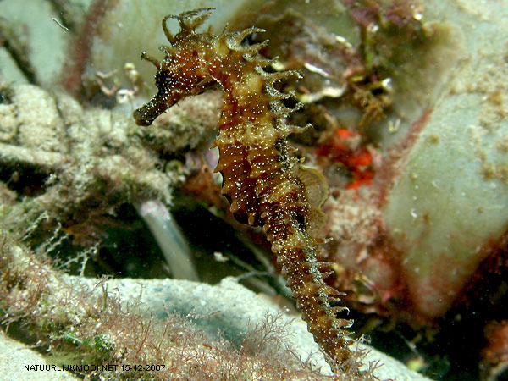
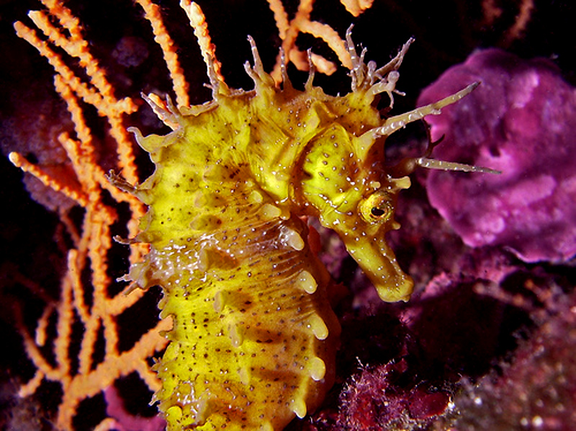
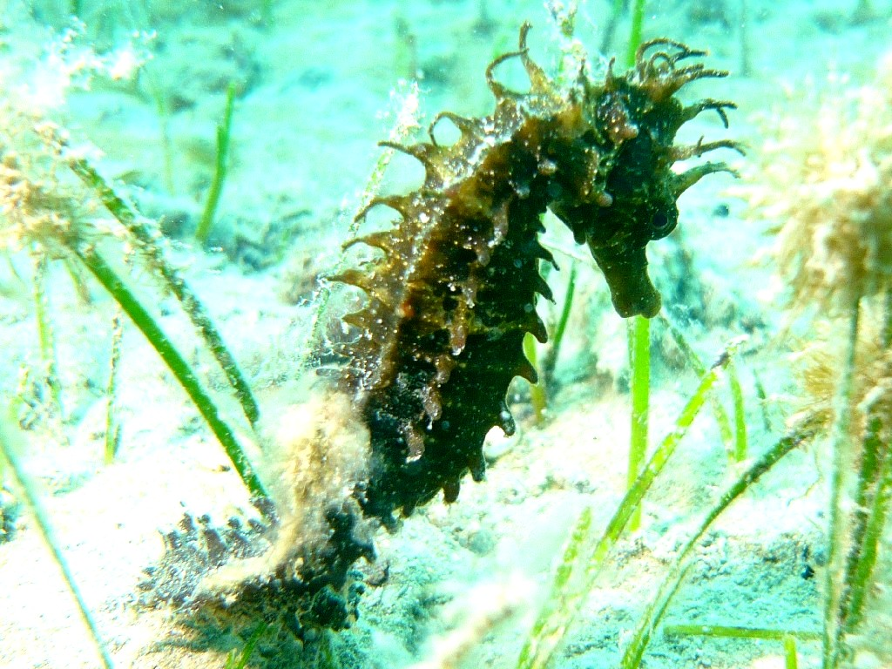
The long-snouted seahorse is a saltwater fish belonging to the Syngnathidae family, common in the Mediterranean Sea. In the province of Salerno it is located along the coast. It’s a rare and fascinating marine creature, often found in the vicinity of seaweed, Posidonia oceanica, and zostera clinging with its tail.
The skin is yellow, sometimes brown or reddish, with irregular white bands. It reaches a maximum length of 15 cm. It is an ovivipary species. The female, after fertilization, lays eggs in the pocket on the male's abdomen. The male will hatch the eggs for 2-5 weeks until they hatch, when offspring already formed will leave the paternal belly. The species has omnivorous diet: it feeds on small fish and algae. In recent years the presence of these beautiful animals has become rarer to the point of considering in most areas disappeared or at least endangered.
Valle di Diano Parco Nazionale del Cilento Italy

Slide 5
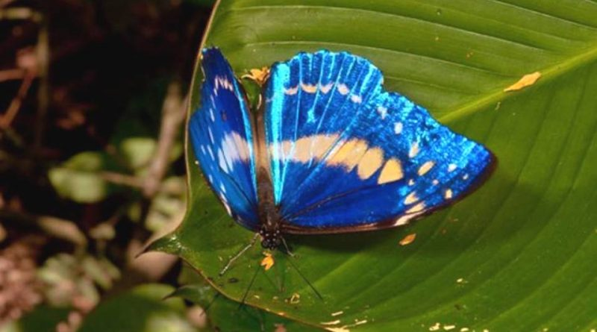
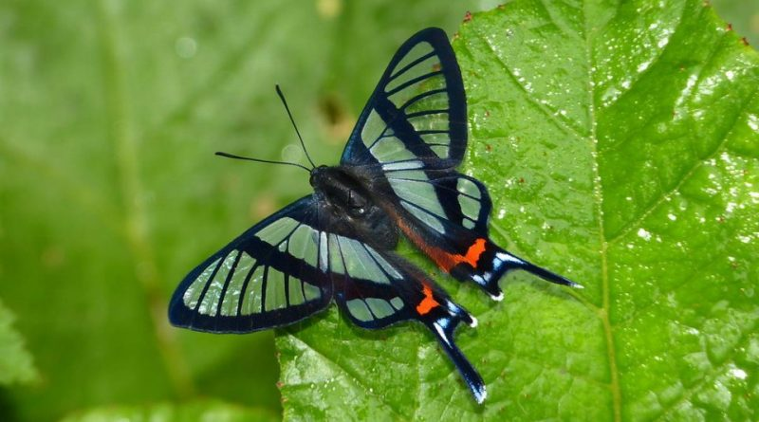
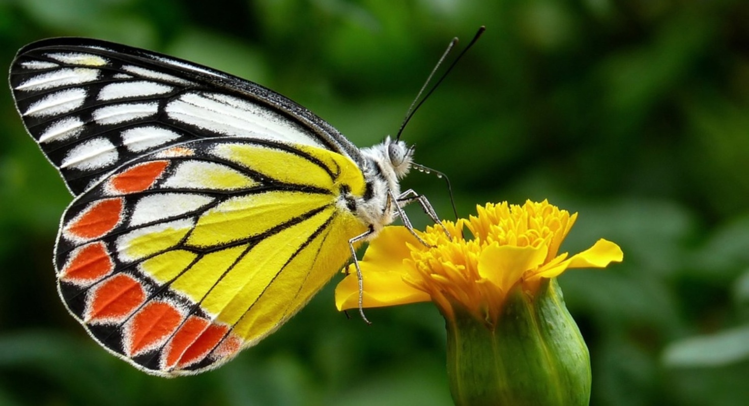
The Morpho cypris is a moth belonging to the Nymphalidae family
Valle di Diano Parco Nazionale del Cilento Italy
Idea leuconoe The paper kite butterfly (Idea leuconoe Erichson, 1834) is a moth belonging to the Nymphalidae family
Chorinea sylphina The Sylphina angel (Chorinea sylphina Bates, 1868) is a butterfly belonging to the Riodinidae family.

Slide 6
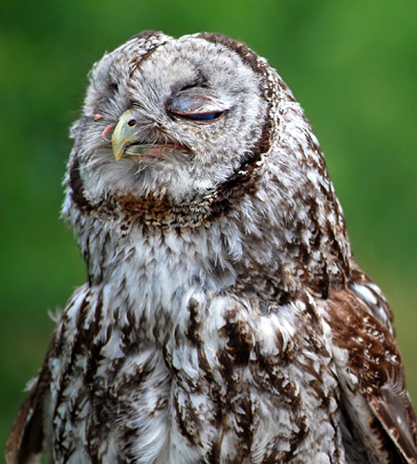
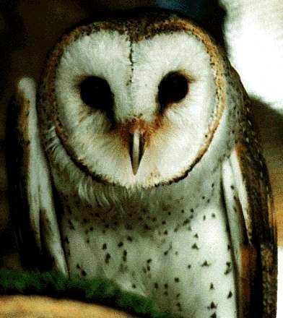
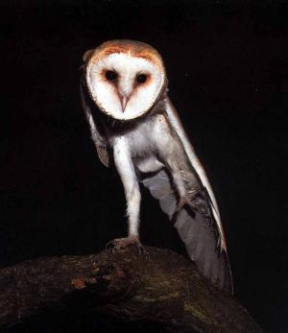
Valle di Diano Parco Nazionale del Cilento Italy
The barn owl (Tyto alba) is the most widely distributed species of owl, and one of the most widespread of all birds. The barn owl is found almost everywhere in the world except polar and desert regions. In Campania, exists in many protected areas of Salerno Province. Like most owls, the barn owl is nocturnal, relying on its acute sense of hearing when hunting in complete darkness in margins of forests. The sound that produces is said to be like this of a steam cooker, but when flying, this animal is completely silent.
Males and females have few differences. Both are medium-sized, pale-colored with long wings and a short tail. The female is slightly larger and darker than the male owl.
They are nourished by water rats, frogs, insects and harmful to human animals such as rats, mice and moles and that is the reason farmers support residences and build wooden boxes for their nests.
Common names such as "demon owl", "death owl", or "ghost owl" show that traditionally, rural populations in many places considered barn owls to be birds of evil omen.

Slide 7
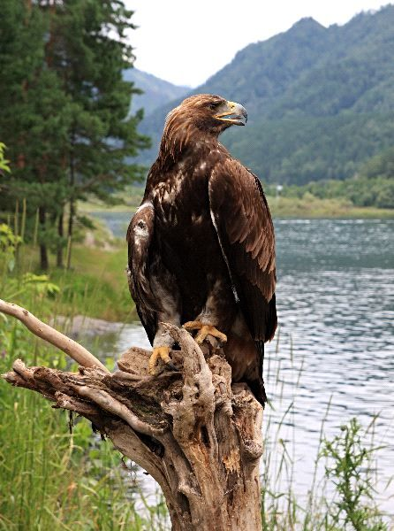
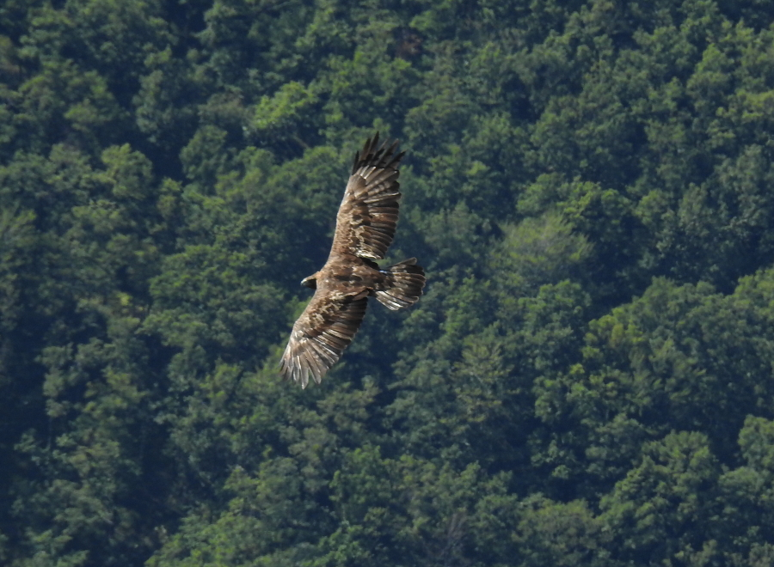
Golden Eagle
Aquila chrysaetos
Valle di Diano Parco Nazionale del Cilento Italy
The Golden Eagle is a large raptor, with prominent head, large and long tail. The colour is dark brown with red-golden reflections on the back and the head (from here comes the name “golden” eagle). It can be recognized for the dimension of the wingspan which can reach 2 meters in the females. The Golden Eagle’s length goes from 74 up to 87cm, while the tail can reach 26-33 cm. The females are usually bigger in size than the males. It has an extremely sharp sight, 6 times human’s, with a visual range of 300°. The eagle is a powerful and long-lived species. In fact it can live 15-20 years if free, and even more (50 years) in captivity.
The Golden Eagle (Aquila crysaetos, Linnaeus 1758) is a bird which belongs to the family Accipitridae. Being the most common species, it is considered the raptor par excellence and it is often simply called eagle.
In Italy it can be found on the Appennine’s dorsal and the Alps. In the province of Salerno it is usually seen in the Cilento’s mountains. This species is disappearing in some area because of man’s persecution, while in the protected areas is raising in number. The Golden Eagle is a protected species according to the law 157/92.

Slide 8
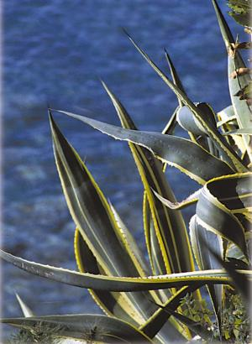
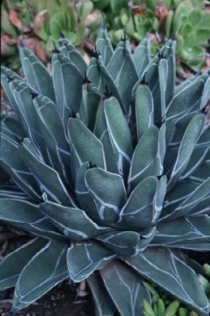
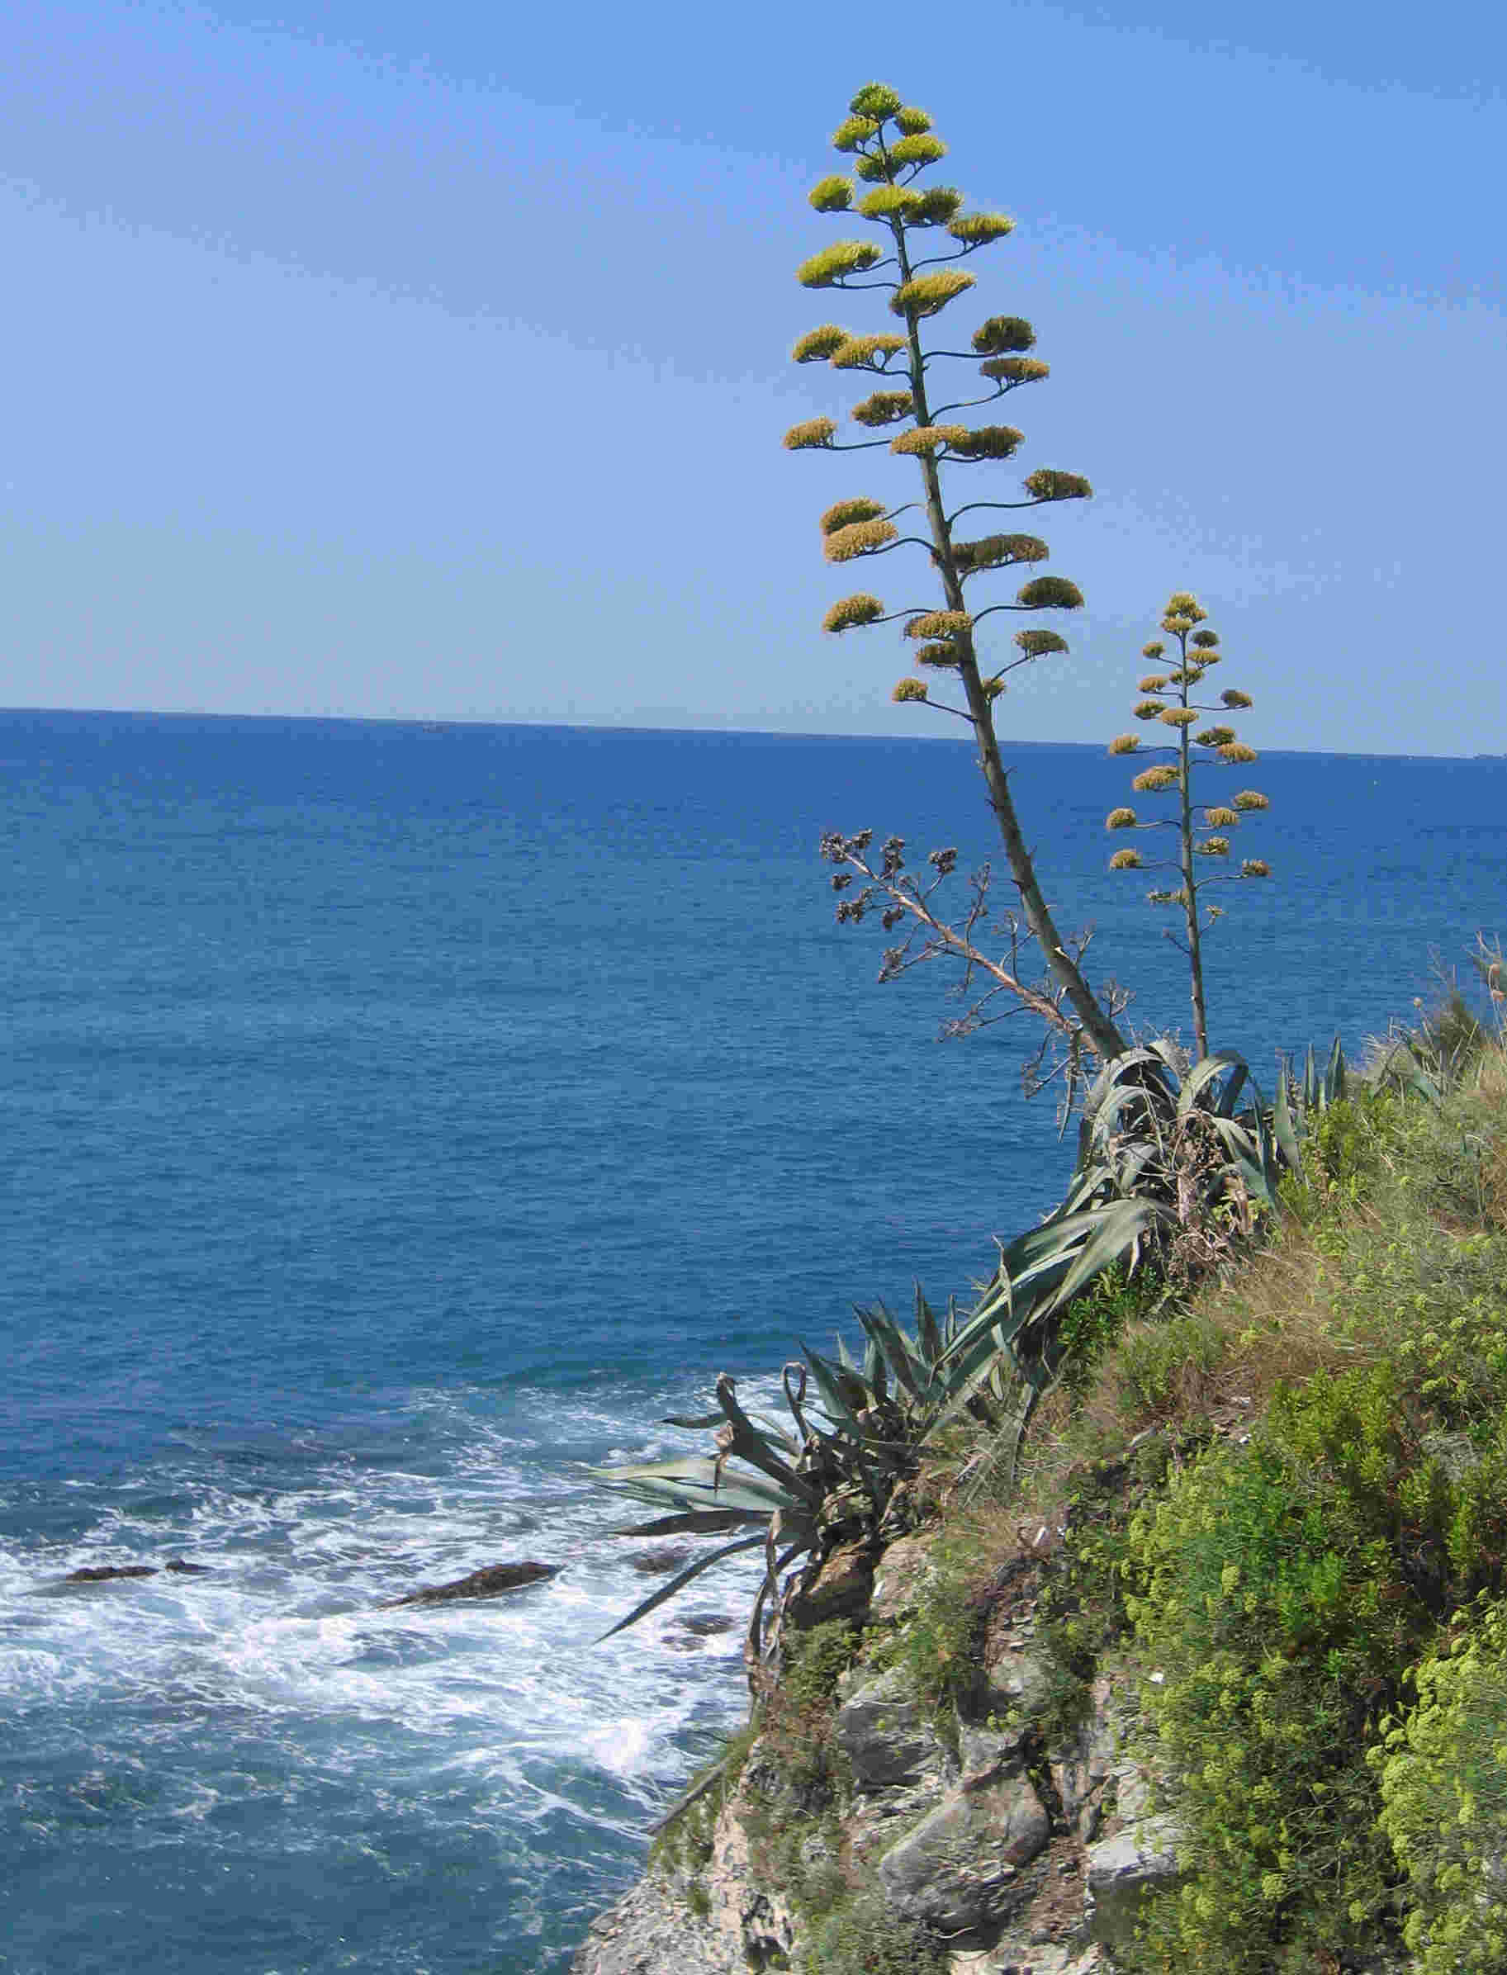
Valle di Diano Parco Nazionale del Cilento Italy
The Agave is a plant that belongs to the family of Agavaceae. Thanks to their appreciated decorative characare tropical and sub-tropical plants of the Italian country.cThe Agave has a stout stem usually very short. It has a large rosette of thick fleshy leaves that can reach 2 meters of length and 30 cm of width, each ending generally in a sharp point and with a spiny margin. This plant’s lifespan can reach 30 years and it dies after generating a single yellowish flower.
The American agave is the most widespread species. There are different varieties which can be distinguish by the colour of its leaves. The colour is bright green and it prefer a temperature of 15 C°. The “Agave ghiesbreghetii”, instead, green-brown colored during winter.

Slide 9
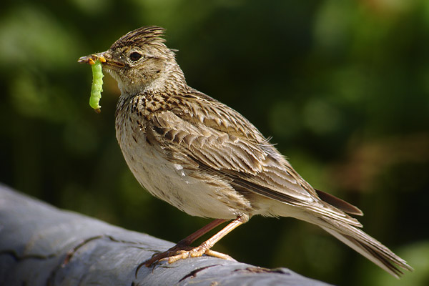
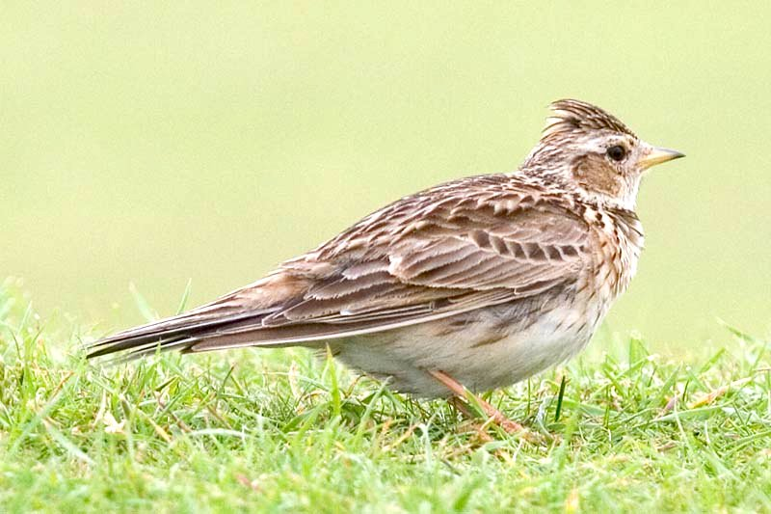
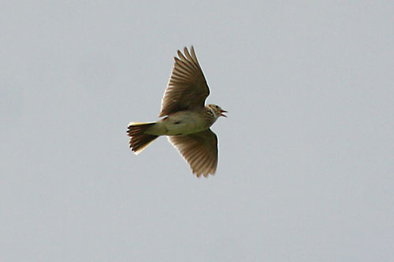
The Eurasian skylark (Alauda arvensis) is a bird species from the order of Passeriformes and the family of Alaudidae. In Italy, in winter season, it migrates to the South; moving forward in October-November and March-April. The appearance of this bird is frequent in cultivated or grazing lands, in Eurasian Steppe, in open and free places like grassy fields, bushy lands and sandy hills; both in a level ground and in height. The characteristics of this species are the small size (between 16-19,5 cm length), the brown plumage with lightly black stripes in the superior part, which becomes lighter ( white, reddish brown) in the lower parts as well as a small rised tuft only when alarmed. It is quite commonly observed especially in autumn season, but this species population is getting diminished because of the various ecological disturbances. This species is also threatened from herbicides, fires and the existence of cement. While singing, the male bird may appear like a dot in the sky from the ground and its song lasts from two to three minutes, but during the mating period can last up to twenty. This bird is the inspiration and subject of many poems and songs and is also considered as a herald animal by William Shakespeare who referred to it as a "morning messenger".
Valle di Diano Parco Nazionale del Cilento Italy

Slide 10
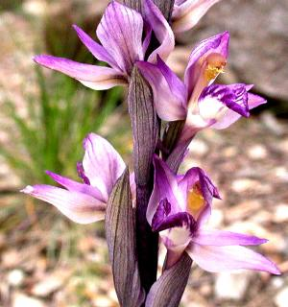
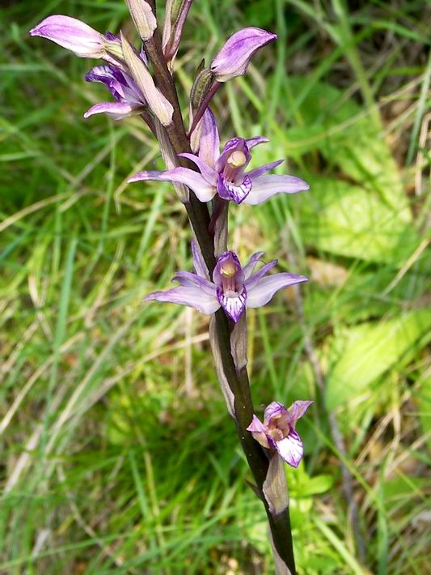
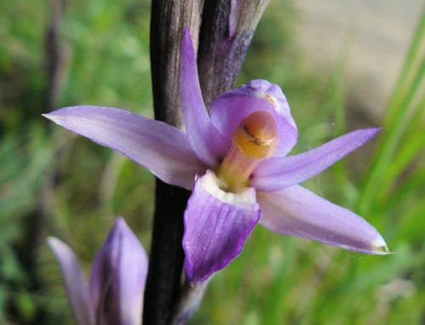
The Limodorum abortivum, or Violet Limodore as it is commonly called, is a plant belonging to the Orchidaceae family that widespread throughout the Italy. In the Province of Salerno they can be found along the Mediterranean and in particular areas such as the Vallone Porto in Positano. The name of this elegant orchid derives from the Latin ‘abortus’, which means abortion, in reference to the scale-like leaves, such as they are aborted.
Being the largest and among the flashiest Italian saprophytic orchids, it is a plant that lives on decaying organic matter in the soil, with a characteristic of scaly trunk, tall and robust, with large flowers which are difficult to observe them being fully opened.
It's a plant high from 20 to 80 cm. The root system is constituted by a short rhizome and numerous short roots
Valle di Diano Parco Nazionale del Cilento Italy

Slide 11
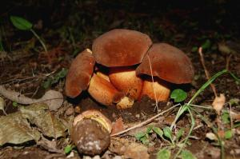
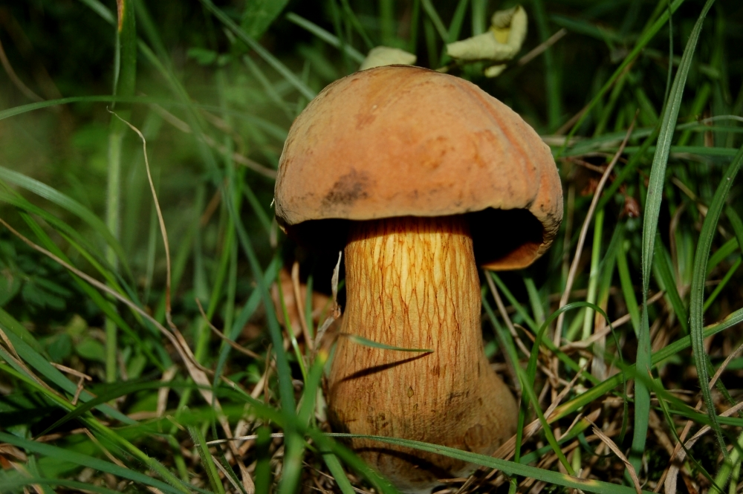
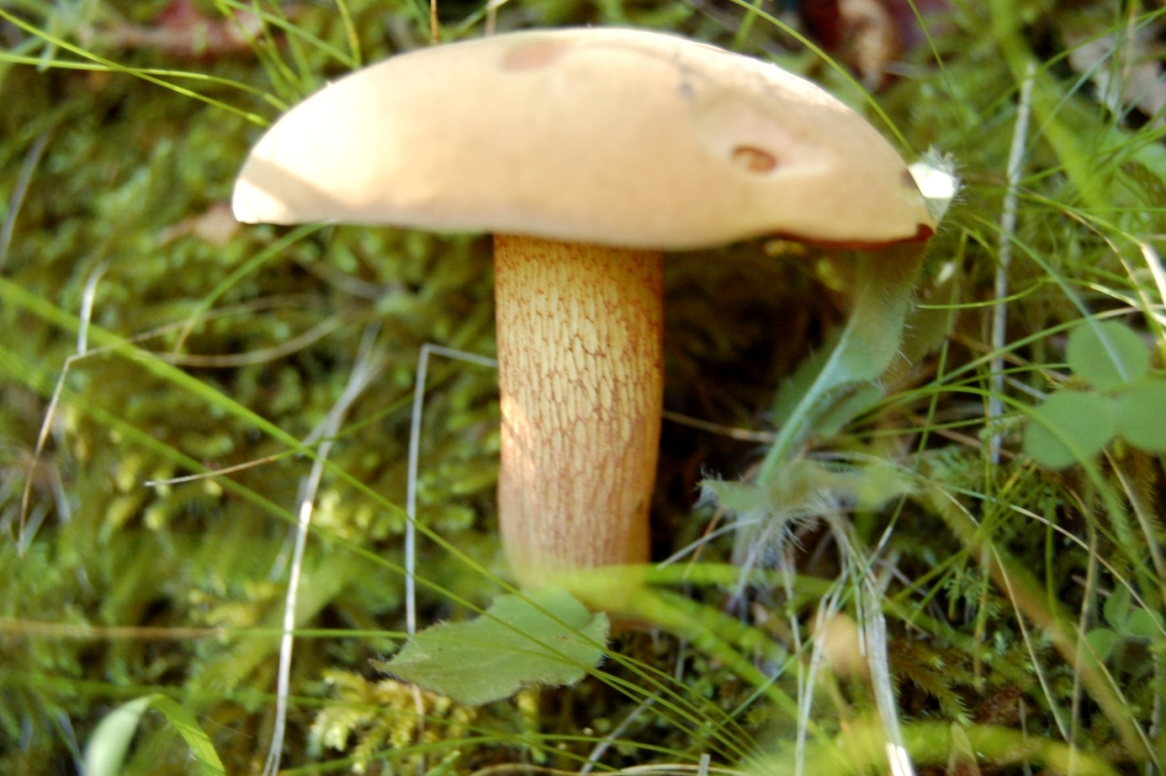
Valle di Diano Parco Nazionale del Cilento Italy
The Suillellus luridus (Boletus luridus) belongs to do the bolete family. The muschroom can be found in the summer and autumn. The cap is olive-brown with a diameter of up to 20 cm. On the underside it has small red pores. This mushroom is edible after it has been cooked but should not be eaten raw and it has not to be confused with the poisonous Boletus satanas.

Slide 12
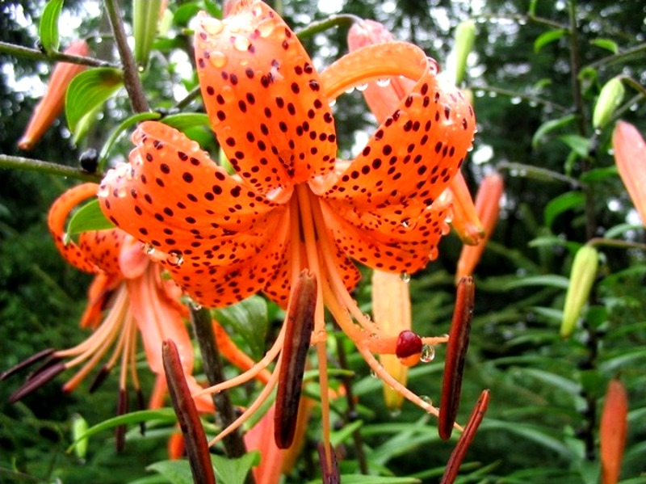
Valle di Diano Parco Nazionale del Cilento Italy
The tiger lily (Lilium tigrinum or scientific name Lilium lancifolium) is a flower belonging to the Liliaceae family, native to Asia.
You can find it with its showy orange flowers, in areas like the Vallone Porto in Positano in the Lattari Mountains Regional Park, along the National Park of Cilento and Vallo di Diano. Its appearance heralds the arrival of summer.
Like all lily it is a flower that grows well anywhere and on any soil provided the soil is deep and fertile. This lily is unmistakable for its orange flowers with black dots and gathered at the height of upright stems, strong and tall even more than one meter. The multiplication of flower is simple either with seeds or bulbils.

Slide 13
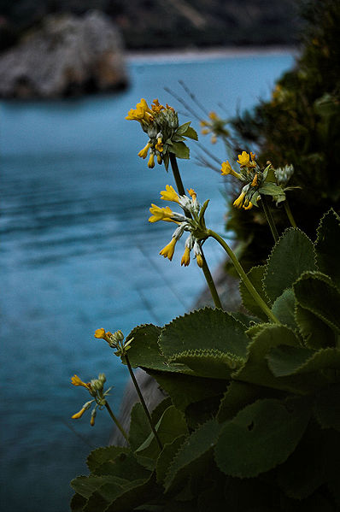
The Primula Palinuro (Primula palinuri) , is a plant belonging to the family Primulaceae, endemic to some parts of the limestone coast of Tirrenihce lucane (southern Campania and Basilicata) and in Calabria it is present in the National Park of Cilento and Vallo di Diano.
The Primula palinuri is a protected species both at regional level and by the EU. It is on the IUCN Red List of Vulnerable species, the list is compiled by the International Union for the Conservation of Nature.
The inflorescence consists of numerous flowers which are yellow to deep golden.
The Primula Palinuro is present in some colonies on the limestone cliffs of the coastal areas of the southern Tyrrhenian Sea, at an altitude of up to 200 meters, it prefers to grow on walls exposed to the North and North-West. Takes root in crevices of the rock, where the roots creep deeply into the soil accumulation.
Valle di Diano Parco Nazionale del Cilento Italy

Slide 14
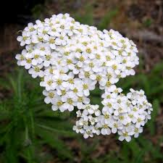
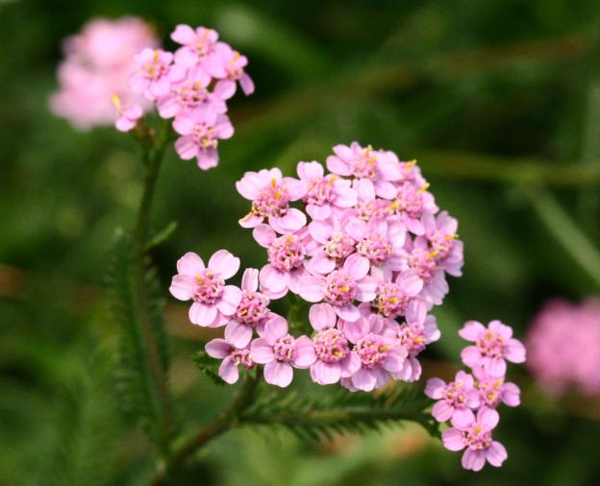
The name 'Achillea' has mythological origin and comes from Achilles, which cured and healed the wounds in Teleforo, king of Mycenae. The plant, in fact, was known for its healing properties and was sought by swordsmen and warriors. The yarrow grows in grassy places, in the fields and along the roads.
Many people still use yarrow to make an herbal tea to calm intestinal pain, and to regulate the menstrual phase. You can use the yarrow to treat minor wounds, abrasions and rashes. As for internal uses, yarrow is benifical to stimulate the digestive processes, for menstrual pain and nervous excitement. An infusion is obtained by placing a handful of yarrow in a cup of water and should be drunk twice a day.
In Salerno area, traditional cuisine still uses the leaves of yarrow for slightly bitter and spicy taste, to gain flavor for salads and to make more delicate and tasty omelettes. The flowers are used to prepare excellent pancakes.

Slide 15
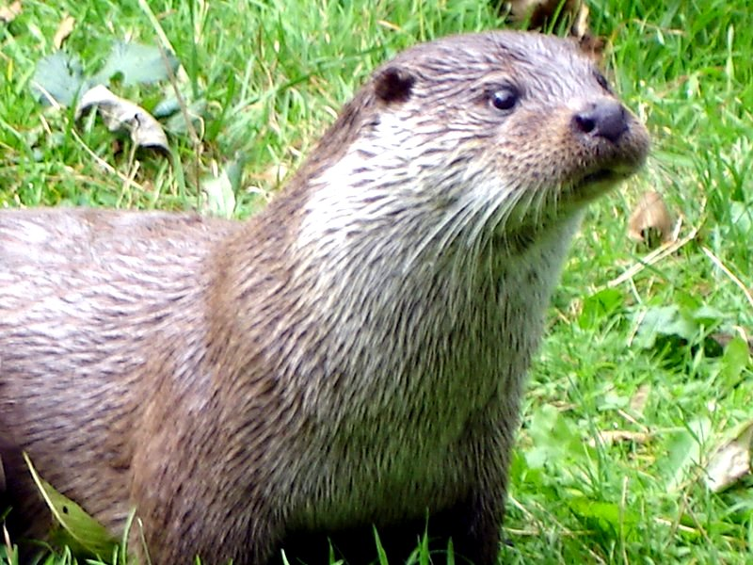
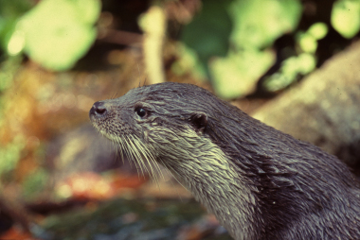
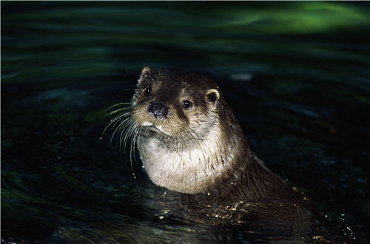
"Being unknown and ignored by most people, being confused with a non-native rodent origin such as nutria, being considered by many now close to extinction in Italy, the European otters, or Eurasian otters, still populate the rivers of the South, representing some extent an environmental quality brand for the region, particularly for the province of Salerno and the Park of Cilento and Vallo di Diano. The poor perception of the presence of this species and the lack of knowledge of conservation issues are a risk to their survival.
Valle di Diano Parco Nazionale del Cilento Italy
It is an excellent swimmer, and its diet consists almost exclusively of fish. It has an intense brown fur at the top and lighter in the lower part, especially on the throat. The body is elongated, while the tail is long and tapered. The muzzle is stocky and covered with moustaches. The ears are very small. The legs are short with webbed feet, ideal for swimming. Often it may travel as far to the coastal areas, when there is shortage of food. The causes of the rapid decline of the otter population in Europe and in Italy are due in large part to the tumultuous post-war development, in particular the growth of industrial activity and consumption that began in the 60s, and the processes of degradation of river habitat that have accrued, triggered by the intense urbanization of the territory and the expansion of intensive agriculture in a context where environmental culture was not yet formed, and in the absence of protection and prevention legislation.

Slide 16
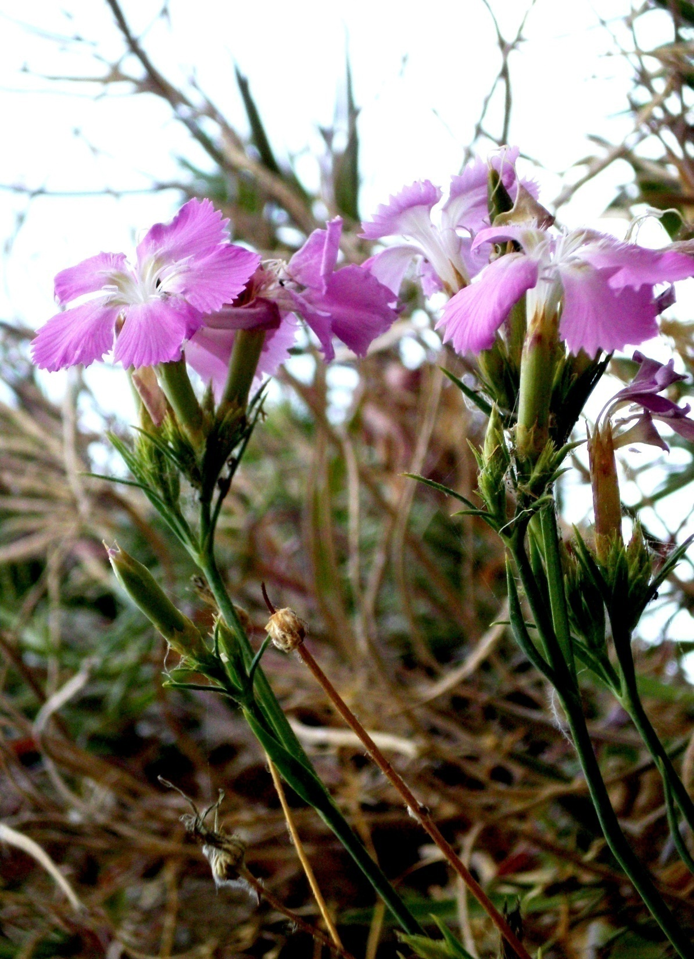
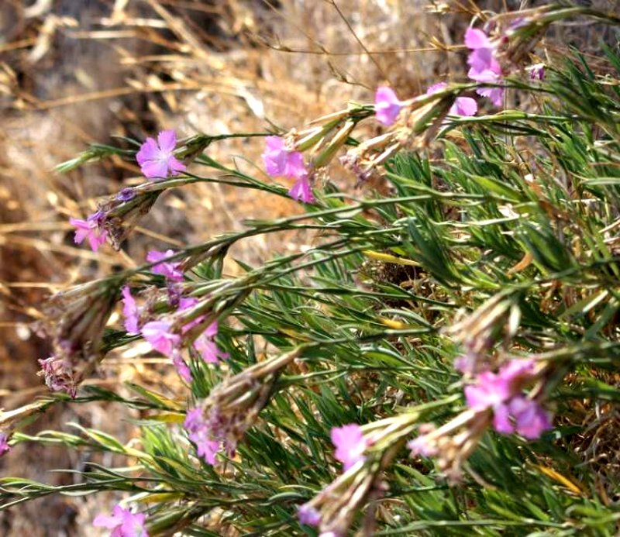
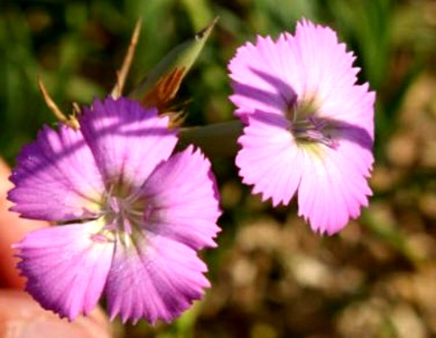
Dianthus rupicola, is a plant in the family Caryophyllaceae.
It is 'widespread only in some areas especially in southern Italy. In the province of Salerno is located at the National Park of Cilento and Vallo di Diano, at Cape Palinuro.
It is a perennial plant and the hight is up to 40 cm.
It has glaucous-green leaves, collected in a rosette at the base. The flowers are lilac-pink and blossom from May to November, the flowers have a diameter of 3-4 cm.
The Dianthus rupicola figure among the important endangered species, and is included in Annex II of the Habitats Directive (Dir. N. 92/43 / EEC) on the list of "Conservation of natural habitats and of wild fauna and flora" adopted by the Council of the European Communities May 21, 1992
Valle di Diano Parco Nazionale del Cilento Italy

