Slide 1
Food Riddles For Kids It´s useful for warming - up, motivation... ☺

Slide 2
What room is never entered?

Slide 3
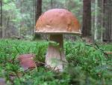
A mushroom.

Slide 4
What gets beaten, and whipped,
but never cries?

Slide 5
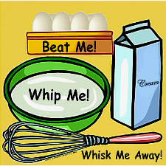
An egg.

Slide 6
What are two things you cannot
have for breakfast?

Slide 7
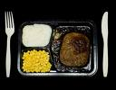
Lunch and dinner.

Slide 8
Is it O.K. to eat hot dogs with hands?

Slide 9
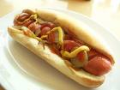
No. Hot dogs don´t have hands!

Slide 10
Where is the best place to eat pizza?

Slide 11
In your mouth!

Slide 12
How do you make a strawberry shake?

Slide 13
Take him to a horor movie!

Slide 14
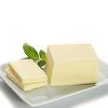
Why did the boy throw butter out of the window?

Slide 15
He wanted to see a butterfly!

Slide 16
Thank you for your attention!

Slide 17
The end...
Many greetings from Slovakia!

