Slide 1
Housing costs
In Finland, Netherlands, Denmark and Turkey

Slide 2
One-room flats
Countries | Finland | The Netherlands | Denmark | Turkey
Prices | 600-650€ | 1000-1250€ | 800-1050€ | 450-650€

Slide 3
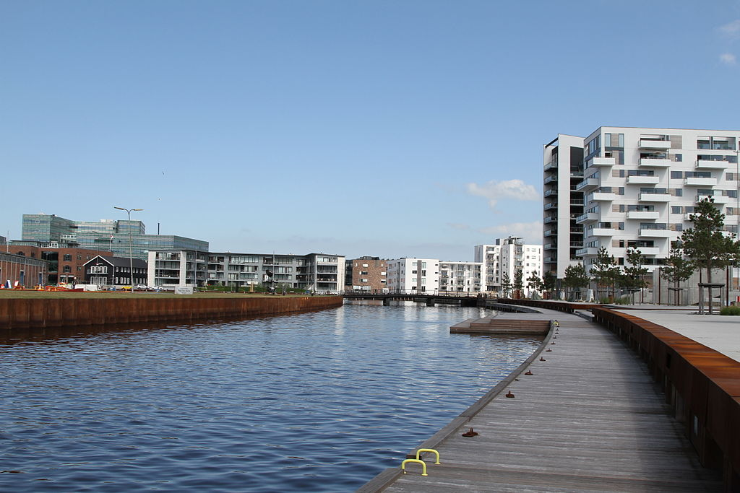
60m2 apartments (2 or 3 rooms)
in a city of around 40 000 residents
 | Finland | The Netherlands | Denmark | Turkey
Rent | 700 - 900 € | 560 € | 600 - 650 €
Selling price | 100 000- 140 000 € | 139 000 € | 195 390 € | 40 000 - 100 000 €

Slide 4
Water, heating and electricity
Finland: Denmark: Turkey: The Netherlands:
Heating Electricity: €480 Heating: 1.07 Liras= €0,24 Water costs: €17,41/month
North: €83/month Water: €1150 Electricity: 0,31 Liras= €0,70 Heating costs:€92/month
South: €100/month Heating: €1450 Water: 2,86 Liras= €0,64 Electricity: €40/month
1 person north: €41/month
South: €44/month
Electricity: €12,30/kWh
Water costs
Flats: €4,56/ m3
Detached houses: €5,57/ m3

Slide 5
Insurances
FINLAND: 120-300 euros per year
NETHERLANDS: 200-300 euros per year
DENMARK: 120-140 euros per year
TURKEY: 100-1000 turkish liras = 20-250 euros per year

