Slide 1
Europe as a workspace the study opportunities in the netherlands
Made by Aurora Hout and Iris Behnke

Slide 2
Hello and welcome to the Netherlands, this is our presitation. about MBO and HBO schools we hope that you going to enjoy it let’s go

Slide 3
5 MBO SCHOOLS IN THE NETHERLANDS
GILDE OPLEIDING
ARCUS
SUMMA
ROC
DE ROOI PANNEN

Slide 4
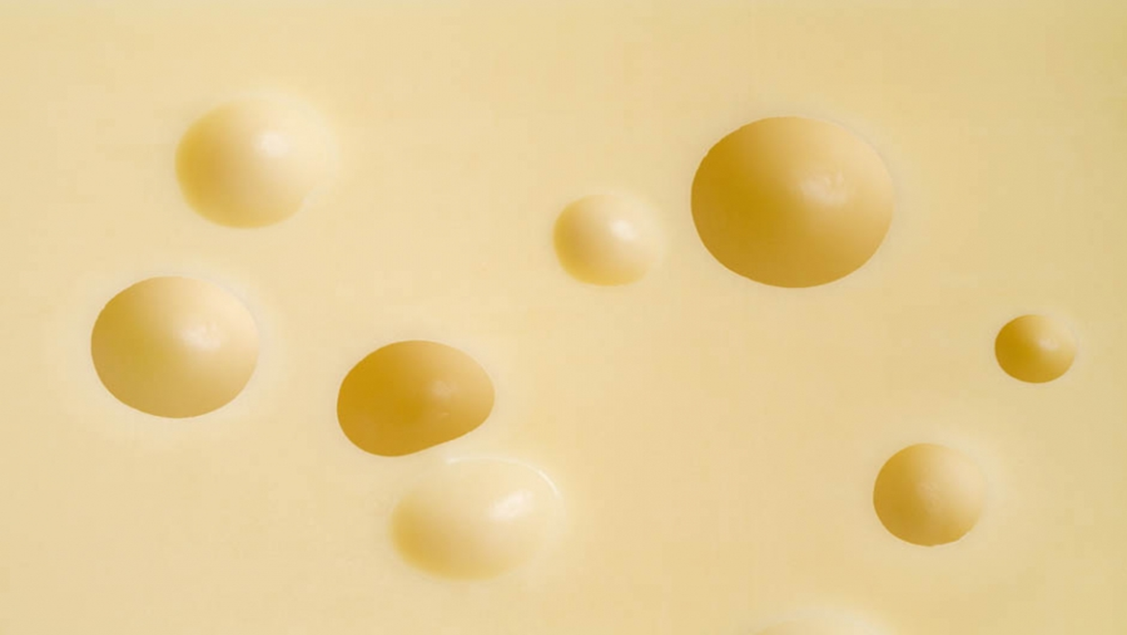
4 HBO SCHOOLS IN THE NETHERLANDS
-FONTYS
-HOGESCHOOL ZUYD
-AVANCE
-HAN

Slide 5
2 UNIVERSITIES
TU DELFT
RADBOUT

Slide 7
Thank you all for listening to our presitation,
We hope you learn something new about schools
In the Netherlands but for now byeee

