Slide 1
DARUVAR THERMAL RESORT
Tara Dašek, Tena Grujić, Stela Novaković
2.H

Slide 3
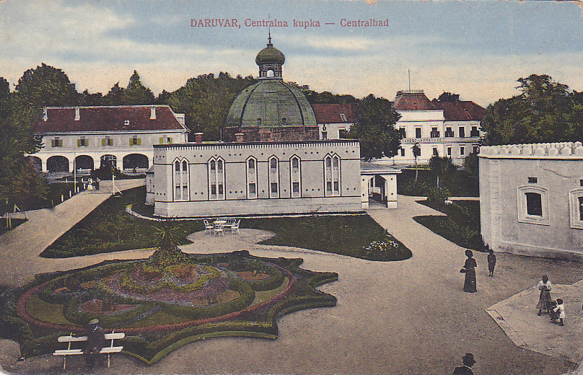
HISTORY
Roman times – ‘’Aquae Ballisae’’
The first springs of healing thermal water were found in 288 BC
In 1980, ‘’Thermal’’ was built in the unit which was well equipped and had modern hospital departments

Slide 4
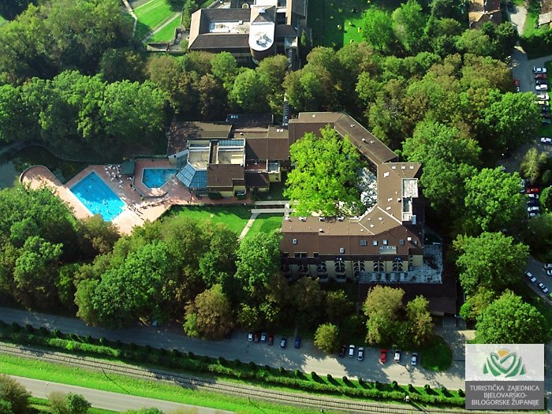
ACCOMMODATION
Thermal resort is located in the northeastern part of Daruvar
Park is full of exotic species of trees, flowers and other plants
Only a few minutes walk to the city centre

Slide 5
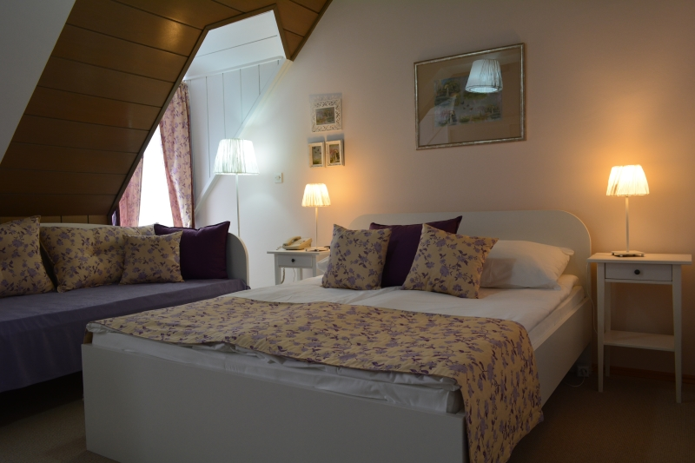
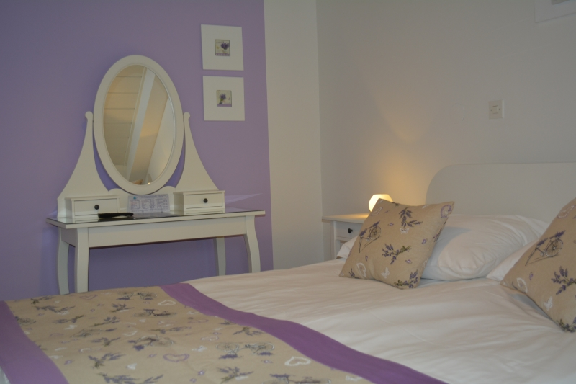
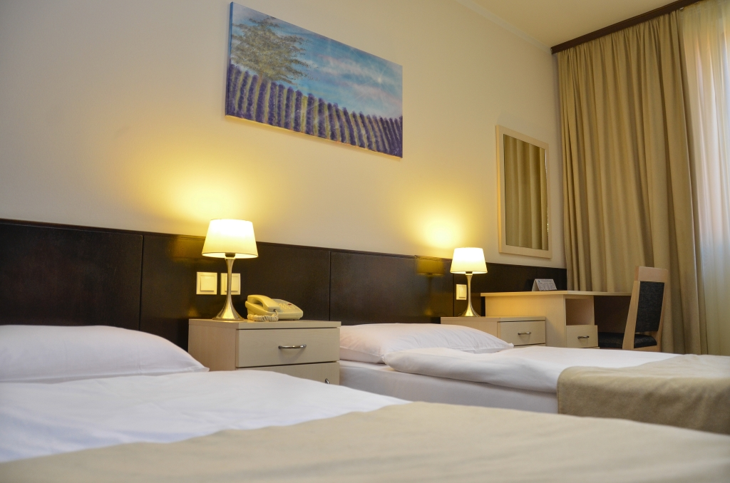
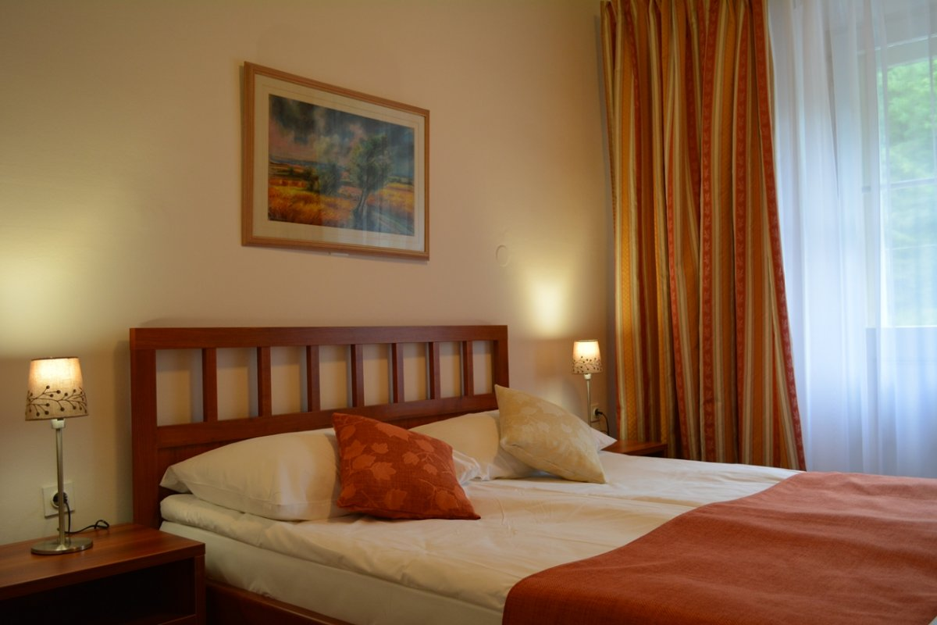
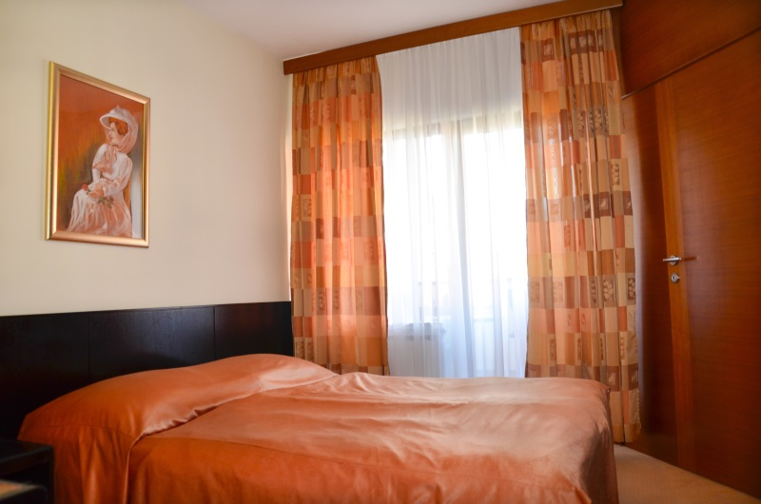
HOTEL
Hotel Termal is well equipped
it has 157 rooms on 4 floors

Slide 6
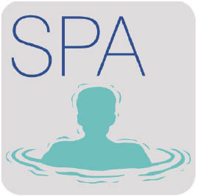
TERMAL OFFERS
Treatment of athletes
Sports and recreation
Wellness and pools
Medical treatments
Gastronomy

Slide 7
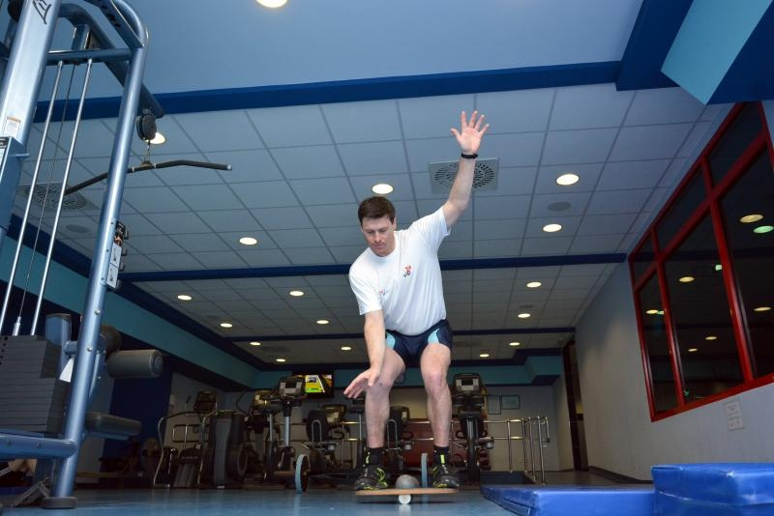
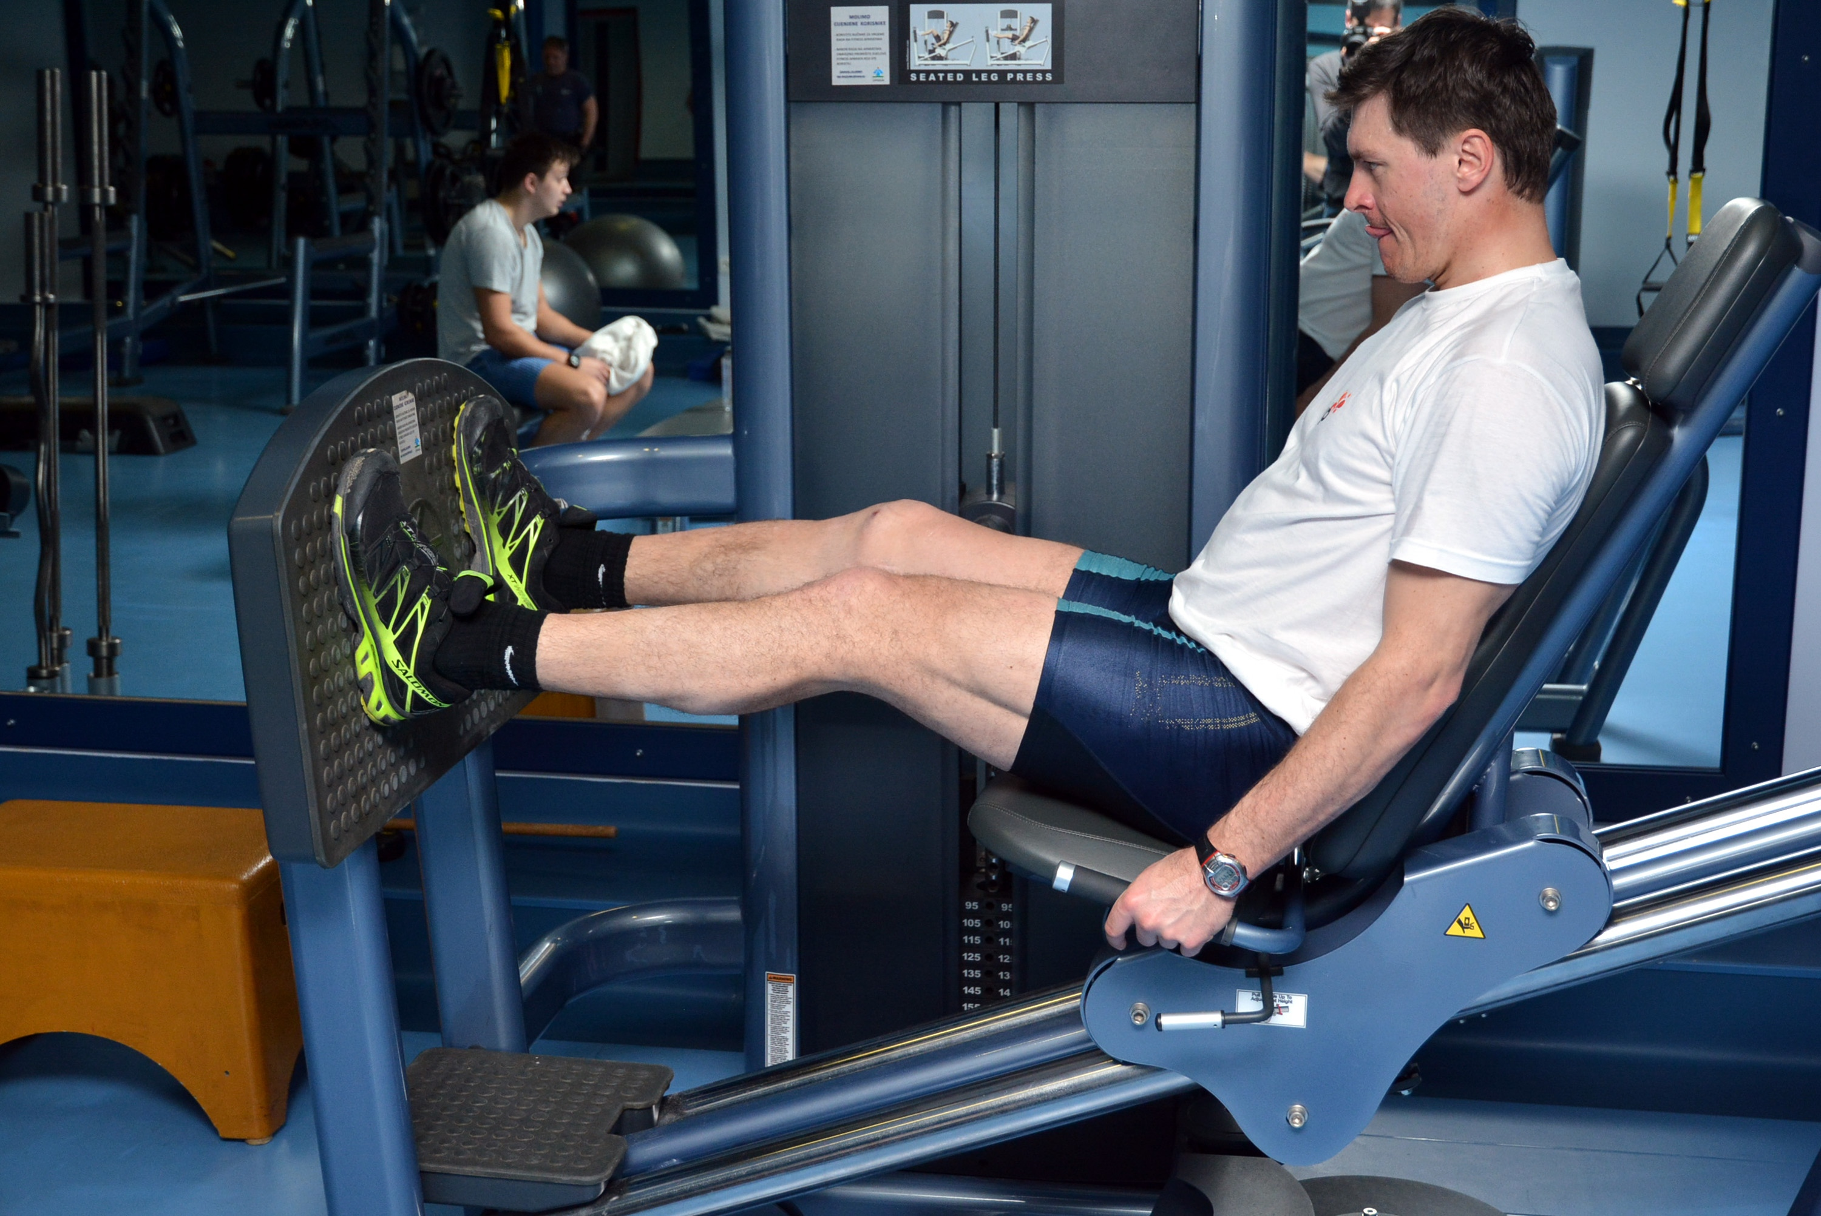
Treatment of athletes
For many years top athletes have been treated here

Slide 8
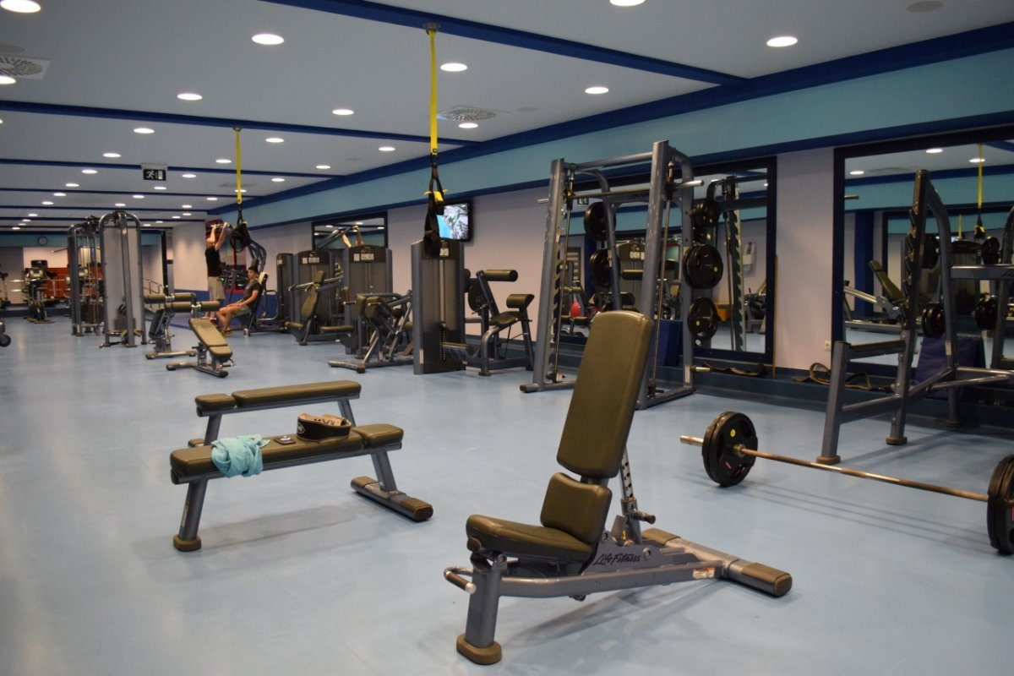
Sports and recreation
The hotel is equipped with:
gym
tennis and table tennis
running track
mini golf
sports hall

Slide 9
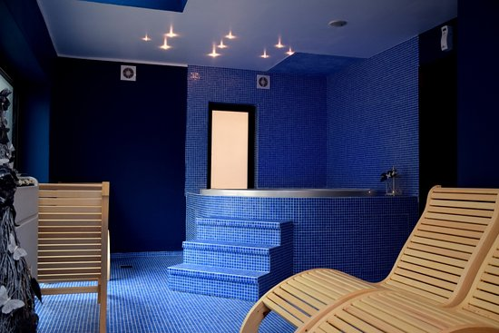
Wellness and pools
Two outdoor pools and one indoor pool with thermal healing waters
Spa zone: jacuzzi, relax room, Finnish and steam sauna
Different kinds of massages

Slide 10
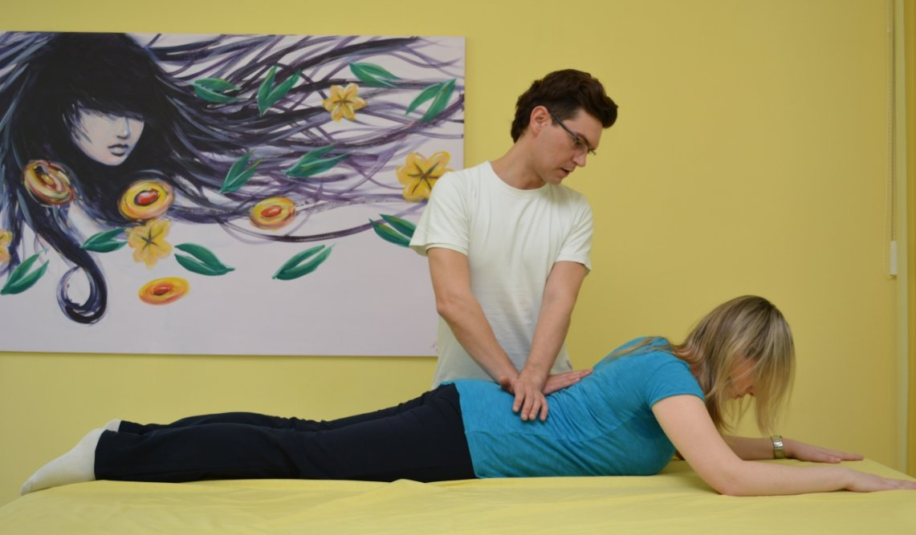
Medical treatments
A small package of health
Medium package of health
A large package of health
Breakfast with outpatient treatment
Programs for seniors
Program to help treat infertility "Joy of Life"

Slide 11
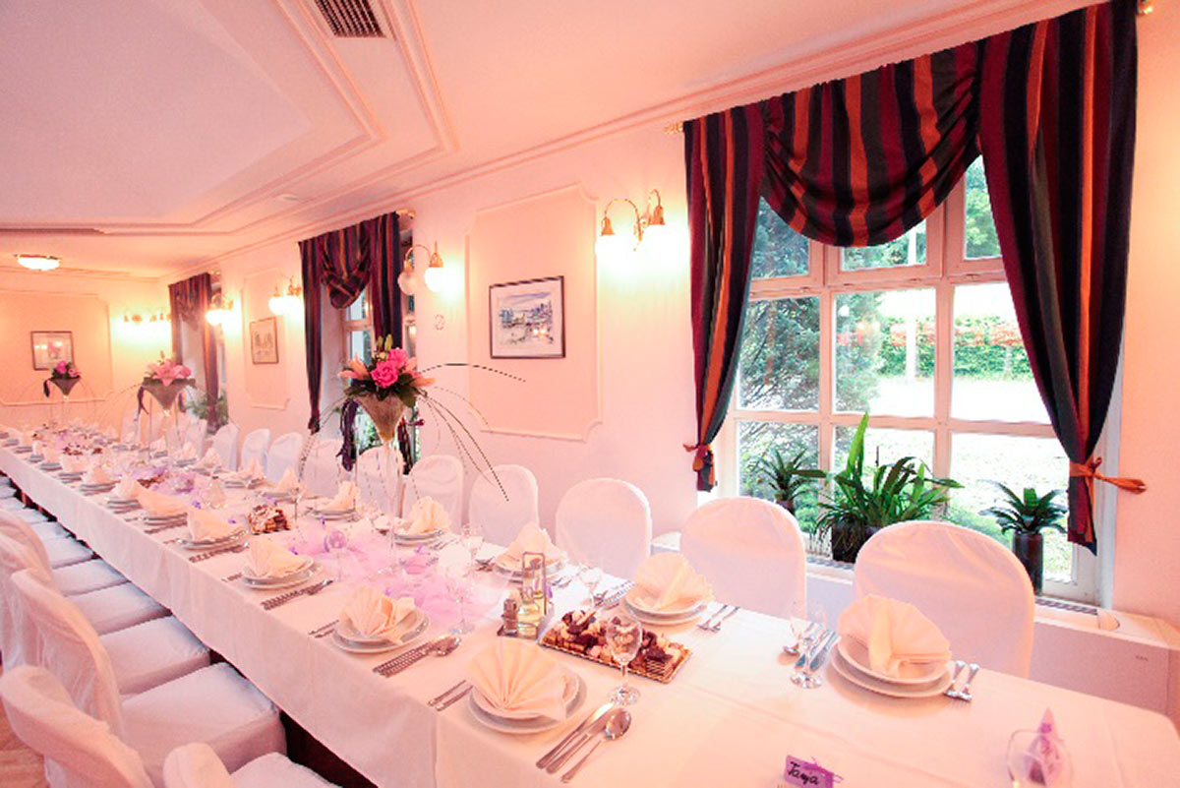
Gastronomy
Offers
traditional and Czech specialties
continental Croatia quality wines

Slide 12
THANK YOU FOR YOUR ATTENTION!
☺

