Slide 1
Education system in Croatia
From kindergarten to university

Slide 2
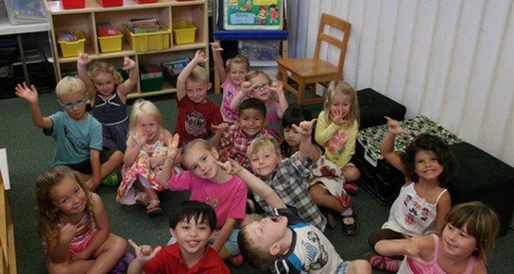
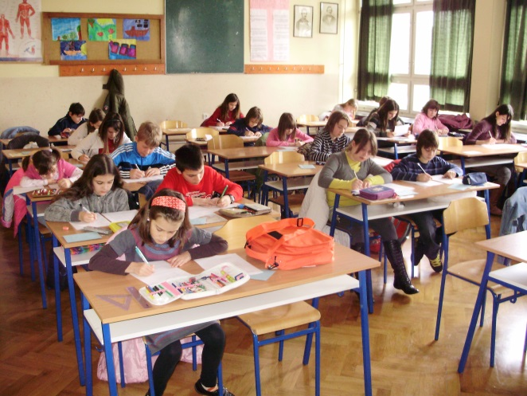
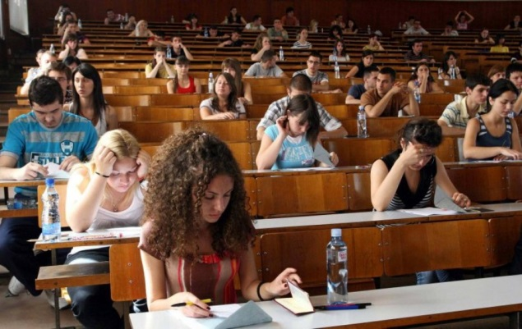
The Educational system in the Republic of Croatia
Preschool education
Elementary education
Secondary education
Higher education

Slide 4
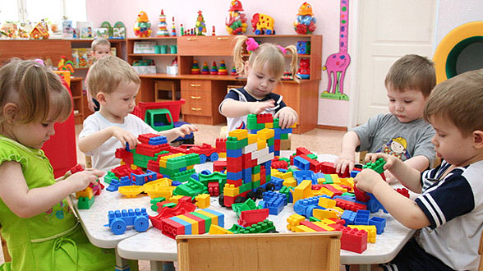
Preschool education
education and care of the children of preschool age
programs for children from the age of six months until school age (6-7 years of age)

Slide 5
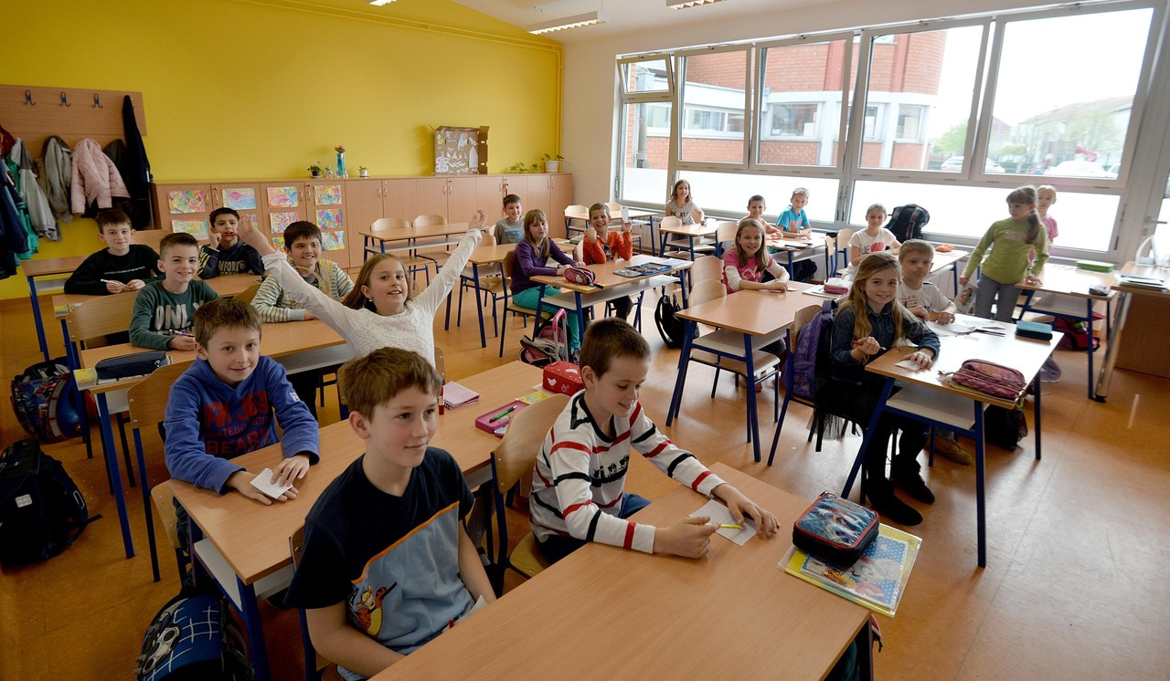
Eight-year elementary education
Compulsory and free for all children between the ages of six and fifteen.
Divided into two levels
1st through 4th grade
5th through 8th grade

Slide 6
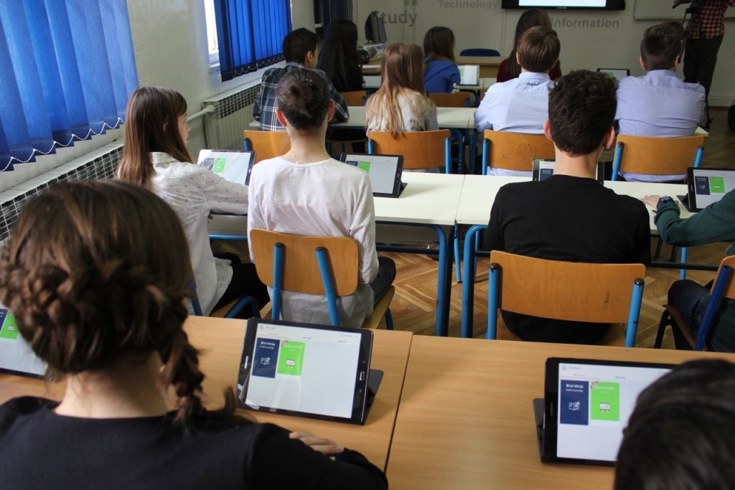
Secondary school
Secondary school is optional and free in Croatia
There are different types of secondary education:
Grammar school
Vocational schools
Art schools

Slide 7
Grammar school offers four different departments
mathematics, IT and science gymnasium,
foreign languages gymnasium,
classical gymnasium,
general education gymnasium .

Slide 8
Vocational schools
lasts between one and four years
offer vocational education
if they want to continue their education students have to take the State Secondary School Leaving Exam (Matura) to enter university
Croatia has 3 and 4-year-educational programs

Slide 9
Higher Education
The higher education system in Croatia has undergone a comprehensive reform within the framework of the Bologna Process
structured according to three cycles (undergraduate, graduate and postgraduate)

Slide 10
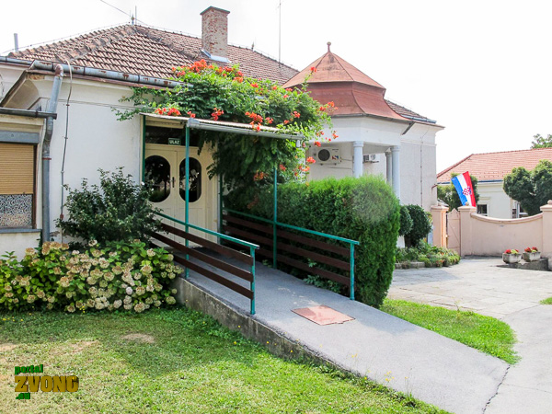
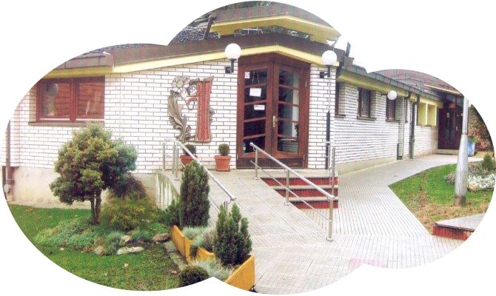
Daruvar - Kindergarten
Kindregarten “V. Nazor”
Czech kindergarten “Ferda Mravenec”

Slide 11
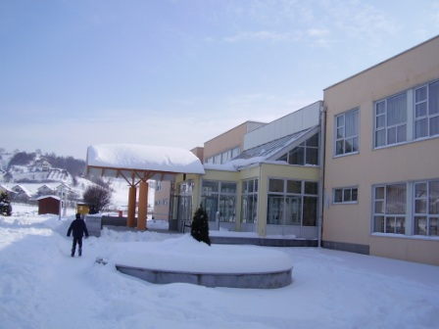
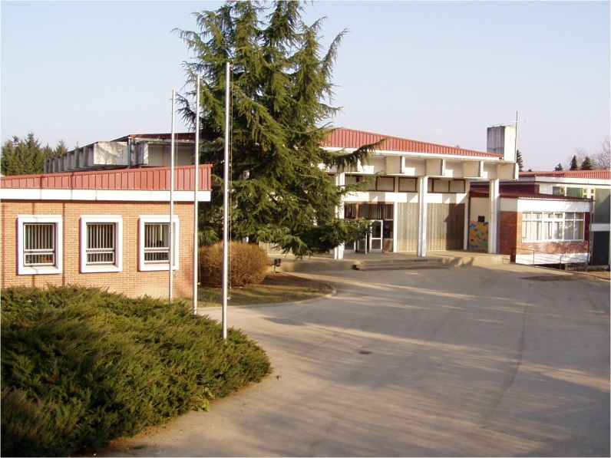
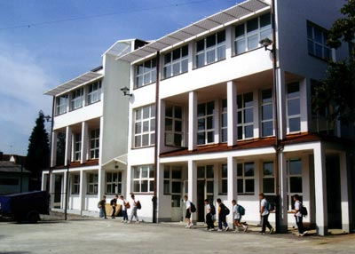
Daruvar - Elementary Schools
Elementary schools “V. Nazor”
Czech elementary school
“J. A. Komensky”

Slide 12
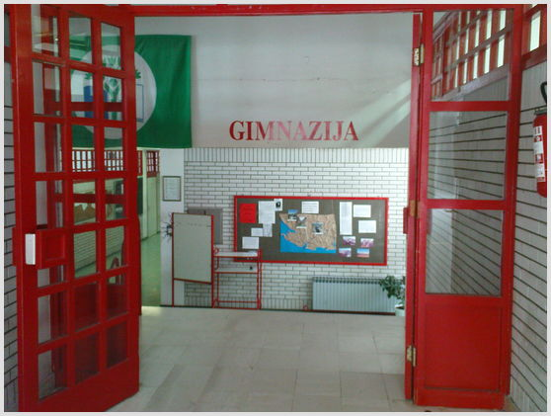
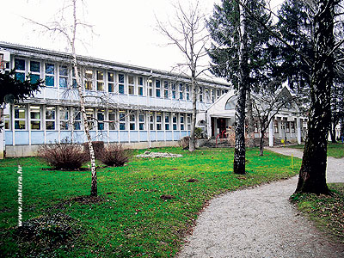
Secondary Schools Daruvar
Grammar School
Technical School
School of Economics and Tourism

Slide 13
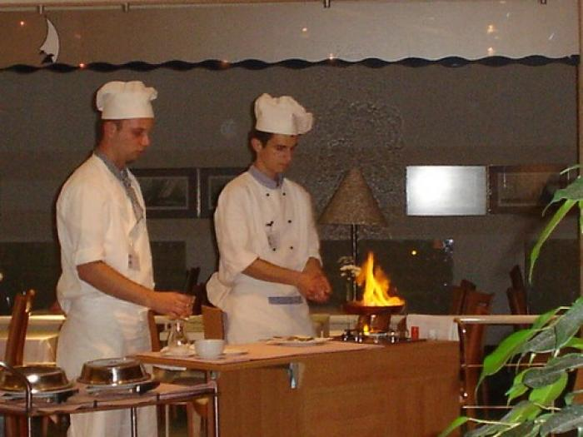
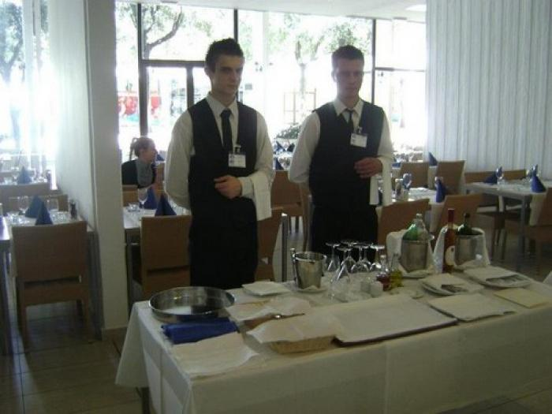
School of Economics and Tourism Daruvar - vocations
3-year programmes
Cook
Waiter
Shop assistant

Slide 14
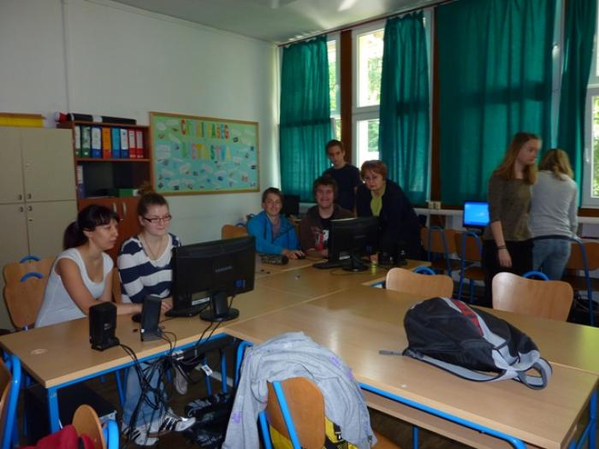
School of Economics and Tourism Daruvar - vocations
4-year programmes
Economist
Hotel and tourism technician
Agro–tourism technician

Slide 15
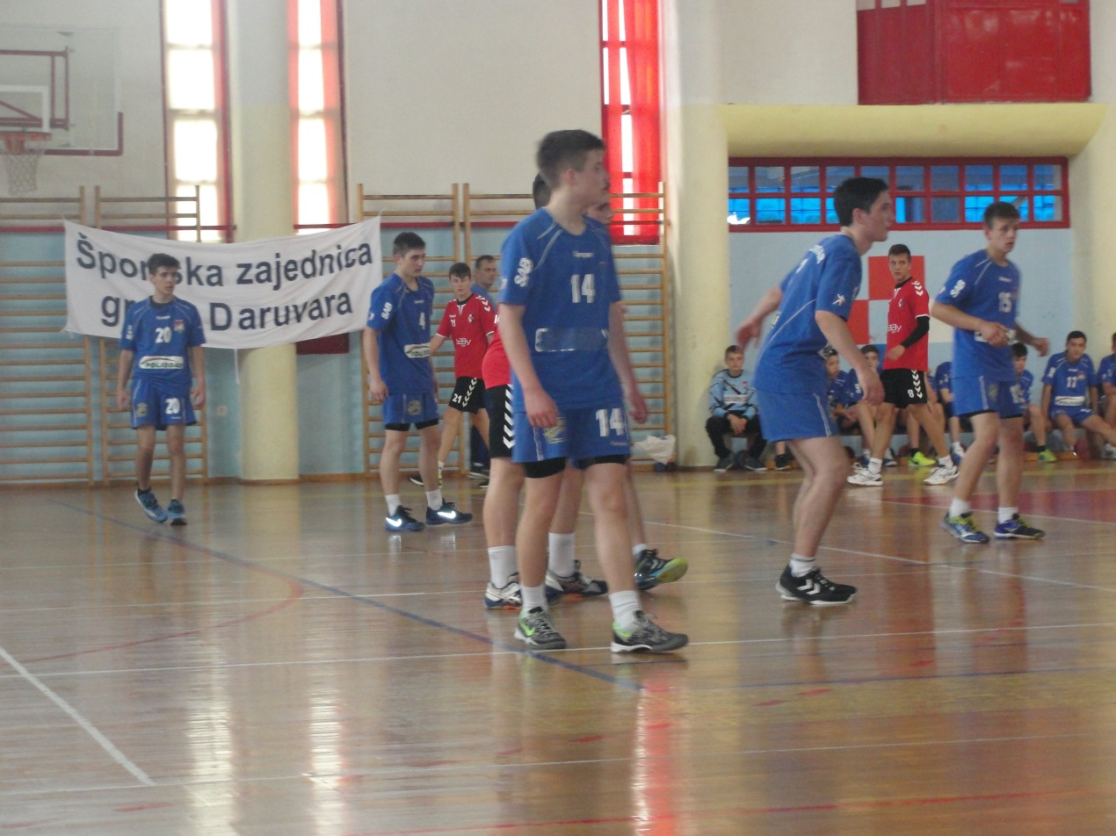
We study a lot , but we also… ...play sports…

Slide 16
… dress up for Halloween…

Slide 17
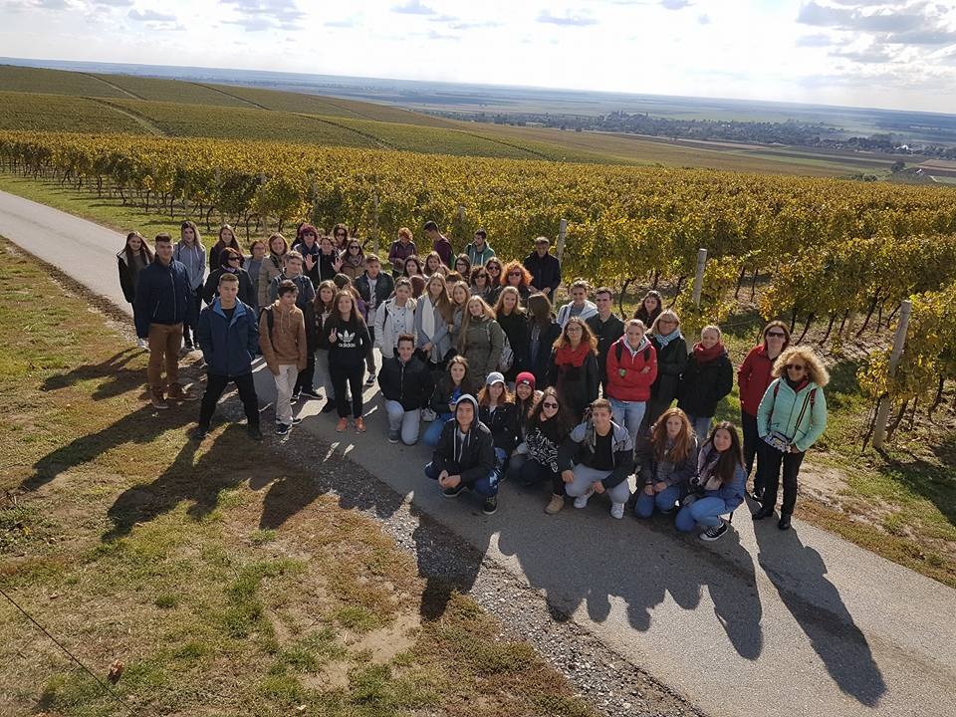
…travel…

Slide 18
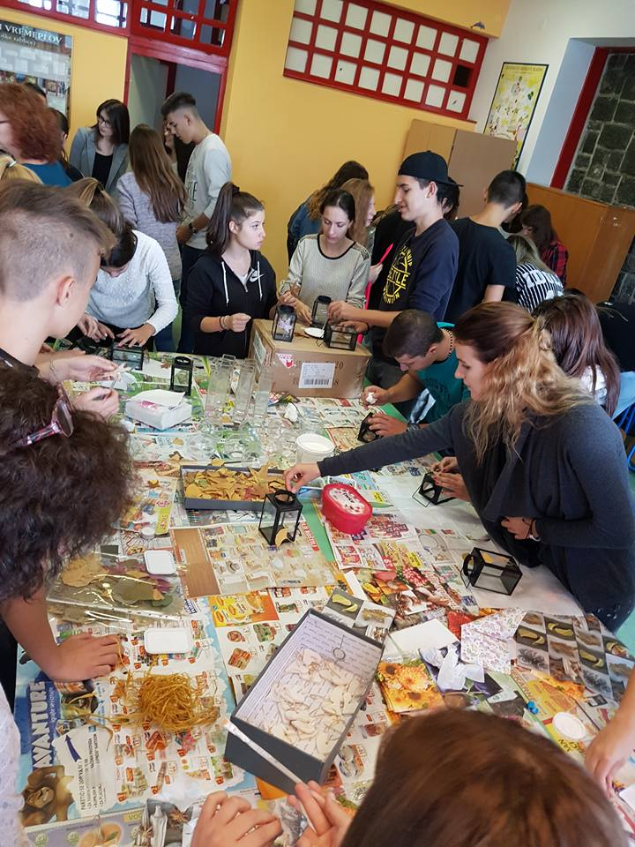
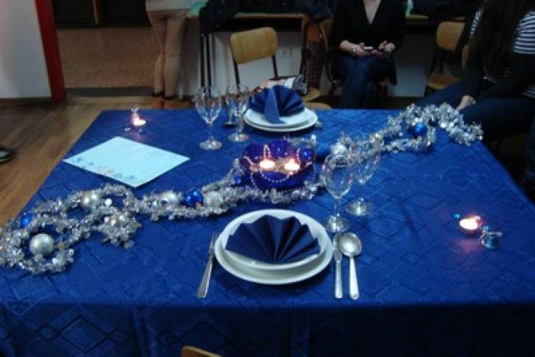
…have workshops…

Slide 19
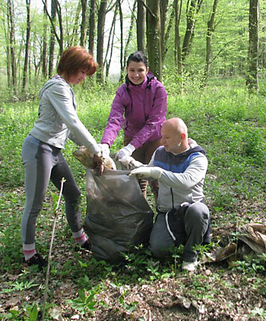
… clean our town…

Slide 20
…help in our community…

Slide 21
We hope you will enjoy your stay when you come to Croatia! ☺

