Slide 1
Our Eco Story

Slide 2
Our project group

Slide 3
Our Eco Activities :

Slide 4
Fall Winter help for animals

Slide 5
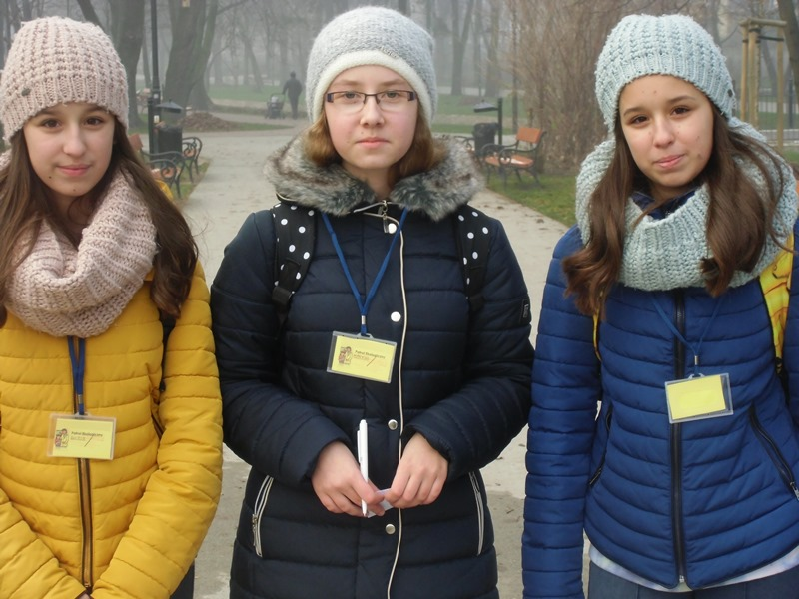
Ecological patrol

Slide 7
Patrol in action

Slide 9
Campaign „A penny for a dog and a cat”

Slide 12
Saving chestnut trees

Slide 14
mechanical fight- raking leaves

Slide 19
Finally we collected 19 bags of dry chestnut tree leaves , the whole lot will be burnt. We destroyed a lot of pupae and hope that next year the condition of these trees will be better.

Slide 20
Thanks for watching
Group from Junior Secondary School No.13 from Radom from Poland

