Slide 1
PLANS
Planning Learning Approaches for Nowadays Students

Slide 2
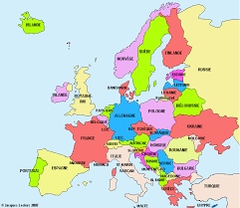
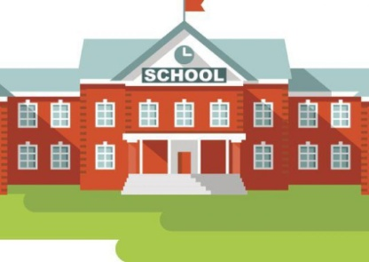
Activity:
“MY SCHOOL AND MY TOWN IN EUROPE”
Portuguese students will work on…
TRADITIONS

Slide 3
Digital Tools
PowerPoint
PREZI
VIDEO / APP

Slide 4
Applying CLIL methodology
Content
and
Language
Integrated
Learning

Slide 5
Working in cooperative teams
In each school students will prepare a questionnaire
to be answered by students from other schools after:
researching their corresponding topics (Portugal: traditions);
selecting and presenting the most appropriate information
on Twinspace;
using technology;
developing communication skills in English;
developing self-confidence when presenting their work.
Results in Google Docs format to be uploaded on school
website.
.

Slide 6
Other members’ topics
Food
(Czech Republic)
Special geographic characteristics
(Romania)
Development
(Germany)
Religions
(Spain)

Slide 7
  ☺     
Do your best!!
Deadline: 28th November

