Slide 1
How would we love to use solar energy in our environment
Students from Varaždin from the class 1.C

Slide 2
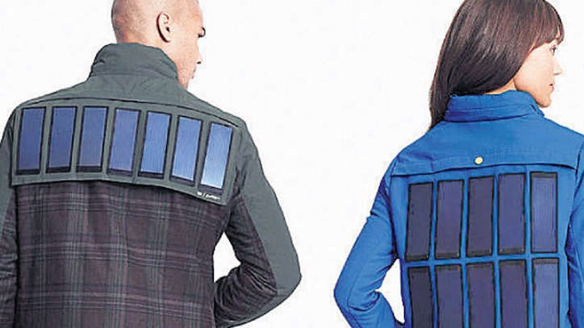
Since we all use smart phones we need to have power for them. One brilliant idea is to use solar power to charge smart phones whenever we want. This is possible if solar pannels are integrated in clothes, like into jackets.
The jacket contains strips of solar panels weighing around four pounds in total on the back side. The solar panels can charge the portable battery that is connected to a concealed cord in the pocket. The completely charged in-built battery is claimed to provide 4 complete charges for a 1500mAh battery device, so I guess the battery pack is of 6000mAh capacity. The charged battery can be used to charge any portable device.
The cool thing about the solar panel is that it’s flexible, waterproof and is removable from the jacket.

Slide 3
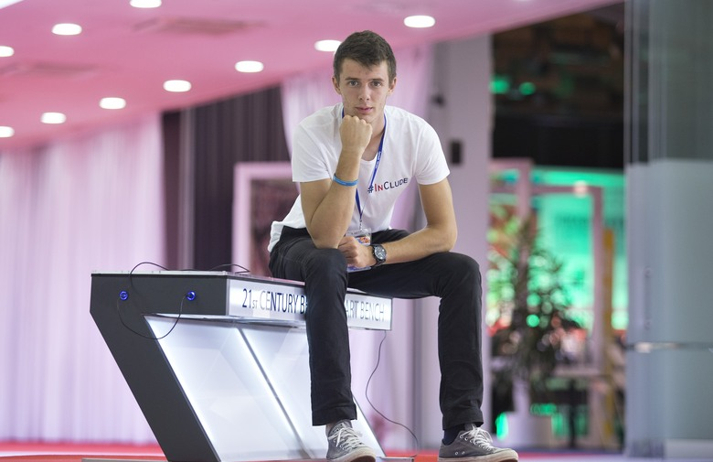
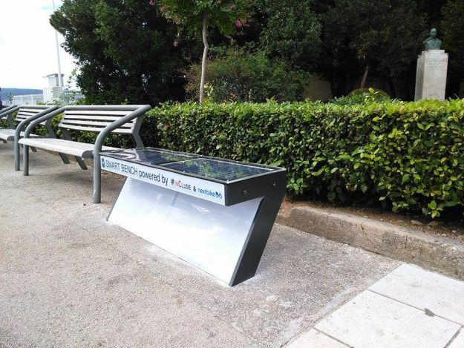
Smart benches are also brilliant idea how to use solar power. The power is free for everyone and itis used to charge smart phones.
Smart benches are equipped with mobile device charging stations, WiFi hotspots, temperature controlled seating, ambient lighting.

Slide 4
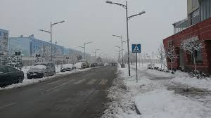
How many times did you wish that all ice is melted from the path were you go by foot? Every winter I suppose.
Well, lets use solar power to heat path so that all ice is melted so that we can carefree walk!
By the path we could put special fences with solar panels on them which would sun light convert into heat that would be on the flor where people walk. That would make life during the winter more easier and with less injuries and bone fractures. ☺

