Slide 1
Distance learning - stay at home!
MARIA ANAGNOSTIDOU 3rd Primary School of Serres, Serres Ελλάδα
Beata KubińskaSzkoła Podstawowa im. kpr. Feliksa Ignacego Grabowskiego w Zespole Placówek Oświatowych w Bodzanowie, Bodzanów Πολωνία
Iwona AdamkowskaSzkoła Podstawowa im. kpr. Feliksa Ignacego Grabowskiego w Zespole Placówek Oświatowych w Bodzanowie, Bodzanów Πολωνία

Slide 2
1. Everything will be fine!
Every rainbow counts!
Our schools are closed! We stay safe at home, but we can still communicate through the eTwinning platform!!!
Students from the schools:
Szkoła Podstawowa im. kpr. Feliksa Ignacego Grabowskiego w Zespole Placówek Oświatowych w Bodzanowie in Poland and
3rd Primary School of Serres in Greece, from their homes, send messages of optimism to all the students in Europe, especially to the students in Italy and Spain!

Slide 3
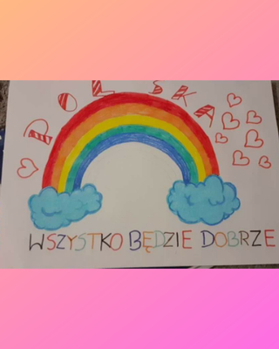
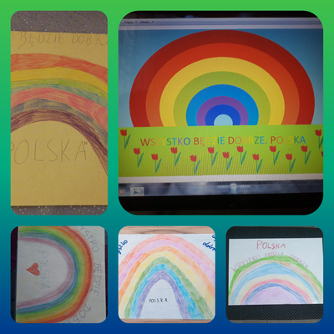
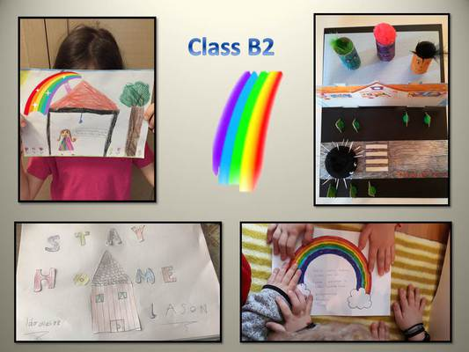

Slide 5
Poland, Bodzanów Everything will be fine!
This is class 3b from Poland-Bodzanów
We celebrated Earth Day dressed in green, with flowers and among plants. In Poland, we have to wear face masks!

Slide 6
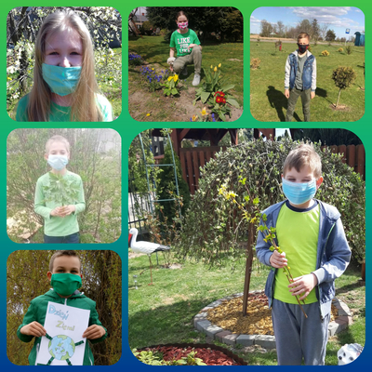
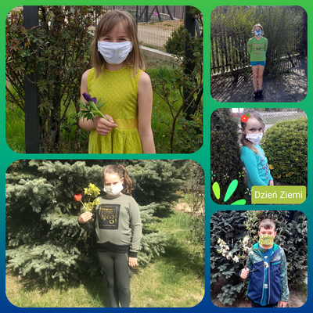
Class 3b

Slide 7
Greece, Serres Everything will be fine!
This is class B2 from the 3rd Primary School of Serres, Greece
Staying at home sometimes is not very easy. Our schools closed on 11 March. Thankfully we have friends all over Europe and we continue learning together in the times of COVID-19.

Slide 8
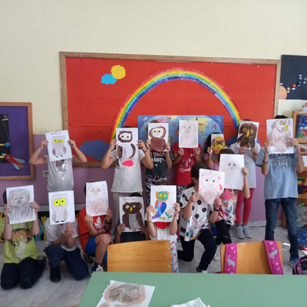
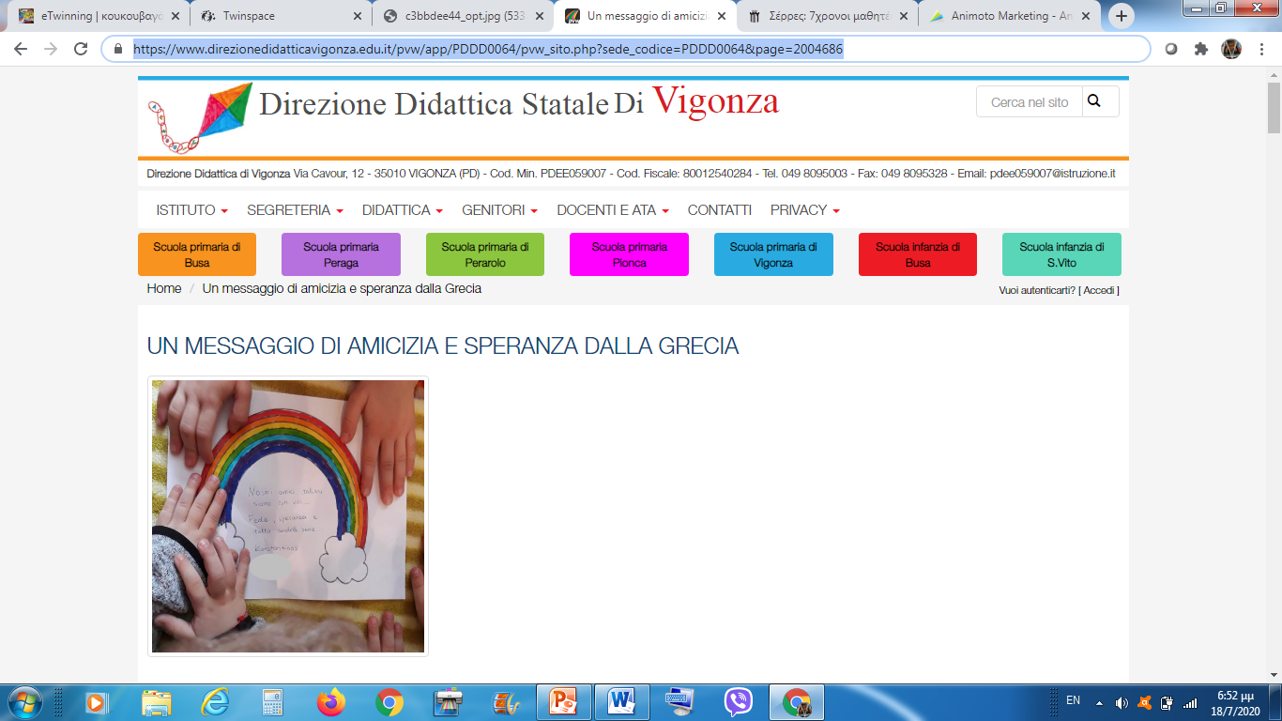
Class 2b
Our work for the Italian and Spanish students who are in quarantine received recognition by the Italian Educational Administration Office!!!

Slide 9
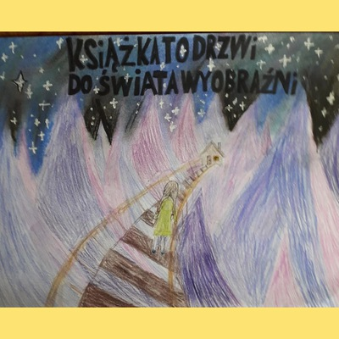
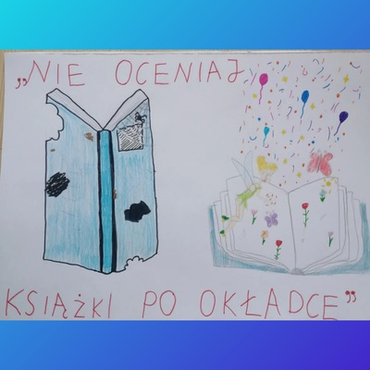
2. International Childrens' Book Day- April 2
https://vimeo.com/404068711
The book is the door to
Do not judge a book
the world of imagination
by its cover!

Slide 10
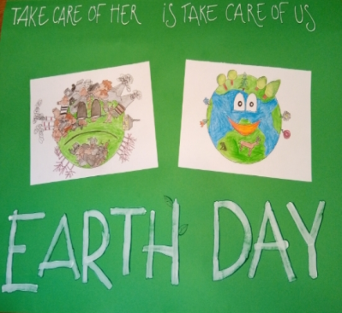
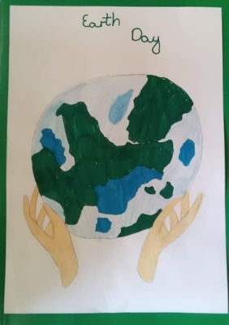
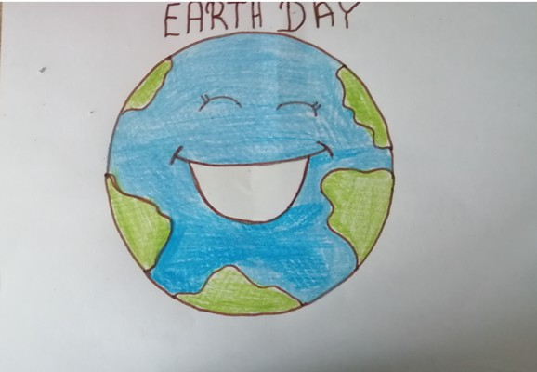
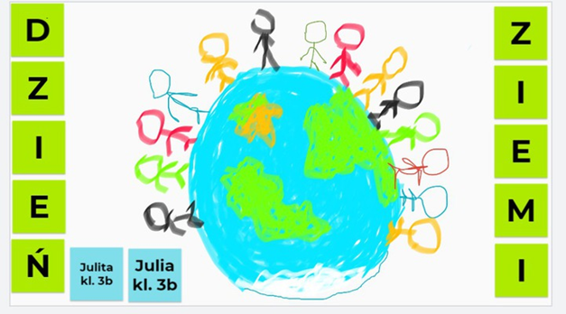
3.Earth Day - Polish-Greek joint activity
https://vimeo.com/434765861

Slide 11
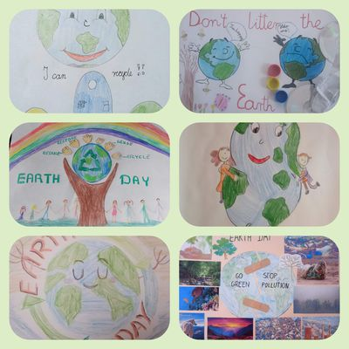
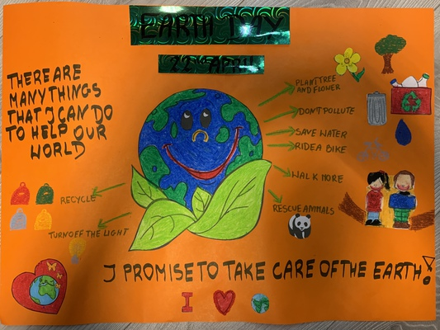
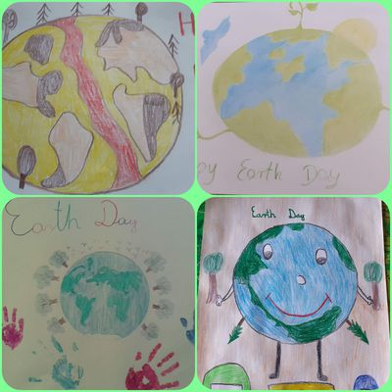
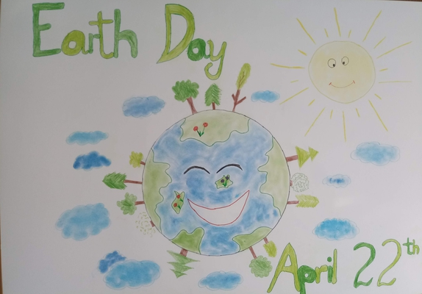

Slide 12
4. Healthy eating
Greek and Polish students learning together about Healthy eating during the quarantine
Our common book
https://issuu.com/beatakubiska/docs/padlet_nowy

Slide 13
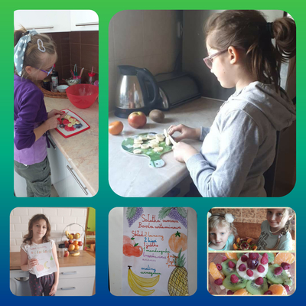
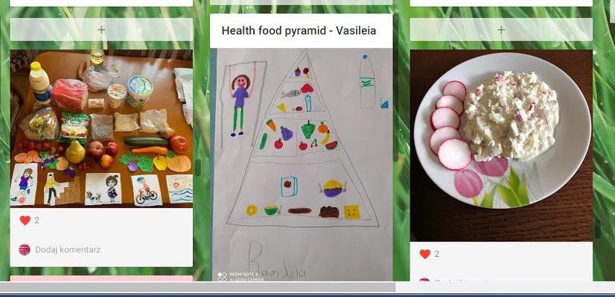

Slide 14
5. Animals-pets,protected, bees
Polish and Greek students learnt together about animals -pets and protected- and in particular about bees
The students from Bodzanow and Serres learnt about different categories of animals, about their characteristics and their needs. They also learnt about bees and their importance for sustainability and the importance of honey in a healthy eating diet.

Slide 15
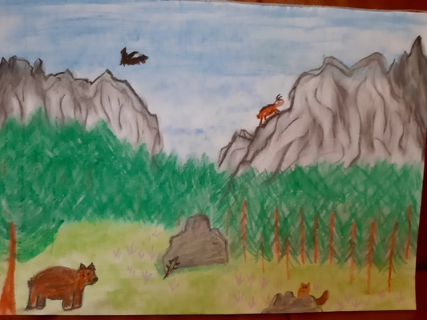
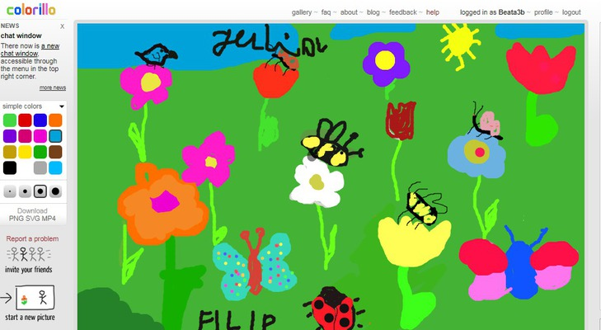
https://www.youtube.com/watch?v=aBtPVwMj-eY&feature=emb_logo

Slide 16
6. Welcome Spring
Polish and Greek students learn together about vegetation in their countries using a common padlet
https://drive.google.com/file/d/18k1Bv_yNZ9TOtTIsVZz61-nrj_A5EkHd/view?usp=sharing
A virtual Exhibition was created containing some of the students' work
https://vimeo.com/433169714

Slide 17
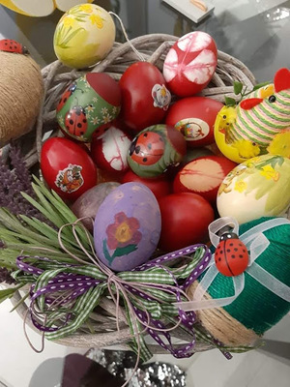
7. Easter Easter in quarantine!
Greek and Polish students took photographs of their Easter activities at home. It is a different Easter this year as we all stay at home!

Slide 18
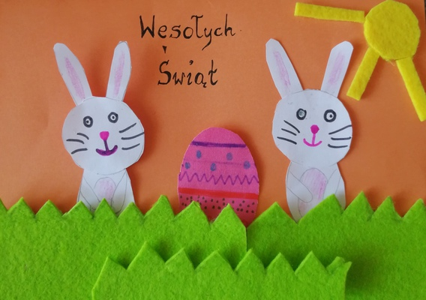
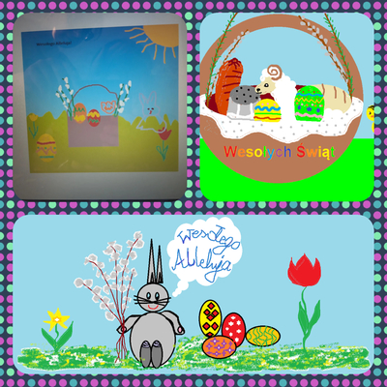
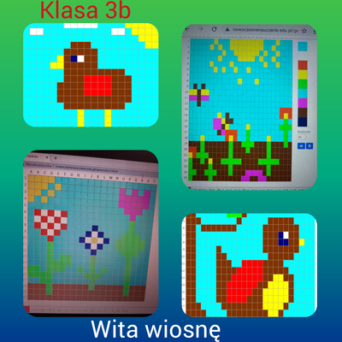
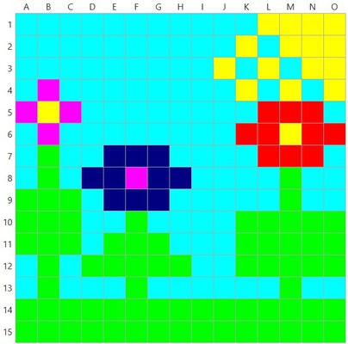
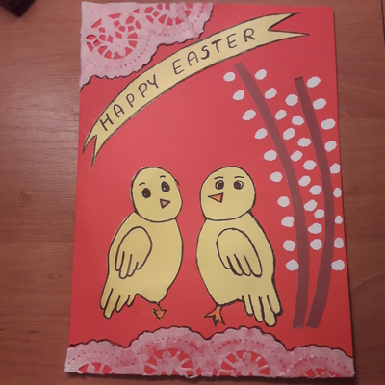
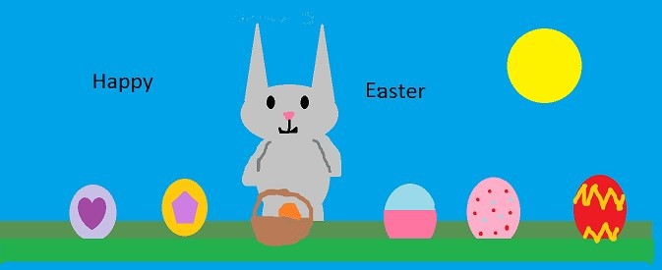
Poland, Bodzanów Easter in quarantine!
Polish students took photographs of their Easter activities at home. They want to say to their European friends Happy Easter!

Slide 19
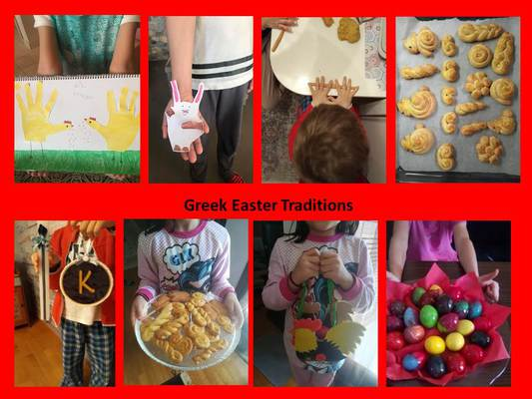
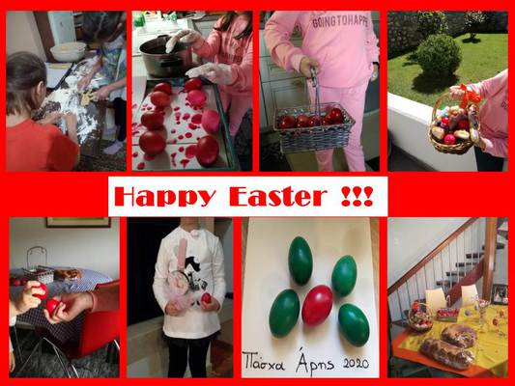
Greece, Serres Easter in quarantine!
Greek students took photographs of their Easter activities at home. They wanted to show to their European friends the Greek Easter traditions.

Slide 20
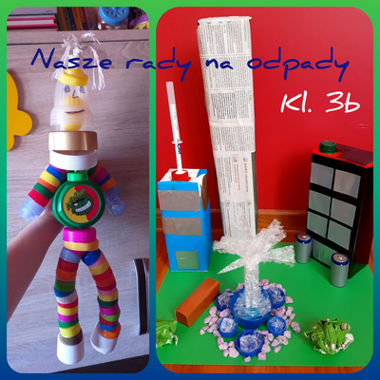
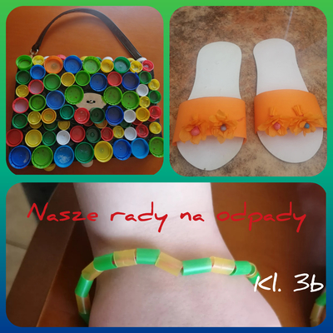
8. Let's recycle!
Waste segregation is a very important matter. Students created objects from waste under the slogan OUR WASTE ADVICE. This was great fun!

Slide 21
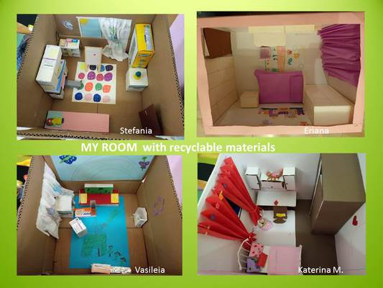

Slide 22
9. Our National Days
Students from Poland and from Greece celebrated their National Days in quarantine
Greece 25 March
Poland 3 May

Slide 23
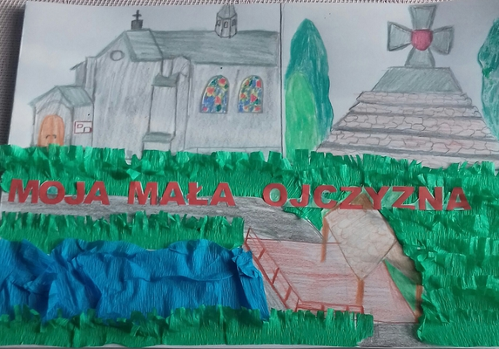
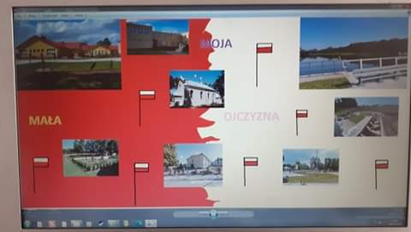
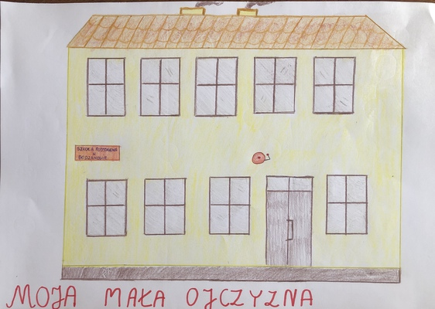
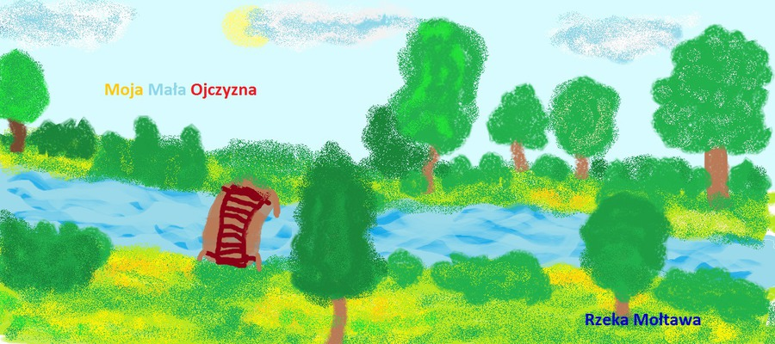
Poland
On May 3, we are celebrating the National Day in Poland. Class 3 b students created posters under the slogan "My Little Homeland", which showed places closest to the children.

Slide 24
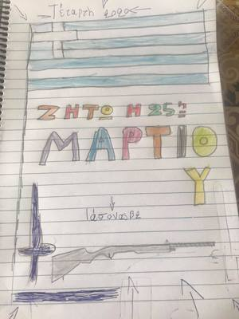
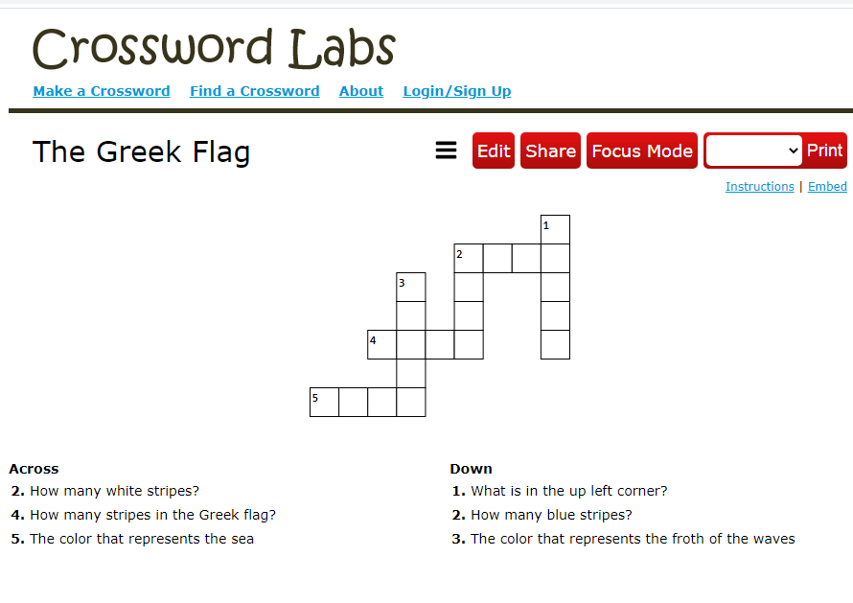
Greece
Celebrating the National day of Greece at home is very sad. No school, no celebrations at school, no parade in the center of our town!
A crossword puzzle about the Greek flag for our partners
https://crosswordlabs.com/view/the-greek-flag

Slide 25
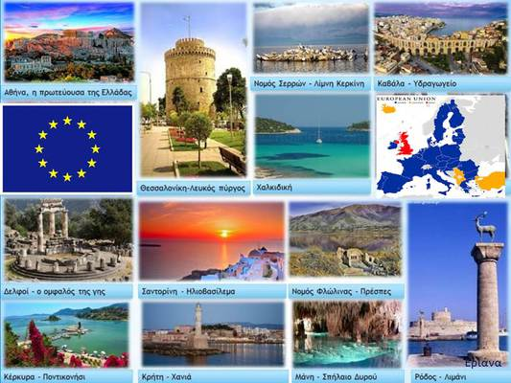
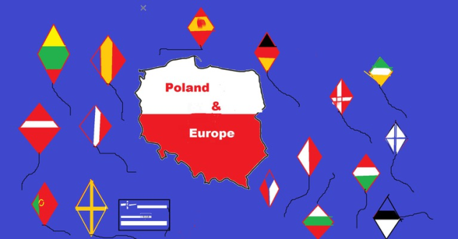
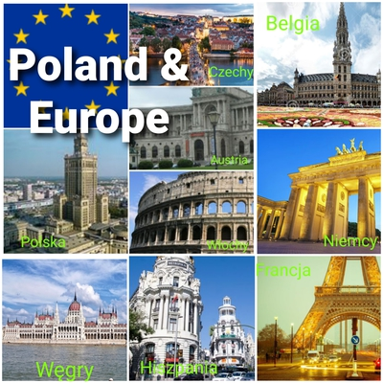
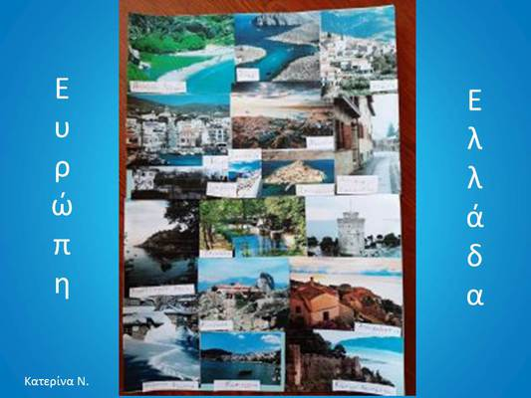
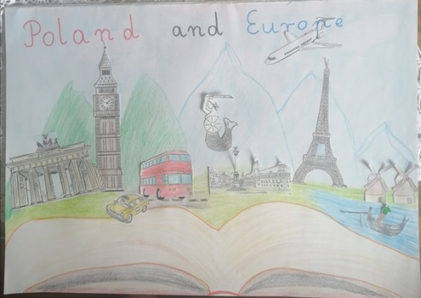
10. Europe Day Europe Day, 9 May, in quarantine
On May 9, classes 3b and 2b celebrated Europe Day and created "Poland and Europe" "Greece and Europe" posters. Beautiful works were created in various art techniques.

Slide 26
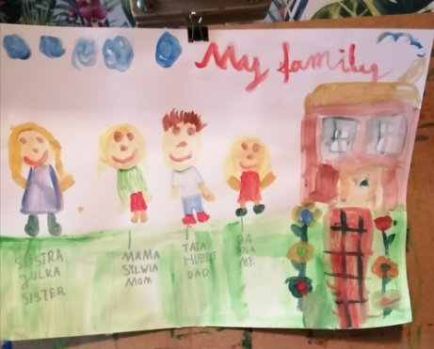
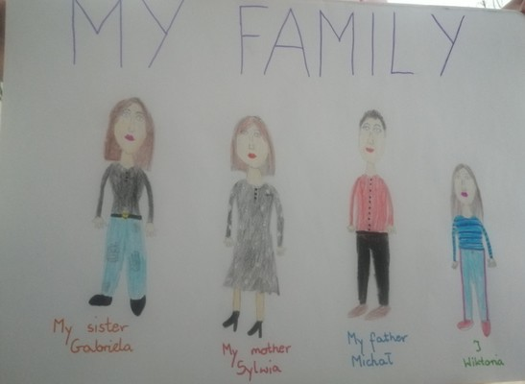
11. International Day of families
On May 15 the International Day of Families is celebrated in order to show the importance of the family in the upbringing of the children.
Our students drew their families in their own unique way. Enjoy their beautiful work!

Slide 27
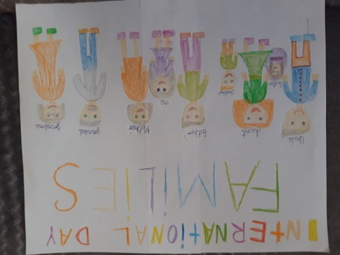
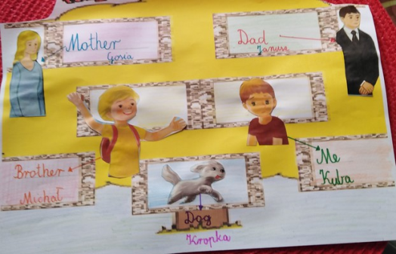
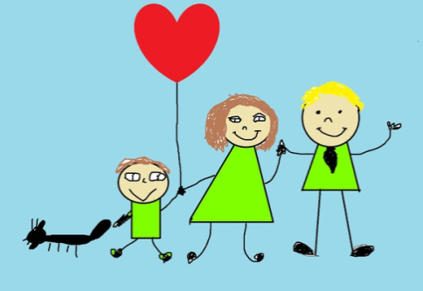
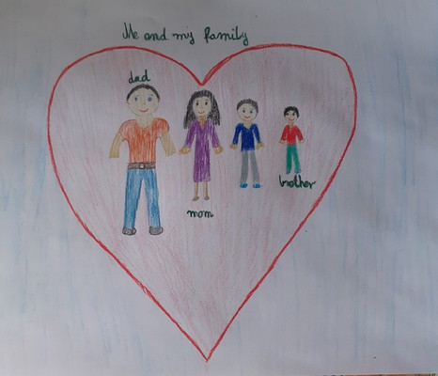
https://vimeo.com/426675396

Slide 28
12. Evaluation of the project
Greek and Polish students and parents loved the project!
Most of them gave 5 stars to most of the activities. It was a fruitful project as our students did so much, in such a short time! Quarantine proved to be a very creative period in our learning lives!

