Slide 1
10 QUOTES OF THE BIBLE, WITH PRACTICAL APPLICATION

Slide 2
„Motivating the Learning Engine to Increase Student's School, Professional and Social Success and Reduce Absenteeism “ № 2019-1-RO01-KA229-063851_1
2019-2021
Secondary school "PROF. UNIV. DR. ION STOIA”

Slide 3
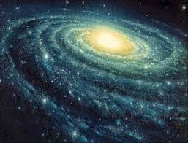
THE LORD IS CLOSE TO THOSE WHO HAVE THE DEATH HEART AND SAVES THOSE WITH THE CRUSHED SPIRIT.
Psalm 34:18
The Lord is near ... Really ... Even if you don't always feel it. When I have a "broken heart" and "broken spirit" I am prone to feel God beyond me, but the Word that is trustworthy says It is near me. And that my pain hurts him.

Slide 4
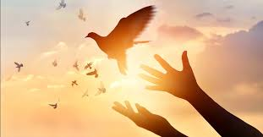
WHEN A LOT OF BLACK THOUGHTS COME UP INSIDE ME, YOUR CONCERNS BRING JOY TO MY SOUL.
Psalm 94:19
I always remember this verse. Just when I had the greatest need for encouragement from the Word of the Lord. To this day, it remains a special verse for anyone, because I have experience with it. It may be the same for you.

Slide 5
VERSET 13 B: » LIVE IN PEACE BETWEEN YOU!«
Mutual peace in the living together of the believers. Peace is a feature of daily life.
The world around us is looking for peace, but we know precisely that people without God vainly seek it. As long as man has no peace with God, he cannot have lasting peace with his fellow men either.

Slide 6
» DON'T BACK Evil TO Evil«
(Romani 12.17)
You have heard that it was said: "Eye for eye and tooth for tooth", but in the Christian morality this exhortation is not indicated, because revenge does not end the conflict and the conflict ruins the soul and the peace.

Slide 7
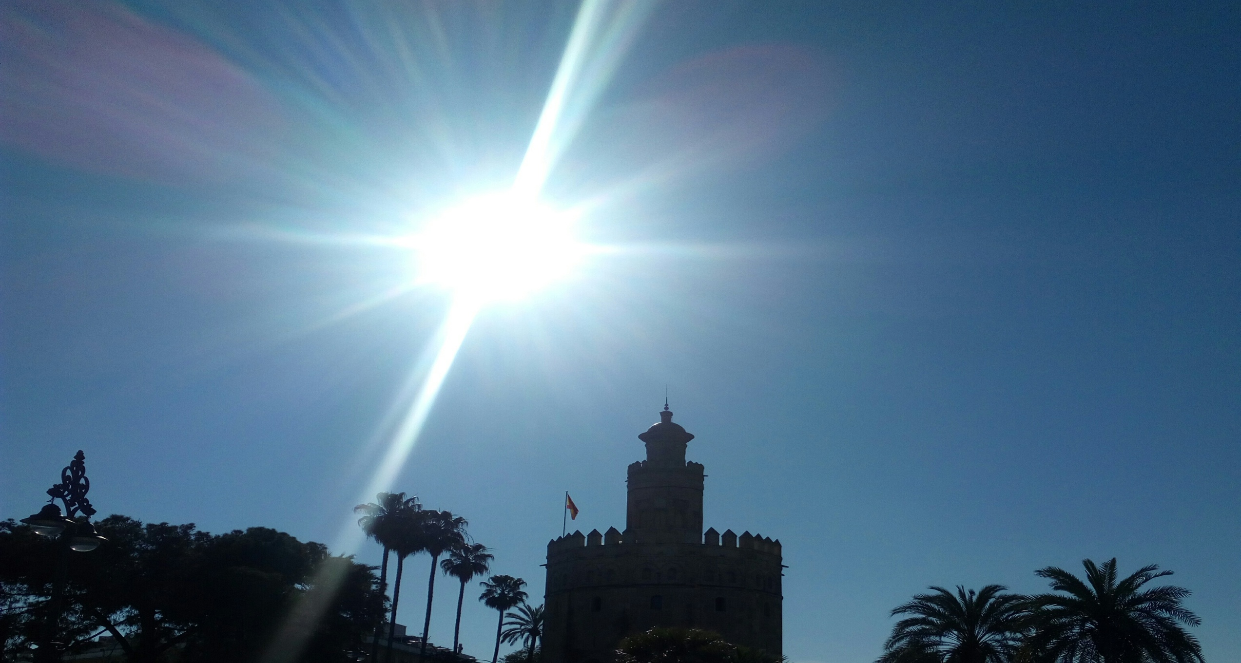
»LIVE IN PEACE BETWEEN YOU!!«
Verset 13 b
Mutual peace in the living together of the believers. Peace is a feature of daily life
The world around us is looking for peace, but we know precisely that people without a vain God seek it. As long as man has no peace with God, he cannot have lasting peace with his fellow men either.

Slide 8
Love the people around you 4:11-12
We must love one another, so that our peace, quietness and security will be preserved as well as those around us.

Slide 9
FORGIVE
Marcu 11:25
And, when you stand up to pray, forgive everything you have against someone, because your Father who is in heaven will forgive you your mistakes.
This will keep the harmony between PEOPLE.

Slide 10
DON’T GIVE UP!
Matei 7:7,8
Ask, and you will be given;
search and you will find;
beat, and it will open.
For everyone asks for an end; who is looking will find; and to him who knocks it opens.
Attitude worth pursuing for positive purposes.

Slide 11
LOVE PEOPLE AROUND YOU
Ioan 4:11-12
Beloved, if God so loved us, then we must love one another. No one has ever seen God; if we love one another, God remains in us, and His love has become perfect in us.

Slide 12
LOVE YOUR ENEMIES
Matei 5:44
Love those who are against you, bless those who speak ill of you, do good to those who hate you and pray for those who wander aimlessly, so you will feel better, without negative thoughts, useful to society.

Slide 13
The Bible, as a literary document, integrates into the ancient literature of the Near East.
Includes: Old Testament and New Testament.
The first full translation of the Bible into Romanian was printed in 1688.

Slide 14
All rights reserved. No part of this publication may be reproduced, in any form or any means, without permission in writing from the authors.
,, The European Commission is not responsible for any uploaded or submitted content. The content reflects the views only of the European Commission cannot be held responsible for any use which may be made of the information contained therein”

Slide 15
Project Financed by the European Union
„Motivating the Learning Engine to Increase Student's School, Professional and Social Success and Reduce Absenteeism “

Slide 16
Secondary school "PROF. UNIV. DR. ION STOIA” CĂLDĂRARU - ARGEŞ
By Students
Fulger Dorin Ionuț, Diaconescu Mihai Octavian
Tatu Daniel George, Niculae Raluca Elena
Nedelea Alexandru Victor, Petrică Marilena Ionela
Zorzonea Ramona Nicoleta, Constantin Cosmin
Coordinator teacher -Drăguț Violeta & Translation teacher -Ghițulescu Daniela

