Slide 1
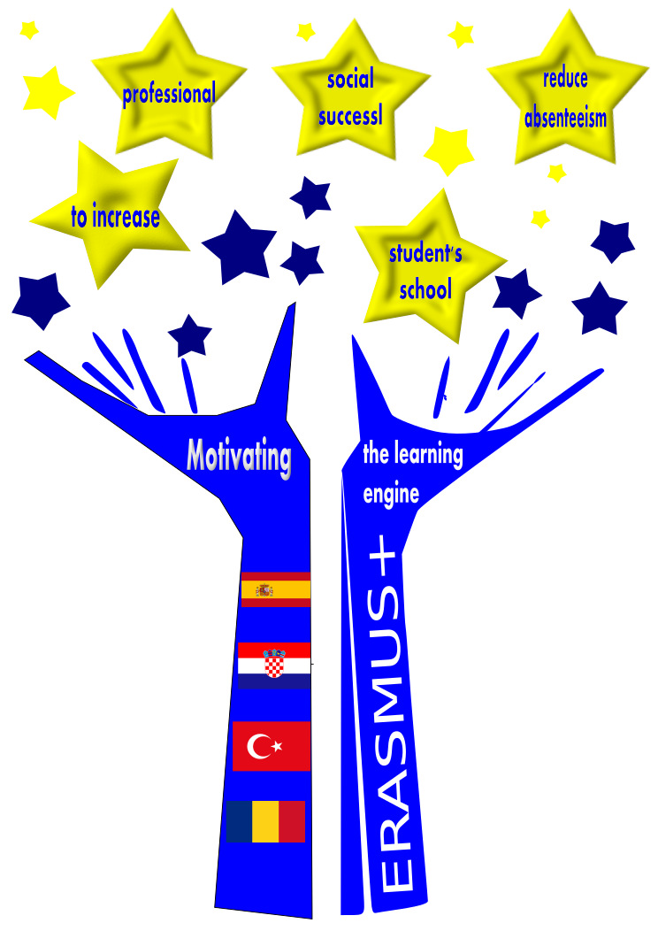
Motivating the learning engine to increase student’s school, profesional and social success and reduce absenteeism
2019-1-RO01-KA229-063851
Project financed by the European Union
Authors:
Carolina Usó
Rosabel Benages

Slide 2
Stereotypes
Which demotivate learning

Slide 3
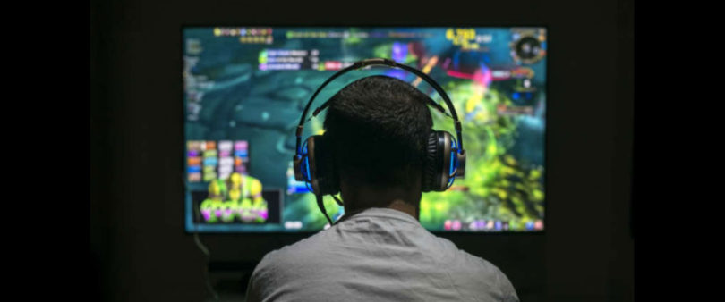
being passionate about video games

Slide 4
thinking that being a digital native makes you an expert in new technologies

Slide 5
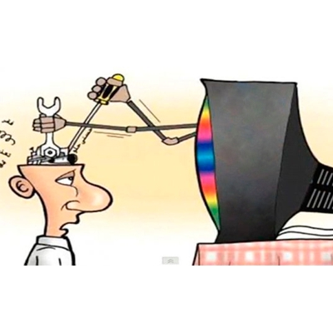
spending your time watching TV

Slide 6
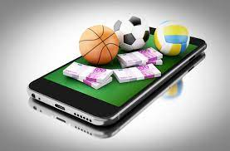
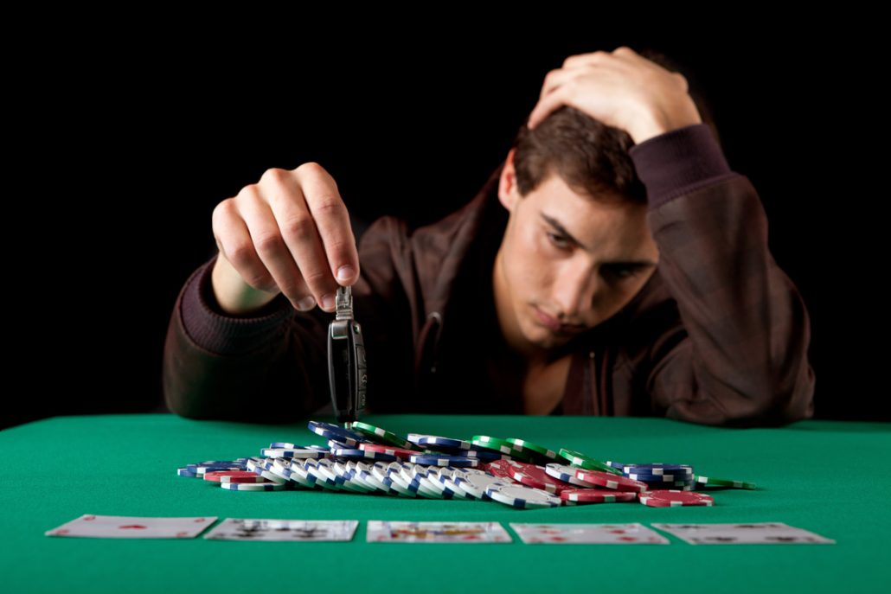
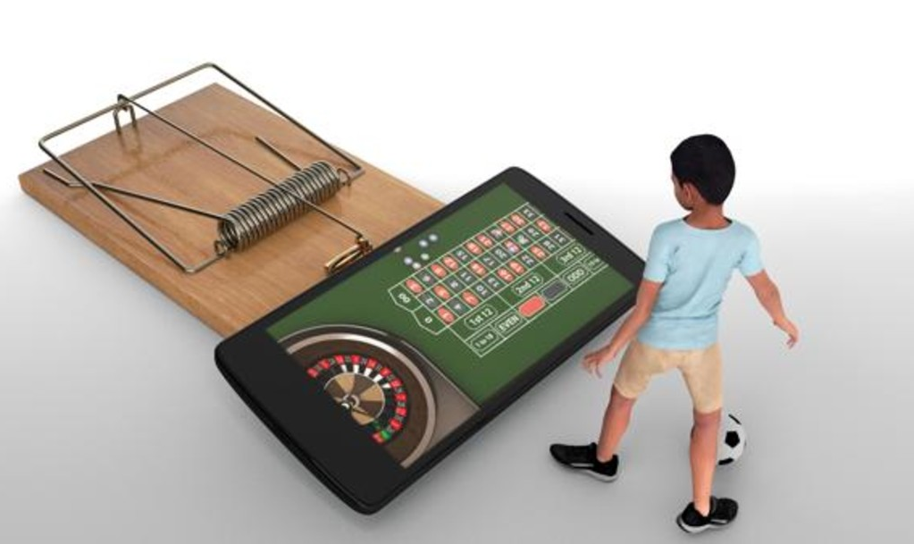
being addicted to gambling

Slide 7
taking the easy way to success

Slide 8
having Too many extracurricular activities.
tiredness and additional exertion.

Slide 9
social class triggering success

Slide 10
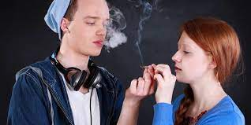
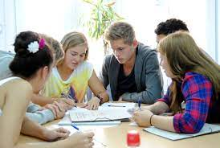
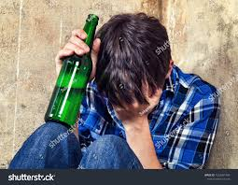
individual’s background/cultural group

Slide 11
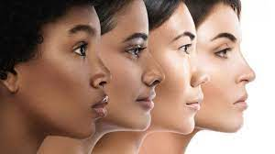
individual’s race

Slide 12
gender

Slide 13
All rights reserved. No part of this publication may be reproduced, in any form or any means, without permission in writing from the authors.
“The European Comission is not responsible for any uploaded or submitted content. The content reflects the views only of the European Comission cannot be held responsable for any use which may be made of the information contained therein”

