Slide 1
Motivating the learning engine to increase students’ school, professional and social success and reduce absenteeism
2019-1-RO01-KA229-063851
Project financed by the European Union
Dúnia Alemany/ Mª Carmen Usó
All rights reserved. No part of this publication may be reproduced, in any form or any means, without permission in writing from the authors. | “The European Comission is not responsible for any uploaded or submitted content. The content reflects the views only of the European Comission cannot be held responsable for any use which may be made of the information contained therein”

Slide 2
LINKS BETWEEN SOCIAL AND ECONOMIC AGENTS

Slide 3
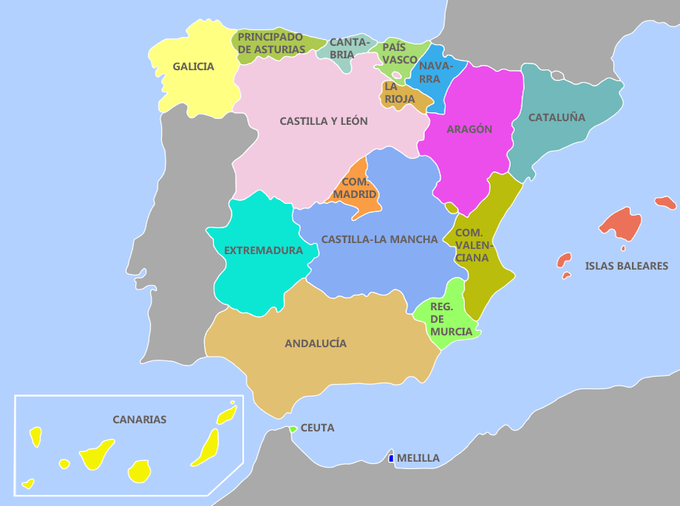
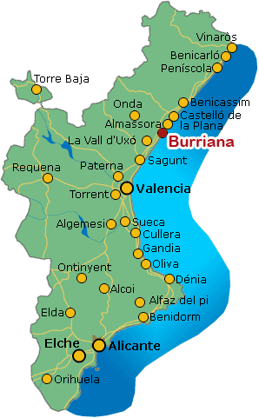
OUR SCHOOL/ OUR CITY: BORRIANA

Slide 4
LINKS IES JAUME I / SOCIAL AND ECONOMIC AGENTS
TOWN HALLS:
Alqueries
Borriana
RESOURCES:
PERSONAL/MONEY
TRANSPORT (BUS)
LOCAL ADMINISTRATION
CONSELLERIA:
Castelló
València
AUTONOMIC
ADMINISTRATION

Slide 5
LINKS IES JAUME I / SOCIAL AND ECONOMIC AGENTS
PRIVATE ENTERPRISES: ECONOMIC FINANCING
WORK PLACEMENTS IN AN ENTERPRISE:
STUDENTS
IES JAUME I

Slide 6
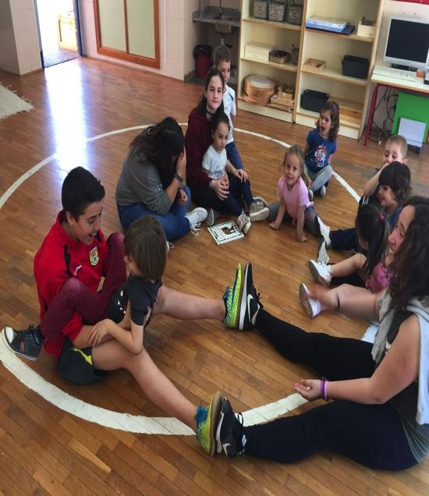
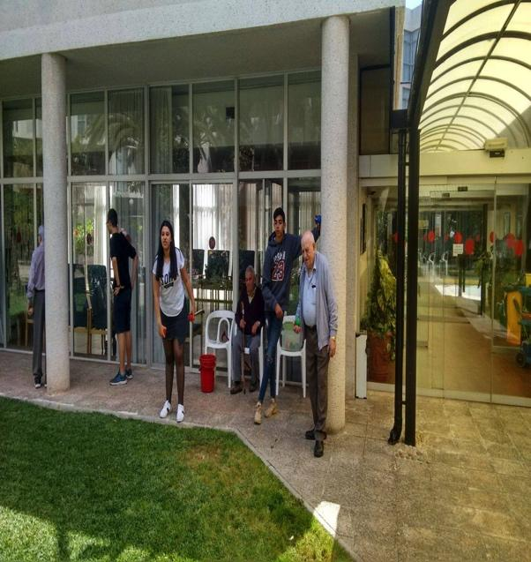
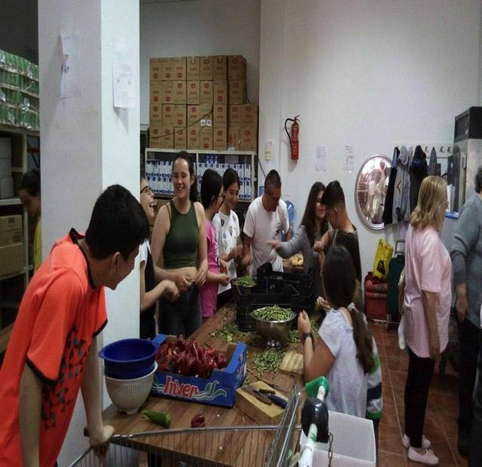
LINKS IES JAUME I /SOCIAL AND ECONOMIC AGENTS
LEARNING THROUGH COMMUNITY SERVICE
PRIMARY SCHOOLS | SENIOR CENTRES: CEAM RESIDENCES FOR ELDERLY PEOPLE | NGO ‘AMOR EN ACCIÓ’ ANIMAL SHELTERS YOUTH CENTRE CHARITY SOCIAL CANTEEN

Slide 7
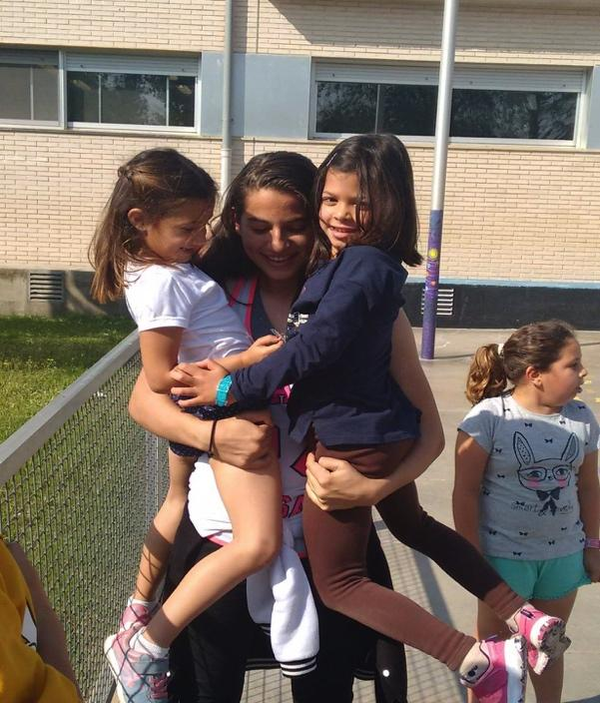
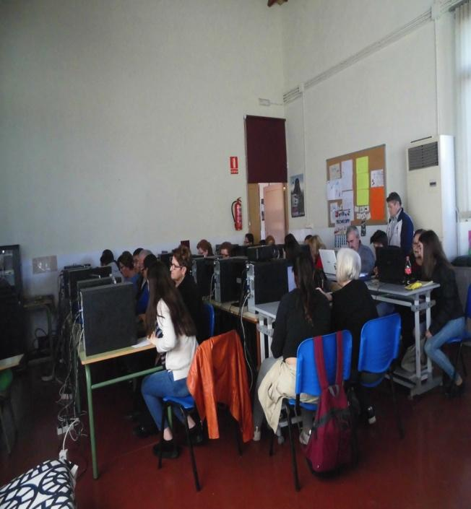
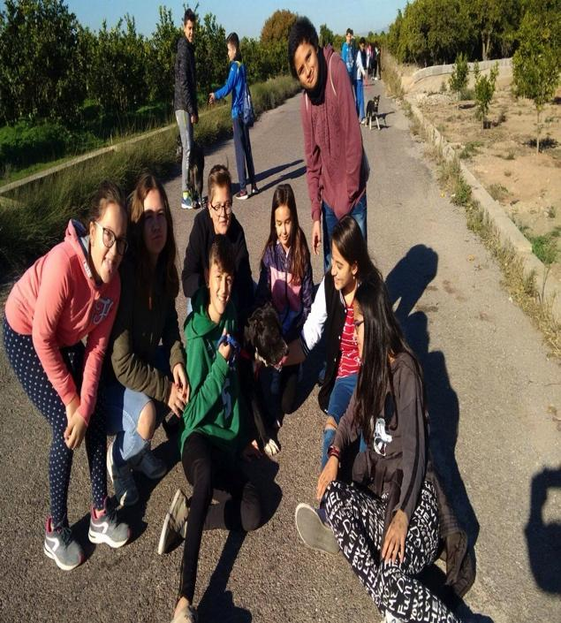
LINKS IES JAUME I/ SOCIAL AND ECONOMIC AGENTS
GREAT | PEOPLE | HELPING

