Slide 1
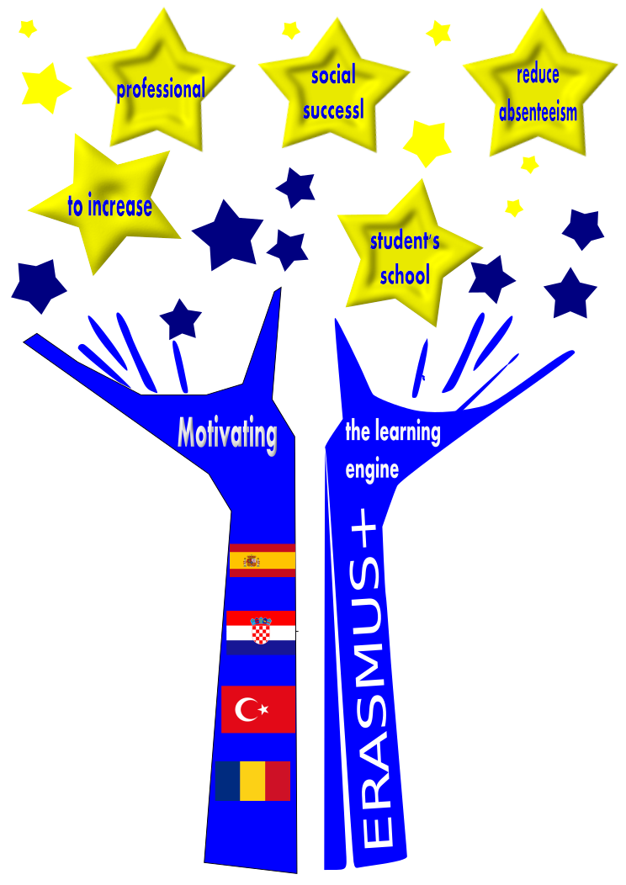
Caricature exhibition
Motivating the learning engine to increase student’s school, professional and social success and reduce absenteeism.
Project. No. 2019-1-RO01-KA-229-063851
The shortest way to success,
by Isabel Corell

Slide 2
YouTuber
Many students think this is a good way to get success and money.
© El jata, comic drawer

Slide 3
Football player
In Spain they are considered as almost gods. They have even political power.
©Joan Vizcarra

Slide 4
Instagram Influencer
Girls love imitating them, they think their life is perfect.
© Naim Comics

Slide 5
Participant in a TV reality show
An easy way to become famous and rich in Spain. After the TV show, they get payed in parties.

Slide 6
Betting in the Internet
A very dangerous problem with our young people: they think that it is possible to become rich betting. They can do it by their phones.

Slide 7
All rights reserved. No part of this publication may be reproduced, in any form or any means, without permission in writing from the authors.
“The European Comission is not responsible for any uploaded or submitted content. The content reflects the views only of the European Comission cannot be held responsable for any use which may be made of the information contained therein”

