Slide 1
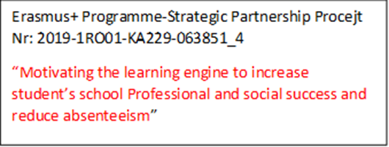
RIDDLES

Slide 2
RIDDLE(1)
What is made of water but if you put it into water it will die?
Answer:
-An ice cube

Slide 3
RIDDLE(2)
I’m tall when I’m young and I’m short when I’m old. What am I?
Answer:
-A candle

Slide 4
RIDDLE(3)
Take off my skin. I won’t cry but you will. What am I?
Answer:
-An onion

Slide 5
RIDDLE(4)
What goes up but never comes down?
Answer:
-Age

Slide 6
RIDDLE(5)
I follow you all the time and copy your every move but you can’t touch me or catch me?
Answer:
-Shadow

Slide 7
RIDDLE(6)
What is always in front of you but can’t be seen?
Answer:
-The future

Slide 8
RIDDLE(7)
A man who was outside in the rain without an umbrella or hat didn’t get a single hair on his head wet. Why?
Answer:
-He was bald

Slide 9
RIDDLE(8)
It belongs to you but other people use it more than you do?
Answer:
-Your name

Slide 10
RIDDLE(9)
I turn once,what is out won’t get in. I turn again, what is in won’t get out?
Answer:
-A key

Slide 11
RIDDLE(10)
David's father has three sons: Snap, Crackle and ______?
Answer:
-David

Slide 12
THANKS FOR LISTENING

