Slide 1
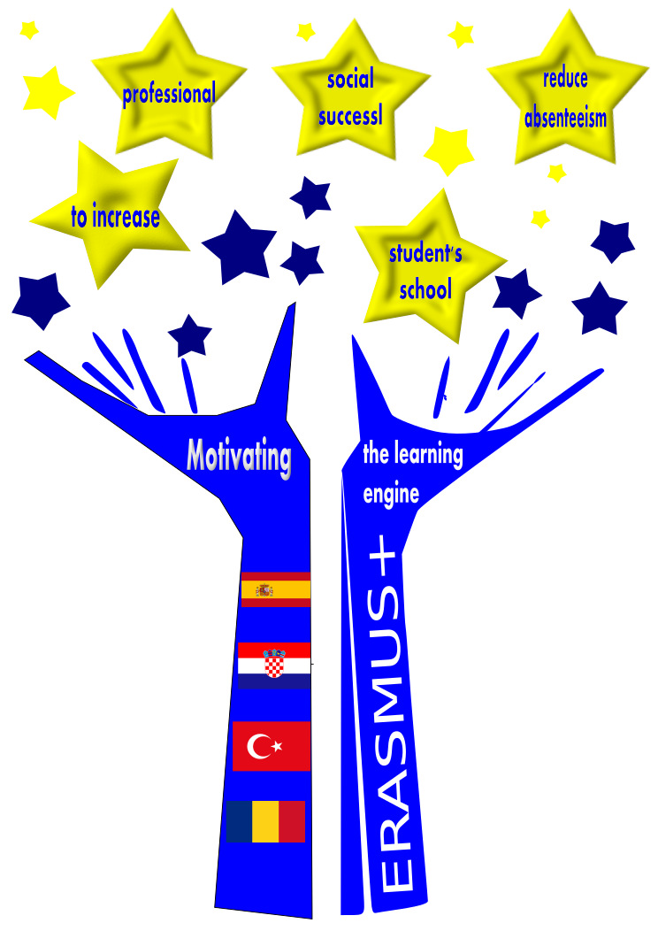
Motivating the learning engine to increase student’s school, professional and social success and reduce absenteeism
2019-1-RO01-KA229-063851
Project financed by the European Union
Authors:
Bianca Tamara Mesaros
Verónica Nebot

Slide 2
So yes, so no
HOW TO ACHIEVE YOUR GOALS

Slide 3
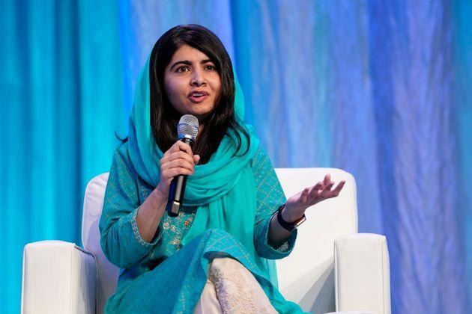
1.Choosing good role models in life
Malala Yousafzai
Big YES

Slide 4
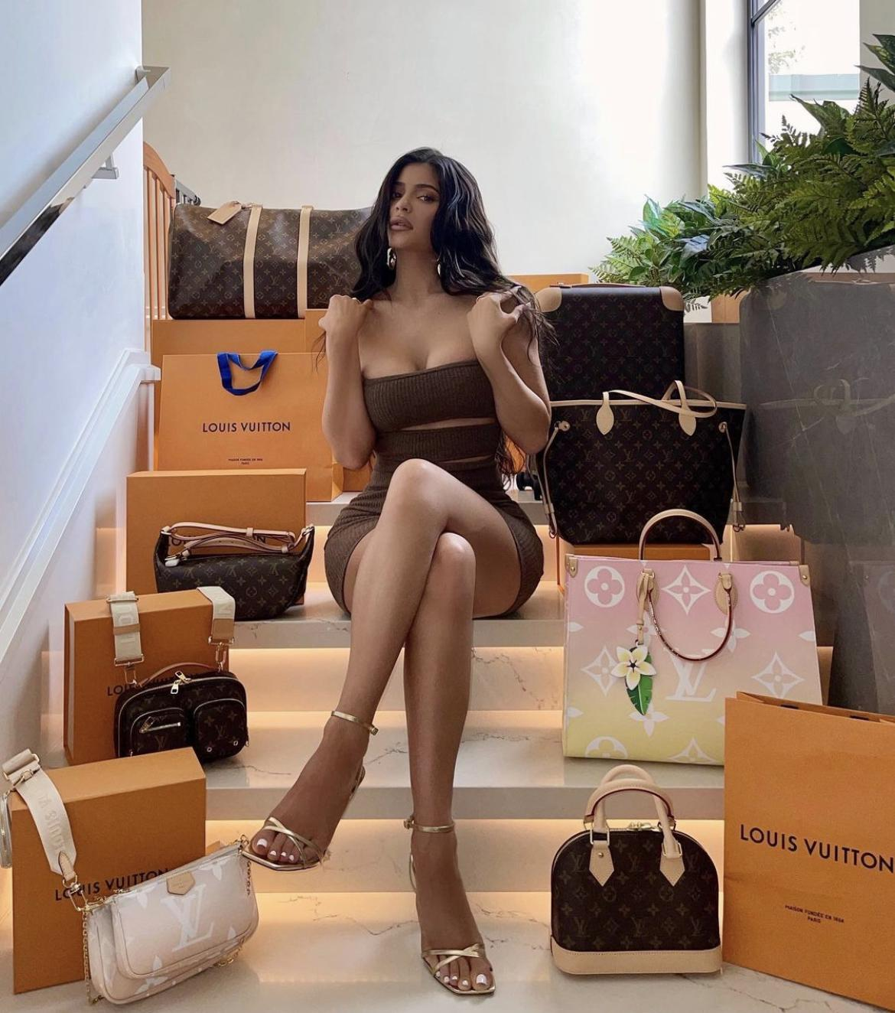
Looking up at an anti-model
Big No

Slide 5
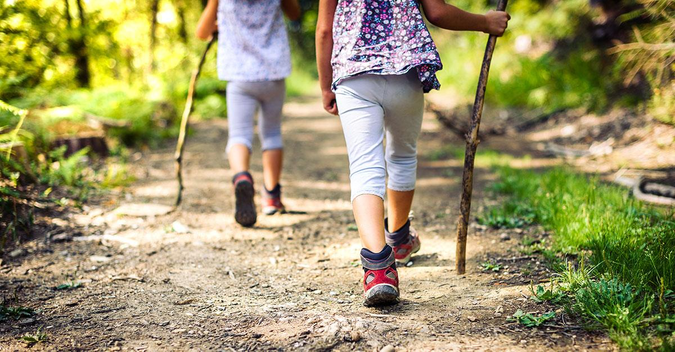
2.Choosing inspiring friends with healthy habits
Big YES

Slide 6
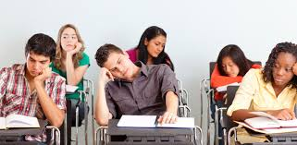
People who are demotivating and apathetic
Big NO

Slide 7
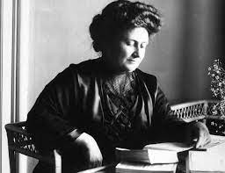
3.Reading biographies of famous people in the world of culture
Maria Montessori
Big YES

Slide 8
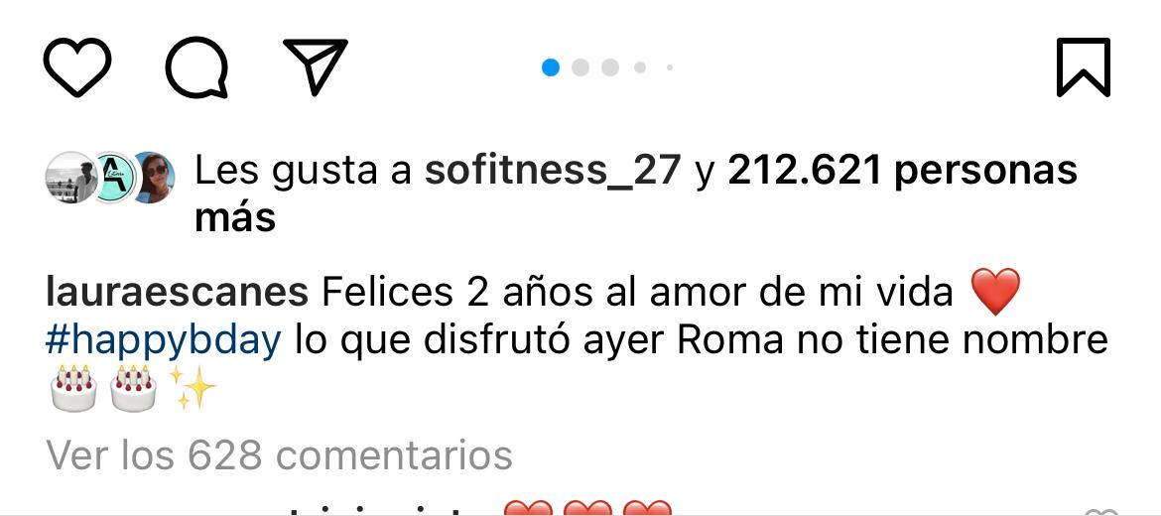
Being interested in the personal life of an influencer on social media
Big NO

Slide 9
4.The light of knowledge is the only way to unbind the secrets and beauty of life
Big YES

Slide 10
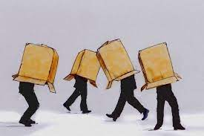
Lack of knowledge & education is ignorance
.
Big NO

Slide 11
5.Spend time reading books
Big YES

Slide 12
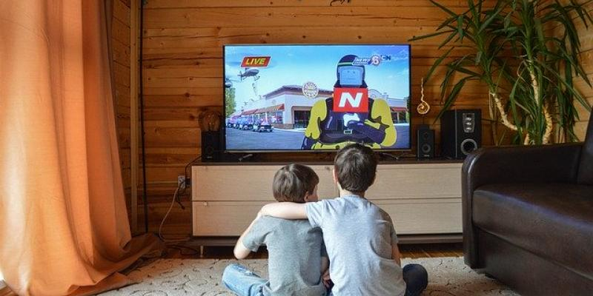
Spending lots of time in front of a screen
Big NO

Slide 13
6.Constant effort and work in school help you see the beauty of life
Big YES

Slide 14
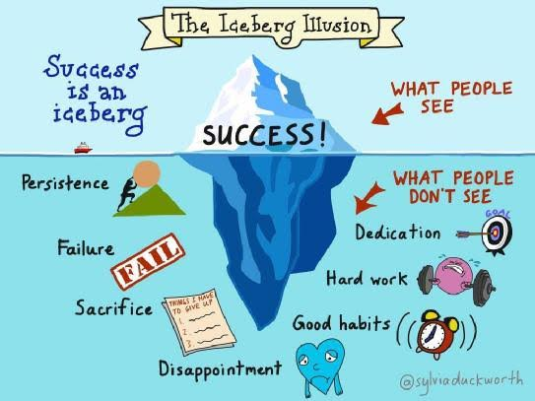
Apathy and lack of interest are a barrier to success
Big NO

Slide 15
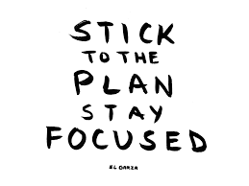
7.Discipline: the golden key to your success
Big YES

Slide 16
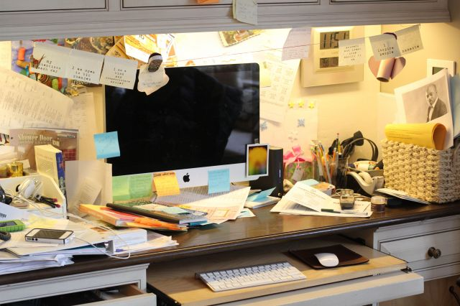
Chaos in your daily life is counterproductive
Big NO

Slide 17
8.Nothing worthwhile is ever easy: be patient and work hard
Big YES

Slide 18
Rushing is a poor friend
Big NO

Slide 19
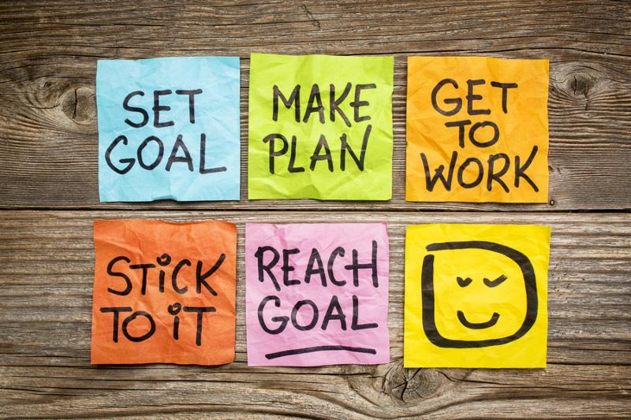
9.Setting a goal and stick to it
Big YES

Slide 20
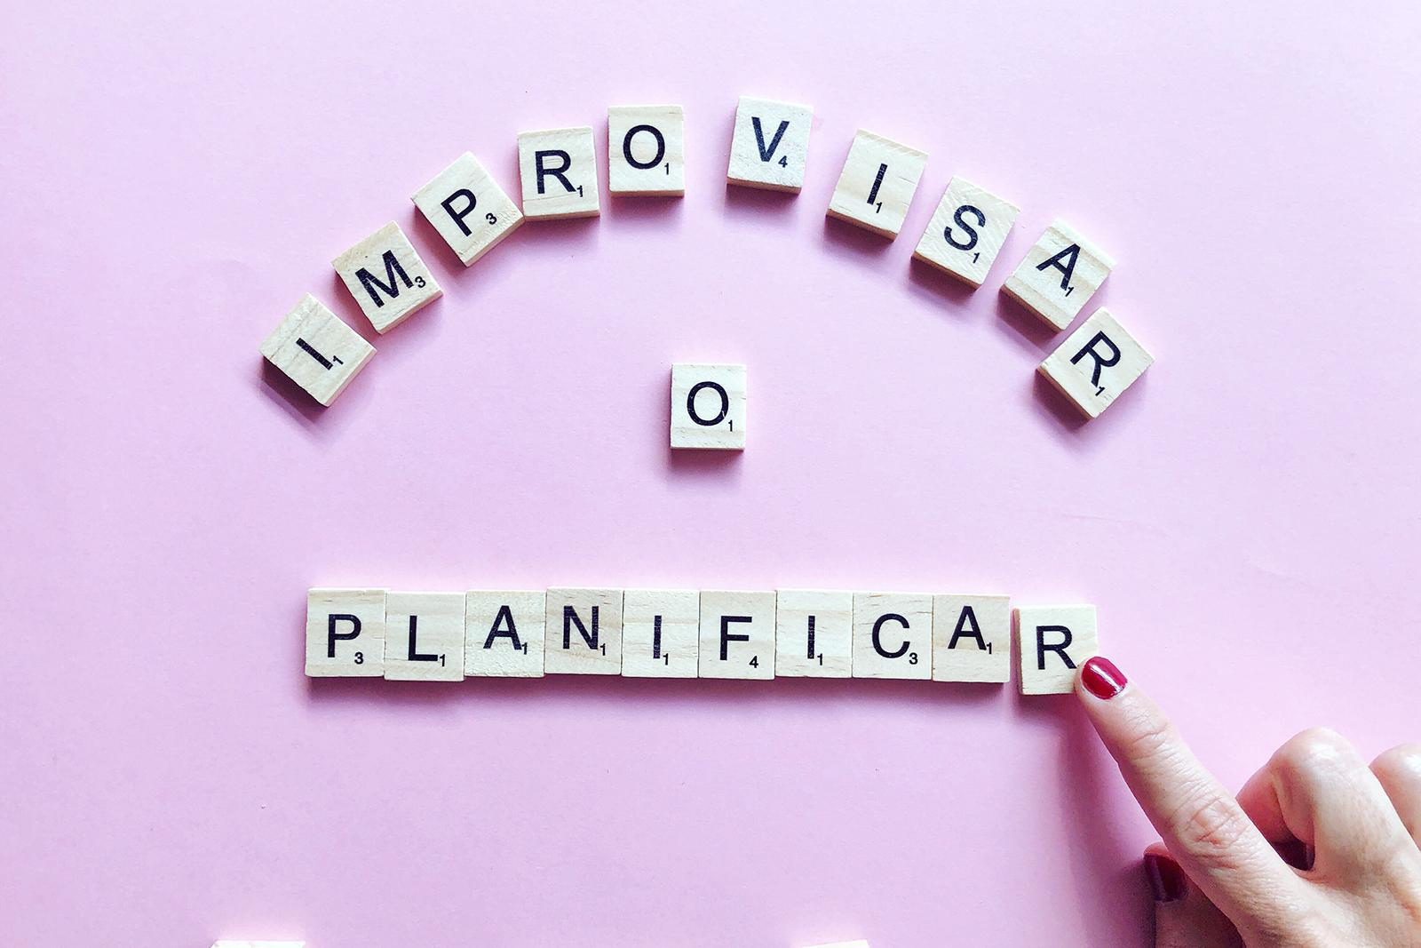
Doing things on the go
Big NO

Slide 21
10.Being present in the moment: real life is offline
Big YES

Slide 22
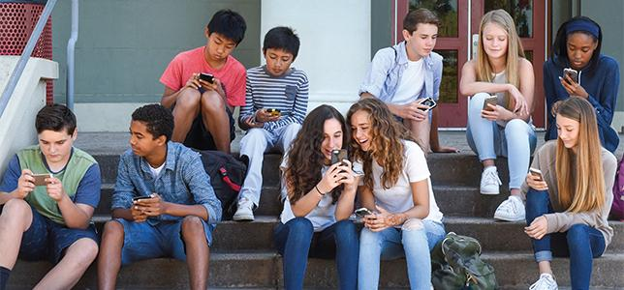
Living most of the time online
Big NO

Slide 23
All rights reserved. No part of this publication may be reproduced, in any form or any means, without permission in writing from the authors.
“The European Comission is not responsible for any uploaded or submitted content. The content reflects the views only of the European Comission cannot be held responsable for any use which may be made of the information contained therein

