Slide 2
You learn something new every day. Everyone you meet knows something you don’t.
Erasmus+ Programme-Strategic Partnership Procejt Nr: 2019-1RO01-KA2
29-063851_4
“Motivating the learning engine to increase student’s school Professional and social success and reduce absenteeism”

Slide 3
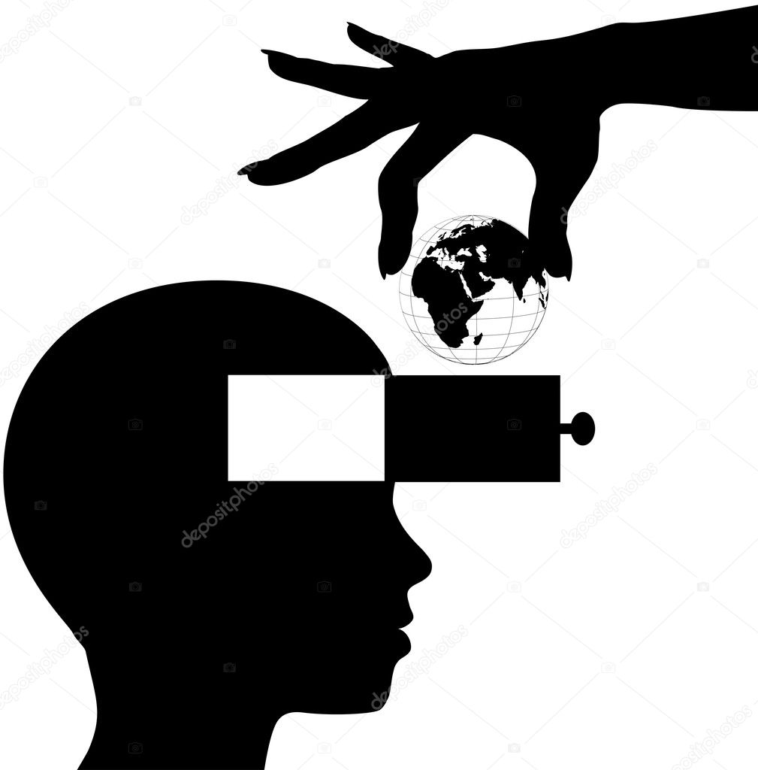
LEARNING OPENS THE MIND

Slide 4
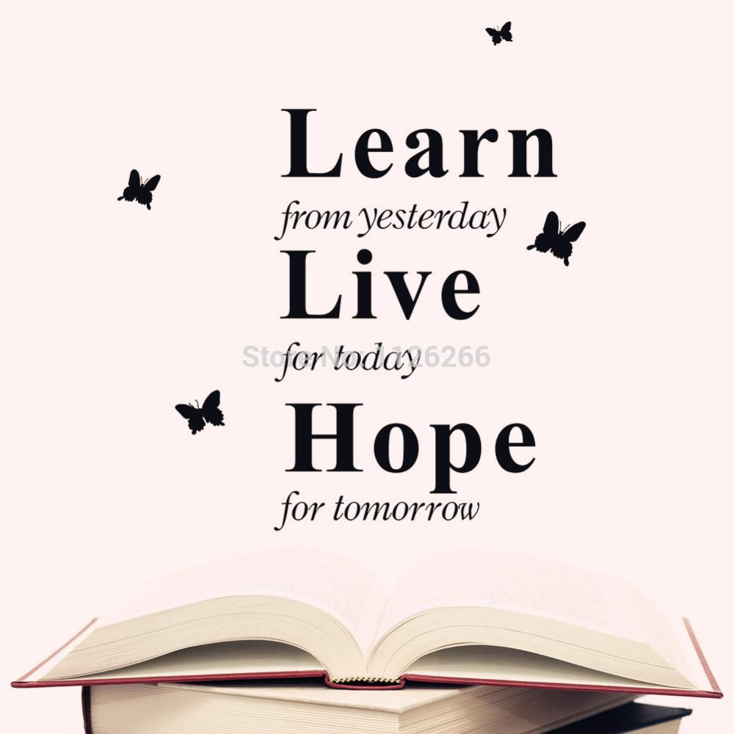
One of my favorite quotes is by Malcolm Forbes:
“Education’s purpose is to replace an empty mind with an open one.” Replace the word “education” with “learning” and you get the same story.
We are all born in a certain place at a certain time, but learning (in its broadest definition) expands our boundaries to include many more people, perspectives, and cultures.
It helps us to understand how and why we think or act a certain way, while illuminating the same about others, without judgement. That wisdom is priceless for navigating life.

Slide 5
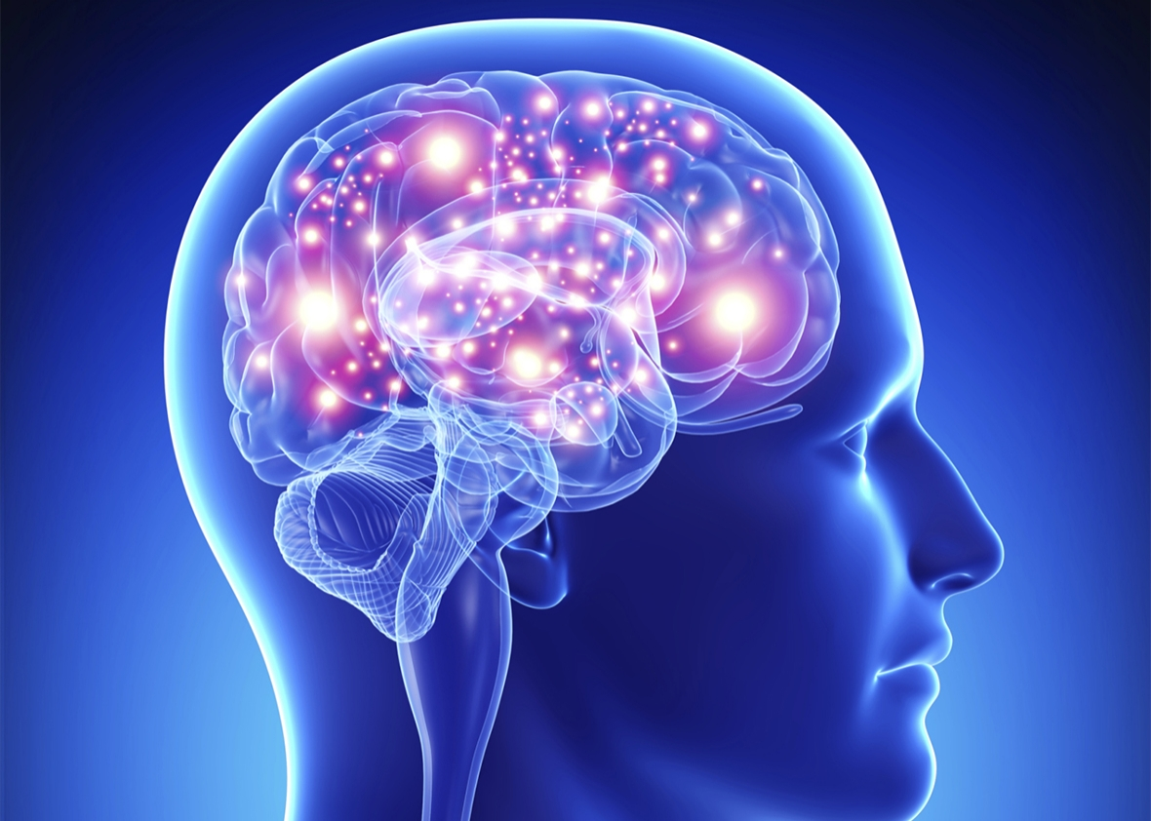
YOUR BRAIN NEEDS STRENGTH, TOO..

Slide 6
We know that physical exercise helps brain health, but there’s another kind of strong—mental and emotional.
Learning helps keep our strongest asset sharp, and even helps fight depression, especially in aging adults.

Slide 7
At the root of this is socializing.
Attending a class, getting into more conversations, or other personal interactions that learning creates, leads people to connect.
And loneliness is a big concern for people as they age.
Regular interactions alone can help fight that feeling of isolation.
Taking in new information and challenging the brain to think, comprehend, and consider new facts also is healthy.
In the words of Joseph Addison, “Reading is to the mind what exercise is to the body.” Give your brain some attention to keep it strong!

Slide 8
PROVERBS
Science is the most reliable guide in life. ― Mustafa Kemal Atatürk
The ink of the scholar is more holy than the blood of the martyr
—Prophet Muhammad
To spend more time in learning is better than spending more time in praying. It is better to teach knowledge one hour in the night than to pray all night.
Learning never exhausts the mind.
Leonardo Da Vinci
The human brain is like a millstone if you don't throw anything new into it,it
will grind itself.
-İbn-i Haldun

Slide 9
All rights reserved. No part of this publication may be reproduced, in any form or any means, without permission in writing from the authors.
,,The European Commission is not responsible for any uploaded or submitted content. The content reflects the views only of the European Commission cannot be held responsible for any use which may be made of the information contained therein”

Slide 10
THANKS FOR
LISTENING

