Slide 1
the benefits of career development from an early age

Slide 2
Ignoring the process of career development occurring in childhood is similar to a gardener disregarding the quality of the soil in which a garden will be planted.- Niles & Harris-Bowlsbey, 2017, p. 276
Flum and Blustein see the process of career development in the early years as a process of helping a child discover who they are. They state, ‘The core outcome is self-construction... the process of developing a coherent and meaningful identity and implementing that identity in a life plan.’ - Herr, Cramer, & Niles, 2004, p. 335
Career-related learning at an early age is not intended to have children make premature choices over future careers; rather it is a process that encourages children to broadly consider a multitude of options that are available and not to restrict or limit their possibilities for their future aspirations. —Herr, Cramer, & Niles, 2004, p. 332
Career learning has the potential to provide children with accurate and relevant information, to challenge restrictive, negative, and stereotypical notions about them-selves and to keep their options open. —Herr, Cramer, & Niles, 2004, p. 334

Slide 3
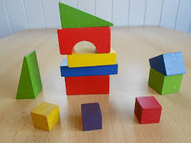
Developing skills, hobbies, and interests at an early age can help a person decide what he/she wants to do for a living.
Learning to deal effectively with change, to make decisions, and to problem-solve increases children’s control over situations and helps reduce anxiety and stress
Gain experience – volunteer work, job..
More training and learning opportunities
Networking
Recovery from mistakes
Smoother Transition Between Studies and a Career

Slide 4
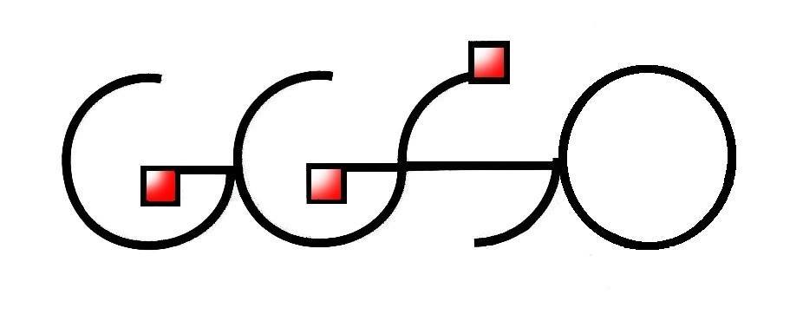
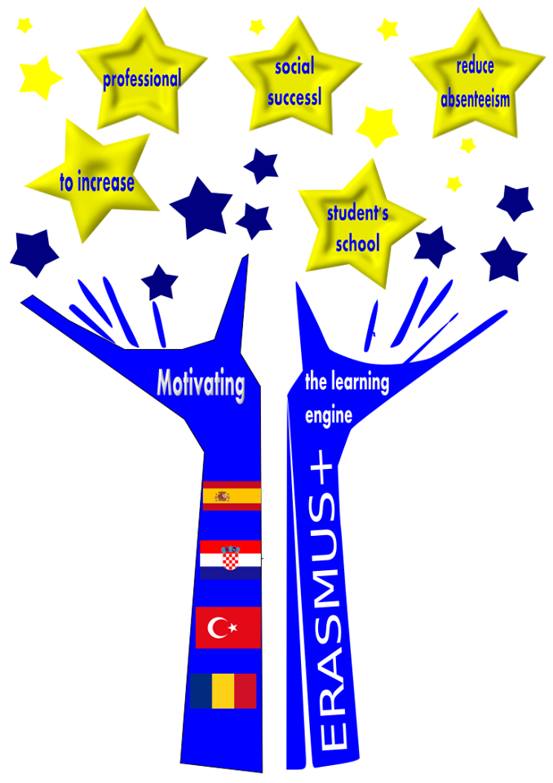
Motivating the learning engine to increase student's school, professional and social success and reduce absenteeism
Author: Sanja Vukelić
Construction and Geodesy School Osijek, Croatia
Bibliography: The Early Years: Career Development for Young Children A Guide for Educators; Cahill, M. and Furey, E
All rights reserved. No part of this publication may be reproduced, in any form or any means, without persmission in writing form the suthor.
„The European Comission is not responsible for any uploaded or submittes content. The content reflects the views only of the European Comission cannot be held responsible for any use which may be made of the information contained therein”

