Slide 1
SOCIAL AND ECONOMIC AGENTS AND THE SCHOOL
Graditeljsko-geodetska škola Osijek

Slide 2
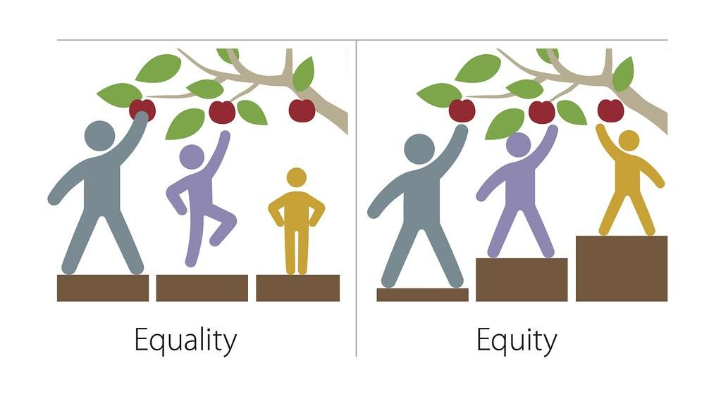
EQUITY IN EDUCATION
- is a major preoccupation for countries around the world
- education systems share the goal of equipping students, irrespective of their social background, with the skills necessary to achieve their full potential in social and economic life

Slide 3
* a consistent finding throughout many assessments is that socio-economic status is related to performance at the:
1. system
2. school
3. student levels

Slide 4
AT THE SYSTEM LEVEL
high socio-economic status is often related to greater wealth and higher spending on education

Slide 5
AT THE SCHOOL LEVEL
socio-economic status tends to be positively correlated with a range of community characteristics that can boost student performance, such as a safe environment or the availability of public libraries and museums

Slide 6
AT THE INDIVIDUAL LEVEL
socio-economic status can be related to parents’ attitudes towards education, in general, and to their involvement in their child’s education, in particular

Slide 7
THE EFFECTS OF SOCIO-ECONOMIC STATUS ON STUDENT ACHIEVEMENT
Students whose parents have higher levels of education and more prestigious and better-paid jobs typically benefit from:
financial
(e.g. private tutoring, computers, books)
cultural
(e.g. extended vocabulary, time in active parenting)
social
(e.g. role models and networks) resources that make it easier for students to succeed in school

Slide 8
ECONOMY (I)
economy, society, and culture of the country affects education
such conditions affect children’s educational outcomes such as school enrollment, attainment, attendance, and performance
slowdown of the economy is associated with reductions in hourly wage rates, numbers of hours worked, and the amount of public and private funds available for schools

Slide 10
ECONOMY (II)
The economy plays an important part in social issues that affect students. As children become older, they begin to notice the financial burdens that their families experience.
Students who belong to deprived families are most probable to attend public schools. These schools are not as good prepared with technology as a private schools. This then automatically lay them at a difficulty when judge against to other students who go to private schools.
In an economy, it can be hard for families. Subsequently, some high scholars drop out of school so that they can assist support the family financially.

Slide 11
Studies have shown that children living below the poverty level may have more behavior problems in school, and most complete fewer years of school overall.
Those students are more likely to grow up and face more years of unemployment than their wealthier counterparts.

Slide 12
EDUCATION INFLUENCING ECONOMY
Less funding means smaller staffs, fewer resources and a lower number of services for students. While some argue that throwing more money at the education problems won’t make them go away, others assert that lack of funding caused many of the problems in the first place.
In advanced societies the educational system has been identified as making a major contribution to national economic prosperity.

Slide 13
SOCIAL AGENTS (FAMILY)
Family factors also play a role in a teacher’s ability to teach students.
Principals and teachers agree that what is going on at home will impact a student’s propensity to learn (divorce, single parents, poverty, violence and many other issues are all challenges a student brings to school every day).
While some teachers and administrators work with children in less than ideal family environments, they can do so much – especially when parents are often not willing to partner with the school to provide for the children.

Slide 14
SOCIAL AGENTS (DEMOGRAPHY)
unequal education opportunities for individuals who come from smaller backgrounds
students who belong to this demographic risk lost out on the similar stage of educational excellence as middle to higher class students of non-minority backgrounds

Slide 15
SOCIAL AGENTS (POVERTY, VIOLENCE...)
Social problems in the world impact the operation and effectiveness of public education.
Social problems, such as vandalism, school violence, and the dropout rate, are exacerbated when students feel alienated from the school structure.
Major portion of the school’s work devotes itself to responding, directly or indirectly, to students whose lives are challenged by social ills, such as poverty or violence.
Such problems, including homelessness, teen parenting, substance abuse, child abuse, and youth suicide, complicate students’ efforts to learn.

Slide 16
CONCLUSION
It’s important to understand how helpful good schooling can be to improve the lives of low-income children.
A large body of research demonstrates that students’ family and neighborhood backgrounds actually matter much more than the quality of schooling for their school performance.
Good schooling, then, can only go so far in overcoming the many strikes that low-income students have against them even before they enter kindergarten and the problems they continue to experience thereafter.

Slide 17
