Slide 1
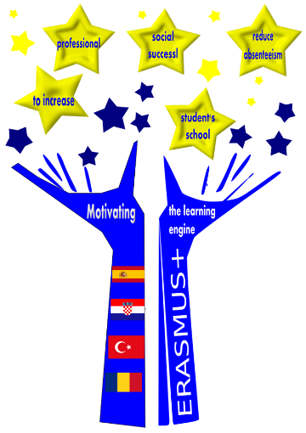
MOTIVATION OF LEARNING

Slide 2
„Motivating the Learning Engine to Increase Student's School, Professional and Social Success and Reduce Absenteeism “ № 2019-1-RO01-KA229-063851_1
2019-2021
Secondary school "PROF. UNIV. DR. ION STOIA”

Slide 3
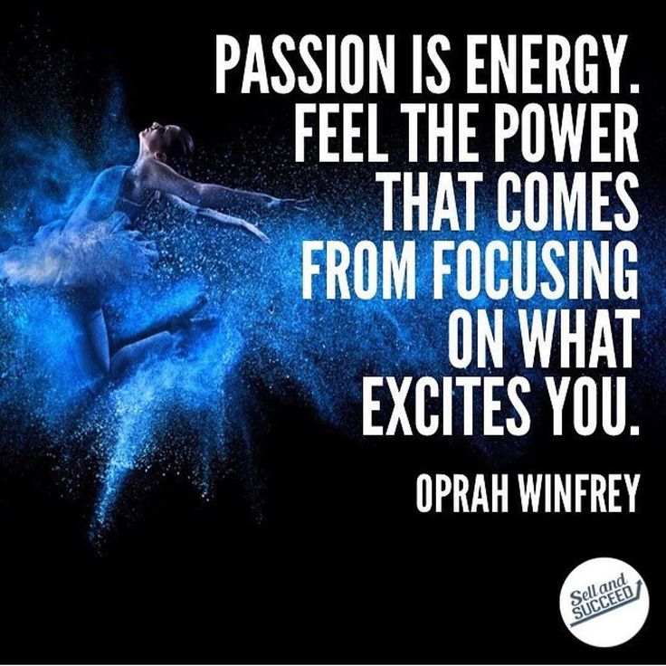
PASSION=LEARNING
Passion is hot. It is a force that sells movies and margarine and everything in between. It is a force the can move mountains, inspire art and make the weak strong. We need to bring passion back into learning, in teaching and all around. Passion motivates. It makes a way out of no way. It allows students to overcome hardships to achieve a goal that is meaningful to them

Slide 4
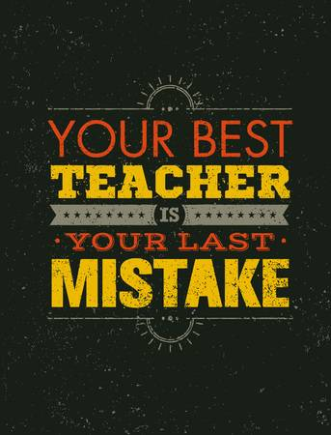
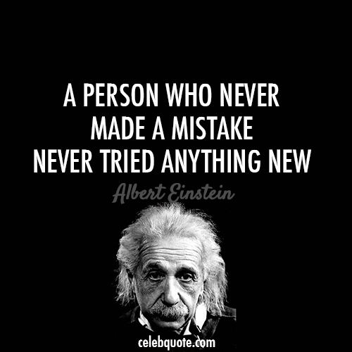
LEARN BY MISTAKES
We all make mistakes, but mistakes are not accidents. A mistake is not something that happens as a random event. By definition, a mistake is an action, judgment or decision that creates an undesired or unintended outcome.
Causes for mistakes include carelessness, insufficient knowledge, poor analysis or reasoning, confusion, and misplaced confidence.
From these causes it is clear that learning from mistakes is possible, and in many cases mistakes can be traced back to errors in decision making.

Slide 5
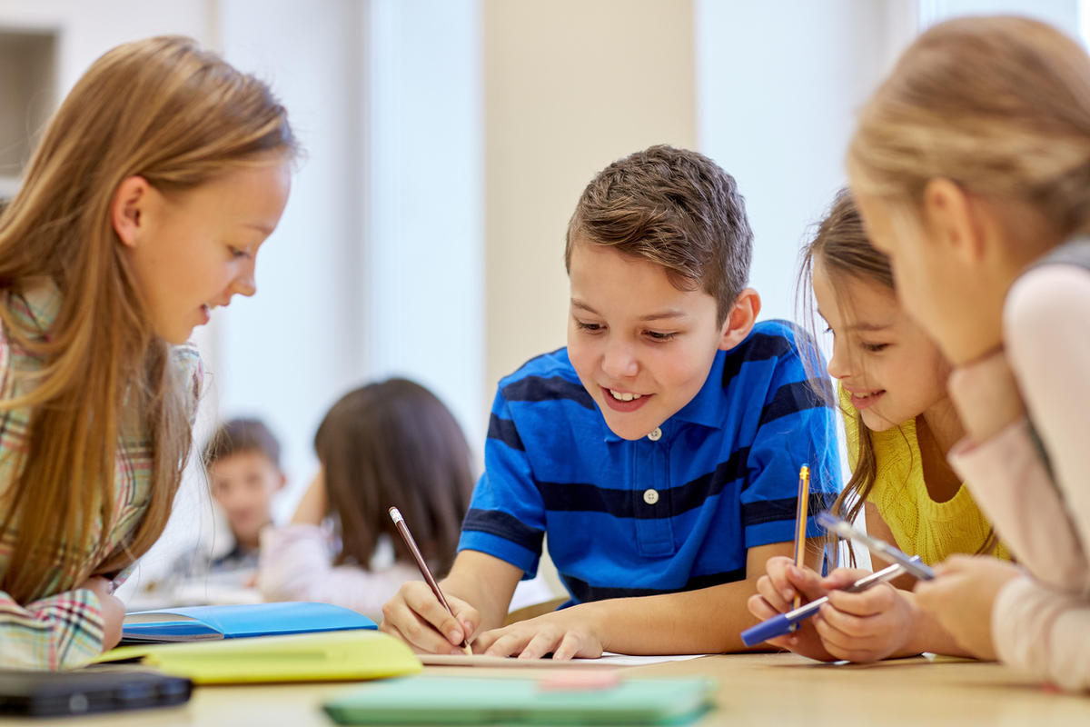
MAKE NEW FRIENDS
You whould believe that it’s impossible, but if you learn something new you’ll grow up the procent of to have something in commun with someone
So, you do friends just from do a new activity.

Slide 6
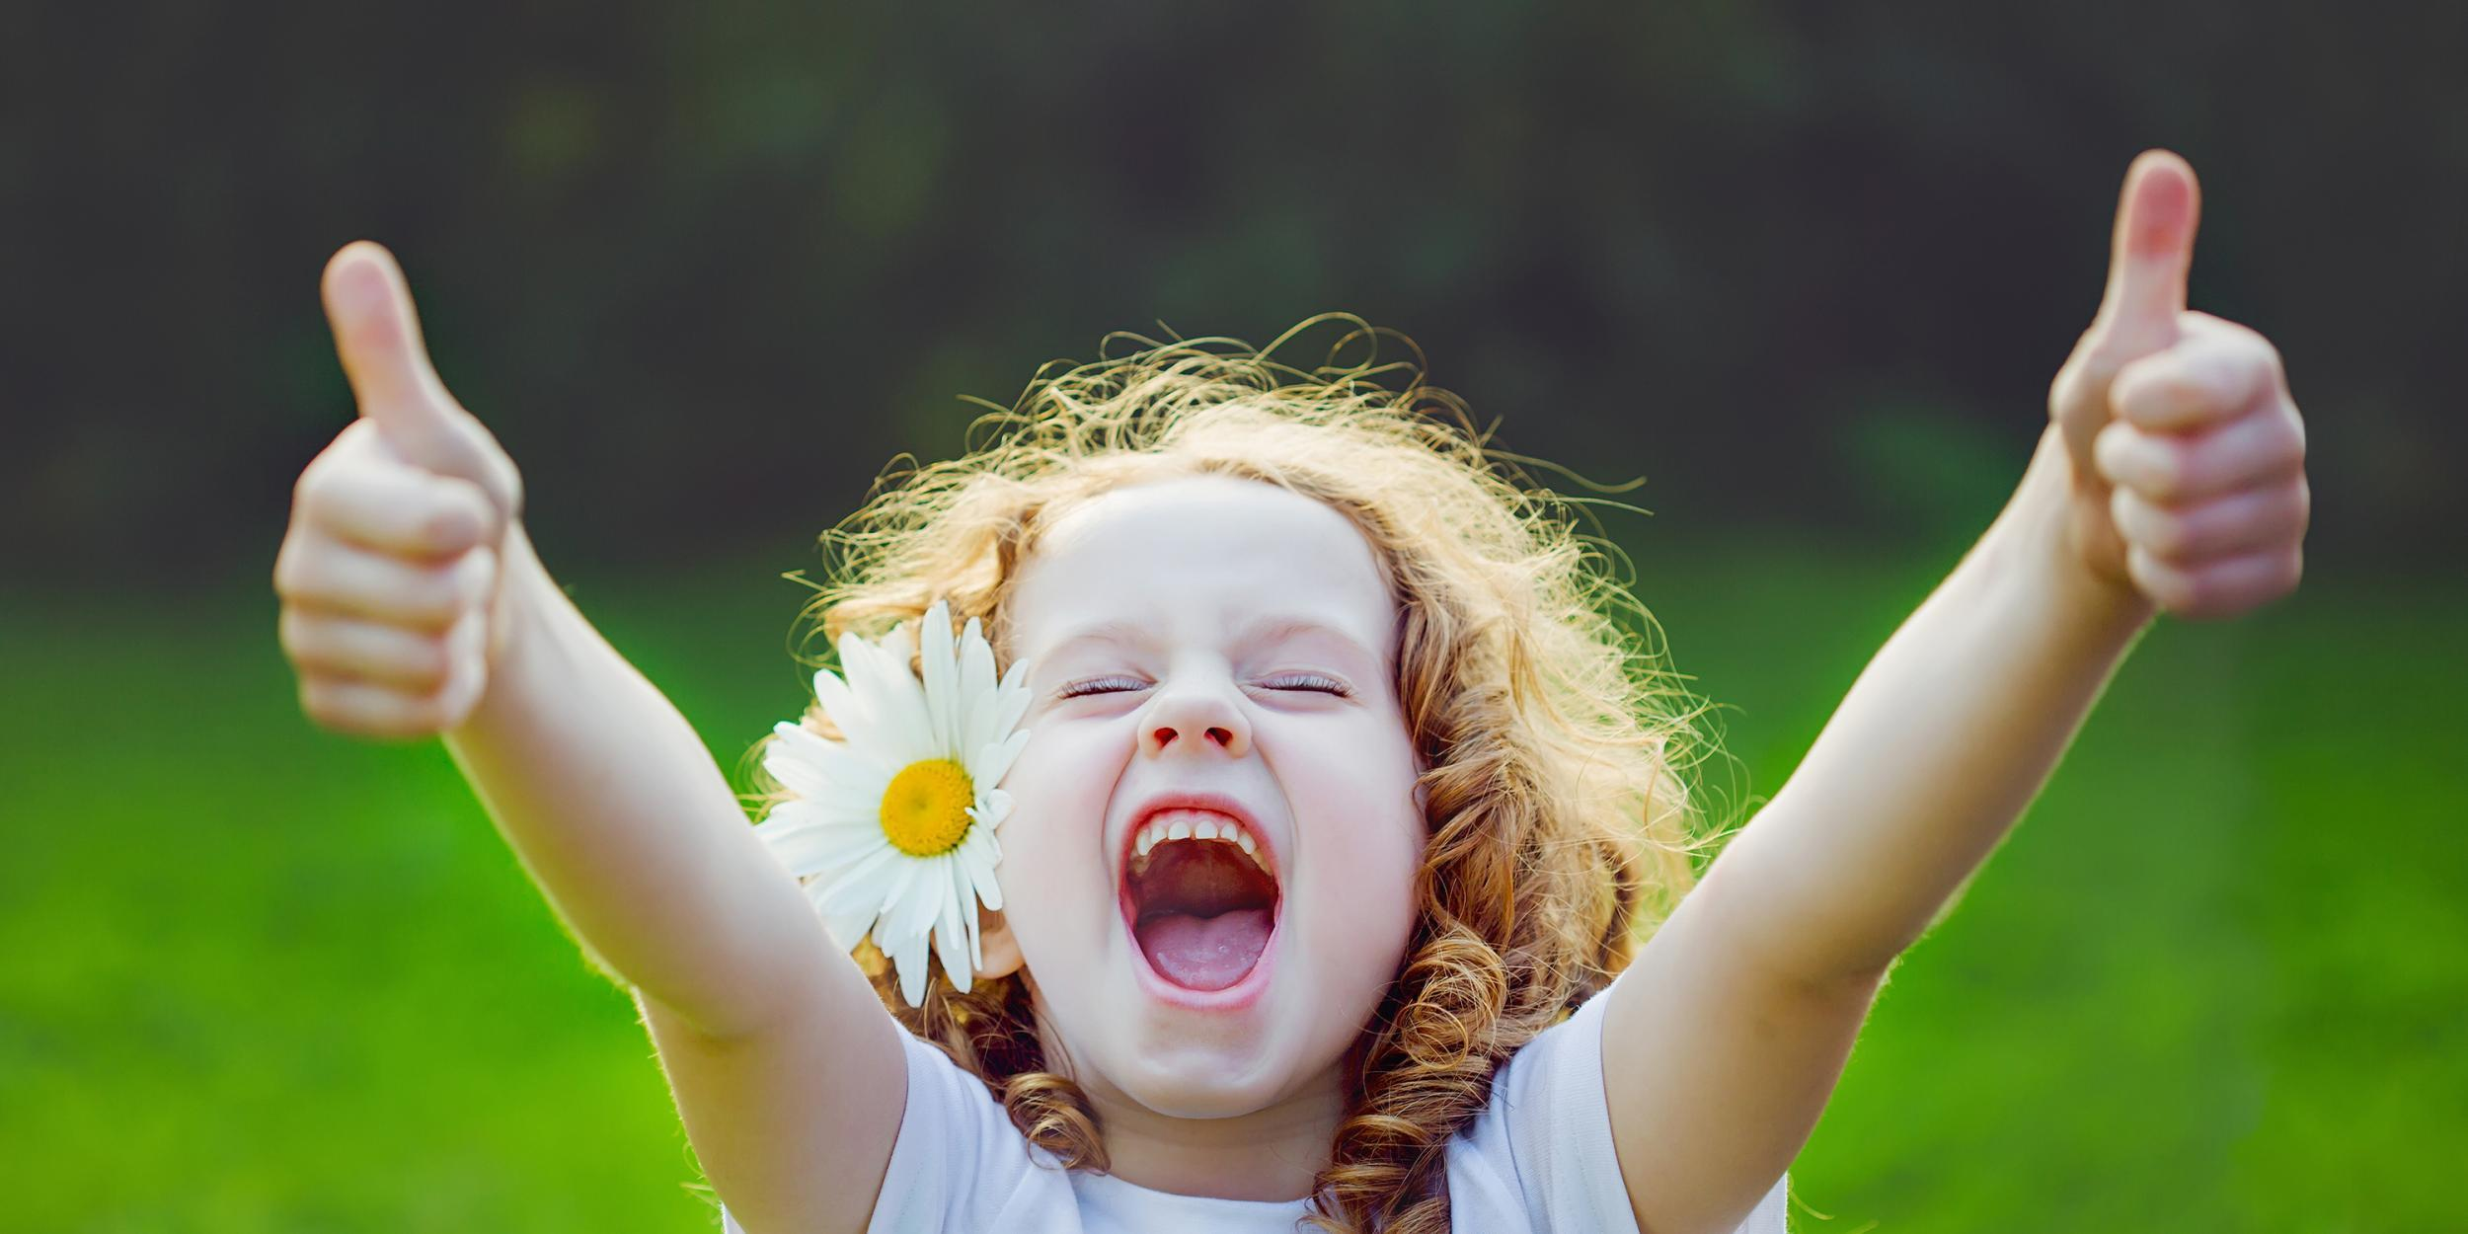
You’ll become happier
Learning is tough and can be frustrating. This is especially true when we talk about taking on new sports like crossfit, or pushing our brain to the limits trying to code. But although the task is hard, nothing is greater than reaching your accomplishment. For highly challenging goals like learning to write software, it is such an amazing feeling when your code works bug free. When we play sports, beating our personal records gives a high like none other.
Several studies have shown that the more ambitious goals that we set, the happier we are. And when we decide our own goals, our happiness is not reliant on others. We pick how many hours we practice, and we take ownership over what we achieve.
Personal development is a way to guarantee us serenity from within.

Slide 7
You will become happier
The more ambitious goals we set, the happier we are. Personal development is a way to guarantee our serenity from within.
Cu cât obiectivele mai ambițioase ni le stabilim, cu atât suntem mai fericiți. Dezvoltarea personală este o modalitate de a ne garanta seninătatea din interior

Slide 8
Unique person= smart person
The person who can adapt the most wins. It is not about the strength of the plane, but instead it's the ability to react to different situations that makes a fighter jet. The best fighter pilots can adjust to more circumstances than the norm, making them much deadlier.
This same idea can be applied to our value to our organizations. If you can only sell your product, you are limited by your contribution. If you can sell, build and run operations, now you've become irreplaceable.

Slide 9
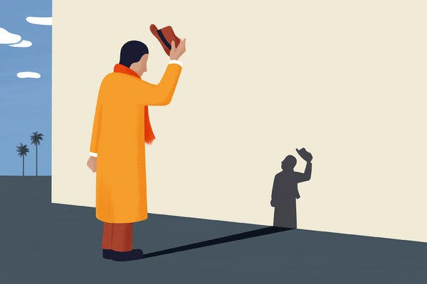
BECAME HUMBLE
When we are looking to learn as much as possible, there's less of a chance that we will come off as arrogant. True charmers don't make themselves look smart, they make others look smart. And when people see that you are trying to learn from them, it makes liking you much easier.
Every interaction you have is a chance to learn something. But by keeping an open mind, you discover patterns in how people present their talks that you can learn from. It just shows you that no matter whom you meet, there is always something valuable to learn from the encounter.

Slide 10
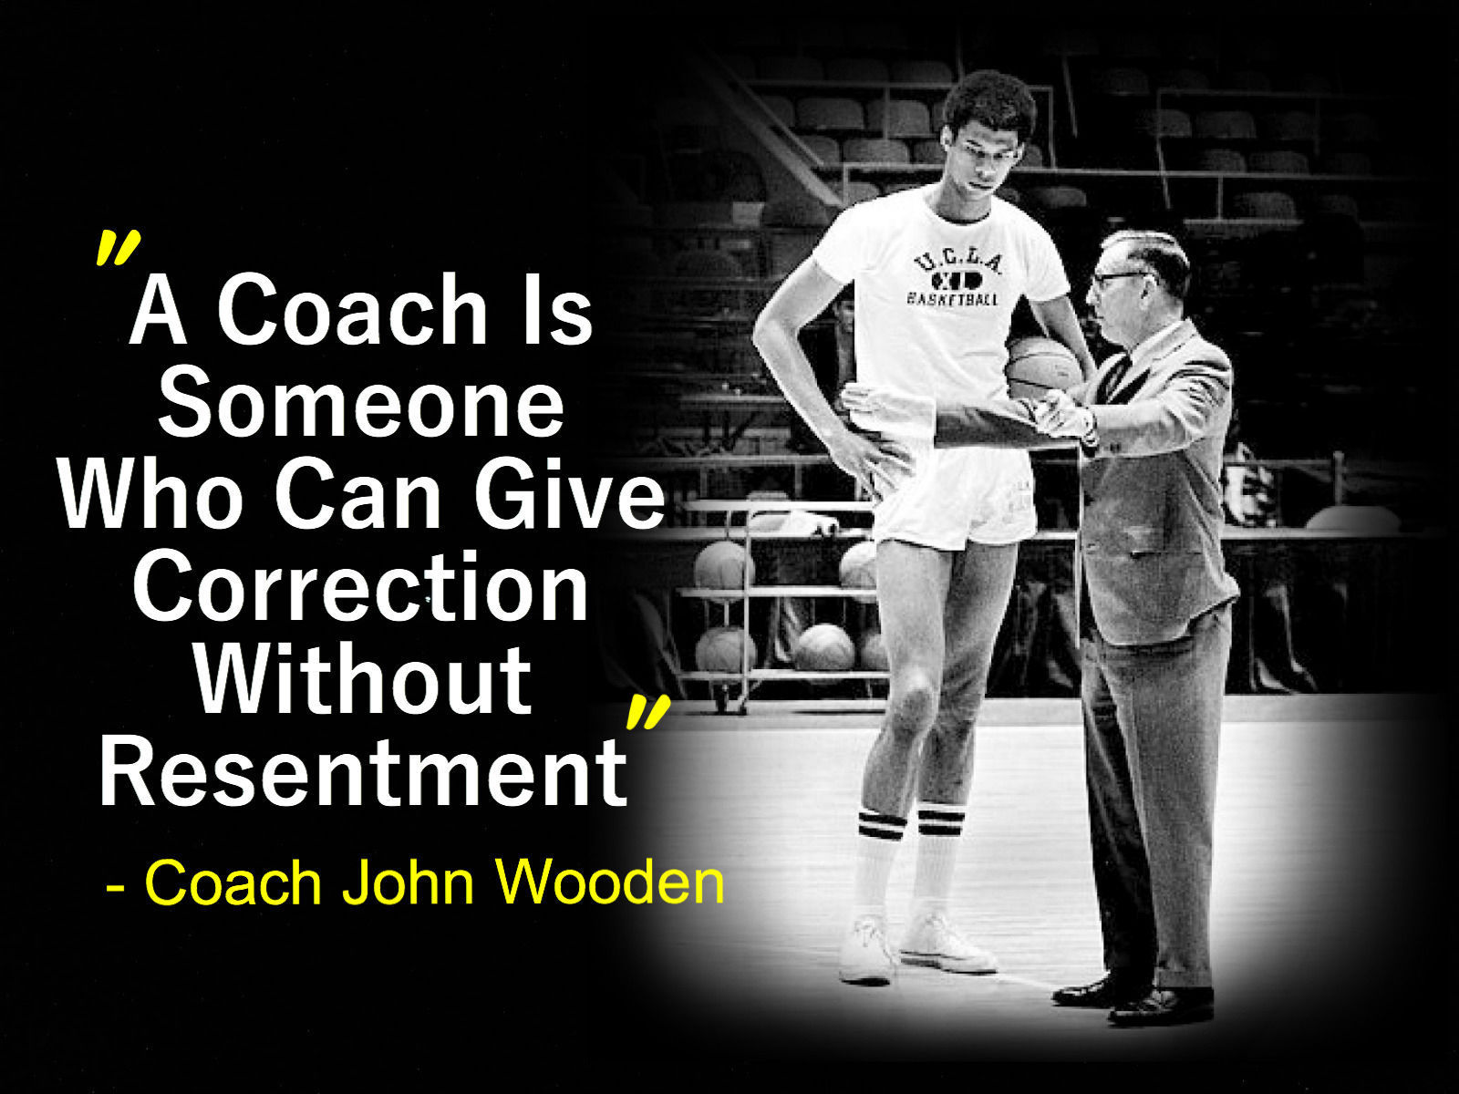
BECOME A GREAT COACH
The only way to mastery is through teaching. One of the best feelings in the world is teaching others what you've learned. Not only will it affect the person you're teaching, but also they in turn will teach others.
As a leader of your organization, you need to make learning a part of your culture. A way to start this is by teaching others what you've learned over time. You want to become such a great teacher that your company can run itself without you there. When you've achieved that, you've truly accomplished the state of mastery.

Slide 11
Learn to be successful
The best entrepreneurs in the world don't act like they know everything. They all understand the fact that they have to continuously learn to be successful.
Cei mai buni antreprenori din lume nu acționează de parcă știu totul. Cu toții înțeleg faptul că trebuie să învețe continuu pentru a avea succes

Slide 12
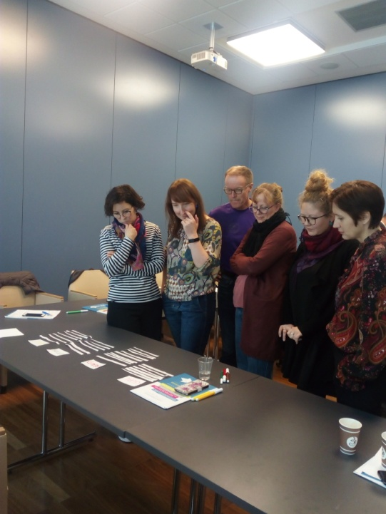
You'll stay human
No matter whom you meet, there is always something valuable to learn from the encounter.
Indiferent pe cine întâlnești, există
întotdeauna ceva valabil de învățat
de la întâlnire.

Slide 13
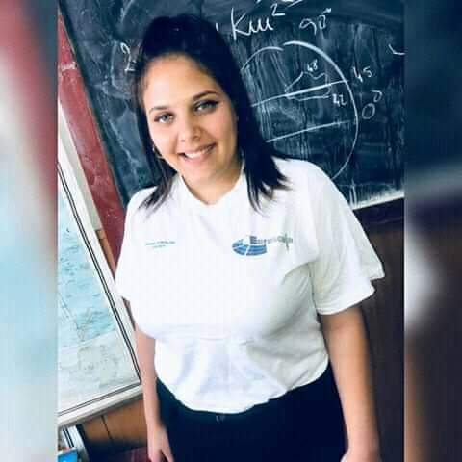
You’ll have a successful career
Self-growth is key for us to live fulfilling lives and to have a successful career.
Creșterea stimei de sine este
esențială pentru a trăi o viață
împlinită și pentru a avea o
carieră de succes.

Slide 14
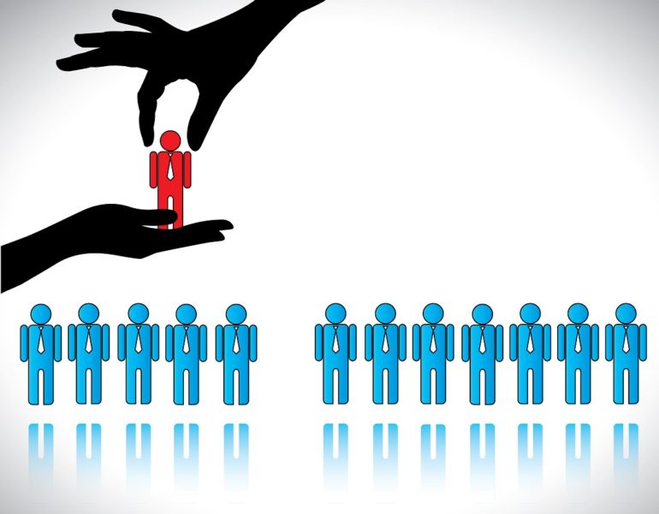
You'll become irreplaceable to your team
The person who can adapt the most wins.It’s the ability to react to different situations and to adjust to more circumstances
than the norm that
makes you irreplaceable.
Persoana care poate adapta castiga. Are capacitatea de a reacționa la diferite situații și de a se adapta la mai multe circumstanțe decât norma care te face de neînlocuit.

Slide 15
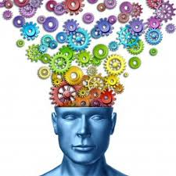
Learning fuels our creativity
Ideas can come from making connections between seemingly unrelated things.Learning something new in one area of our life can trigger ideas in another.
Curiosity and creative thinking go hand in hand.
Îti pot veni idei făcând legături între lucruri diferite Învatand ceva nou dintr-un domeniu din viața ta poate genera alte idei.
Curiozitatea și creativitatea merg mână în mână.

Slide 16
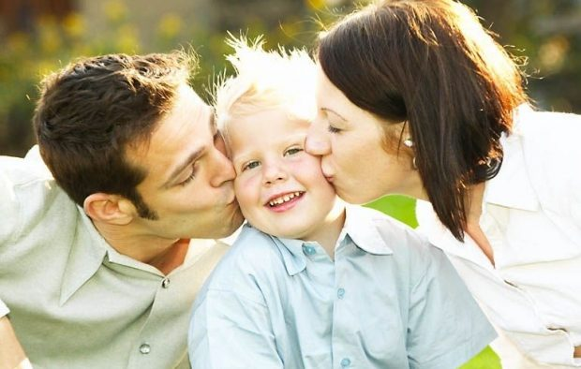
You can make your parents proud
You should learn in order to make your parents proud of you
Să-ți faci părinții mândri de tine.

Slide 17
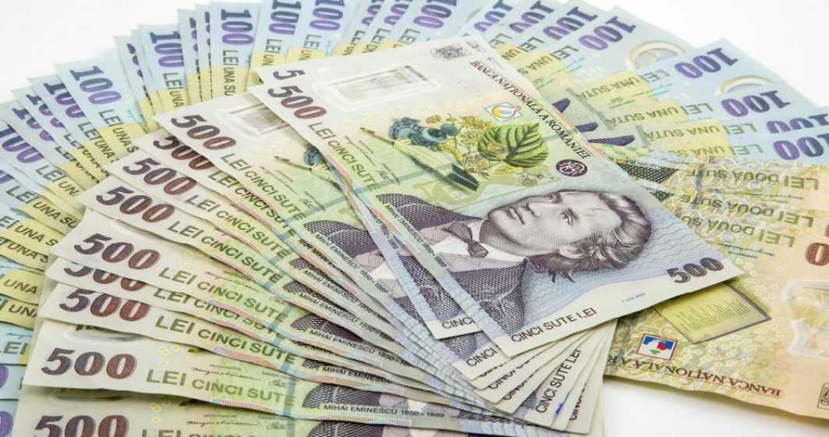
MORE MONEY
You will earn more money. Your degree may get you great financial resources
O să ai mulți bani. Diploma poate duce rezultate frumușele în contul tău bancar.

Slide 18
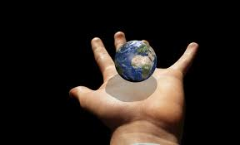
Self satisfaction
Learning may give you a self satisfaction and rise your self esteem.
Să te faci pe tine mândru de tine.

Slide 19
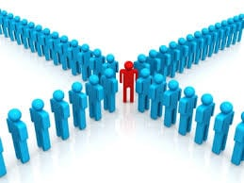
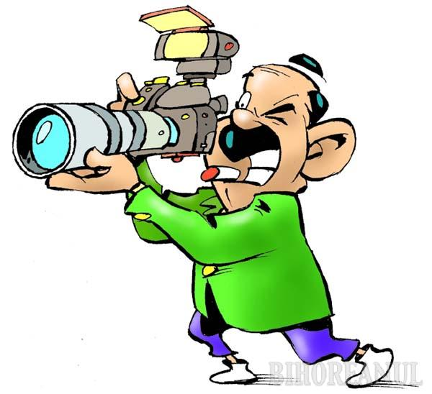
You will become a model for the others
People will take your model.They will see how successful you are and they will try as hard as they can to do the same.
Oamenii îți vor urma modelul. Persoanele din jurul tău vor vedea cât de productivi sunteți și asta îi va îndemna și pe ei să facă același lucru.

Slide 20
You should take the opportunity
School is a great opportunity.In some countries , children do not have the chance to study.
Școala este un privilegiu. Gândește-te că în privința ta, școala este o opțiune, pe când în alte țări copiii nu beneficiază de ea.

Slide 21
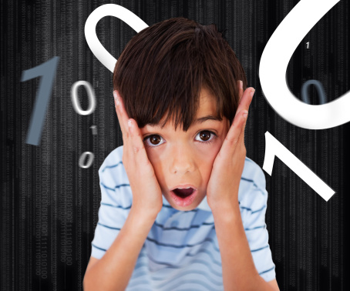
Soul peace
The anxiety and fear to taking small grades will gradually decrease.
Pentru că anxietatea și frica de a nu lua note mici va scădea progresiv.

Slide 22
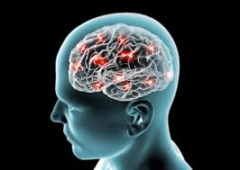
Learning develops Intellectual capacity
Take advantage of what you are capable of. Because you just can't waste a mind as brilliant as yours.
Profită de ceea ce ești capabil. Pentru că pur și simplu nu ai cum să irosești o minte atât de briliantă precum a ta.

Slide 23
All rights reserved. No part of this publication may be reproduced, in any form or any means, without permission in writing from the authors.
,, The European Commission is not responsible for any uploaded or submitted content. The content reflects the views only of the European Commission cannot be held responsible for any use which may be made of the information contained therein”

Slide 24
Project Financed by the European Union
„Motivating the Learning Engine to Increase Student's School, Professional and Social Success and Reduce Absenteeism “

Slide 25
https://www.inc.com/aj-agrawal/4-reasons-why-we-should-never-stop-learning.html
https://templates.office.com/en-us/parcel-design-tm56596226
https://brookeromney.com/2017/02/dont-care-kids-get/
https://www.nytimes.com/2019/10/21/health/psychology-humility-pride-behavior.html
https://www.csp.com/15-qualities-of-a-good-coach-in-the-workplace/#.XmQUtqgzbIU
https://www.google.com/search?q=persoana+de+neinlocuit+in+echipa&tbm=isch&ved=2ahUKEwibu-ziyIboAhVCJMUKHYsBAesQ2-cCegQIABAA&oq=persoana+de+neinlocuit+in+echipa&gs_l=img.3...31570.33593..33925...0.0..0.167.1211.0j9......0....1..gws-wiz-img.pmbvDSpPfoc&ei=haJiXtvkBMLIlAaLg4TYDg&bih=608&biw=1366&rlz=1C1AVFC_enRO829RO830#imgrc=RvGc8Js456SnnM
https://www.google.com/search?q=creativitatea&rlz=1C1AVFC_enRO829RO830&source=lnms&tbm=isch&sa=X&ved=2ahUKEwiU0Kz974voAhWHAhAIHbx2ArMQ_AUoAXoECBIQAw&biw=1366&bih=657
google.com/search?q=parinti+multumiti+de+copii&tbm=isch&ved=2ahUKEwispo2M9IvoAhWLLOwKHcnwD0wQ2-cCegQIABAA&oq=parinti+multumiti+de+copii&gs_l=img.3...96575.98753..99121...0.0..0.258.2162.2-9......0....1..gws-wiz-img.HKrRyOb5zts&ei=CW9lXux9i9mwB8n
https://www.google.com/search?q=sa+fii+model+pentru+altii&rlz=1C1AVFC_enRO829RO830&source=lnms&tbm=isch&sa=X&ved=2ahUKEwi-n53M9ovoAhVqk4sKHVHRDVkQ_AUoAXoECAsQAw&biw=1366&bih=657#imgrc=oF77aYR1JiH4YM
https://www.google.com/search?q=frica+de+note+mici&tbm=isch&ved=2ahUKEwjV3Pb3-IvoAhVOtaQKHY0gCU4Q2-cCegQIABAA&oq=frica+de+note+mici&gs_l=img.3...83538.88014..88434...0.0..0.264.4321.2-18......0....1..gws-wiz-img.......0j0i10j0i8i30j0i30j0i5i30j0i24.q97P42eeSSM&ei=HHRlXtXeNc7qkgWNwaTwBA&bih=657&biw=1366&rlz=1C1AVFC_enRO829RO830#imgrc=Vx3HiWgFmdNgQM

Slide 26
Secondary school "PROF. UNIV. DR. ION STOIA” CĂLDĂRARU - ARGEŞ
By Students
Fulger Dorin Ionuț, Diaconescu Mihai Octavian
Tatu Daniel George, Niculae Raluca Elena
Crucean Raluca
By teacher coordinator -Drăguț Violeta

