Slide 1
20 REASONS TO LEARN

Slide 2
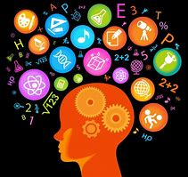
Personal and professional development.
It can provide us with more and better opportunities (employment, personal life, etc) and improve our quality of life.
A sense of accomplishment and pride.
You gain confidence for trying new things.
Learning something new will make you feel happier.

Slide 3
6- You get out of your comfort zone.
7- It helps you to acquiring new skills and find innovative solutions in your life.
8- It changes your mind and opens your attitude towards different perspectives.
9- You build stronger connections with other people that share your same or different interests.
10- Learning contributes to higher levels of resilience and self-efficacy in completing a task or tackling a challenge.

Slide 4
11- You can discover hidden talents or passions.
12- You have an open mind, ready to share new ideas and projects.
13- Learning helps you to face new situations.
14- Learning provides you experience.
15- Learning is beneficial emotionally, financially, physically and socially.

Slide 5
16-Learning helps you to understand other cultural contexts.
17-Learning helps you to learn from your mistakes.
18-It can help you to be more disciplined.
19- Learning can be fun!
20-You can grow as a person, develop your knowledge base and improve yourself for the better.

