Slide 1
"The simplest and yet the most difficult exercises"

Slide 2
Task 1
Peter has exactly 10 balls and 2 bags, and he must arrange the balls so that there are exactly twice as many of them in one bag than in the other. How will he do that if he has to use all 10 balls?

Slide 3
Task 2
There is a new night club in the city. The problem is that only a few people can get inside. There is a bouncer at the door asking people to continue the sequence. Only those who answer correctly can get inside.
The bouncer says: ten – five, eight – four, six – two.
Most people answered three and did not get inside.
Why? What is the correct answer?

Slide 4
Task 3
What number is the result of multiplying all numbers from the keyboard of any computer?

Slide 5
Task 4
How to substract 1 from 19 to get 20?

Slide 6
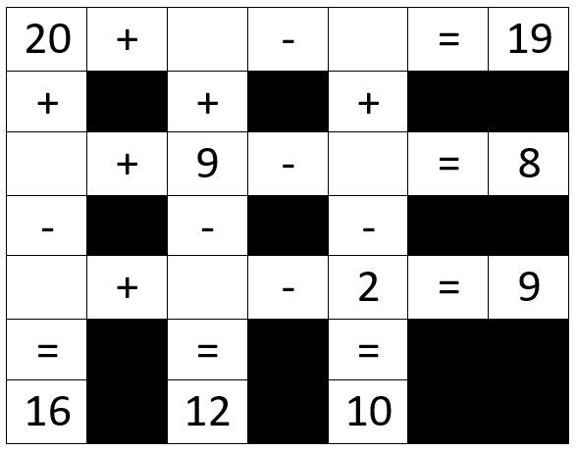
Task 5
Fill in the crossword with numbers 3 – 8 so that all equations are correct. Use each number only once.

Slide 7
Motivating the learning engine to increase student's school, professional and social success and reduce absenteeism
Authors: Ana Vrabec and Ena Ćorluka, teacher Jasmina Horvatović
Construction and Geodesy Vocational School Osijek, Croatia
All rights reserved. No part of this publication may be reproduced, in any form or any means, without persmission in writing form the author.
„The European Comission is not responsible for any uploaded or submittes content. The content reflects the views only of the European Comission cannot be held responsible for any use which may be made of the information contained therein”

