Slide 1
Social and economic agents

Slide 2
Positive social and economic agents
Parents who get on well and support their children
Democratic parenting
Parents who value and support education
Children with average or above average IQ
Good social-emotional status

Slide 3
Negative social and economic agents
Divorced parents
Disfunctional families
Learning disabilities
Lack of support
Socioeconomic status
Stereotypes and prejudice

Slide 4
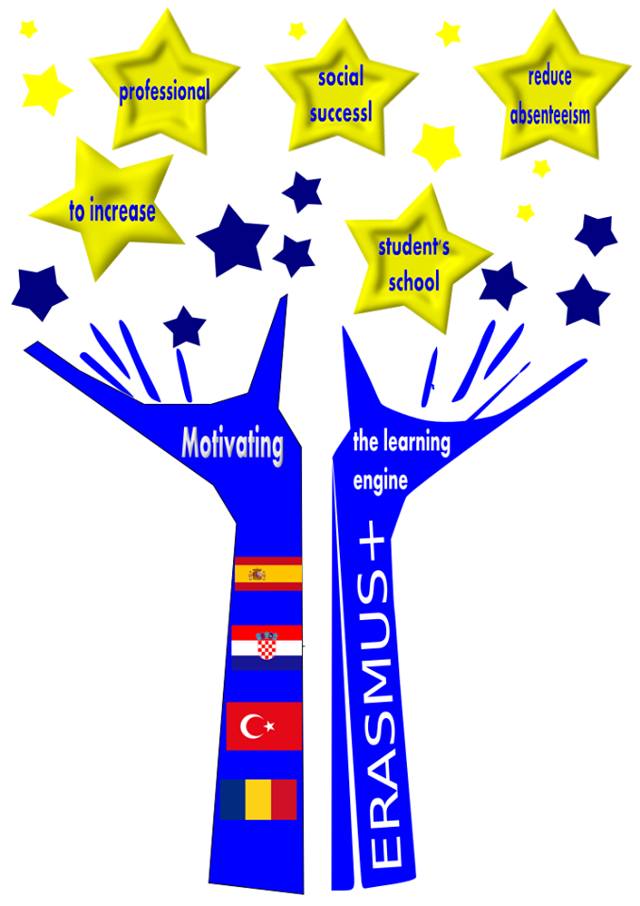
Motivating the learning engine to increase student's school, professional and social success and reduce absenteeism (2019-1-RO01-KA229-063851_5)
Authors: school pedagogue Mirjana Knežević and Sanja Vukelić, teacher
Construction and Geodesy Vocational School Osijek, Croatia
Funded by the European Commission
All rights reserved. No part of this publication may be reproduced, in any form or any means, without persmission in writing form the author.
„The European Comission is not responsible for any uploaded or submittes content. The content reflects the views only of the European Comission cannot be held responsible for any use which may be made of the information contained therein”

