Slide 1
„LEARN, I CHOOSE!”

Slide 2
Secondary School "PROF. UNIV. DR. ION STOIA”
„Motivating the Learning Engine to Increase Student's School, Professional and Social Success and Reduce Absenteeism “
№ 2019-1-RO01-KA229-063851_1

Slide 4
“Read!
Only by reading your brain will become a lab of ideas and images! "
School is an open gate to education, knowledge, ambition and fulfillment.
The school provides equal opportunities for students.
Students learn how to be tolerant and respectful to each other, how to cherish the unanimously accepted values, but also those of the place where they were born.
Through social, cultural and economic services, the school establishes a real partnership with the community, becoming an educational service center.

Slide 5
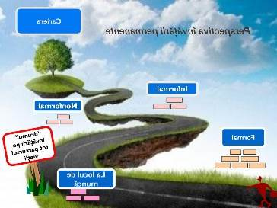
The services that the school offers are based on the quality, performance, promotion of European values, equal opportunities for all participants in the educational act and openness to lifelong learning.

Slide 6
Students are offered a wide range of attractive extracurricular educational activities, many of them performed by their wish, because our aim is to encourage their initiative spirit and cultivate and support their ideas and options.
Also, through all these educational activities, our main goal is that of students to achieve solid life skills and to encourage and build their personal development.

Slide 7
One of the most difficult questions for a student is, what do we learn?
Learning means evolution, knowledge, socialization.
„Education is the best provision for old age”
(Aristotle)

Slide 8
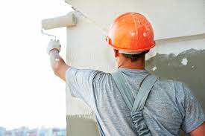
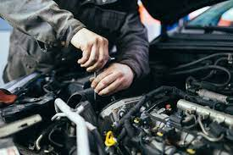
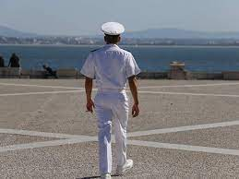
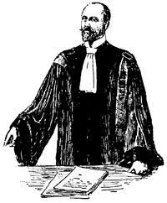
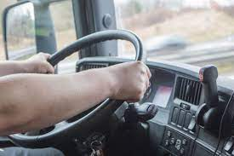
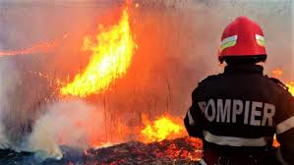
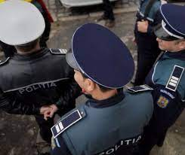
„ Educating the mind, without educating the heart is no education at all! ”

Slide 9
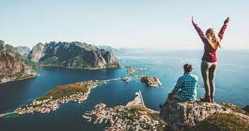
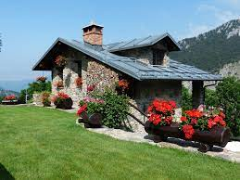
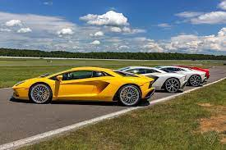
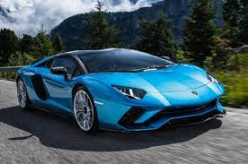
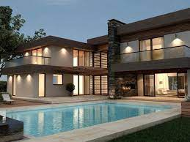
“Education is not
the learning of facts,
but the training of the mind to think.”
(Albert Einstein)

Slide 10
“If you are not willing to learn no one can help you, if you are determined to learn, no one can stop you.”
(Zig Ziglar)

Slide 11
All rights reserved. No part of this publication may be reproduced, in any form or any means, without permission in writing from the authors.
,, The European Commission is not responsible for any uploaded or submitted content. The content reflects the views only of the European Commission cannot be held responsible for any use which may be made of the information contained therein”

Slide 12
Project Financed by the European Union
„Motivating the Learning Engine to Increase Student's School, Professional and Social Success and Reduce Absenteeism “

Slide 13
Secondary School "PROF. UNIV. DR. ION STOIA” CĂLDĂRARU - ARGEŞ
Teacher coordinator – Magdalena Stănculescu

