Slide 1
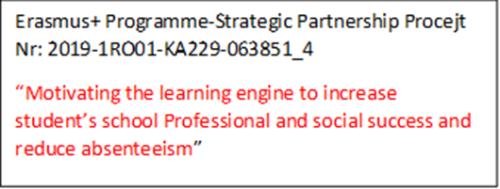
MATH EXERCISES THAT REQUIRE LOGIC
STUDENTS: Emirhan kişi
Metehan Zambak
Sude Naz Conkar
Sahra Naz Gürten

Slide 2
EXERCISE(1)
How to get a number 100. Using four sevens(7) and a one(1) ?
Answer:
177-77=100

Slide 3
EXERCISE(2)
2 | 3 | 4
6 | 7 | 8
10 | 11 | 12
58 | 74 | ?
How can you solve this logic exercise?
Answer:
In the first column:
(10×6)-2=58
In the second column:
(11×7)-3=74
In the last column:
(12×8)-4=92

Slide 4
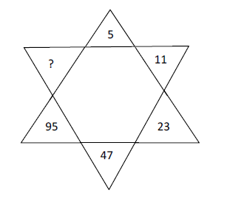
EXERCISE(3)
Can you solve this exercise?
Answer:
(5×2)+1=11
(11×2)+1=23
(23×2)+1=47
(47×2)+1=95
(95×2)+1=191

Slide 5
EXERCISE(4)
11×11=4
22×22=16
33×33=?
How can you solve this exercise?
Answer:
11×11=4
2×11×11×2=16
3×11×11×3=36

Slide 6
EXERCISE(5)
Using only addition, how do you add eight and get the number 1000?
Answer:
888+88+8+8+8=1000

Slide 7
THANKS FOR LISTENING

