Slide 1
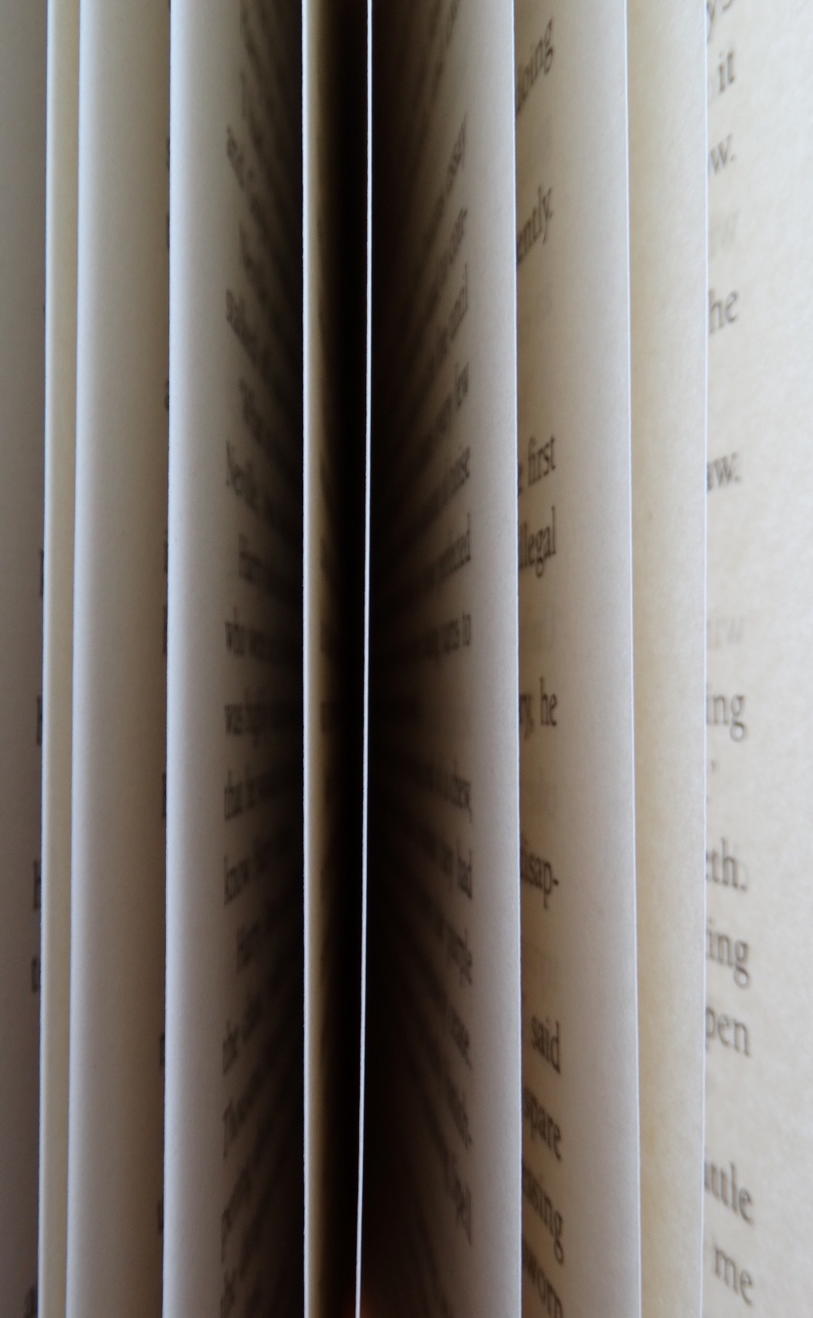
PROVERBS

Slide 2
„Motivating the Learning Engine to Increase Student's School, Professional and Social Success and Reduce Absenteeism “ № 2019-1-RO01-KA229-063851_1
2019-2021
Secondary school "PROF. UNIV. DR. ION STOIA”

Slide 3
PROVERBE
PROVERBS

Slide 4
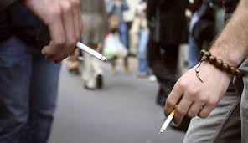
Năravul din fire n-are lecuire.
The vicious has no cure

Slide 5
Unde dai și unde crapă
Where do you hit and where it breaks
Do we have the bank? Bankers we call!

Slide 6
Lacomului nu-i ajunge, Oltu-n gură de i-ar curge
For greedy is not enough, Oltu if he drinks.

Slide 7
Bate fierul cât e cald.
Beat the iron while it's hot.

Slide 8
Toata lumea este o scoala
Everyone is a school

Slide 9
Tare-i bine si frumos cand e omul sanatos.
It's good and nice when man is healthy.

Slide 10
Cel care are incredere in el castiga increderea celorlalti
The one who trusts himself earns the trust of others.

Slide 11
Casa este cea mai mare scoala a virtutilor umane.
The House is the largest school of human virtues.

Slide 12
Omenia este arma cea mai insemnata a bunatatii!
Humanity is the most important weapon of goodness!

Slide 13
Prietenul adevarat nu-ti intinde mana pentru o zi, ci pentru totdeauna !
The true friend does not stretch your hand for a day, but forever!

Slide 14
Omul fără patrie este ca privighetoarea fără cântec.
Man without a country is like a nightingale without a song.

Slide 15
Pentru țara ta să te jertfești și să te războiești, dar nu pentru a supune o țară străină.
For your land to be a warrior and fight, but not to submit to a foreign country.

Slide 16
Apa, vântul şi gura lumii nu o poţi opri
The water, the wind and the mouth of the world cannot be stopped.

Slide 17
Chipul omului e oglinda sufletului.
The image of man is the mirror of the soul.

Slide 18
Cine ştie carte are patru ochi.
Who knows the book has four eyes.

Slide 19
Cine dă săracilor împrumută pe Dumnezeu.
He who gives to the poor borrows God.

Slide 20
Dacă prietenul tău este miere, tu nu umbla să-l mânânci tot.
If your friend is honey, you should not eat it all.

Slide 21
Îndoaie-te ca trestia şi vântul nu te va rupe.
Bend as the reed and the wind will not break you.

Slide 22
Mai bine să-ţi pară rău că ai tăcut decât că ai zis.
Better to feel sorry that you were silent than that you spoke.

Slide 23
Nu e bun ce e bun, ci e bun ce-mi place mie.
It's not good what is good, but it's good what I like.

Slide 24
Toţi se plâng de lipsă de bani, dar de lipsă de minte, nimeni
Everyone complains about lack of money, but nobody complains about lack of brains.

Slide 25
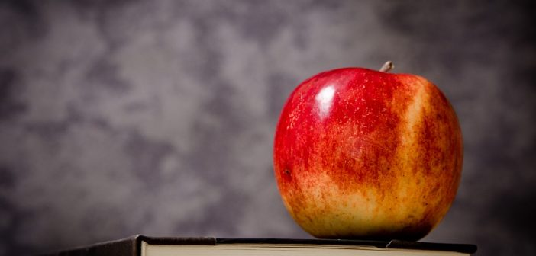
Unii vorbesc ce ştiu şi unii ştiu ce vorbesc.
Some speak what they know and some know what they speak about.

Slide 26
Unde scoala se iveste, pamantul se-mbogateste
Where the school rises, the earth is blooming.

Slide 27
Timpul e dascalul cel mai bun, fiindca el ne-nvata toate
Time is the best teacher because he teaches us everything

Slide 28
Tot pațitu-i priceput
He who encountered knows

Slide 29
Strange omul ca furnica, cand moare, nu ia nimica
Man gathers as an ant when he dies does not take anything

Slide 30
Tot ce e prea mult nu e sanatos
All that's too much is not healthy

Slide 31
Tinerii inaintea batranilor sa aiba ochi iara nu gura
The young men facing the elders shall have eyes and no mouth

Slide 32
Vorbă multa, saracia omului
Much talk, man's poverty

Slide 33
Timpul pierdut nu se mai intoarce
The lost time does not return

Slide 34
Toata pasarea isi apara puii
All birds defend their offspring

Slide 35
Spune-mi cu cine te insotesti, ca sa-ti spun cine esti
Tell me who you gather with to tell you who you are

Slide 36
Unde mananca doi, mananca si al treilea
Where eat two, eats also the third one

Slide 37
Vorba batraneasca multi bani pretuieste
Speaking of the olders, much money cherishes

Slide 38
Cine nu are batrâni, să-si cumpere !
Who does not have olders should buy them!
Who does not have olders should buy them!

Slide 39
Banul e o mica roata, ce-nvarteste lumea toată
Money is a small wheel that makes the whole world spin.

Slide 40
Mitul este răsuflarea unui popor care nu vrea să dispară.
Myth is the breath of a people who does not want to disappear

Slide 41
Dacă vezi un om, el este fie fratele tău întru religie, fie fratele tău întru umanitate
"If you see a man, he is either your brother in religion, or your brother in humanity"

Slide 42
Câinele care latră nu mușcă.
The dog that barks does not bite.

Slide 43
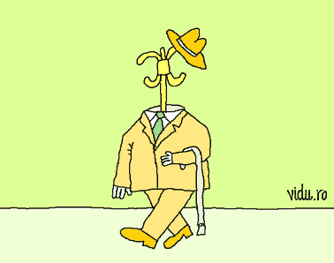
Nu haina îl face pe om.
Not the coat makes a man.

Slide 44
BIBLIOGRAPHY
http://proverbe-zicatori.com/
https://ro.pinterest.com
http://adevarul.ro/locale/slobozia/
http://lolzmonster.com/vorba-lunga-saracia-omului-cea-mai-adevarata-zicala-romaneasca/
http://observator.tv/inedit/numerologie-ce-spune-marimea-familiei-tale-despre-tine
http://radiocluj.ro/2016/01/17/cine-n-are-batrani-sa-si-cumpere/
https://laurentiumihai.ro/proverbe-despre-bani/
http://ziarullumina.ro/miturile-esentiale-ale-culturii-romanesti-miorita-si-mesterul-manole
http://alinailioi.ro/se-spune-cainii-care-latra-nu-musca/
https://jurnalspiritual.eu/nu-haina-face-pe-om/

Slide 45
All rights reserved. No part of this publication may be reproduced, in any form or any means, without permission in writing from the authors.
,, The European Commission is not responsible for any uploaded or submitted content. The content reflects the views only of the European Commission cannot be held responsible for any use which may be made of the information contained therein”

Slide 46
Project Financed by the European Union
„Motivating the Learning Engine to Increase Student's School, Professional and Social Success and Reduce Absenteeism “

Slide 47
Secondary school "PROF. UNIV. DR. ION STOIA” CĂLDĂRARU - ARGEŞ
By Students
Fulger Dorin Ionuț, Diaconescu Mihai Octavian
Tatu Daniel George, Niculae Raluca Elena
Crucean Raluca
By teacher coordinator -Drăguț Violeta

Slide 48
THANK YOU

