Slide 1
"Educated Learner-Future Student"

Slide 2
Warm-up activity:
Materials: PPT
Description: One by one, various statements are shown on PPT slides (e.g. I’m good at math/English/…). The students need to stand up if the statement is true for them or stay sitting down if it’s not.
To serve as a good warm-up, the activity should be fast-paced.

Slide 3
Main part:

Slide 4
1st activity:
Materials: papers, colored pens, props…
Description: Students are divided into groups. Each group is assigned a faculty within a university (e.g. faculty of humanities and social sciences). Their task is to find information about it and advertise it to the rest of the class by: performing a sketch/making a brochure/acting out an interview (e.g. between a high school student and a college student)/…
The goal is to inform students about the choices they have after high school in a creative way.

Slide 5
2nd activity:
Materials: handouts
Description: Students are still in the same groups. Each group receives an envelope with names of different faculties and their descriptions (main information). Their task is to match them.
The goal is for the students to revise and summarize the information about the faculties from the previous activity.

Slide 6
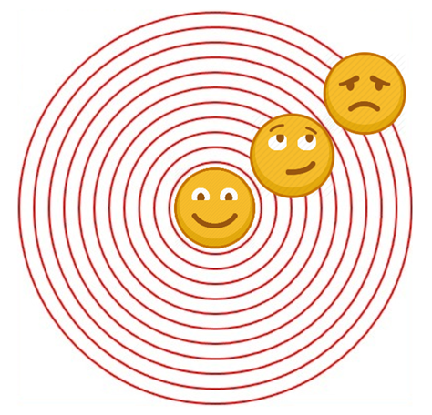
Conclusion:
Materials: post-it papers, board
Description: Each student is given a post-it paper. They have to write their thoughts after the workshop (Have they learnt anything? Was the workshop useful?) and place it within the concentric circles on the board depending on what they feel like after the workshop (happy, neutral, or sad):

Slide 7
Motivating the learning engine to increase student's school, professional and social success and reduce absenteeism
Authors: Arijana Tomić and Sanja Vukelić
Construction and Geodesy Vocational School Osijek, Croatia
All rights reserved. No part of this publication may be reproduced, in any form or any means, without persmission in writing form the author.
„The European Comission is not responsible for any uploaded or submittes content. The content reflects the views only of the European Comission cannot be held responsible for any use which may be made of the information contained therein”

