Slide 1
Teaching on nuclear issues

Slide 2
Change the way we teach
Active participation
Own responsibility in learning
Learning with/from each other
Holistic learning – head – heart – hand
Competency development - knowledge – skills – attitudes
Learning through challenge
Learner-centered approach
Experiential learning
Process oriented learning
Learning by doing
Power of reflection
Unlearning and relearning
comfort zone
challenge zone
panic zone
experience
application
reflection
conclusion

Slide 3
Teach tolerance and acceptance

Slide 4
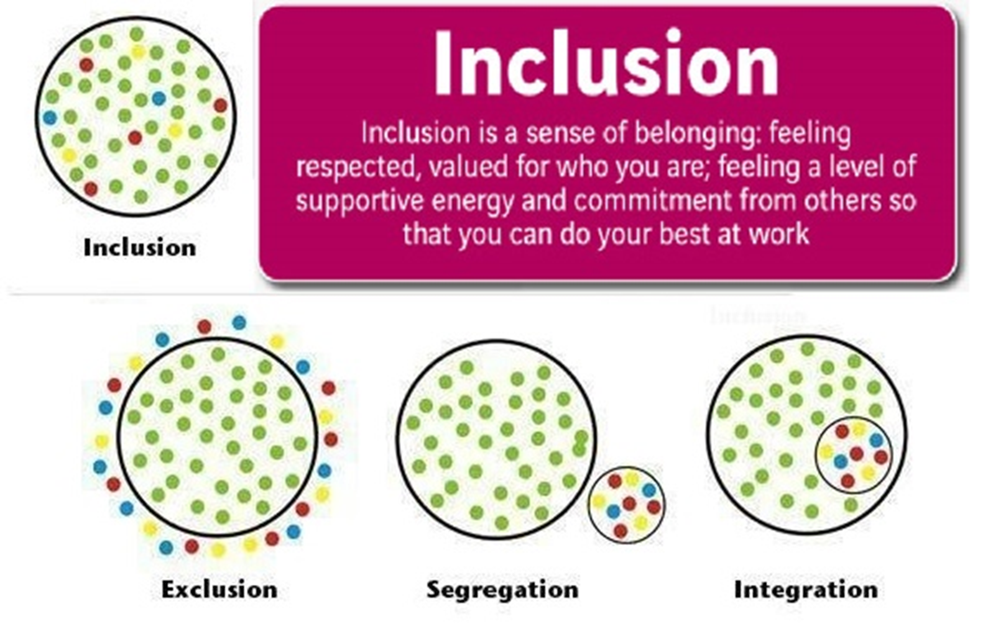
Latvian rental house

Slide 5
What we should strive to

Slide 6
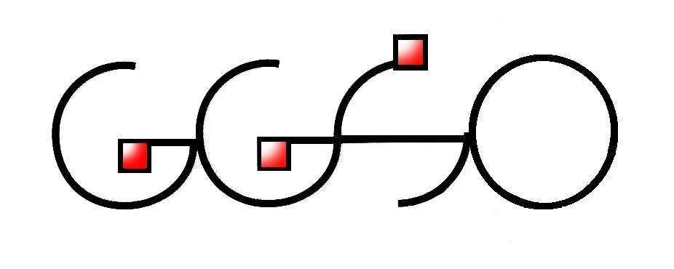
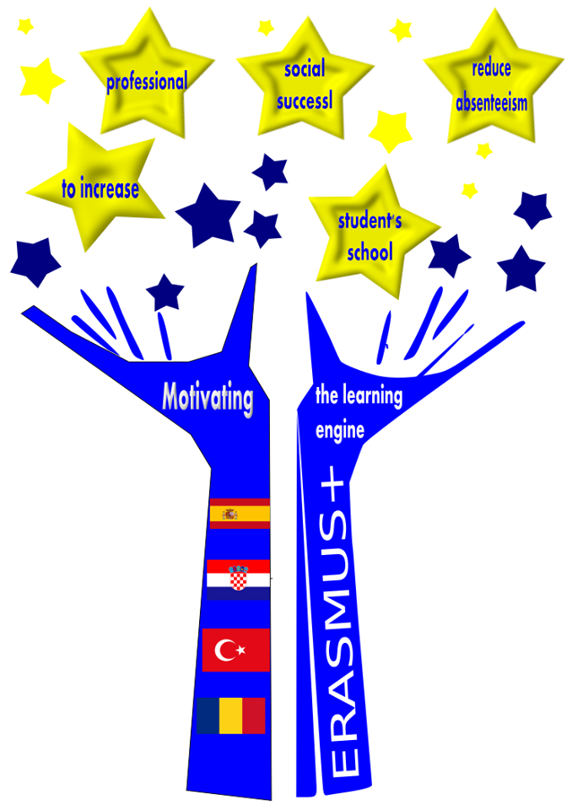
Motivating the learning engine to increase student's school, professional and social success and reduce absenteeism
Authors: Martina Španić and Sanja Vukelić
Construction and Geodesy Vocational School Osijek, Croatia
Bibliography: pictures used from prior Erasmus+ projects – Gaming Power and From Consumer to Co-ownership
All rights reserved. No part of this publication may be reproduced, in any form or any means, without persmission in writing form the author.
„The European Comission is not responsible for any uploaded or submittes content. The content reflects the views only of the European Comission cannot be held responsible for any use which may be made of the information contained therein”

