Slide 1
USING ITC IN THE LESSON CLASS

Slide 2
„Motivating the Learning Engine to Increase Student's School, Professional and Social Success and Reduce Absenteeism “ № 2019-1-RO01-KA229-063851_1
2019-2021
Secondary School "Prof. Univ. Dr. Ion Stoia”

Slide 3
ITC in Education
Modern technology has a very important place in the lives of our students and teachers.
The advantages of using them are a reality of today's world to which the school must show openness.
Computer use in school should not be limited to one area; the computer must also find a place in all disciplines.

Slide 4
GOOGLE CLASSROOM

Slide 5
PORTAL GOOGLE CLASSROOM
GOOGLE CLASSROOM is a free web service, developed by Google for schools, which aims to simplify the creation, distribution and classification of tasks in a way that does not involve paper.
The main purpose of the Google classroom is to streamline the process of sharing files between teachers and students.

Slide 6
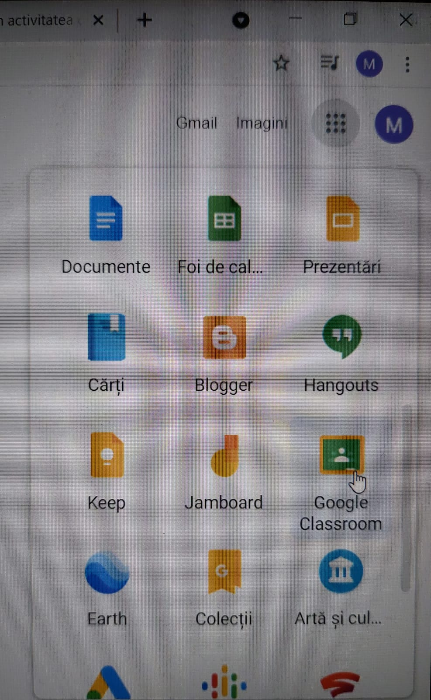
This is an interactive online portal to store and trasmit material to and from students.
They can use it on iPad or iPhone, but also on any internet site.

Slide 7
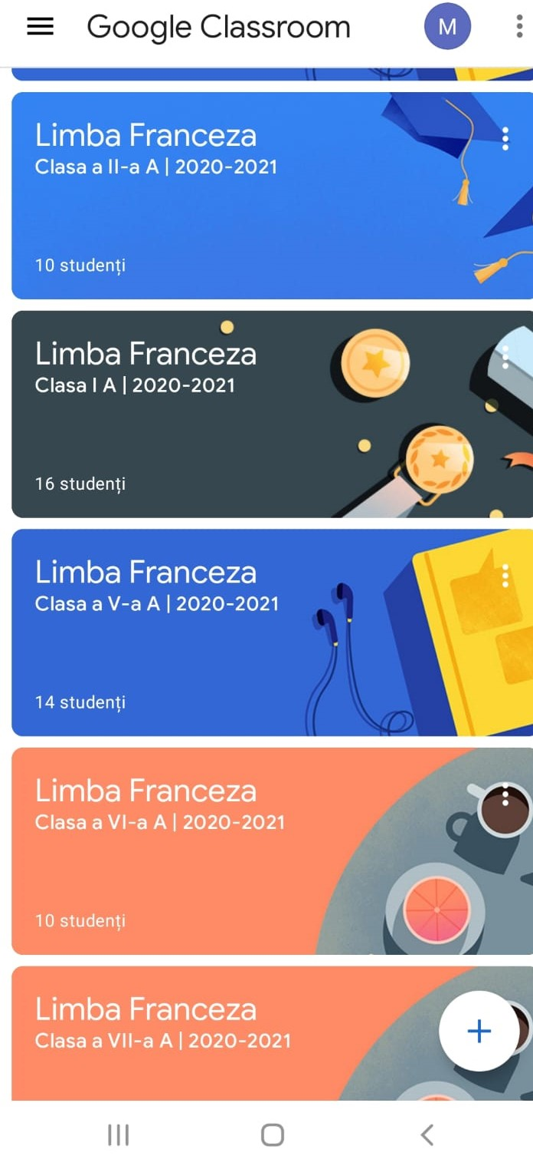
Each class has a unique code which you share with your pupils.
You can have as many classes as you want.

Slide 8
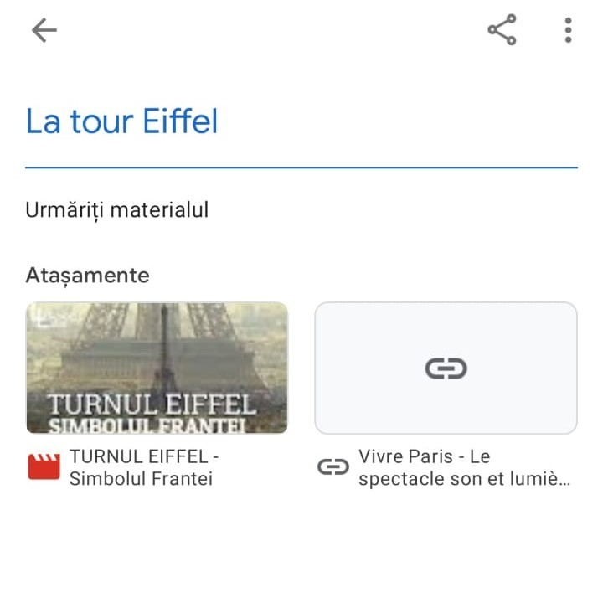
We can use it to lay out our courses for class access.
Every topic could covered and you can include your class notes; presentations; Worksheets; WAGOLL answers, guides from exam boards; Past exam papers, YouTube videos and Web links .

Slide 9
You can set assignments; send a class message; ask a Question or uploud learning material.
It is designed to augment your lessons and act as a teaching learning and revision tool.
We can put materials in this that we cannot put anywhere else. It is only open to our pupils. We give them codes for the classrooms they need which they sing into. This gives them access to our material.

Slide 10
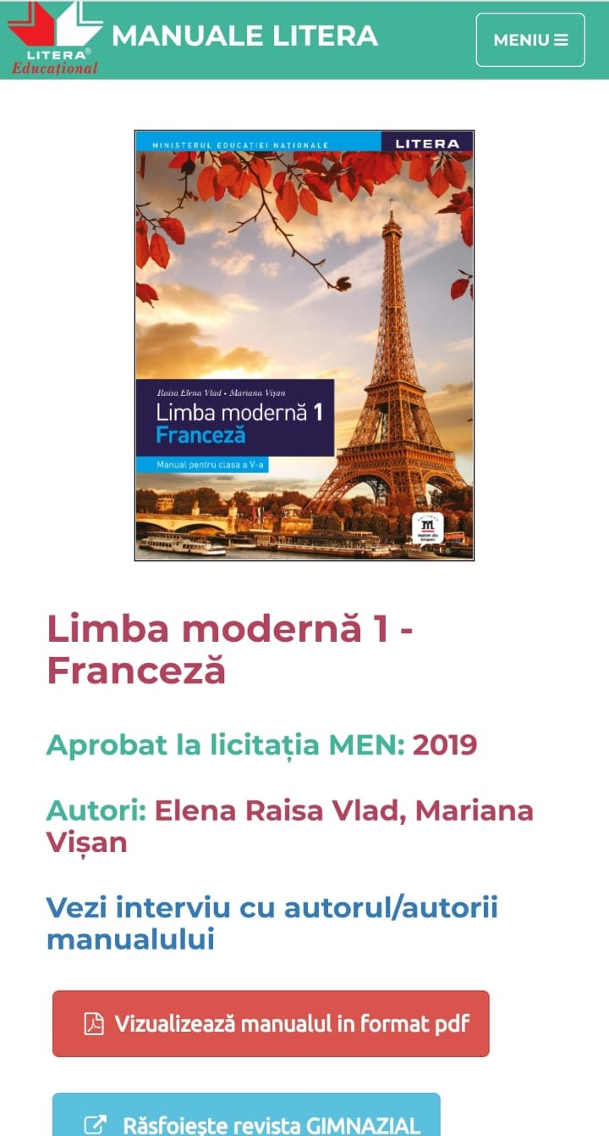
DIGITAL MANUAL
They have the same informations as in the classic textbooks, informations supplemented with interactive multimedia activities, which aim to facilitate the learning process.

Slide 11
POWER POINT
Use in class:
making presentations that may include images, sound, videos;
making interactive tests / presentations for teaching-learning-evaluation.

Slide 12
Teachers can use ICT resources and tools to:
To motivate and involve students;
to customize the learning process;
to use diversity for inclusion;
to develop computer skills;
to evaluate the learning process and the teaching process;
to stimulate students to select activities, applications and modes of communication;
to involve students in creating activities;
to use information from online sources.

Slide 13
All rights reserved. No part of this publication may be reproduced, in any form or any means, without permission in writing from the authors.
,, The European Commission is not responsible for any uploaded or submitted content. The content reflects the views only of the European Commission cannot be held responsible for any use which may be made of the information contained therein”

Slide 14
Project Financed by the European Union
„Motivating the Learning Engine to Increase Student's School, Professional and Social Success and Reduce Absenteeism “

Slide 15
Secondary school "Prof. Univ. Dr. Ion Stoia” Căldăraru - Argeş
By teacher–MOLEA MELANIA MIHAELA

