Slide 1
GHICITORI
RIDDLES

Slide 2
„Motivating the Learning Engine to Increase Student's School, Professional and Social Success and Reduce Absenteeism “ № 2019-1-RO01-KA229-063851_1
2019-2021
Secondary school "PROF. UNIV. DR. ION STOIA”

Slide 3
Uneori e alb-pufos,
Alteori gri, încărcat,
Cu picuri ce-i lasă-n jos,
Apoi rostim: "A plouat!“
Sometimes it is fluffy white
Sometimes it is heavy grey
Having drops that fall down
Then we say: “It rained!”

Slide 4
Răspuns: Norul
Answer: The cloud

Slide 5
Frumuşel şi mititel,
Şi ţipă de-ţi ia auzul.
Nice and small,
And cries loudly.

Slide 6
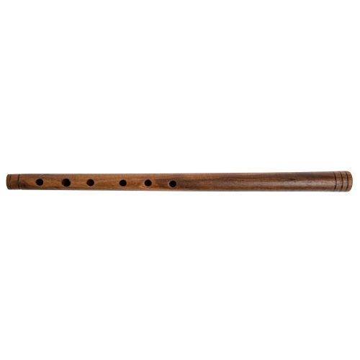
Răspuns: Fluierul
Answer: The whistle

Slide 7
Câmpul alb, oile negre,
Cine�paşte le cunoaşte.
The field white, the sheep black,
Who graze them, knows.

Slide 8
Răspuns: Cartea
Answer: The book

Slide 9
Este în Constanţa
Şi în Timişoara
Este în Turcia
Şi în Italia
It is in Constanta
And in Timisoara
It is in Turkey
And in Italy

Slide 10
Răspuns: Litera T
Answer: Letter T

Slide 11
Rotundă, prin mii de stele,
O marchiză printre ele,
Se plimbă (N-are picioare)
Până-n răsărit de soare!
Round, among thousands of stars
A lady between them
She walks (but has no legs)
Until dawn

Slide 12
Răspuns: Luna
Answer: The moon

Slide 13
Dacă-i dulce, mult aduce.
Dacă-i rea, toţi fug de ea.
If it is sweet, it helps a lot,
If it is rough, brings troubles.

Slide 14
Răspuns: Vorba
Answer: Speech

Slide 15
Vultur falnic pe un scut
E simbol pe steag demult.
Great eagle on a shield
Was the symbol on the flag.

Slide 16
Răspuns: Stema
Answer: The emblem

Slide 17
Pe un steag sunt aşezate,
într-un cerc sunt adunate,
12 stele aurite,
stau acolo liniştite.
On a flag they are set,
Gathered in a circle,
12 golden stars,
Stay still.

Slide 18
Răspuns: Steagul Uniunii Europene
Answer: European Union Flag

Slide 19
Are foi şi nu e pom,
Îţi vorbeşte ca un om
Şi cu cât o îndrăgeşti
Tot mai mult o foloseşti.
It has leaves and is not tree,
It speaks to you like a person
And if you start loving it
You use it more frequently.

Slide 20
Răspuns: Cartea
Answer: The book

Slide 21
Există o casă.
Cei care intră în ea, intră orbi.
Când ies, pot vedea.
Ce este?
There is a house.
Those who enter are blind.
When they get out, they can see.
What is it?

Slide 22
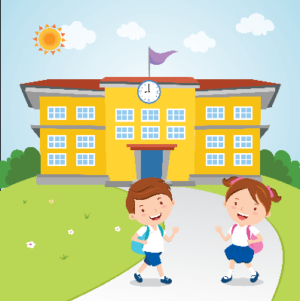
Răspuns: Şcoala
Answer: School

Slide 23
Cum se numeşte femeia care ştie mereu unde este soţul ei?
How we call the woman who always knows where her husband is?

Slide 24
Răspuns: Văduvă
Answer: Widow

Slide 25
Care este pluralul de la sticlă?
What is the plural of glass?

Slide 26
Răspuns: Cioburi
Answer: Pieces

Slide 27
Ce are 2 ochi şi 150 de dinţi?
What has got 2 eyes and 150 teeth?

Slide 28
Răspuns: Un crocodil
Answer: A crocodile

Slide 29
Cine primăvara vine
De pe meleaguri străine,
Are coada furculiţă
Şi-şi clădeşte odăiţă,
Sub o streaşină de casă?
Who's coming in spring
from the foreign countries,
has the tail fork,
and builds it’s room,
under a house straitjacket?

Slide 30
Răspuns: Rândunica
Answer: The swallow

Slide 31
Pe geam făureşte flori,
Iar în obrăjori, bujori.
On the window it makes flowers,
And on the face, roses.

Slide 32
Răspuns: Gerul
Answer: Frost

Slide 33
Are zeci de ace groase
Dar nu ţese nici nu coase.
It has tens of thick needles
But it neither sews, nor weaves.

Slide 34
Răspuns: Ariciul
Answer: The hedgehog

Slide 35
Patru picioare are
Să şi le mişte
Nu e în stare.
It has 4 legs
To move them
It cannot.

Slide 36
Răspuns: Scaunul
Answer: The chair

Slide 37
Nu e cal, dar are coamă
Și-i puternic fără seamă,
Îl ghicești ușor, când vrei,
Că e scris pe banii mei!
It’s not horse, but it has mane
And it has great power,
You guess it easily, if you want,
As is written on my money!

Slide 38
Răspuns: Leul
Answer: The lion

Slide 39
Are blana mătăsoasă,
La căldură toarce-n casă;
La lăbuțe-are gheruțe – Stau ascunse în pernuțe.
It has a fluffy fur,
When it’s warm it weaves inside;
It has claws at its paws –
Hidden inside.

Slide 40
Răspuns: Pisica
Answer: The cat

Slide 41
Iarna fuge,
Vara zace.
In winter it runs,
In summer it sleeps.

Slide 42
Răspuns: Sania
Answer: The sledge

Slide 43
Barbă are,
Popă nu-i
Coarne are
Vacă nu-i.
It has a beard
But it’s not priest
It has horns
But it’s not cow.

Slide 44
Răspuns: Capra
Answer: The goat

Slide 45
Are pene dar nu zboară.
It has feathers but doesn’t fly.

Slide 46
Răspuns: Perna
Answer: The pillow

Slide 47
Iarna-n frig, vara la soare
Neschimbat e la culoare!
In winter and in sunny summer
It has the same colour!

Slide 48
Răspuns: Bradul
Answer: The fir tree

Slide 49
O mie de frăţiori,
O mie de dinţişori
Stau înfipţi câte şi-o mie
Într-un fund de farfurie.
A thousand of brothers,
A thousand of teeth
Stay stuck
A plate.

Slide 50
Răspuns: Floarea soarelui
Answer: Sunflower

Slide 51
Poţi să fugi de ea
Prea bine,
Că tot vine
După tine.
You can run away of it
That it always follows you.

Slide 52
Răspuns: Umbra
Answer: The shadow

Slide 53
Vestă mândră ţărănească
Bărbăteasc-ori femeiască.
Countryside beautiful vest
For men or women.

Slide 54
Răspuns: Ilic

Slide 55
Ciupercă uscată
Pe cap aşezată.
Dry mushroom
On the head.

Slide 56
Răspuns: Pălărie
Answer: Hat

Slide 57
Ce trece pe dinaintea ochilor
şi nu-l poţi vedea?
What passes by and you cannot see it?

Slide 58
Răspuns: Timpul
Answer: The time

Slide 59
În grădina lui Pandele
e un pom plin cu mărgele
la culoare-s roşii toate
cu codiţe-nperechiate
ghici ce e?
In Pandele’s garden
Is a tree full of beads
They are all red
In couples
What is it?

Slide 60
Răspuns: Cireşul
Answer: The cherry tree

Slide 61
Fără cărbuni
Mă-ncălzesc,
Pânza albă
Netezesc.
Without coals
I got hot
White coat
I smooth.

Slide 62
Răspuns: Fierul de călcat
Answer: The iron

Slide 63
Ce copac stufos şi-nalt
Înfloreşte-n luna mai
Şi dă floare pentru ceai?
Cine este l-aţi aflat ?
What kind of tall and big tree
Blossom in May
And is used for tea
What is it?

Slide 64
Răspuns: Teiul
Answer: Linden

Slide 65
Către soare se avântă
Dimineaţa-n zori şi cântă.
Towards the sun it rushes in the morning
And sings.

Slide 66
Răspuns: Ciocârlia
Answer: The skylark

Slide 67
All rights reserved. No part of this publication may be reproduced, in any form or any means, without permission in writing from the authors.
,, The European Commission is not responsible for any uploaded or submitted content. The content reflects the views only of the European Commission cannot be held responsible for any use which may be made of the information contained therein”

Slide 68
Project Financed by the European Union
„Motivating the Learning Engine to Increase Student's School, Professional and Social Success and Reduce Absenteeism “

Slide 69
BIBLIOGRAFIE Bibliography
https://www.google.ro/search?q=vorba&source=lnms&tbm=isch&sa=X&ved=0ahUKEwjNzcrp_I3UAhXCJ5oKHWESCqAQ_AUICigB&biw=1350&bih=586#imgrc=3e4Dfz0UQlqg3M:
https://www.google.ro/search?q=scola&source=lnms&tbm=isch&sa=X&ved=0ahUKEwi48e-qiY7UAhUJDywKHbegA2sQ_AUICigB&biw=1350&bih=586#tbm=isch&q=scoala&imgrc=fRN7ZLPfkMMkaM:
https://www.google.ro/search?q=vaduva&source=lnms&tbm=isch&sa=X&ved=0ahUKEwi8ldORio7UAhXLFJoKHUnqD_oQ_AUICigB&biw=1350&bih=586#imgrc=0zic4r_-LXjcXM:
https://www.google.ro/search?q=cioburi&source=lnms&tbm=isch&sa=X&ved=0ahUKEwicsLjuio7UAhWlAJoKHThzAdcQ_AUICigB&biw=1350&bih=586#imgrc=gdMgwhBYc7HD-M:
https://www.google.ro/search?q=crocodil&source=lnms&tbm=isch&sa=X&ved=0ahUKEwjonKLkjI7UAhVJD5oKHaWZAAMQ_AUICigB&biw=1350&bih=586#imgrc=8P2JtNrZ1PF2YM:
https://www.google.ro/search?q=randunica&source=lnms&tbm=isch&sa=X&ved=0ahUKEwji2J2Vko7UAhWFO5oKHZ8tD9wQ_AUICigB&biw=1350&bih=586#imgrc=BuWBSHC-dquAuM:
https://www.google.ro/search?q=TIMPUL&source=lnms&tbm=isch&sa=X&ved=0ahUKEwjV4bTOoI7UAhUEG5oKHU00BHIQ_AUICigB&biw=1350&bih=586#tbm=isch&q=timpul+trece&imgrc=buQHVji0FWlFbM

Slide 70
Secondary school "PROF. UNIV. DR. ION STOIA” CĂLDĂRARU - ARGEŞ
By Students
Fulger Dorin Ionuț, Diaconescu Mihai Octavian
Tatu Daniel George, Niculae Raluca Elena
Crucean Raluca
By teacher coordinator -Drăguț Violeta

