Slide 1
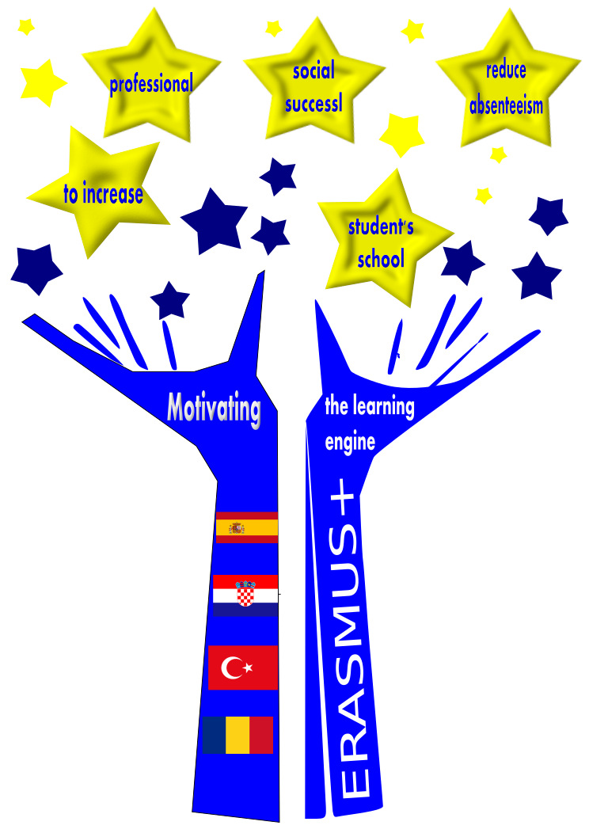
Motivating the learning engine to increase student’s school, professional and social success and reduce absenteeism
2019-1-RO01-KA229-063851
by Rosabel Benages / Reyes Sánchez
Project financed by the European Union
All rights reserved. No part of this publication may be reproduced, in any form or any means, without permission in writing from the authors. | “The European Comission is not responsible for any uploaded or submitted content. The content reflects the views only of the European Comission cannot be held responsable for any use which may be made of the information contained therein”

Slide 2
Educated Learner-Future Student

Slide 4
Why is important Lifelong Learning?

Slide 5
The European Commission works with EU Member States to promote key competences, knowledge and perspectives facilitating lifelong learning.

Slide 6
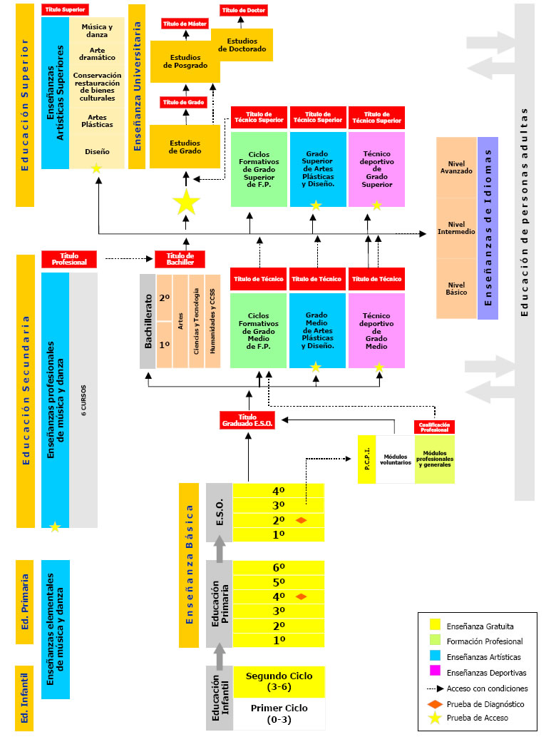
The Spanish Education system
In the EU, the organization and management of the education and training systems is the Member States’ responsibility

Slide 7
The European Commission has the role of supporting member states:
- By cooperating in policies through the ET 2020 framework
- Financing instruments such as the Erasmus + program and the European Structural and Investment Funds.
- European education Area.The Commission is developing initiatives to help establish a European Education Area enabling all young people to benefit from the best education and training, and to find employment across Europe.
- With the socioeconomic program, which includes the Europe 2020 Strategy and the European Semester, where the economic policies of the Member States are coordinated.

Slide 8
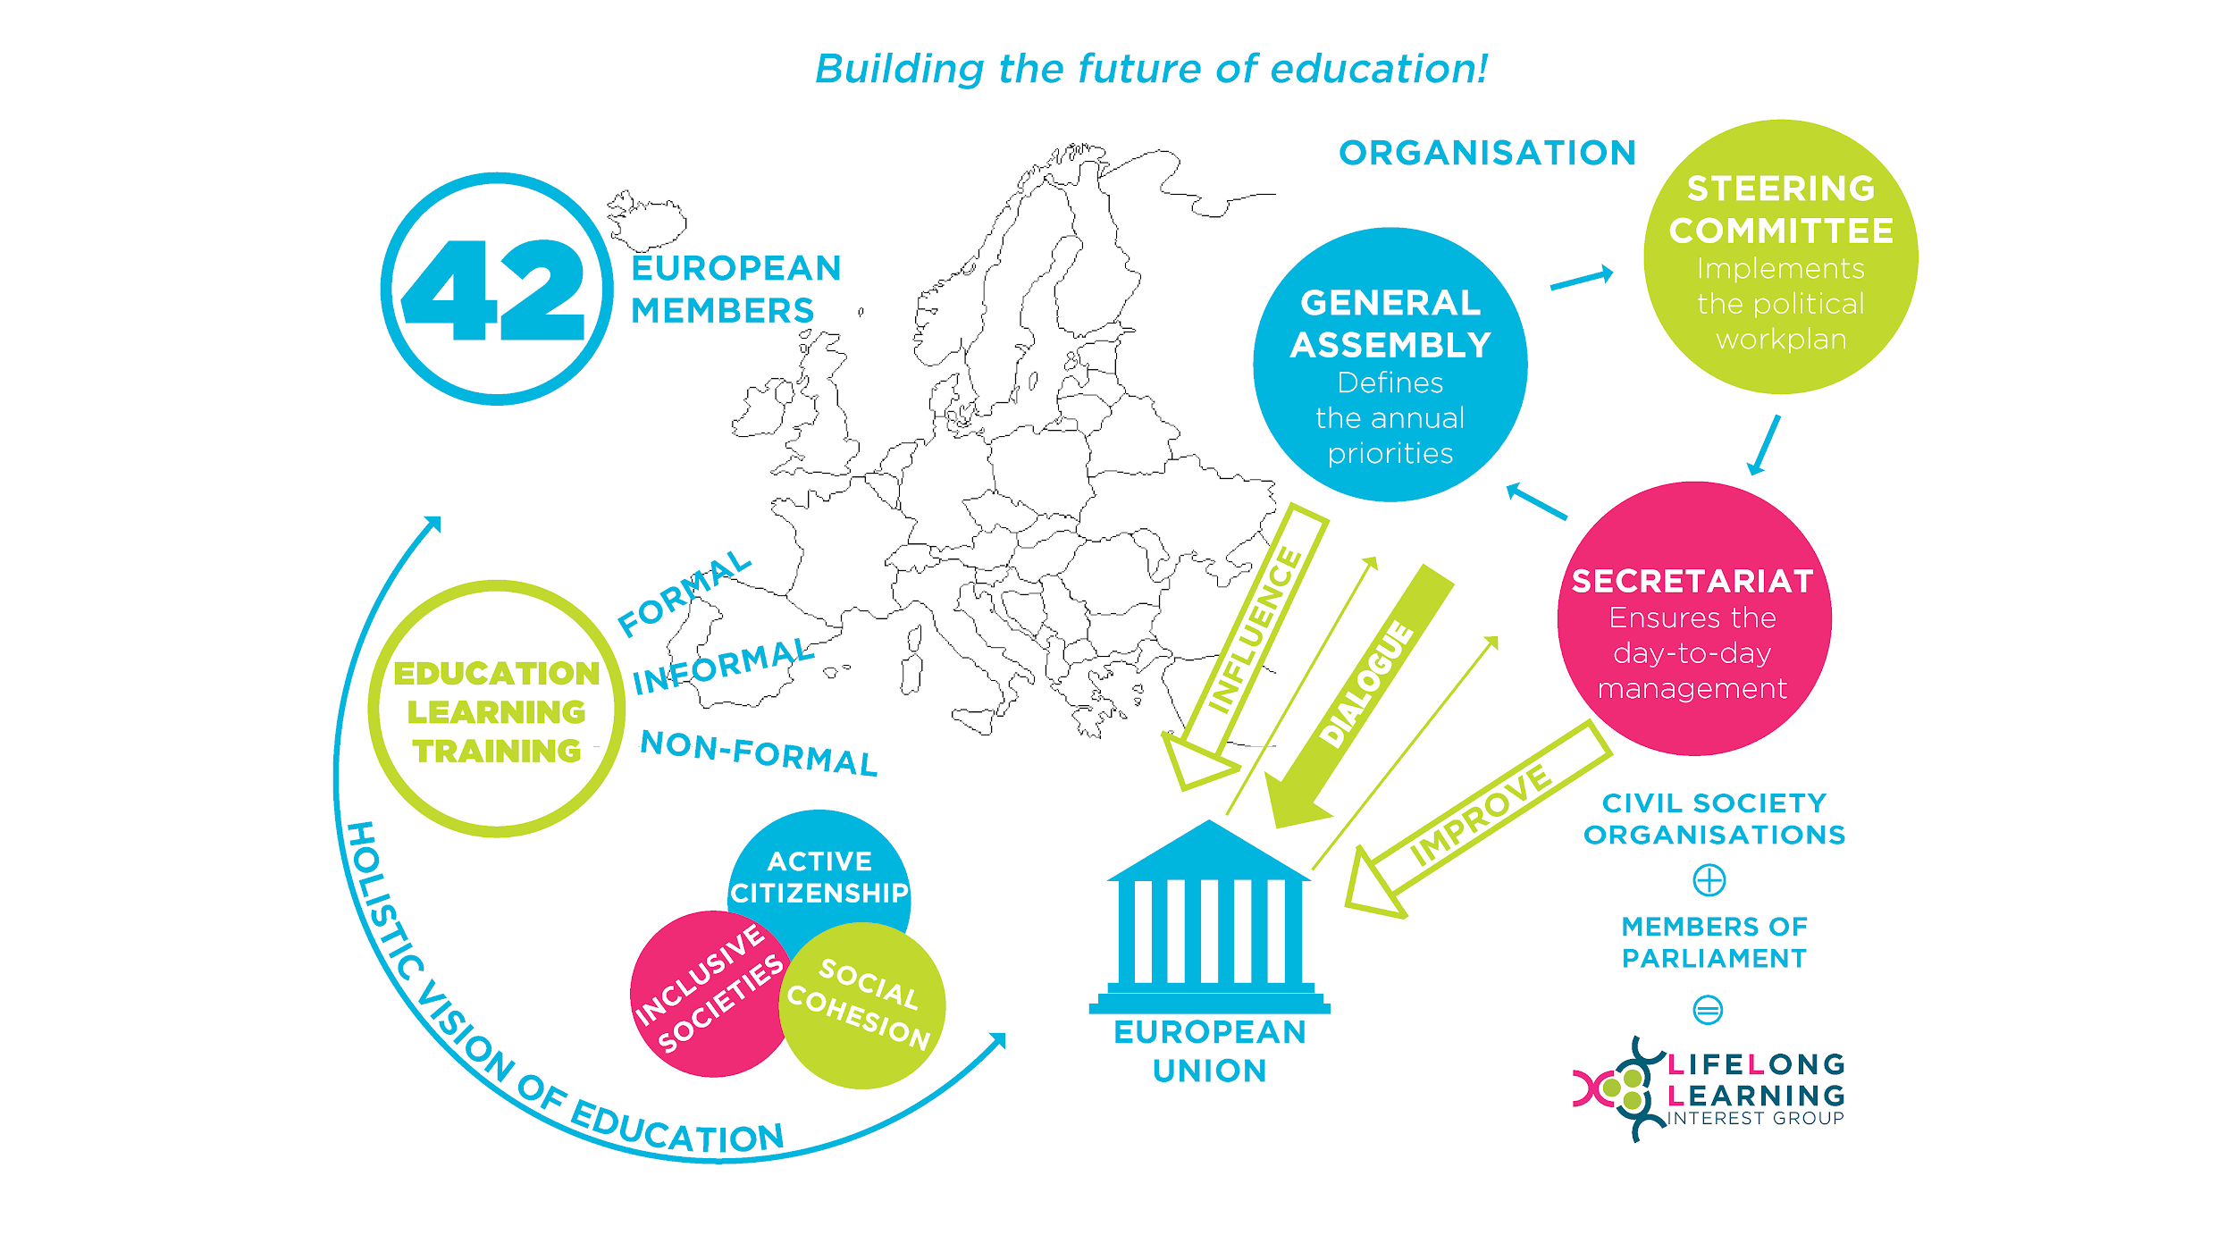
The Lifelong Learning Platform is an umbrella that gathers 42 European organisations active in the field of education, training and youth.

Slide 9
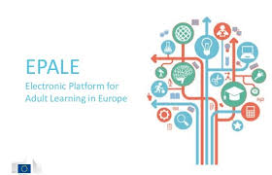
Electronic Platform for Adult Learning in Europe
Covers the entire range of formal, non-formal and informal learning activities — both general and vocational — undertaken by adults after leaving initial education and training.

