Slide 1
NATURE, MAN, THEORY

Slide 2
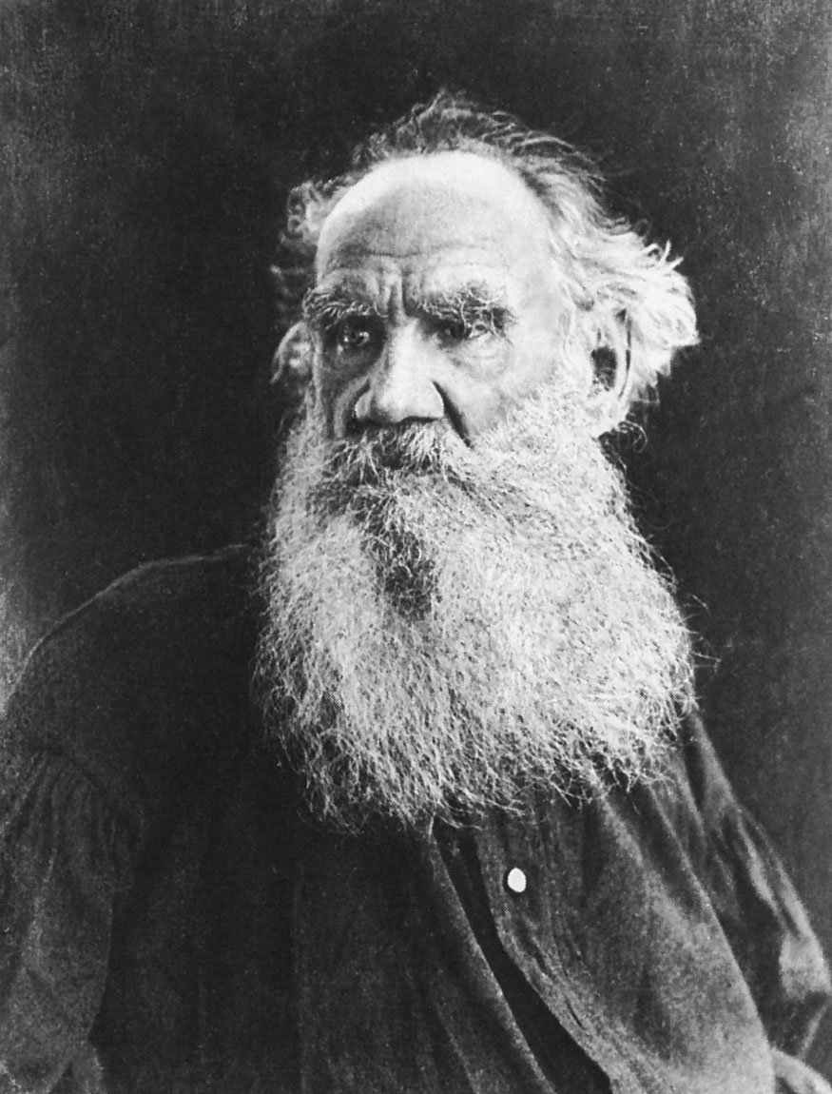
ONE OF THE FIRST CONDITIONS OF HAPPINESS IS THAT THE LINK BETWEEN MAN AND NATURE SHALL NOT BE BROKEN
- Leo Tolstoy

Slide 3
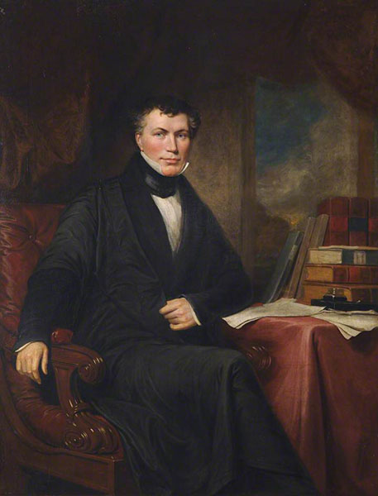
THERE IS A MASK OF THEORY OVER THE WHOLE FACE OF NATURE
- WILLIAM WHEWELL

Slide 4
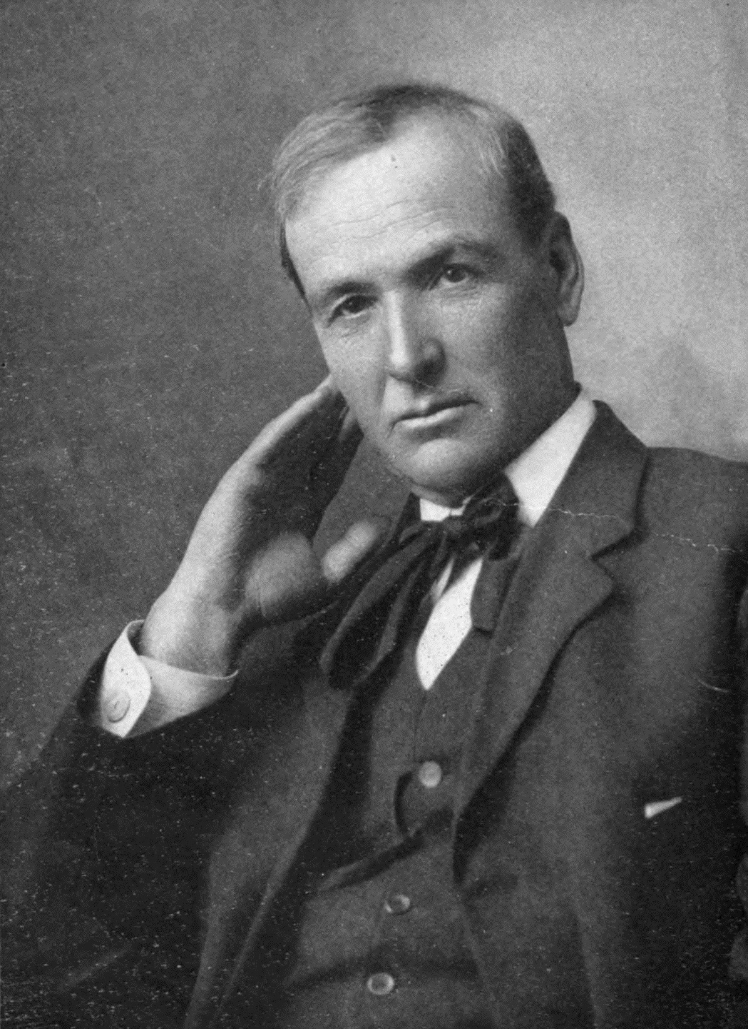
A YOUNG MAN IS A THEORY, AN OLD MAN IS A FACT
- Edgar Watson Howe

Slide 5
THE TRUTH OF A THEORY IS IN YOUR MIND, NOT IN YOUR EYES
- ALBERT EINSTEIN

Slide 6
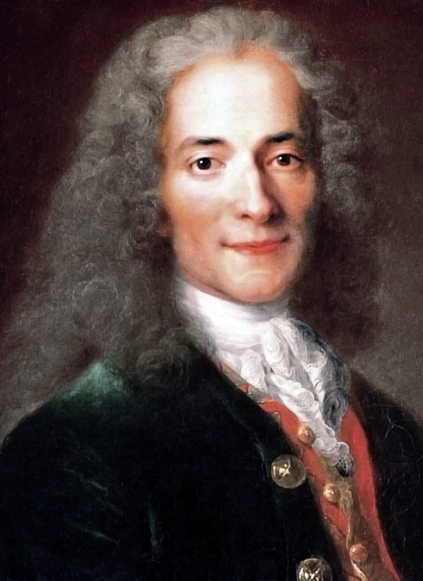
MEN ARGUE, NATURE ACTS
- VOLTAIRE

Slide 7
