Slide 1
15 EASY QUESTIONS BUT WITH LOGICAL TRAPS

Slide 2
„Motivating the Learning Engine to Increase Student's School, Professional and Social Success and Reduce Absenteeism “ № 2019-1-RO01-KA229-063851_1
2019-2021
Secondary school "PROF. UNIV. DR. ION STOIA”

Slide 3
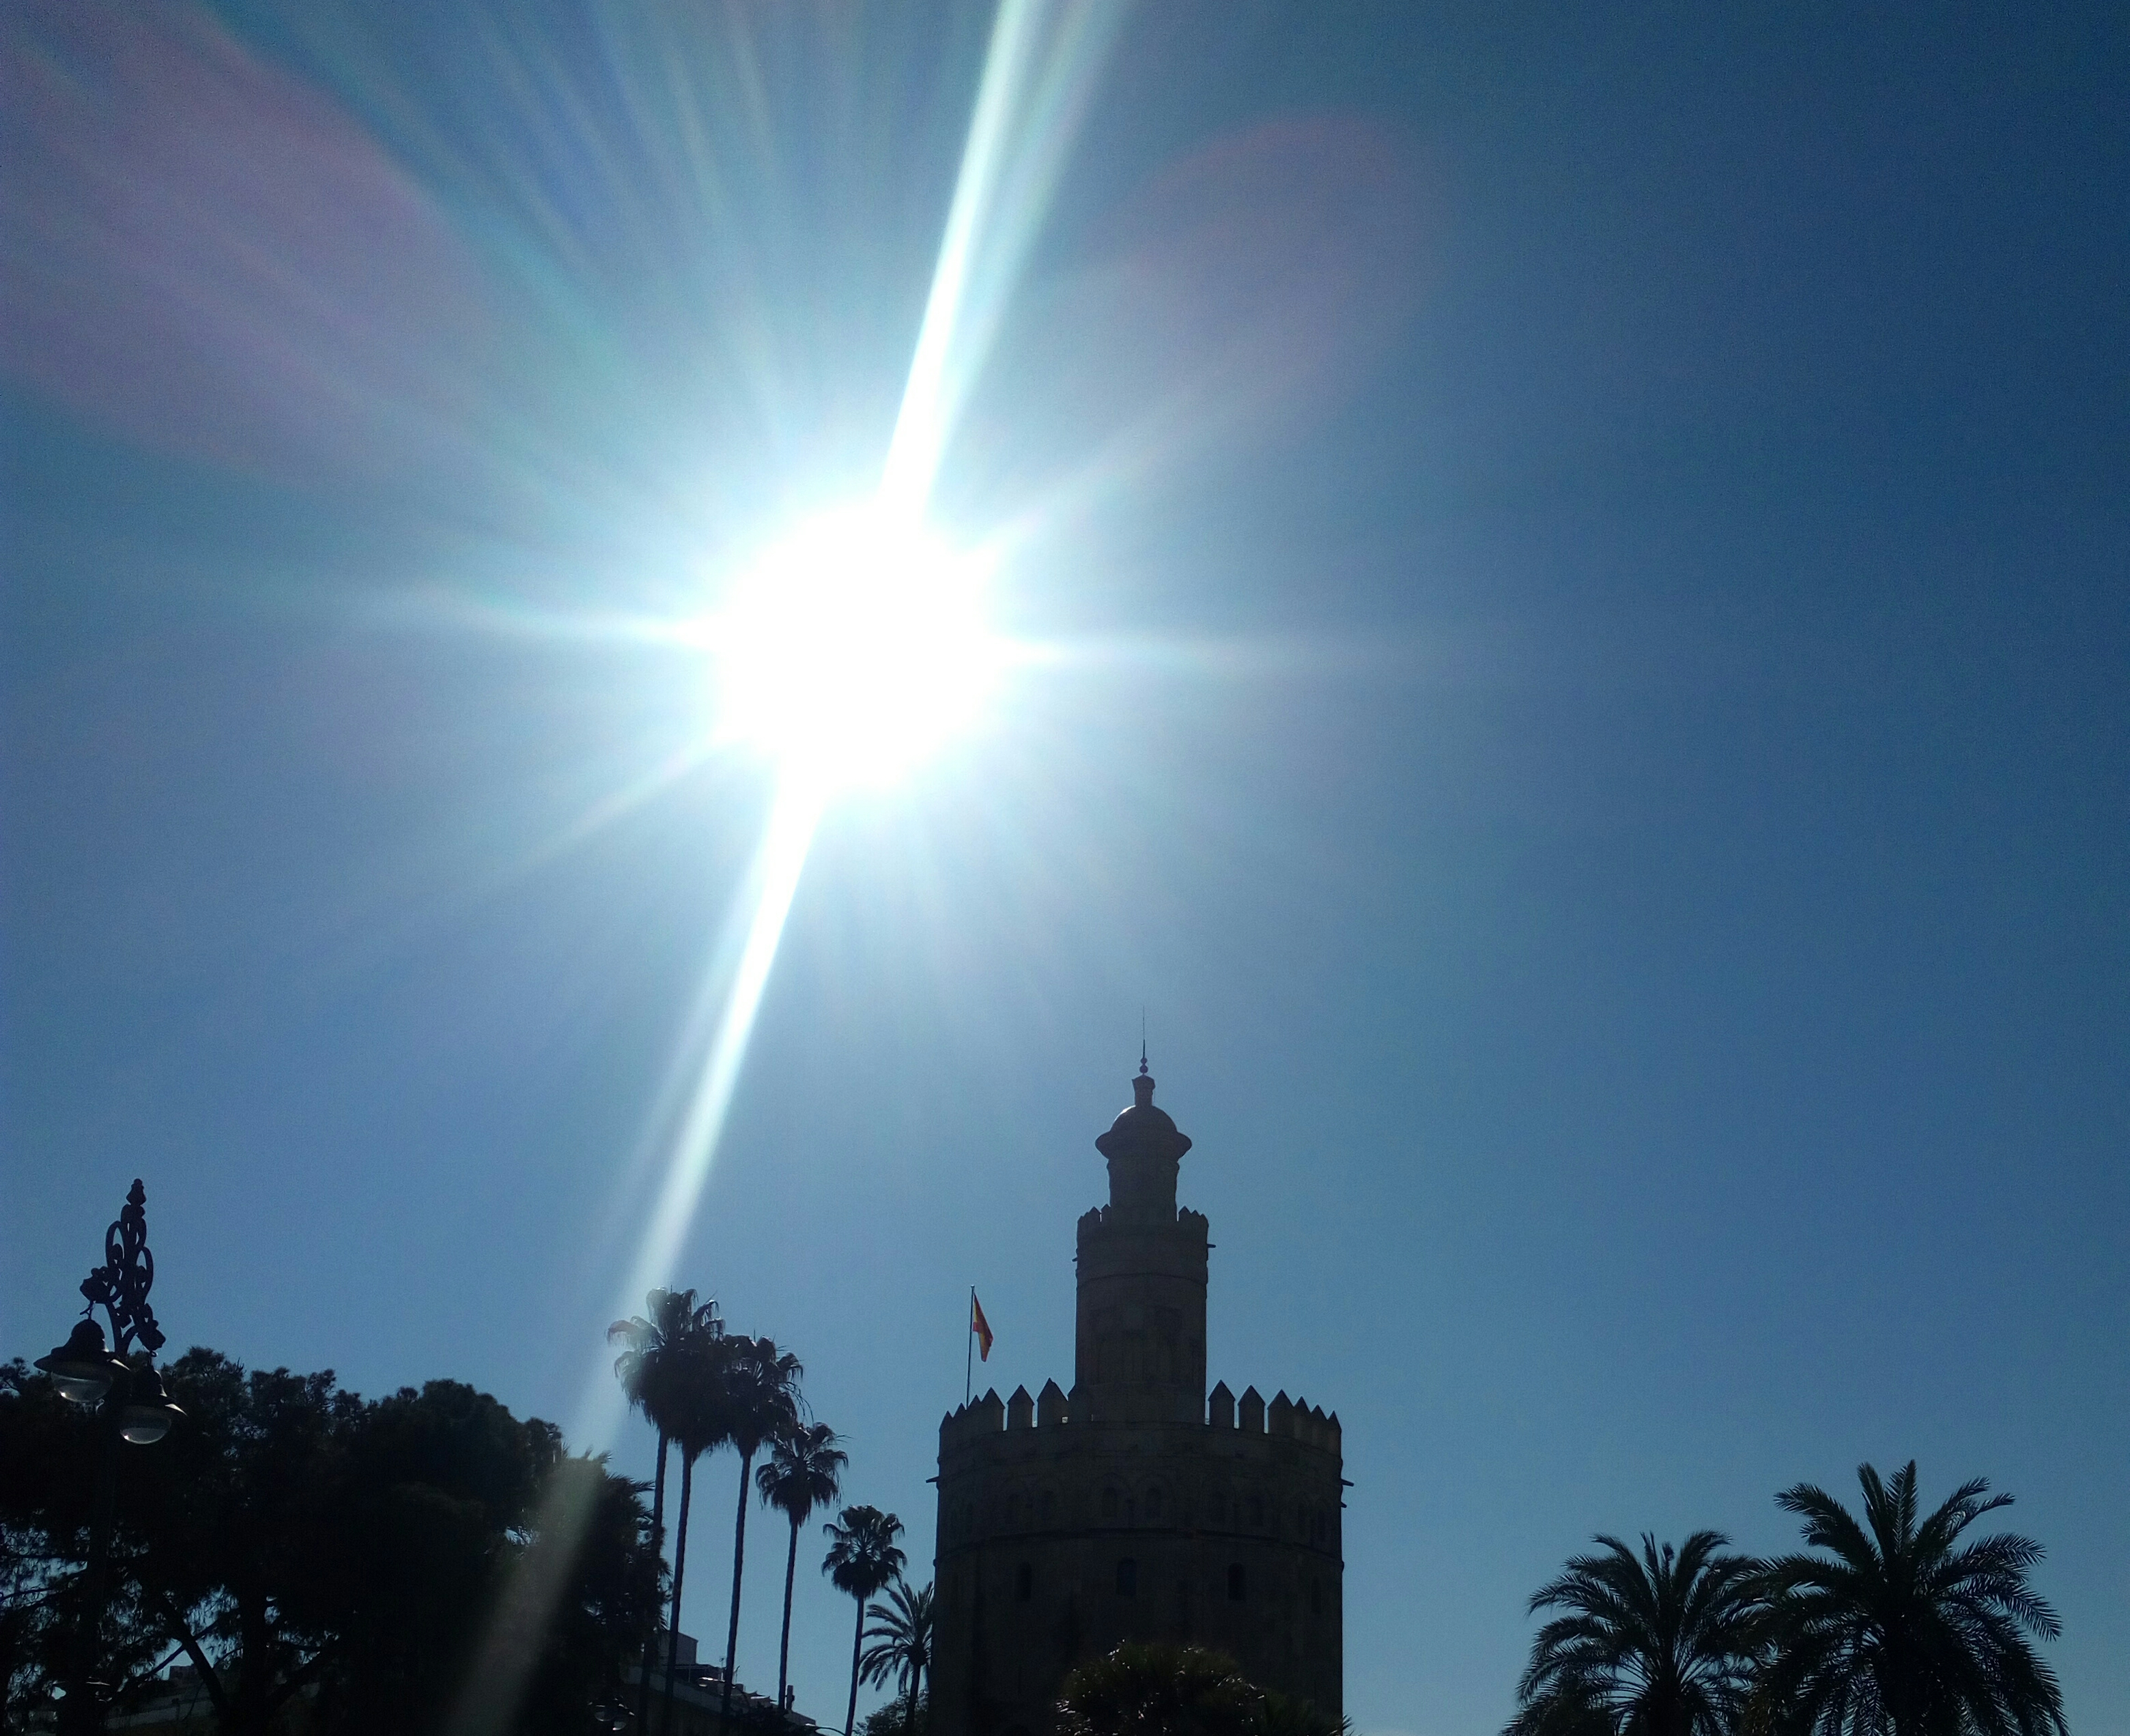
1 EASY QUESTION BUT WITH LOGICAL TRAPS
Appoint 3 consecutive days without using the words Monday, Tuesday, Wednesday, Thursday, Friday, Saturday, Sunday.
Numește 3 zile consecutive fără să folosești cuvintele luni, marți, miercuri, joi, vineri, sâmbătă, duminică.

Slide 4
Answer: yesterday, today and tomorrow.

Slide 5
2 EASY QUESTION BUT WITH LOGICAL TRAPS
How many apples can you eat in the morning on an empty stomach?
Câte mere poți mânca dimineața pe stomacul gol?

Slide 6
Answer: one alone, the rest are no longer on an empty stomach.
Răspuns: unul singur, restul nu mai sunt pe stomacul gol.

Slide 7
3 EASY QUESTION BUT WITH LOGICAL TRAPS
A truck driver enters a one-way street and goes in the wrong direction.
He gets past two police crews, but law enforcement doesn't stop him.
Why?
Un șofer de camion intră pe o stradă cu sens unic și merge în direcția greșită. El trece pe lângă două echipaje de poliție, dar oamenii legii nu îl opresc.
De ce?

Slide 8
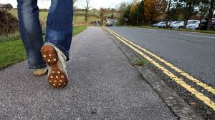
Answer: because he is walking.
Răspuns: pentru că merge pe jos.

Slide 9
4 EASY QUESTION BUT WITH LOGICAL TRAPS
What belongs to you and is used more than others?
Ce îţi aparţine şi este folosit mai mult de alţii?

Slide 10
Answer: the name.
Răspuns: numele.

Slide 11
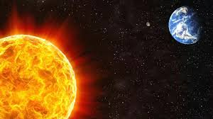
5 EASY QUESTION BUT WITH LOGICAL TRAPS
What is between the Sun and the Earth?
Ce se află între Soare şi Pământ?

Slide 12
Answer: and.
Răspuns: și.
AND

Slide 13
5 EASY QUESTION BUT WITH LOGICAL TRAPS
Who does not ask any questions but needs an answer?
Cine nu pune nicio întrebare, dar are nevoie de răspuns?

Slide 14
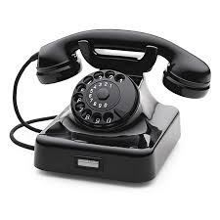
Answer: a phone call or ringtone.
Răspuns: un apel telefonic sau soneria.

Slide 15
6 EASY QUESTION BUT WITH LOGICAL TRAPS
What is the only question that is answered with NO because it would be impossible to answer with YES?
Care este singura întrebare la care se răspunde cu NU pentru că ar fi imposibil să se răspundă cu DA?

Slide 16
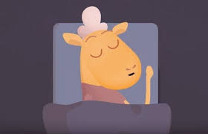
Answer: Do you sleep?
Răspuns: Dormi?

Slide 17
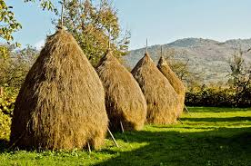
7 EASY QUESTION BUT WITH LOGICAL TRAPS
What is harder, one kilogram of lead or one of hay?
Ce este mai greu, un kilogram de plumb sau unul de fân?

Slide 18
Answer: They are equal
Răspuns: Sunt egale

Slide 19
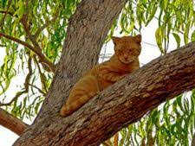
8 EASY QUESTION BUT WITH LOGICAL TRAPS
A white cat climbs into the tree. How do you get off?
O pisică albă se urcă în pom. Cum se dă jos?

Slide 20
Answer: White.
Răspuns: Albă.

Slide 21
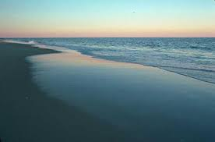
9 EASY QUESTION BUT WITH LOGICAL TRAPS
In the Mediterranean, tourism is a Big bang.
Why doesn't Macedonia develop its coastal tourism?
La Marea Mediterană turismul este un Big-bang.
De ce nu își dezvoltă turismul litoral Macedonia?.

Slide 22
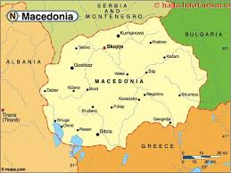
Answer: Macedonia has no opening to the sea.
Raspuns: Macedonia nu are deschidere la mare.

Slide 23
10 EASY QUESTION BUT WITH LOGICAL TRAPS
The highest mountain peak is Elbrus in Europe, it is 5462 m, do we allow the Serbs to climb it?
Cel mai înalt vârf- Elbrus din Europa este de 5462 m, ne permit sârbii să-l escaladăm?

Slide 24
Answer: it is not in Serbia
Răspuns: nu este în Serbia

Slide 25
11 EASY QUESTION BUT WITH LOGICAL TRAPS
Pot verişorii tăi să aibă o mătuşă comună pe care tu nu o ai? Cum?
Can your cousins have a common aunt you don't have?
How?

Slide 26
Answer: Yes, my aunt is my mother
Răspuns: Da, mătușa comună este chiar mama mea

Slide 27
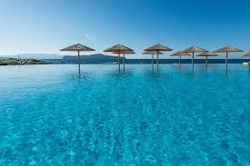
12 EASY QUESTION BUT WITH LOGICAL TRAPS
What is the sea dressed?
Care este marea îmbrăcată?

Slide 28
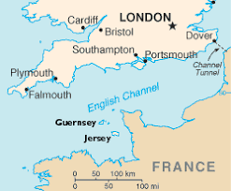
Answer: Marea Mânecii (The Sea of Sleeve)
Răspuns: Marea Mânecii

Slide 29
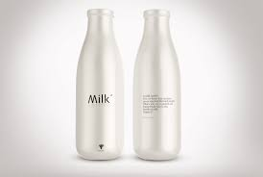
13 EASY QUESTION BUT WITH LOGICAL TRAPS
In what bottle can you not put milk?
In ce sticla nu poti pune lapte?

Slide 30
Answer: In broken glass
Răspuns: În sticlă spartă

Slide 31
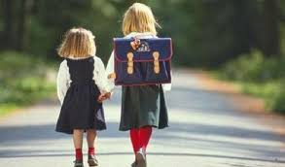
14 EASY QUESTION BUT WITH LOGICAL TRAPS
What does a student learn first when he goes to school?
Ce invata mai intai un elev cand merge la scoala?

Slide 32
Answer: The road to school
Răspuns: Drumul spre școală

Slide 33
15 EASY QUESTION BUT WITH LOGICAL TRAPS
The city of Strasbourg has closed its gates. Why did the Germans shut down their city?
Orașul Strasbourg și-a închis porțile. De ce germanii și-au închis orașul?
STRASBURG

Slide 34
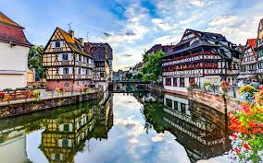
Answer: The city-Strasbourg is in France
Răspuns: Orașul Strasbourg este în Franța

Slide 35
All rights reserved. No part of this publication may be reproduced, in any form or any means, without permission in writing from the authors.
,, The European Commission is not responsible for any uploaded or submitted content. The content reflects the views only of the European Commission cannot be held responsible for any use which may be made of the information contained therein”

Slide 36
Project Financed by the European Union
„Motivating the Learning Engine to Increase Student's School, Professional and Social Success and Reduce Absenteeism “

Slide 37
Secondary school "PROF. UNIV. DR. ION STOIA” CĂLDĂRARU - ARGEŞ
By teacher coordinator -Drăguț Violeta

Slide 38
SOURCES
https://www.google.com/search?q=DORMI&tbm=isch&ved=2ahUKEwjW3eD4tZPoAhVHM-wKHciOCFgQ2-cCegQIABAA&oq=DORMI&gs_l=img.12..0l10.1713.4318..7200...0.0..0.1679.3918.6-1j1j1......0....1..gws-wiz-img.TApAY7ICOvw&ei=m19pXpakFcfmsAfInaLABQ&bih=657&biw=1366&rlz=1C1AVFC_enRO829RO830
https://www.google.com/search?q=elev+spre+scoala&tbm=isch&ved=2ahUKEwjBqvfluJPoAhVEs6QKHf2eCKsQ2-cCegQIABAA&oq=elev+spre+scoala&gs_l=img.3...1914237.1917902..1918220...0.0..0.659.4758.2-13j0j1j2......0....1..gws-wiz-img.......0j0i67j0i30j0i8i30j0i5i30j0i10i24.uBBLsrcRzaM&ei=mWJpXoH6CsTmkgX9vaLYCg&bih=657&biw=1366&rlz=1C1AVFC_enRO829RO830
https://www.google.com/search?q=MULTUMESC+IN+ARTA&rlz=1C1AVFC_enRO829RO830&source=lnms&tbm=isch&sa=X&ved=2ahUKEwjbuObFwpPoAhWFjqQKHcKgDMoQ_AUoAXoECAsQAw

