Slide 1
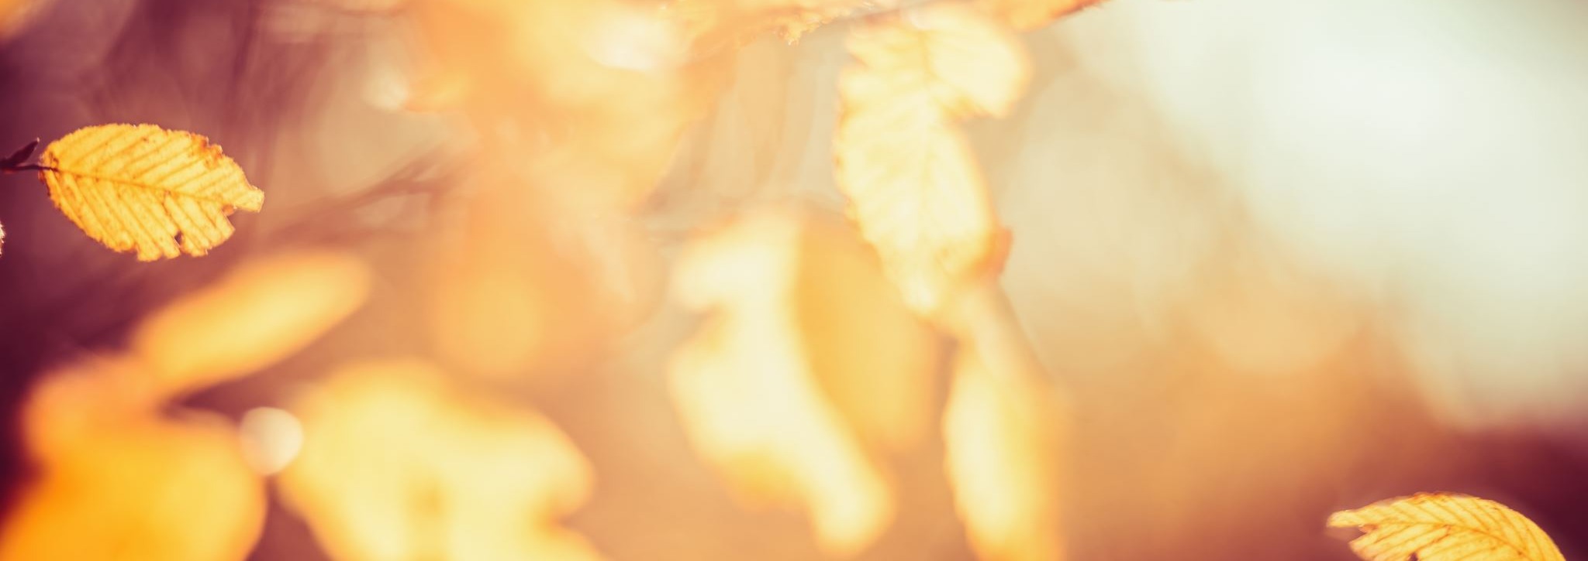
Stefani Ivanova

Slide 2
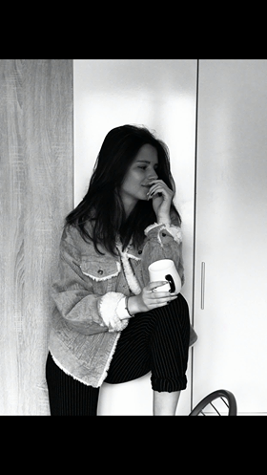
My photos

Slide 3
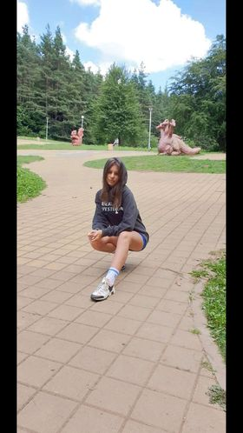
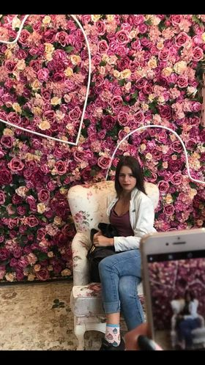
My photos

Slide 4
About me...
I'm Stefani and I'm seventeen.In my free time I spend time with friends. But one of my favorite activities is skating. Also in my free time I read books or watch movies that are science fiction. My favorite book is "Сами" by Michael Grand. The thing I don't like most about people is that they don't take personal responsibility. and that they have no goals and desires for what their future will be.

