Slide 1
Presentation about myself ☺

Slide 2
General information and education
Hello! My name is Daria Levi and I’m a 15-year-old from Sofia, Bulgaria. I’m a student in 134th school “Dimcho Debelyanov”, which is located near the center of the city.

Slide 3
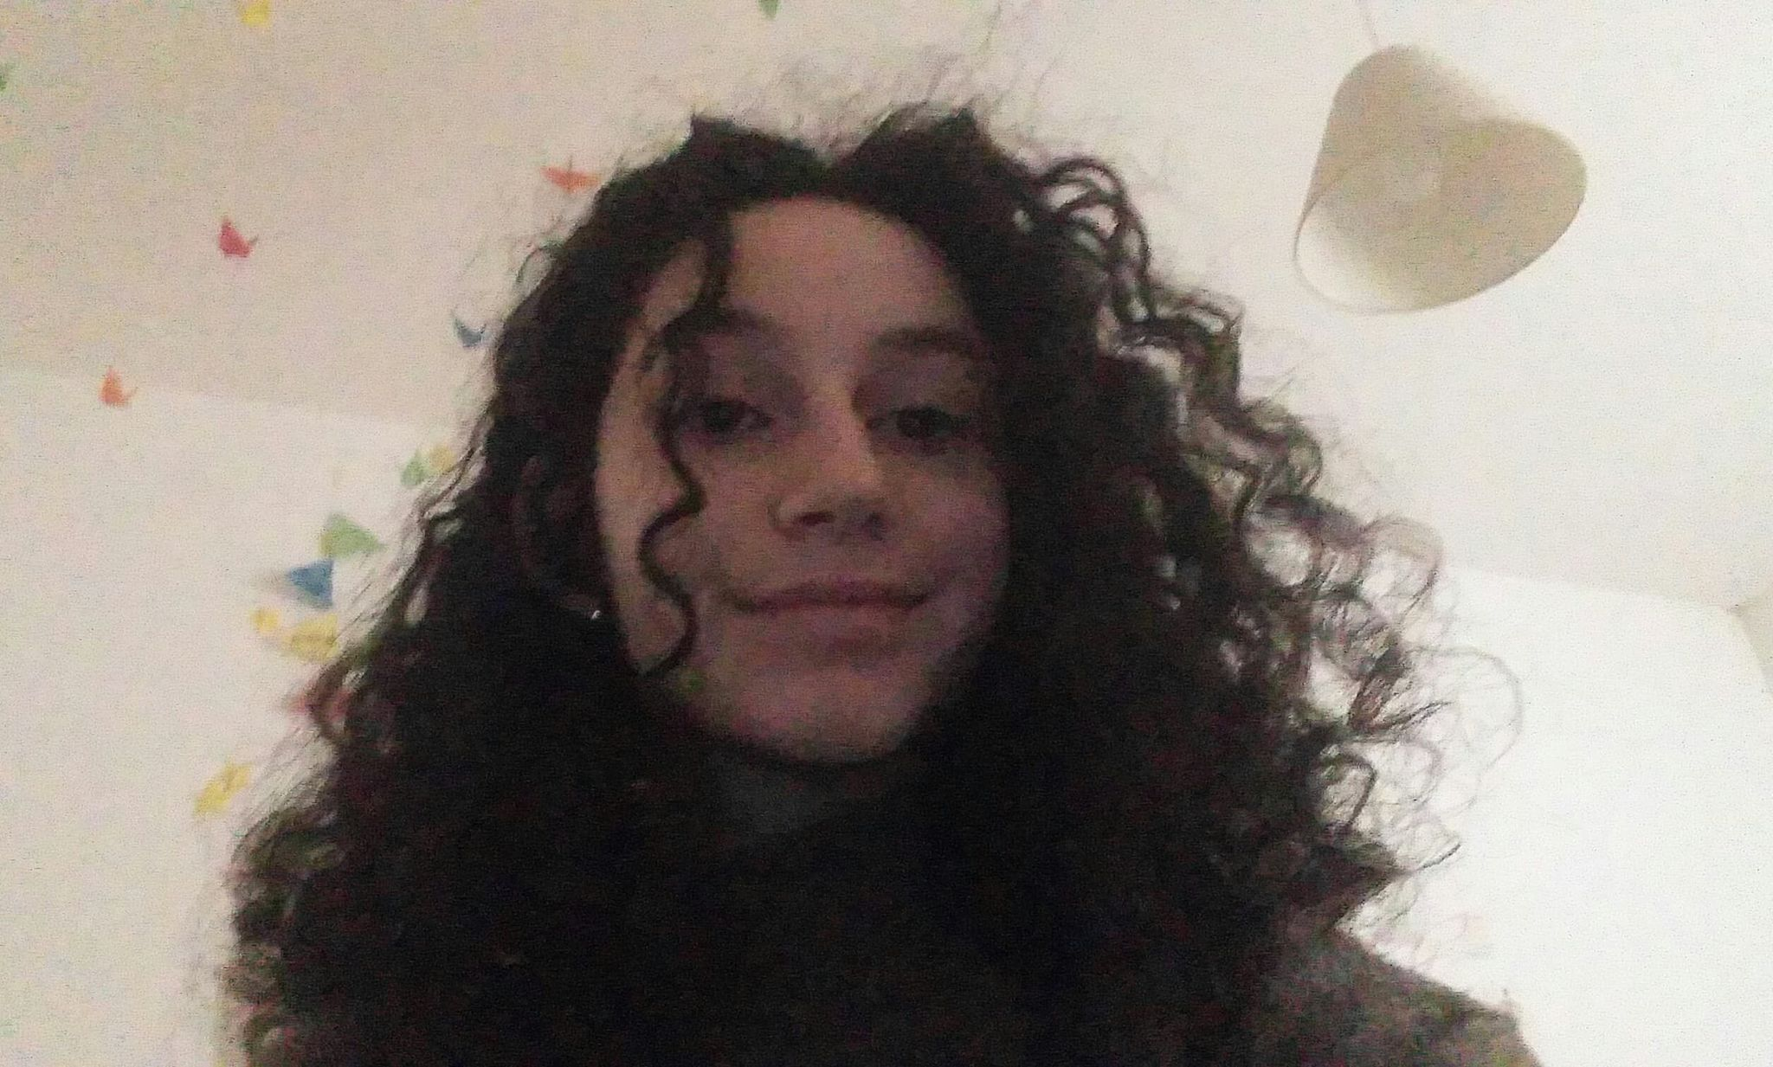
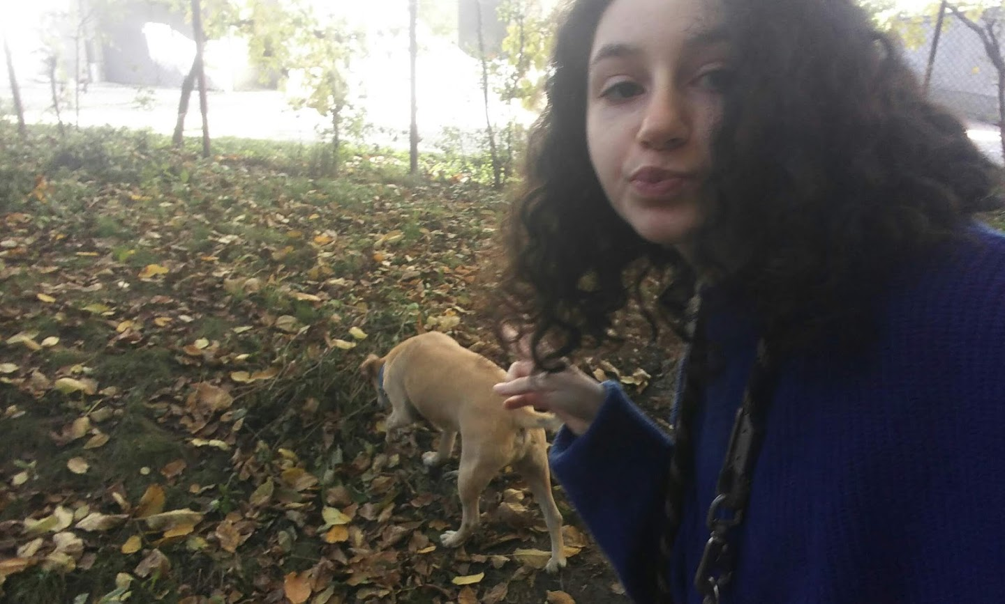
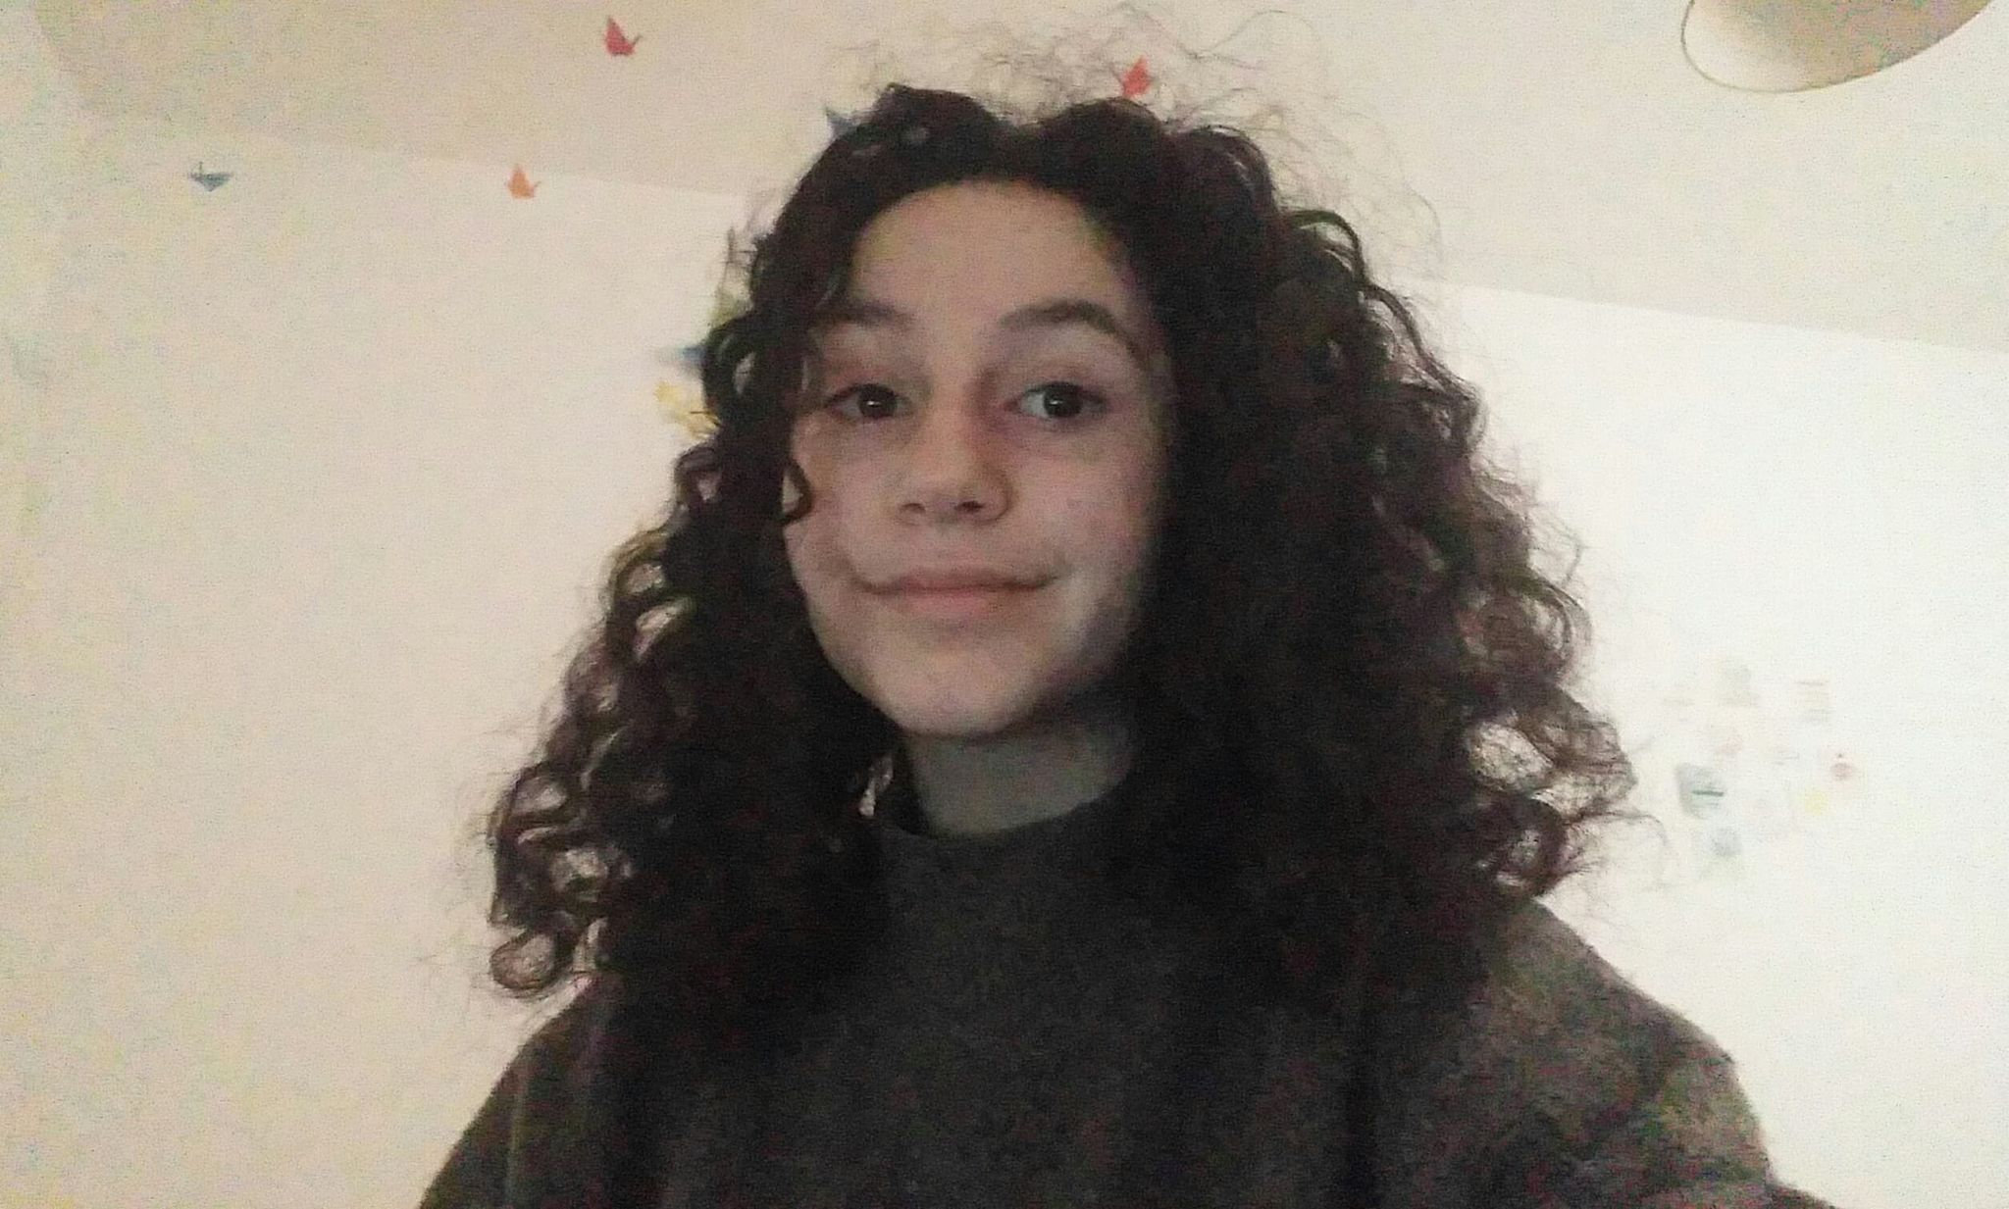
This is me!
Me and my pets
Me right now making this presentation

Slide 4
My hobbies
I have a lot of hobbies, but in my free time I usually like to draw, listen to (or even make) music, play games with my friends or just chill with my pets and watch a movie

Slide 5
My likes
choosing a favorite movie or book is a bit difficult for me since I consume a lot of media on a daily basis, so but if I had to make a decision I would say my favorite movie is Forrest Gump, and my favorite book is Life of Pi.

Slide 6
My dislikes
The thing I dislike the most about other people is close-mindedness and ignorance – I don’t like it when people have preconceived notions about things they’re not well-educated about

Slide 7
Thank you for your attention and I hope you enjoyed my presentation!

