Slide 1
My name is Kirila Kirilova Yovcheva, 11th grade and I am at the age of 17. I am currently studying in 134CY "Dimco Debelyanov", in the capitol - "Sofia". My main subjects are biology and chemistry.
I want to apply for medicine studies and I want to improve and grow in the branch of phytotherapy.
My dream is to help and cure people with natural medicines in order to lower the risks of any side effects that may occur from the treatment.

Slide 2
In my free time, I love drawing, listening to music and taking walks in the nature. My favourite movie is "Znachor" because I think that everyone can forget who he is and where he comes from but he can never forget his calling as a doctor.
I do not approve of violence and arrogance. I also, do not accept racism and people who are not tolerant towards the other kinds of people.

Slide 3
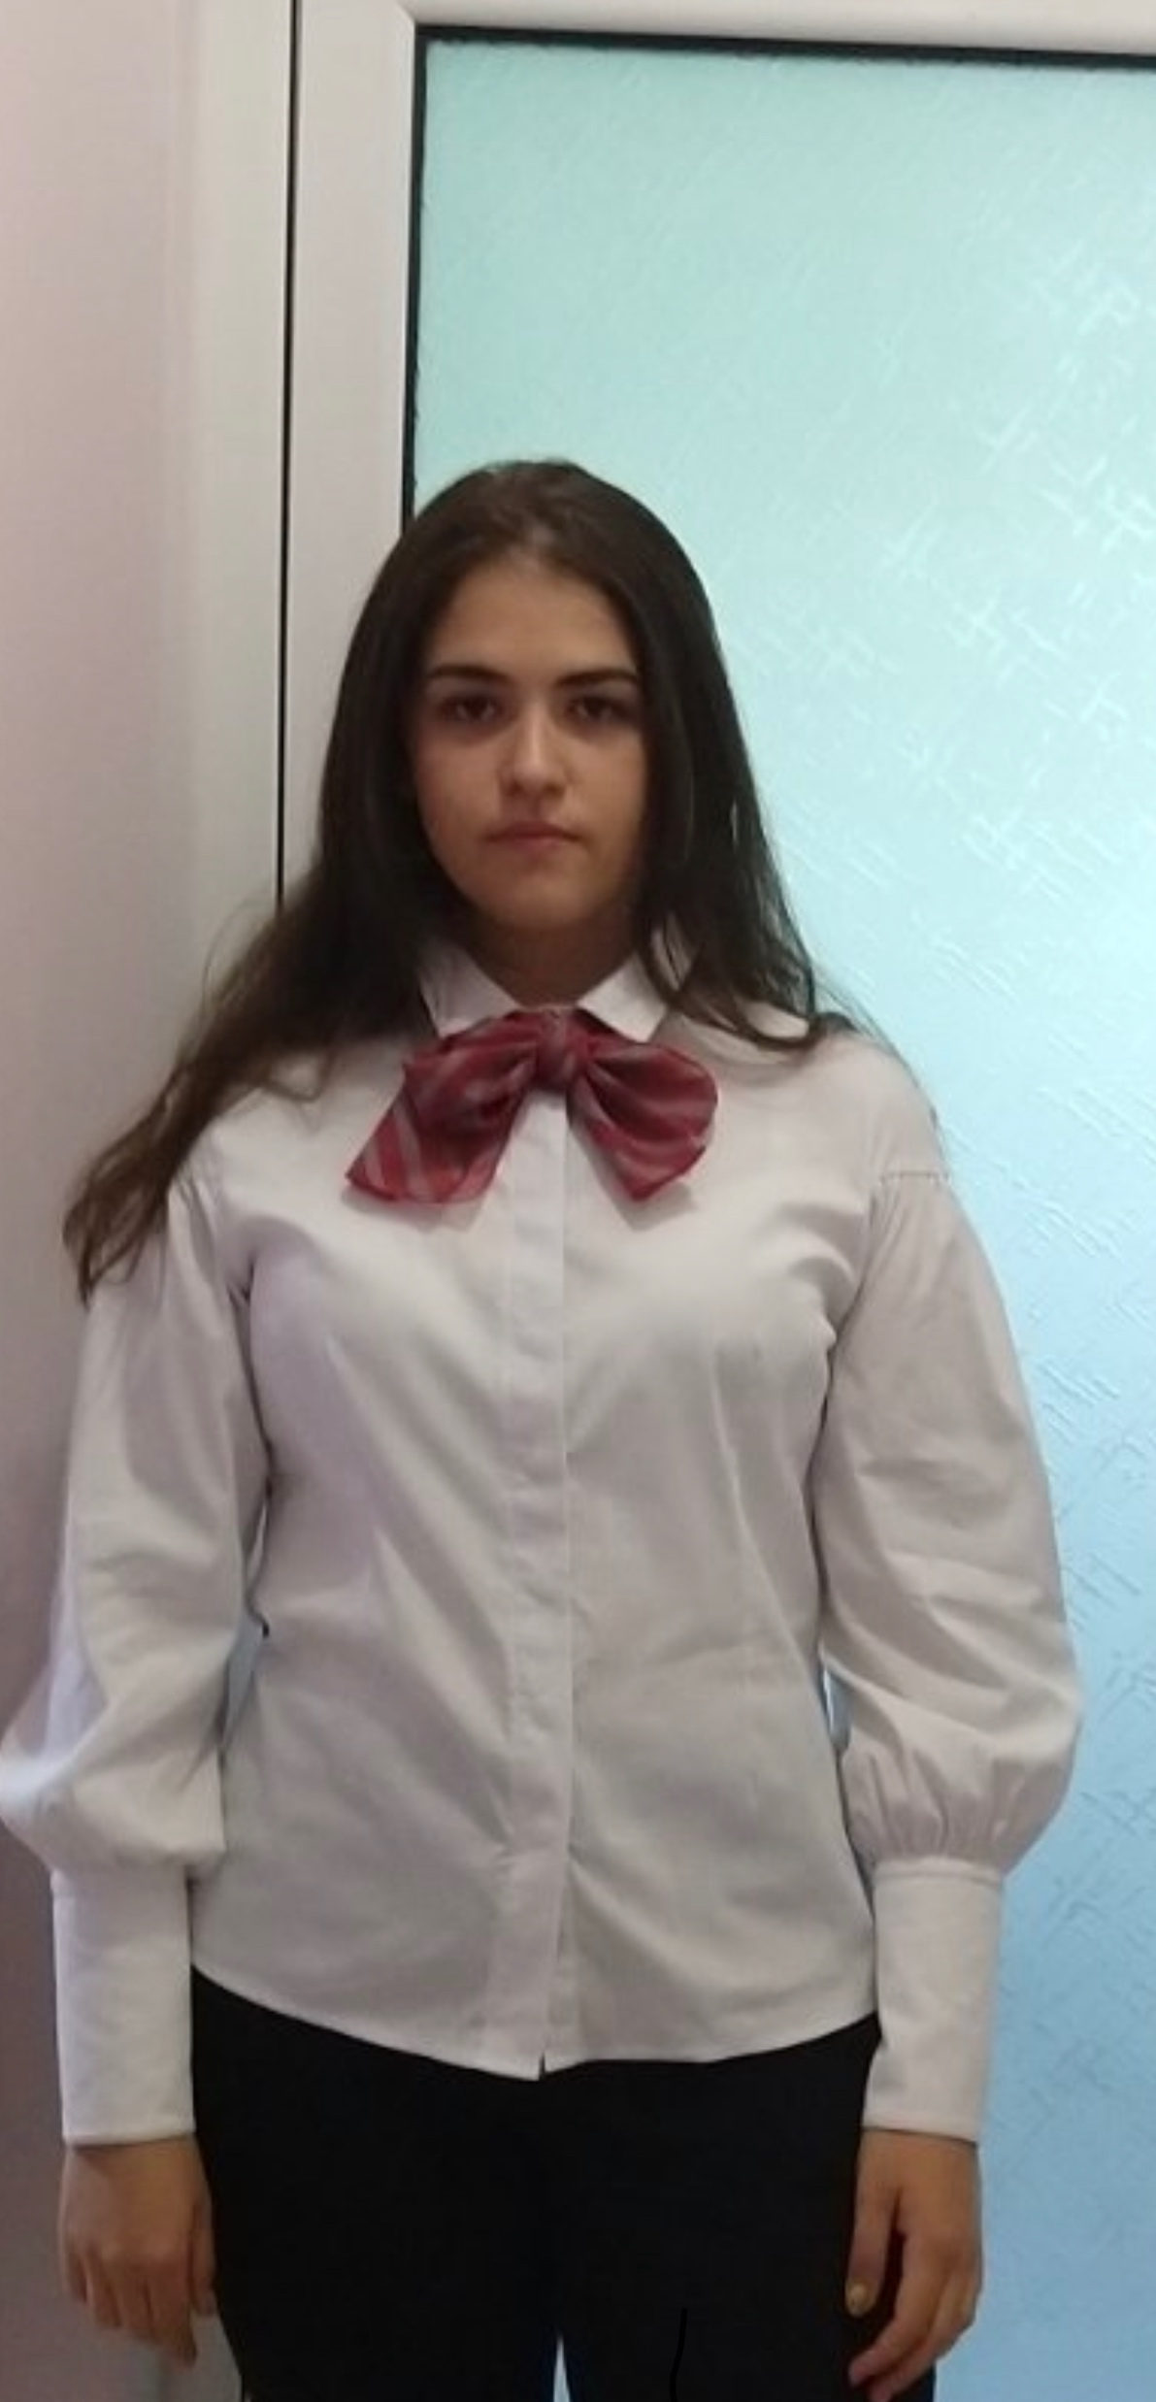
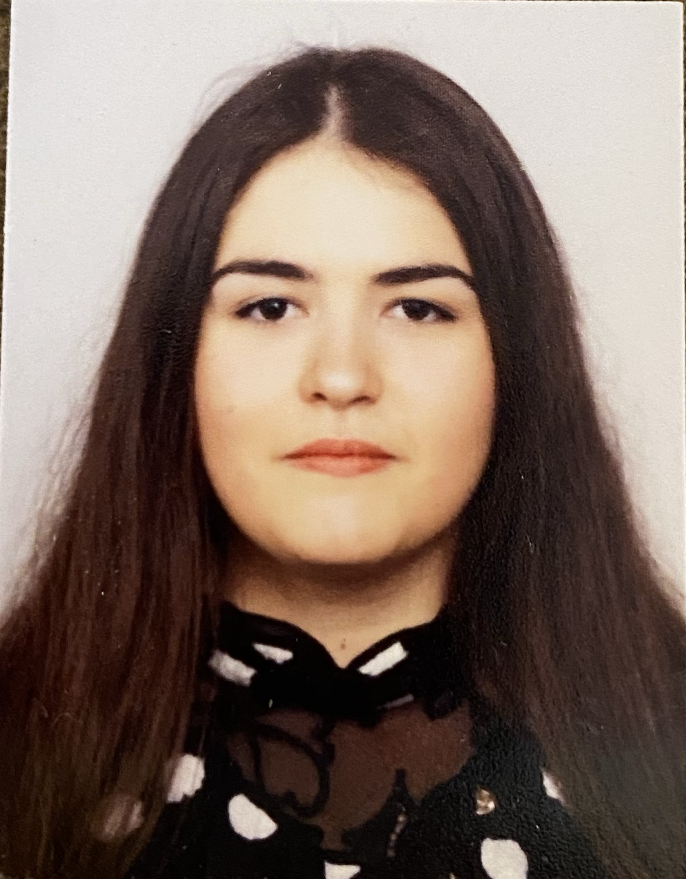
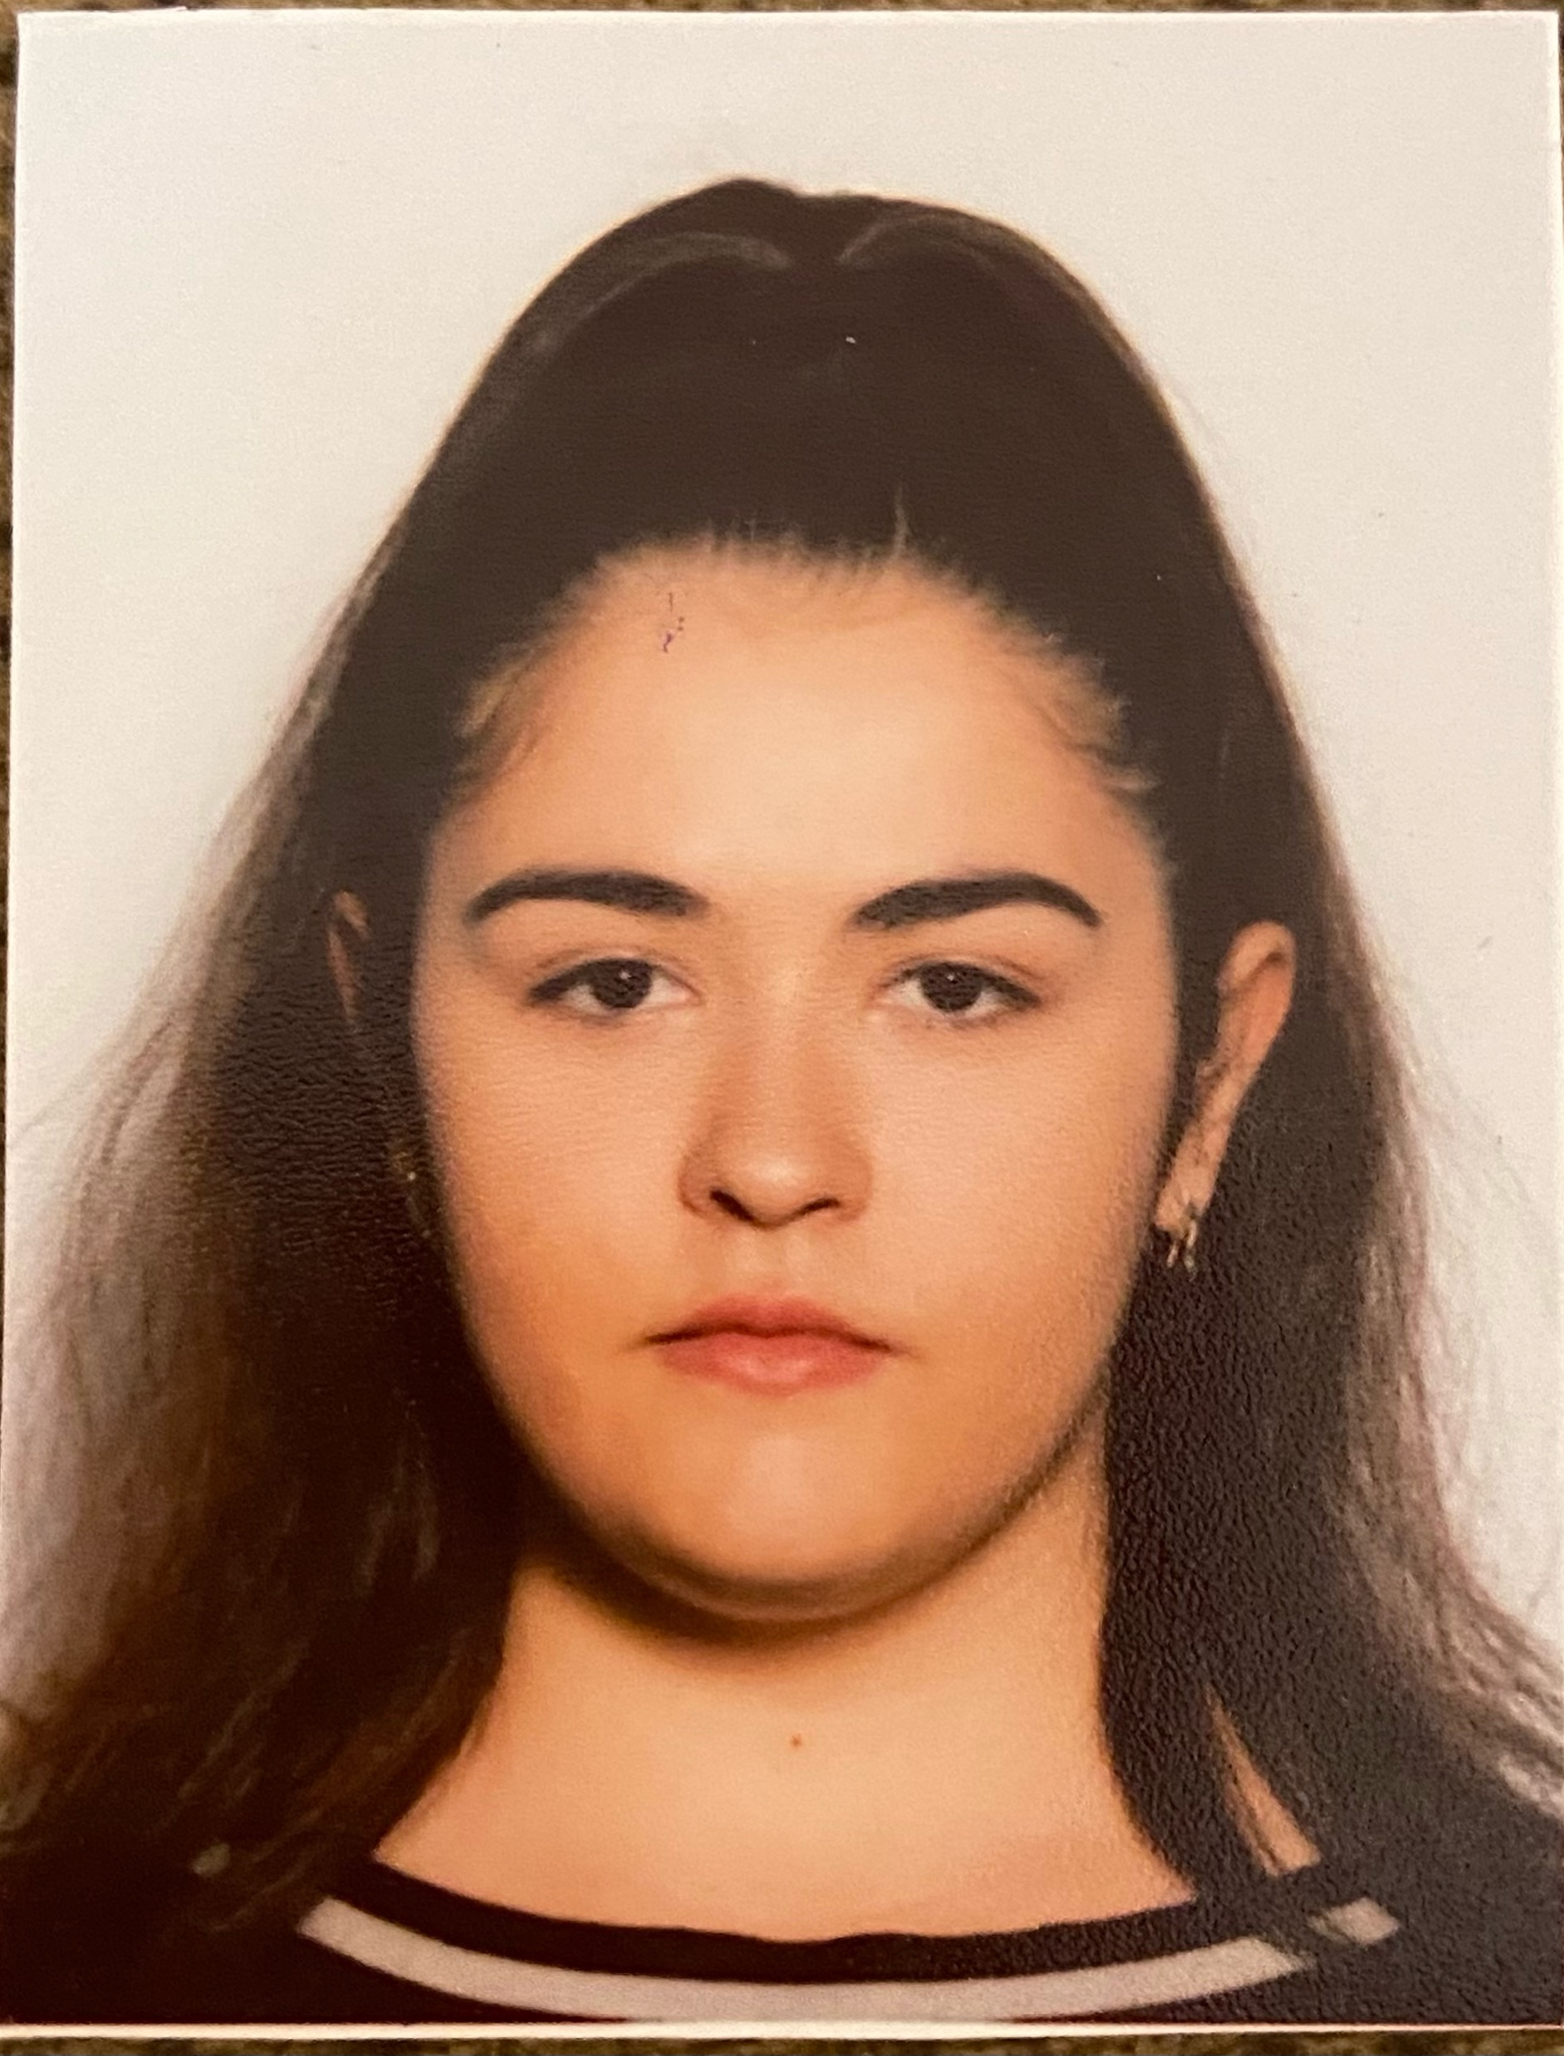
Thank you for your attention!

