Slide 1
Who am I
Daniela Zheleva

Slide 2
You may be wondering who is this smiley girl... Hi, my name is Daniela Zheleva. I'm 16 and I'm from Bulgaria. I live in Sofia, which is the capital of the state.
I am one of the participants in the Plant Biodiversity project this year and I'm very excited to see what we can do together.

Slide 3
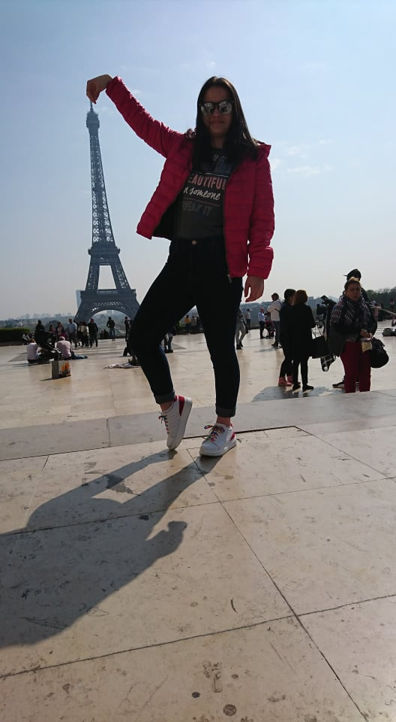
If we take vacations for free time I would say that I love traveling. My family and I travel to a different country every year. I've visited many cities but I liked Paris the most. The people and the atmosphere were very nice.

Slide 4
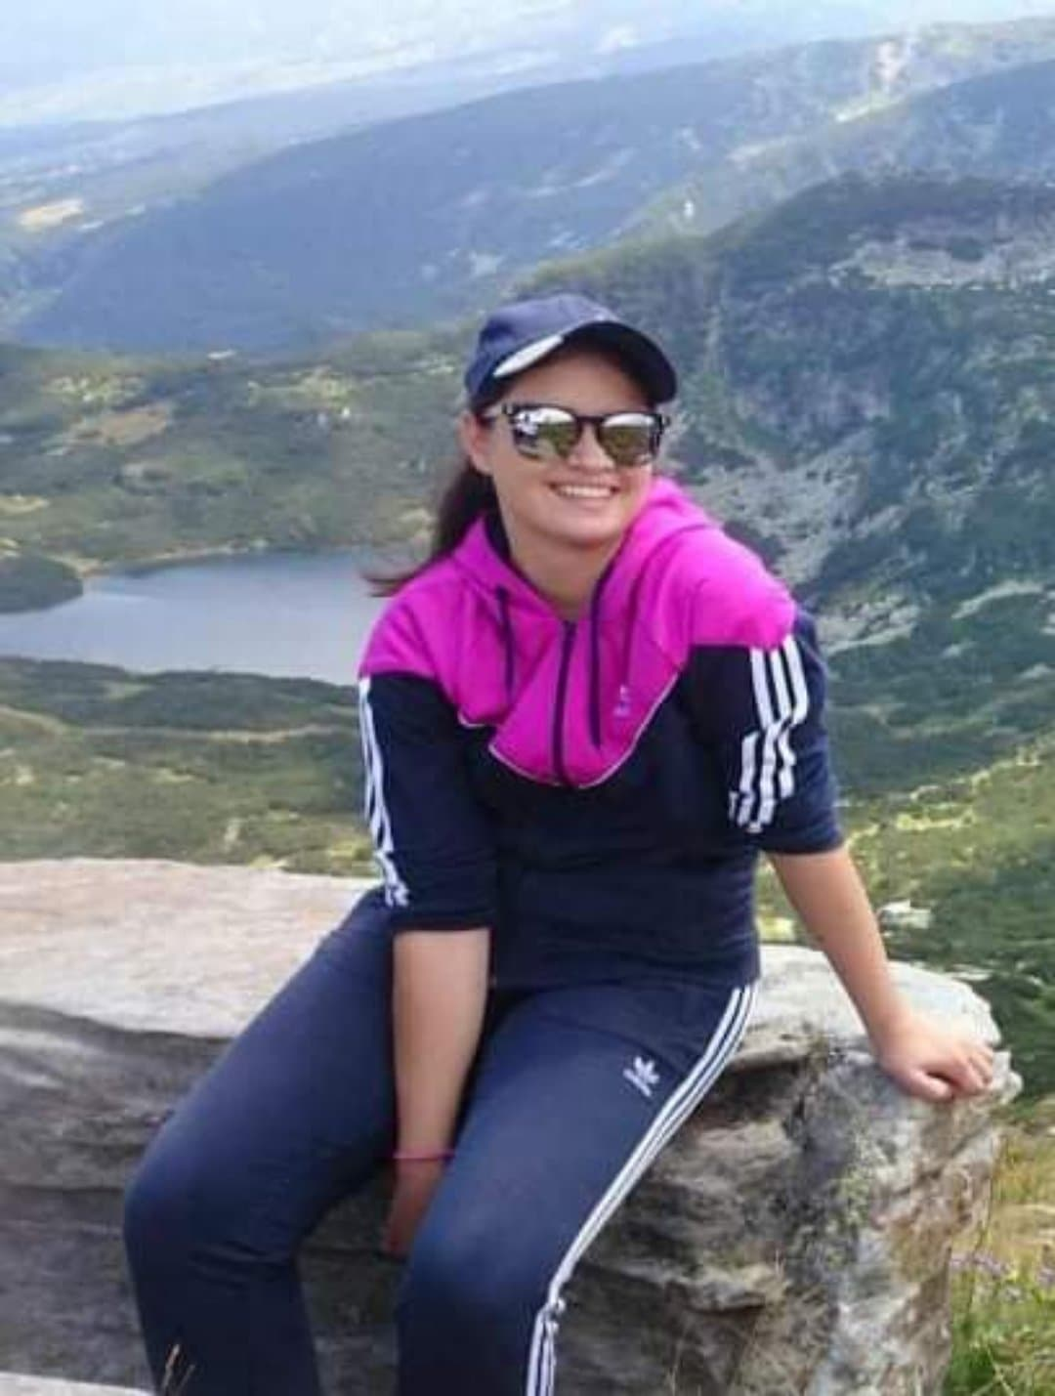
In my free time I sometimes watch movies or listening to music depending on my mood. My favorite move is Lion King. It might sound stupid but I'm really into animations. Although I really like romantic movies so I always have something to watch. Again it's depending on my mood.

Slide 5
In general I try to see the good in people but I also find things that I don't like at all. I find it irresponsible not to care about the environment. I know this topic is very popular these days but it still fails to awaken people and show them that they need not words but actions. Most people say how much they care about our planet but do nothing to protect it .

Slide 6
I like spending time with my friends and family. My family is very important part of my life. I'm the type of person who relies heavily on my family. I have a twin brother which makes me kind of calm that no matter what I have someone by my side.

Slide 7
Тhanks for your Attention

