Slide 1
BE THE CHANGE
№ 2017-1-NO01-KA219-034143_5
COMPREHENSIVE SCHOOL”ST. ST. CYRIL AND METHODIUS”
SMOLYAN, BULGARIA

Slide 2
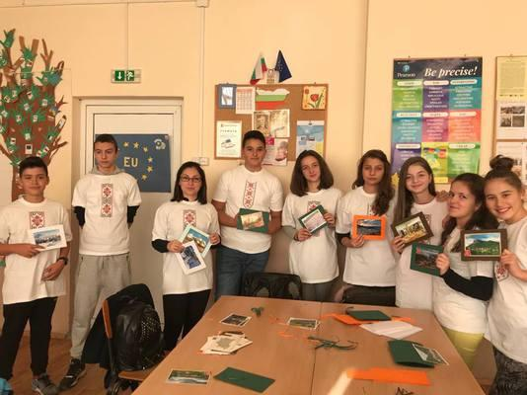
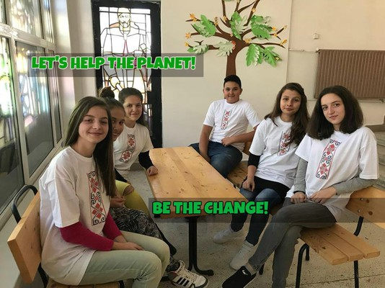
SEPTEMBER 2017
CREATING SCHOOL CLUB ”BE THE CHANGE”
FIRST SCHOOL MEETING

Slide 3
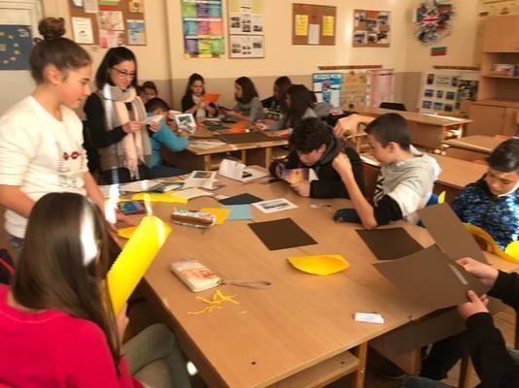
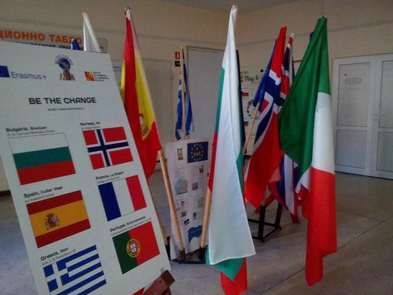
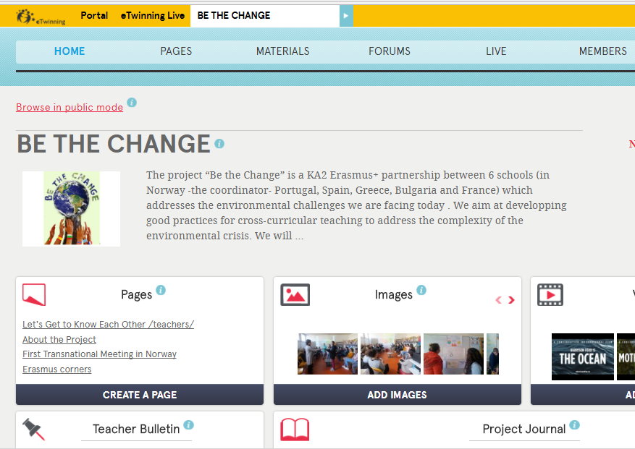
OCTOBER 2017
REGISTRATING IN TWINSPACE “BE THE CHANGE”
REFRESHING EUROPEAN CORNER AT SCHOOL
PREPARING POSTCARDS FOR EUROPEAN FRIENDS

Slide 4
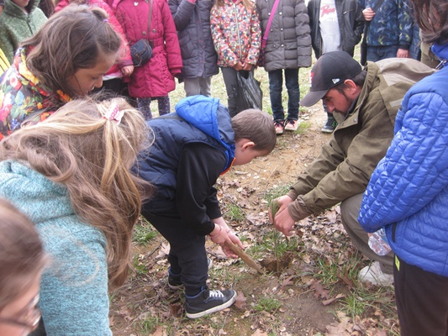
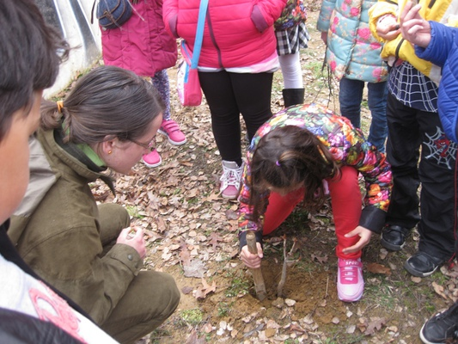
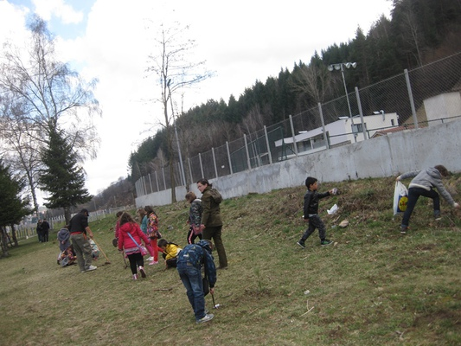
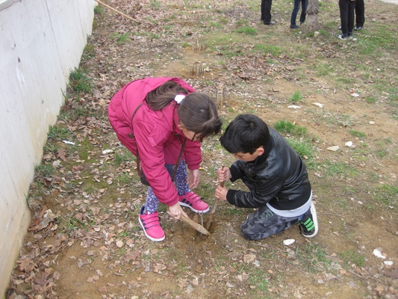
OCTOBER 2017 - EXPERIENCES IN NATURE
GREEN ACTIVITIES WITH STUDENTS FROM 3th GRADE

Slide 5
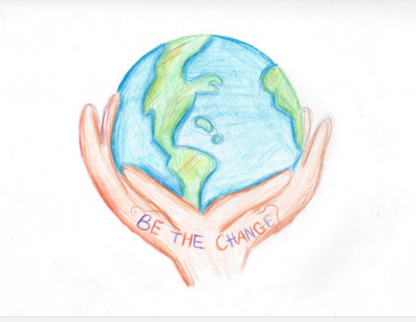
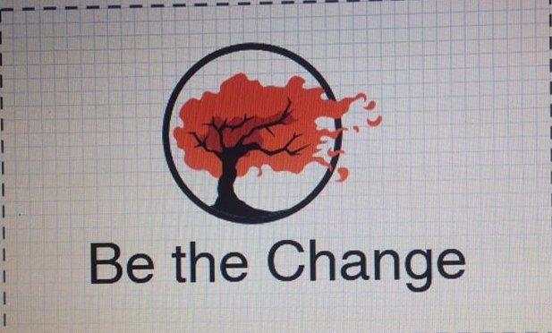
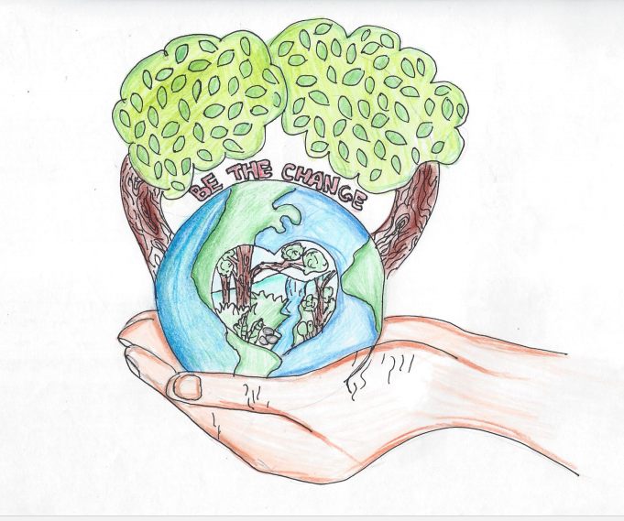
NOVEMBER 2017
LOGO COMPETITIONS

Slide 6
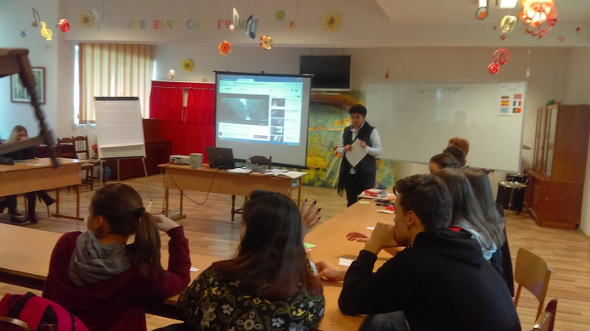
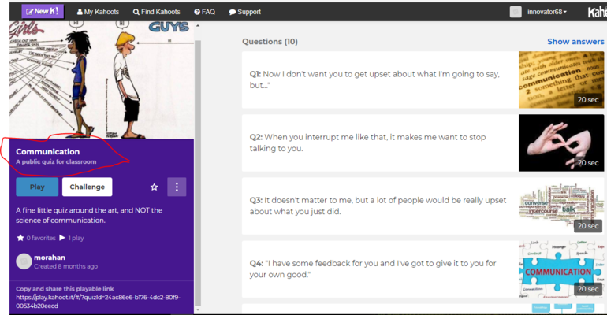
NOVEMBER 2017
PHILOSOPHICAL DIALOGUE “WHAT MAKES A GOOD COMMUNICATION?”

Slide 7
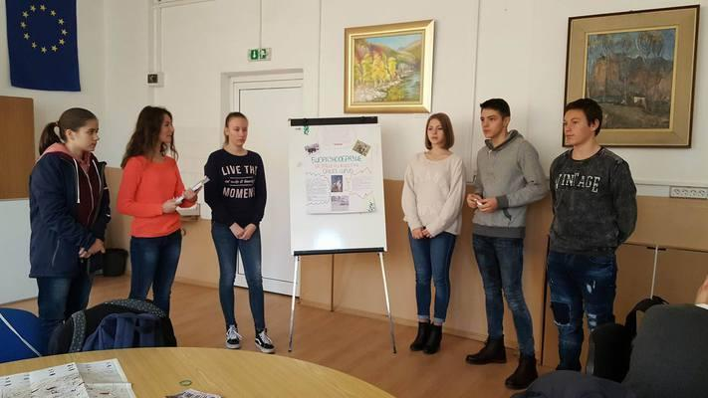
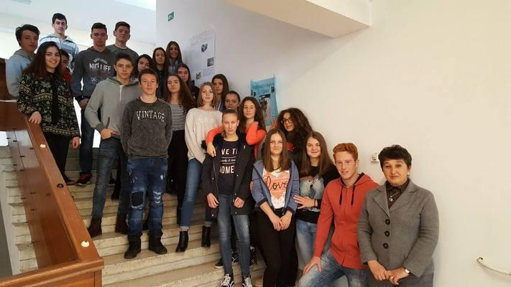
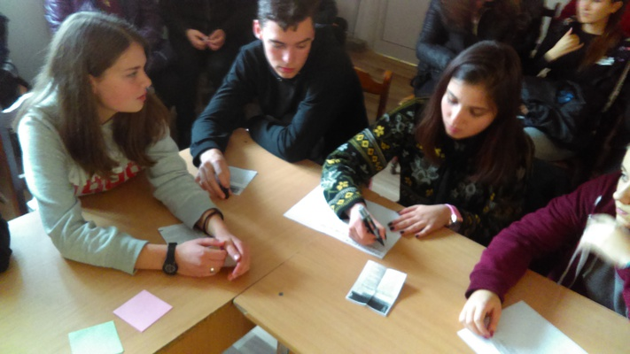
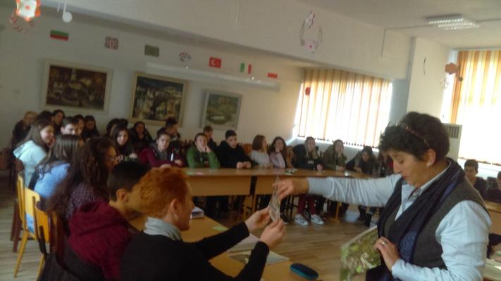
NOVEMBER 2017
CROSS-CURRICULAR LESSON “BIODIVERSITY” - STUDENTS FROM 9th GRADE

Slide 8
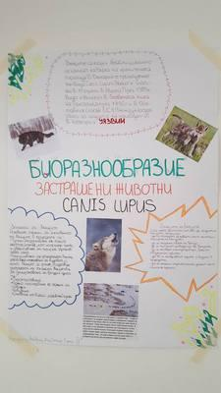
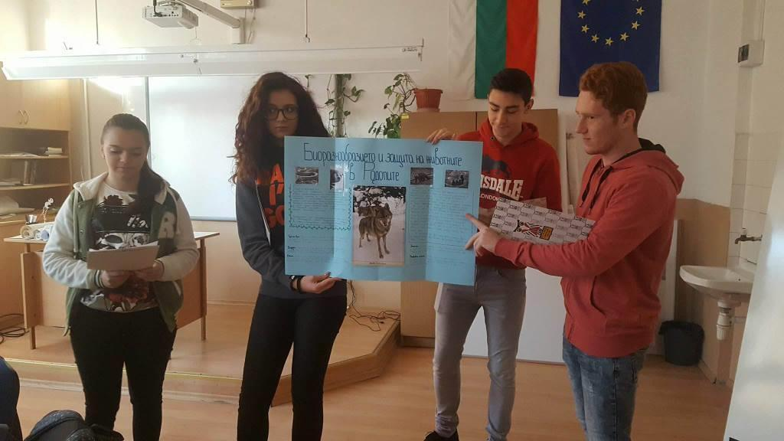
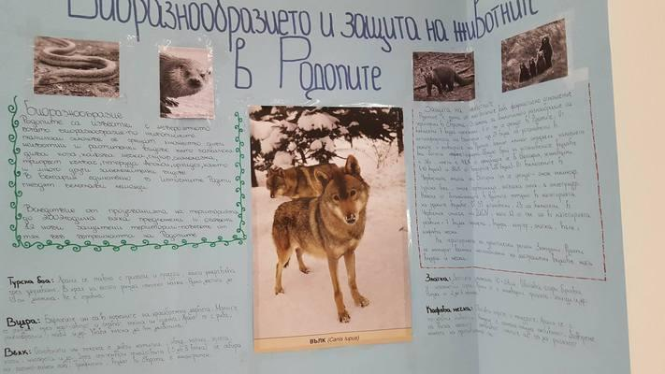
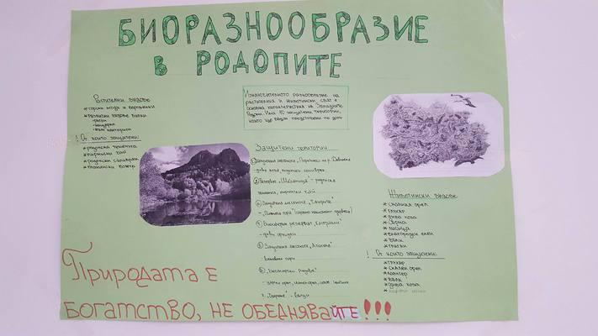
NOVEMBER 2017
“MAKER SPACE” - “BIODIVERSITY”

Slide 9
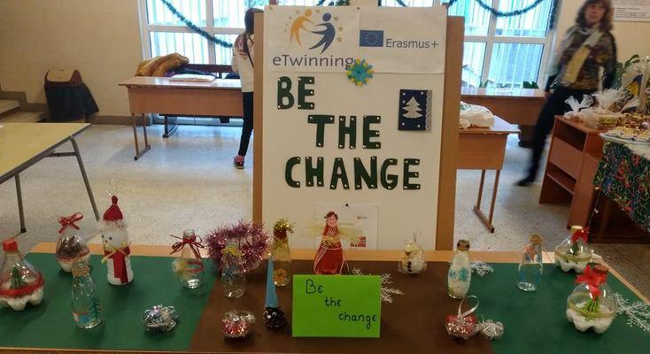
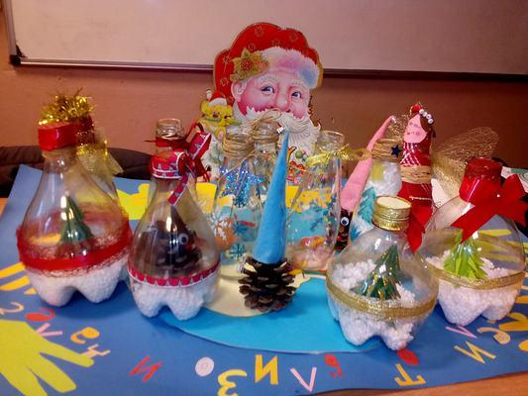
DECEMBER 2017
“MAKER SPACE” - CREATING CHRISTMAS DECORATING FROM RECYCLE MATERIALS

Slide 10
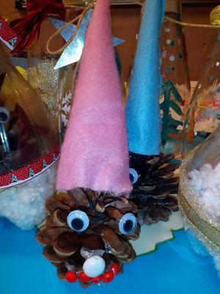
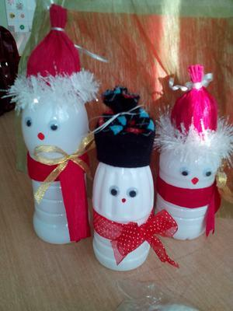
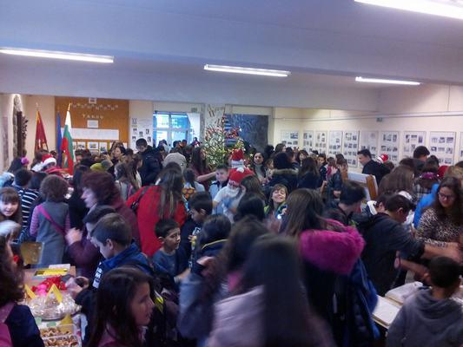
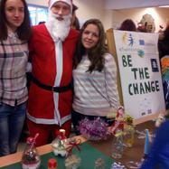
DECEMBER 2017
ORGANIZING A CHRISTMAS CHARITY BAZZAR

Slide 11
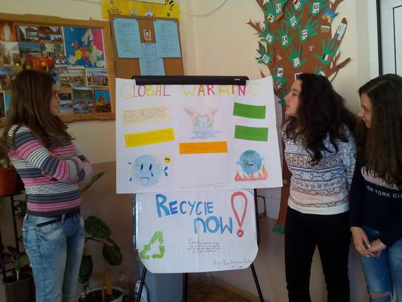
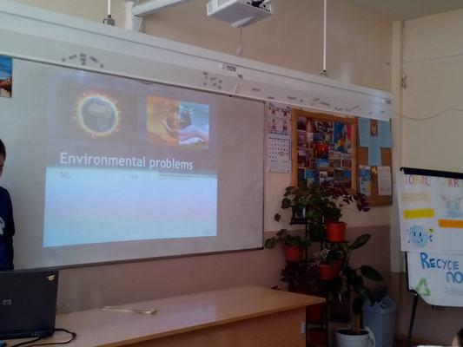
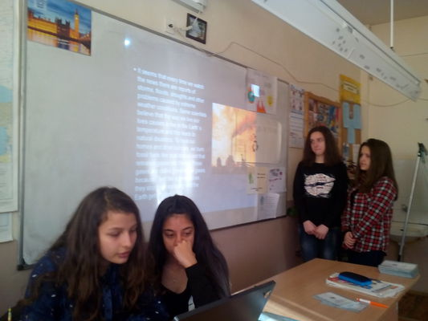
JANUARY 2018
CROSS-CURRICULAR LESSONS “ENVIRONMENTAL PROBLEMS” - 7th grade

Slide 12
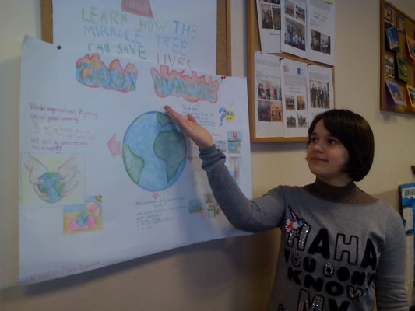
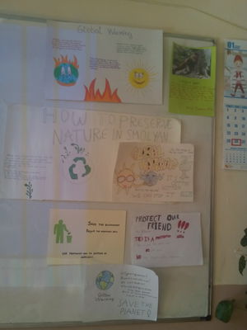
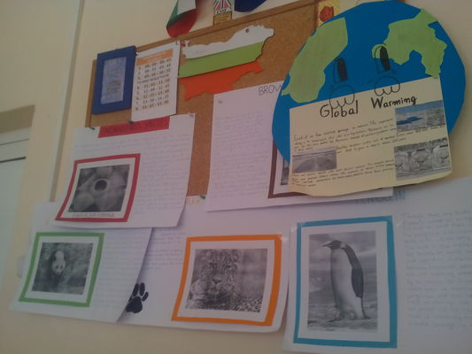
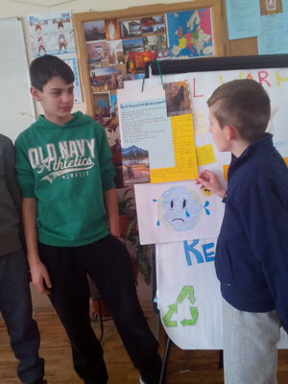
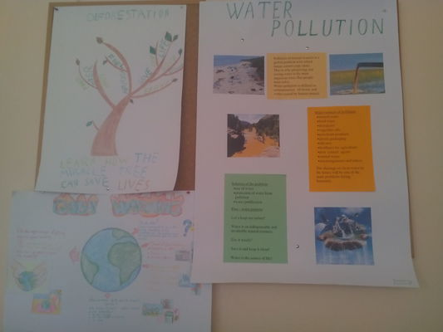
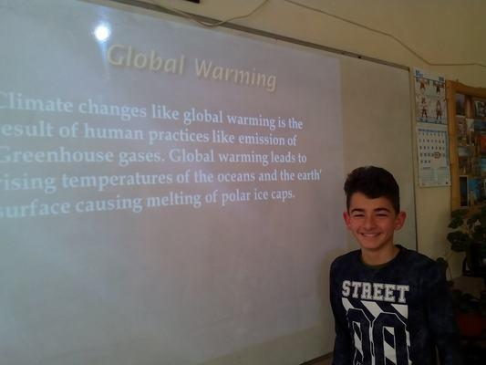
JANUARY 2018
“ENVIRONMENTAL PROBLEMS” - POSTERS, PRESENTATIONS, LEAFLETS

Slide 13
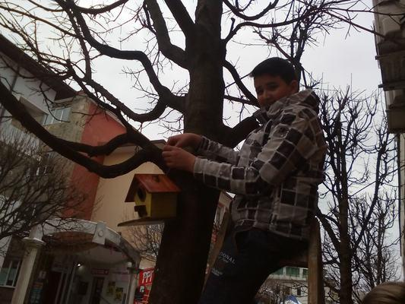
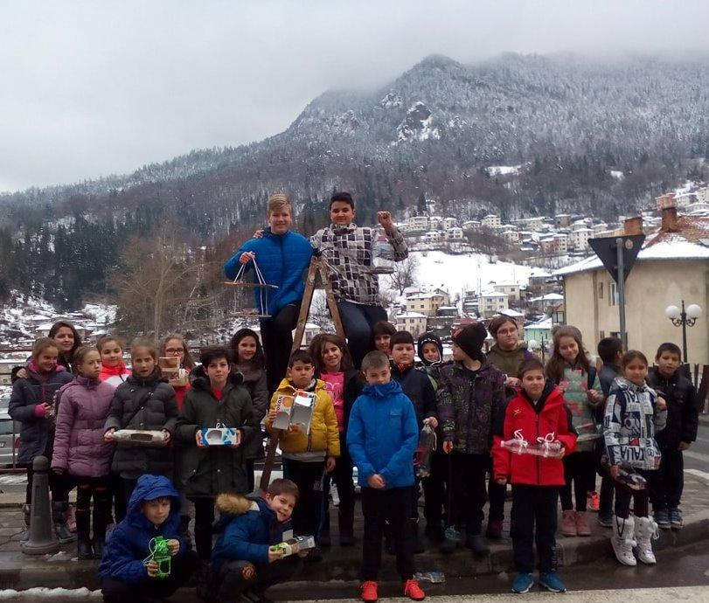
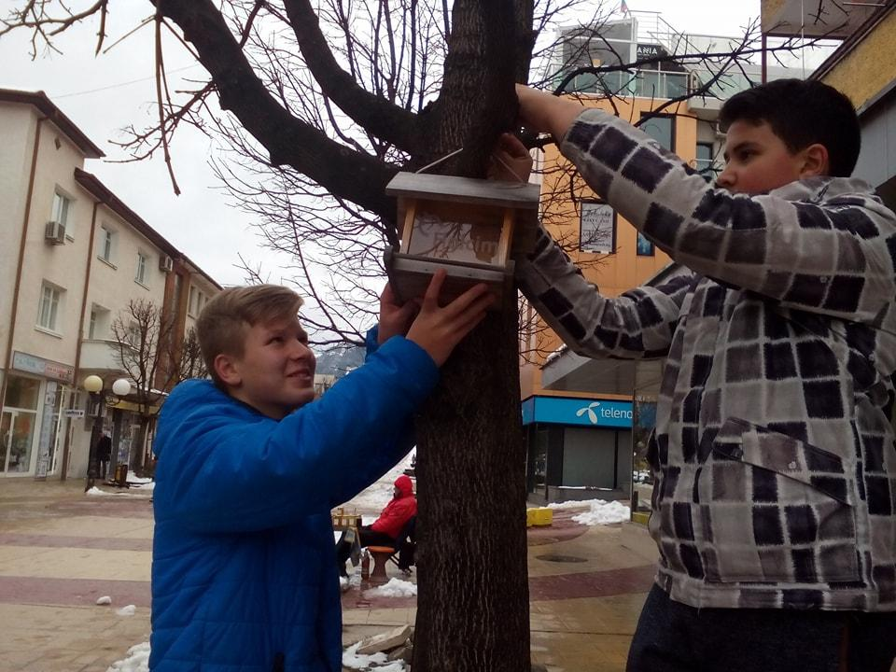
FEBRUARY 2018
EXCPERIENCE IN NATURE - CREATING BIRDS’ FEEDERS

Slide 14
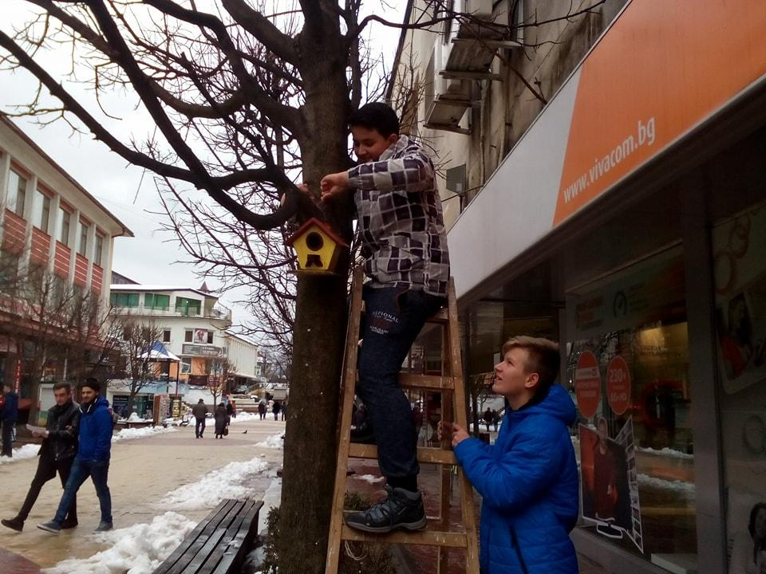
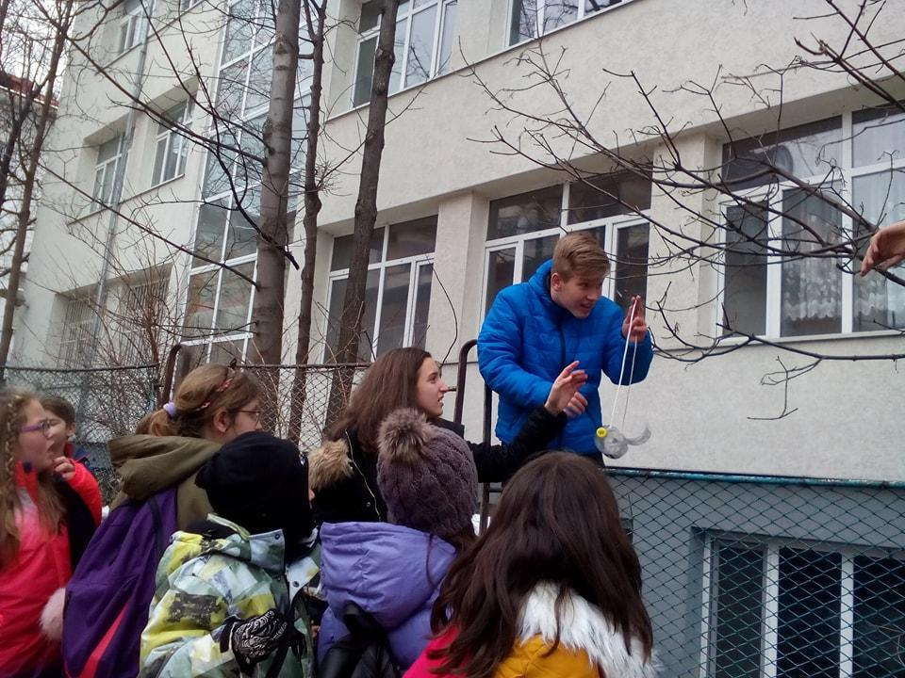
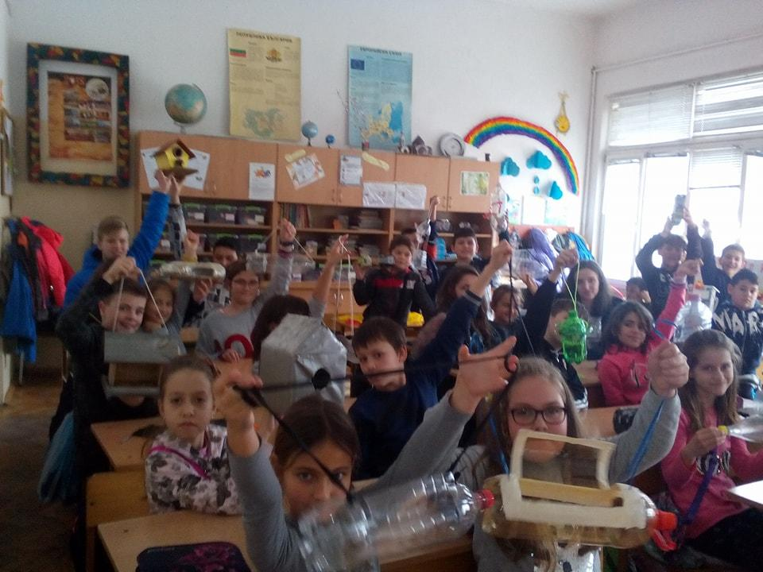
FEBRUARY 2018
LOVE NATURE - HELP BIRDS!

Slide 15
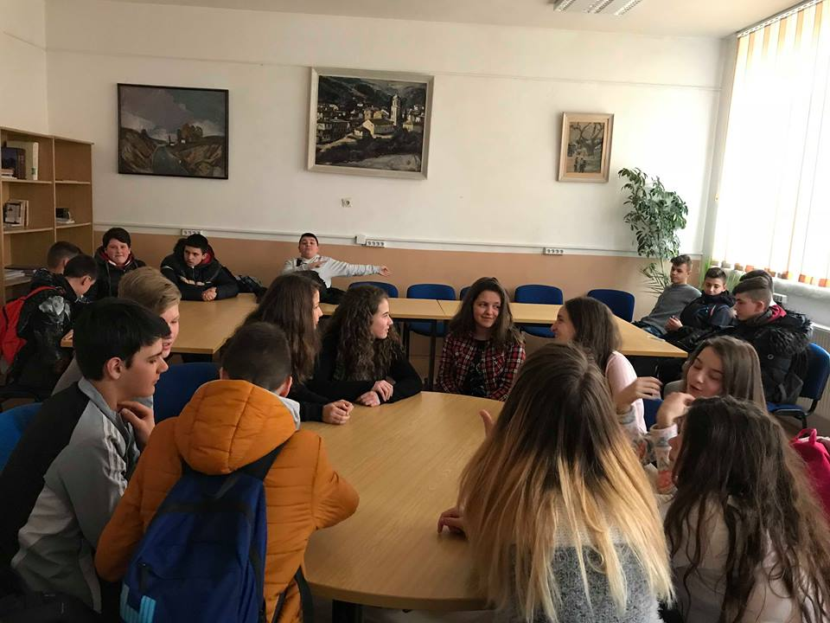
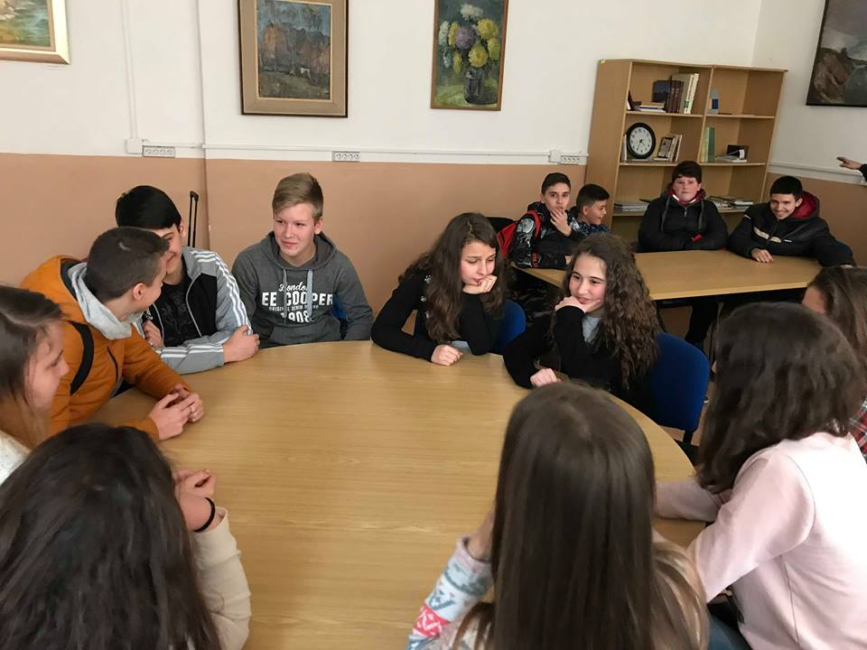
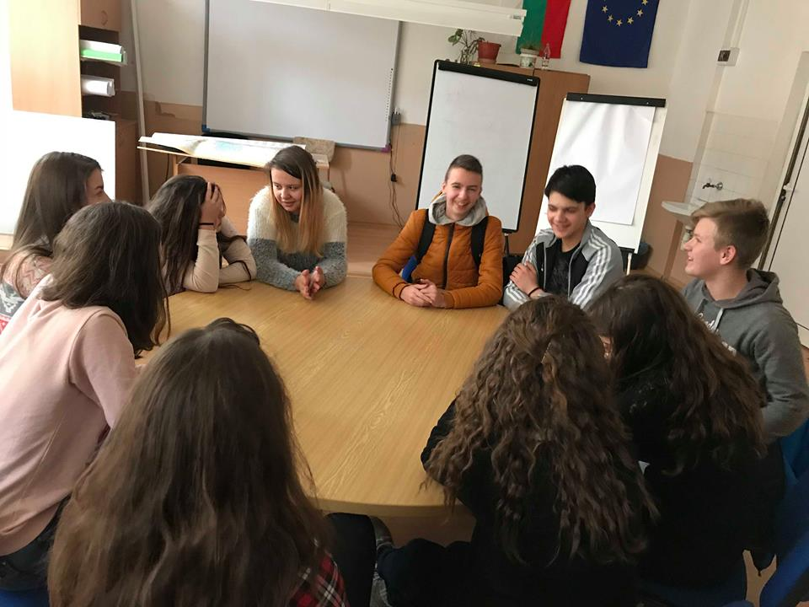
FEBRUARY 2018
PHILOSOPHICAL DIALOGUE - “WHAT DOES IT MEAN TO BE RESPONSIBLE”; “WHAT IS MY RESPONSIBLITY”

Slide 16
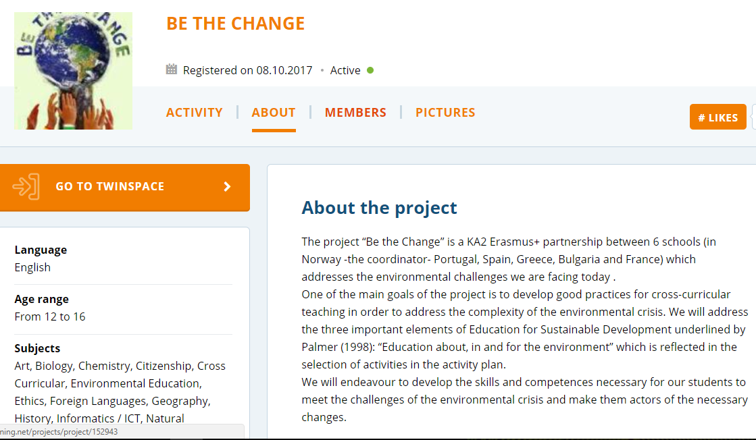
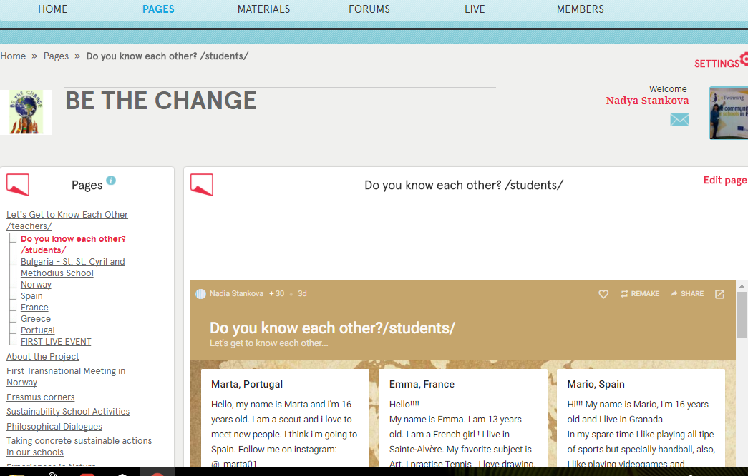
eTwinning Live - TwinSpace
Notes:
All our results we upload on the TwinSpace as well, we created Live Eent. It was exciting to communicate each other.

Slide 17
BE THE CHANGE
№ 2017-1-NO01-KA219-034143_5
THANK YOU FOR YOUR
ATTENTION!
Aleksandra, Djesika, Stanislav, Daniel and Vasil
COMPREHENSIVE SCHOOL”ST. ST. CYRIL AND METHODIUS” - SMOLYAN, BULGARIA

