Slide 1
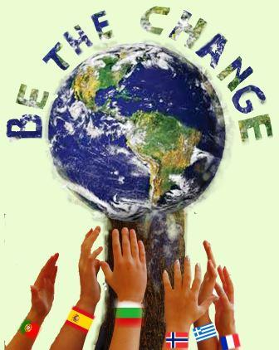
Be the Change
Educating for sustainable living and citizenship

Slide 2
“Be the Change”...
...you want to see in the world (Gandhi)
Erasmus Plus 2017-2019
6 European countries (Spain, Portugal, France, Bulgaria, Greece, Norway)
“Be the Change” addresses the environmental challenges we are facing today and the need for united cooperation in order to develop more sustainable life practices. The main objective is to develop and enhance cross-curricular teaching and learning practices that promotes the development of democratic and intercultural competences as well as increased environmental awareness and entrepreneurship.

Slide 3
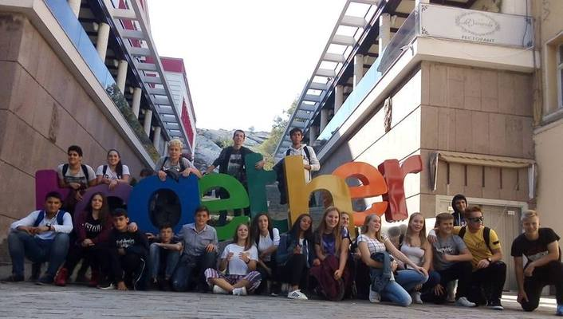
Empowering students - to ignite a spark!
International Cooperation (an elective 8-10th grade): Simen, Sandrica, Trygve + 50 others
“Leading the Way” at Ås ungdomsskole
A whole school project
An international project
“Citizen of the World”

Slide 4
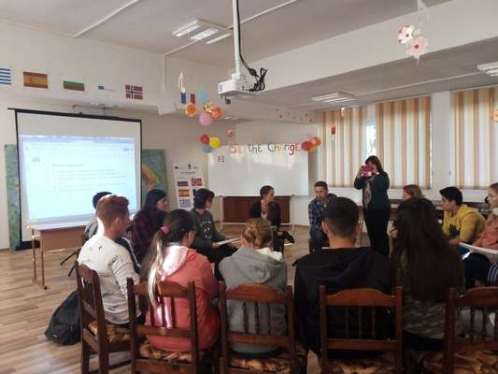
Philosophical Dialogue
Exploring core concepts: Responsibility, Respect, Happiness, Nature, Hope
A community of Enquiry: Collaborative, caring, critical, creative thinking (P4C-method)
Motivational:
“It makes me want to do something about it”
Bringing thinking into being - taking action

Slide 5
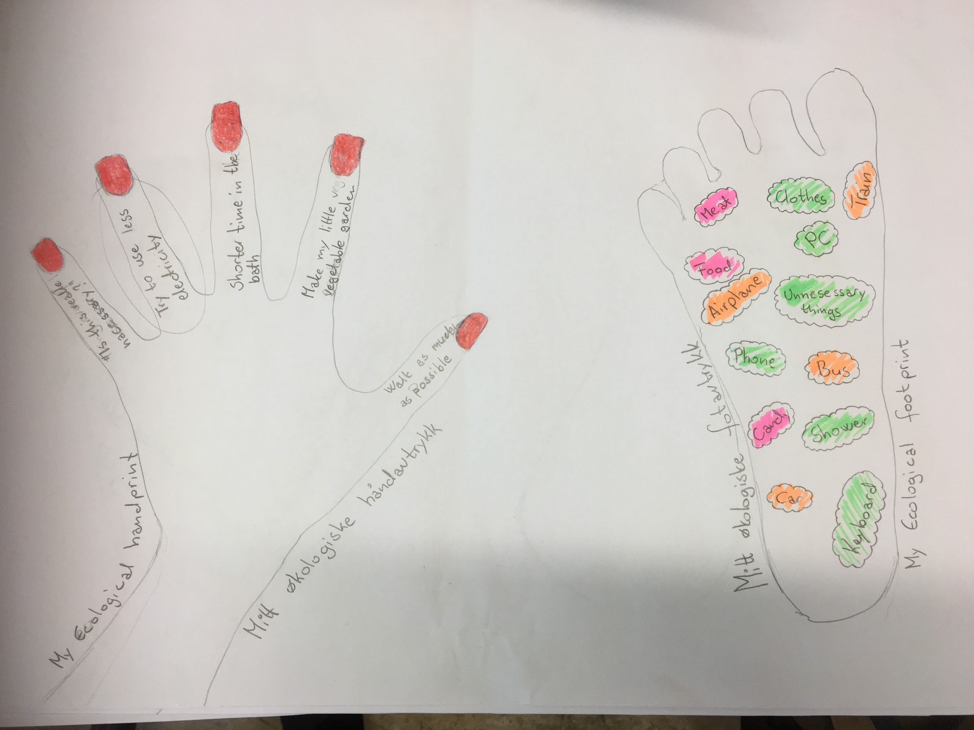
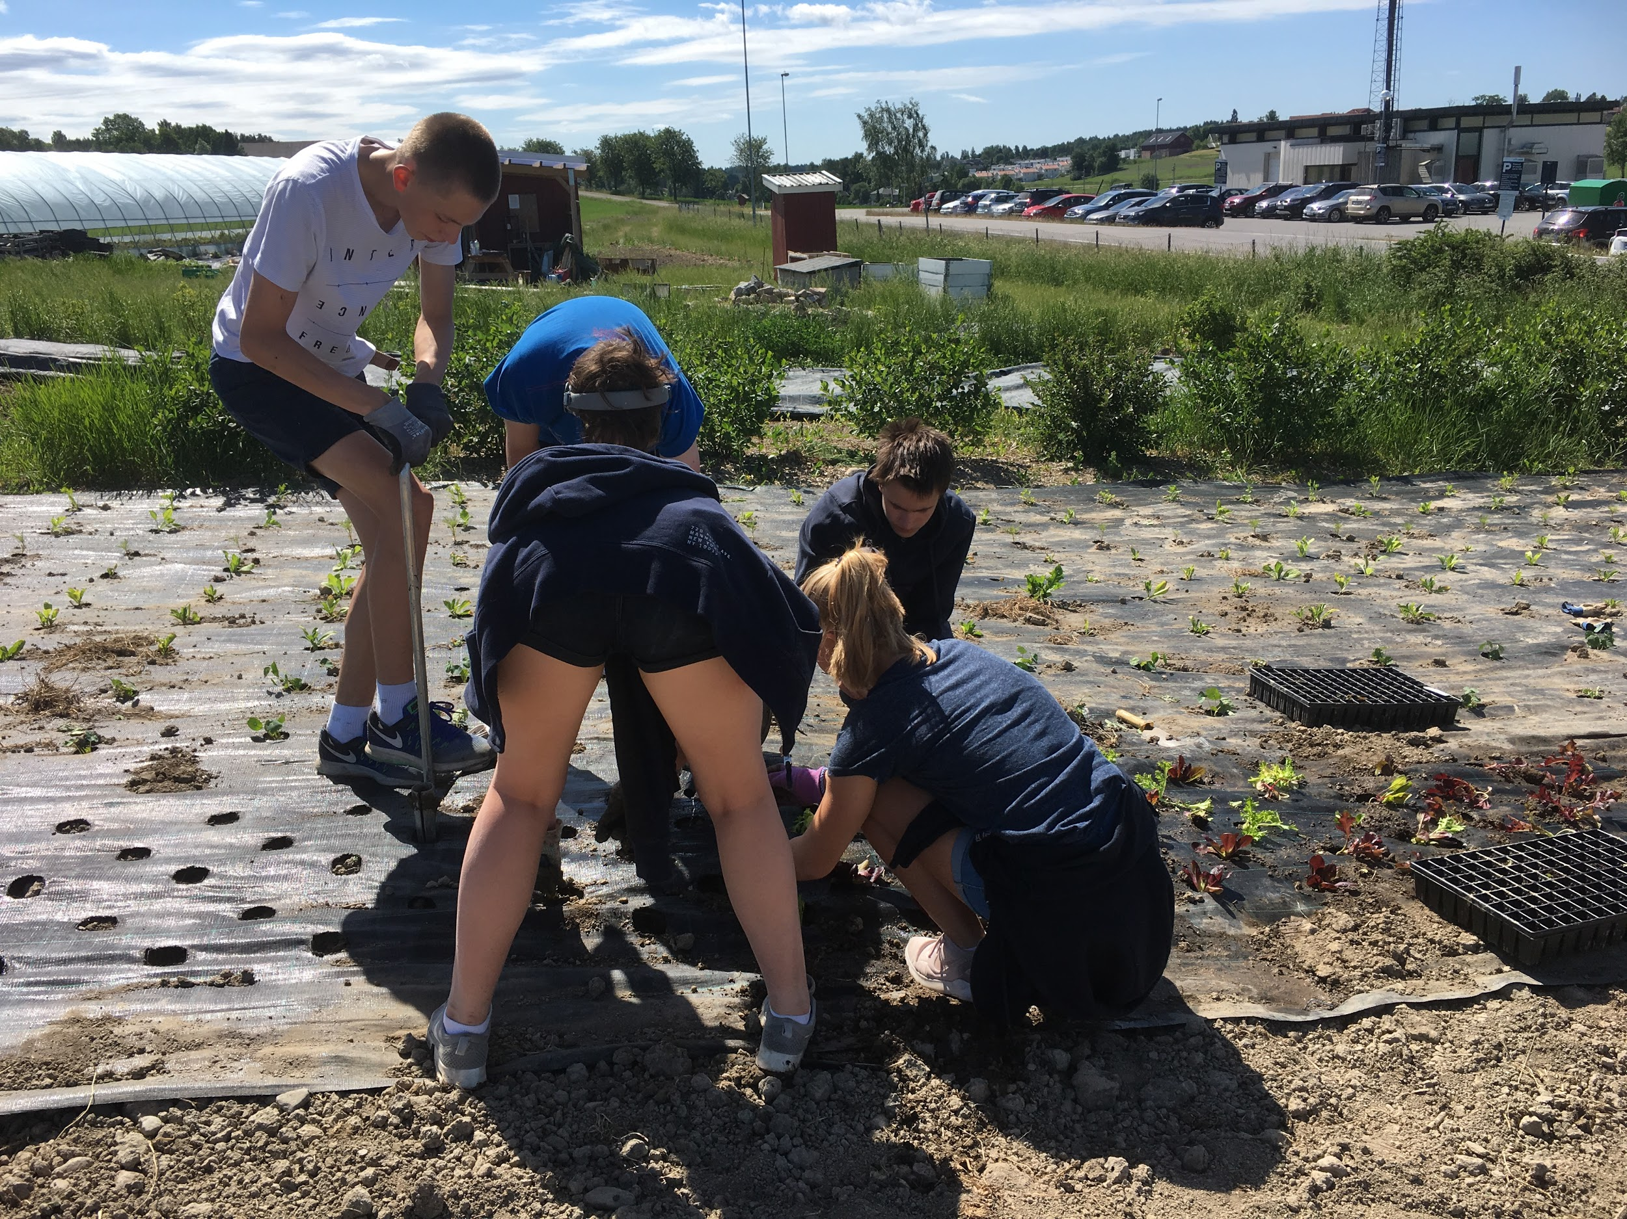
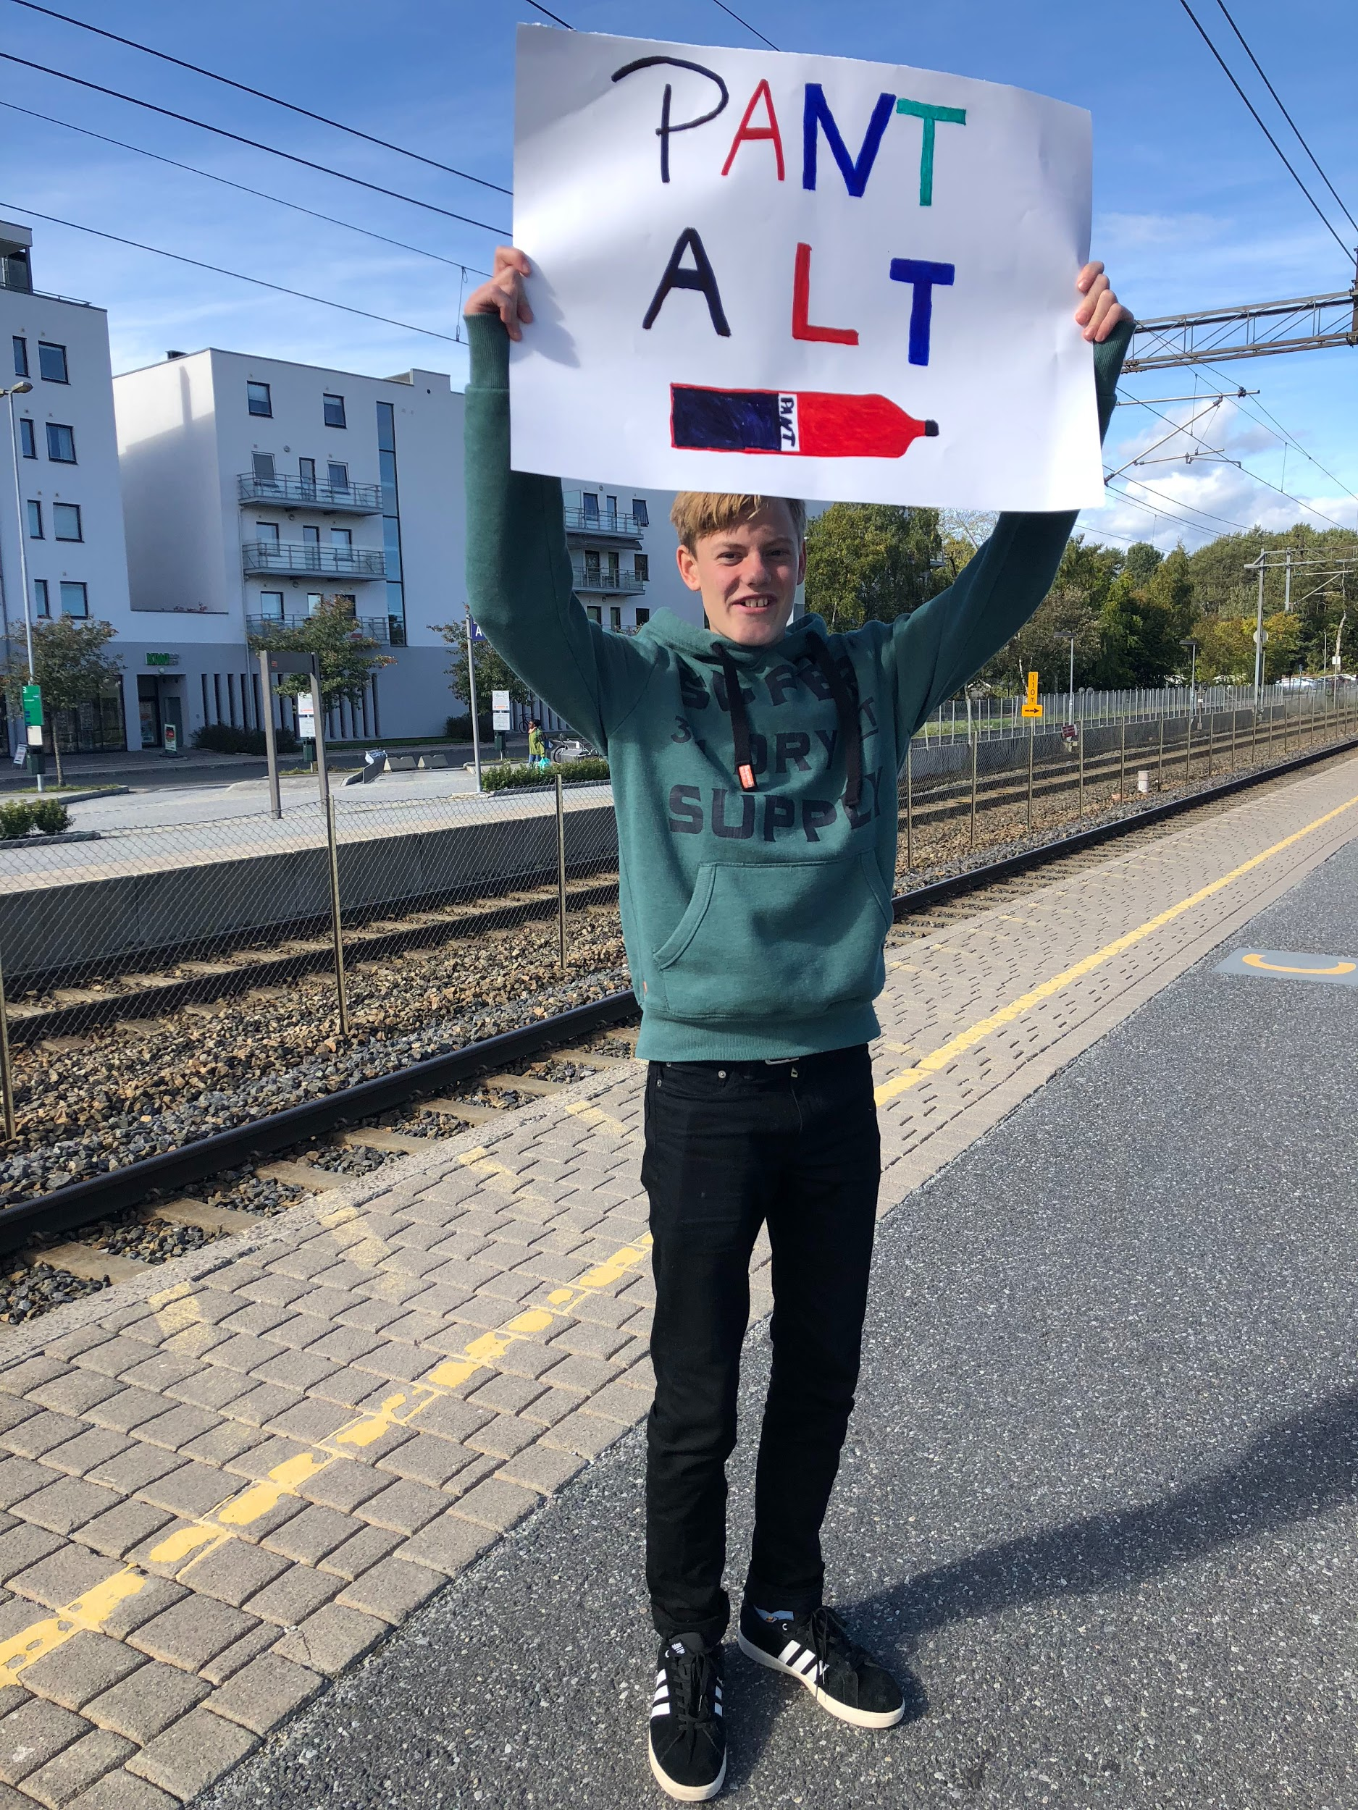
2) Taking action towards sustainability
Researching the phenomenon in question
cChange - in my own life
Sharing and inspiring: eTwinning and Social Media
Social activism
Entrepreneurship

Slide 6
3) Transcending boundaries: School - Society
Cooperating with NMBU/Science Center and local big-shots (Bjørn Samset, CICERO)
Inviting in local NGO’s: Amnesty, Nature and Youth, OD
Taking part in EWC’s Democracy-camp at Utøya:
Peer-to-peer workshop about Utøya and Democratic citizenship
Student led staff workshop about Utøya and Democratic citizenship

Slide 7
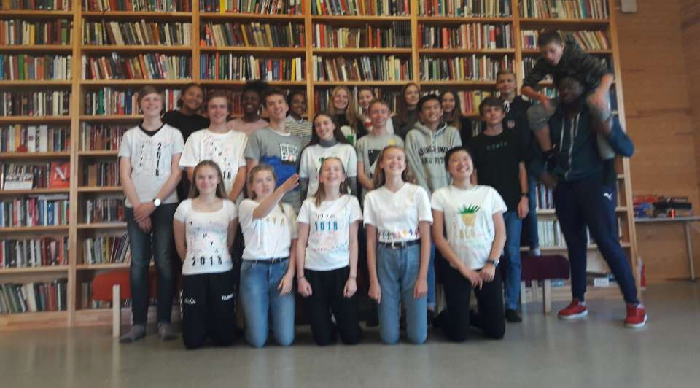
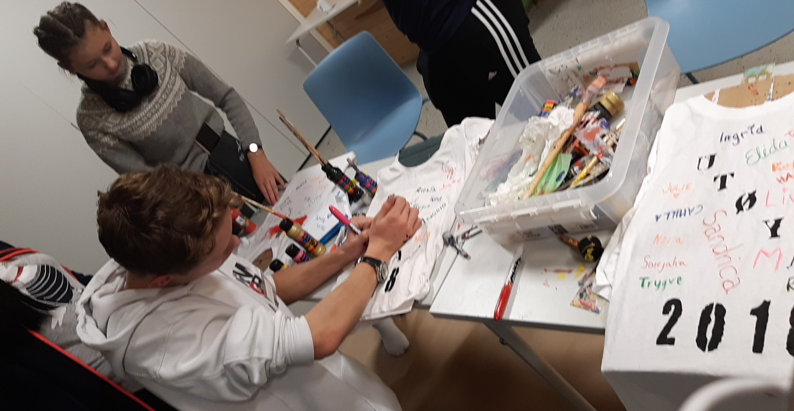
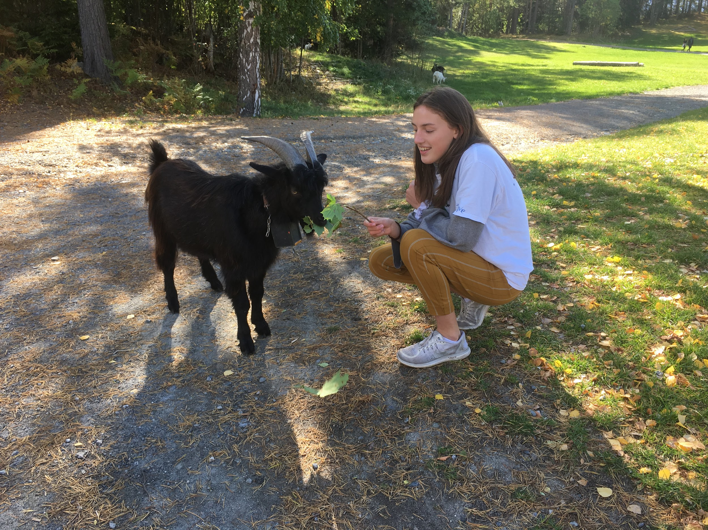
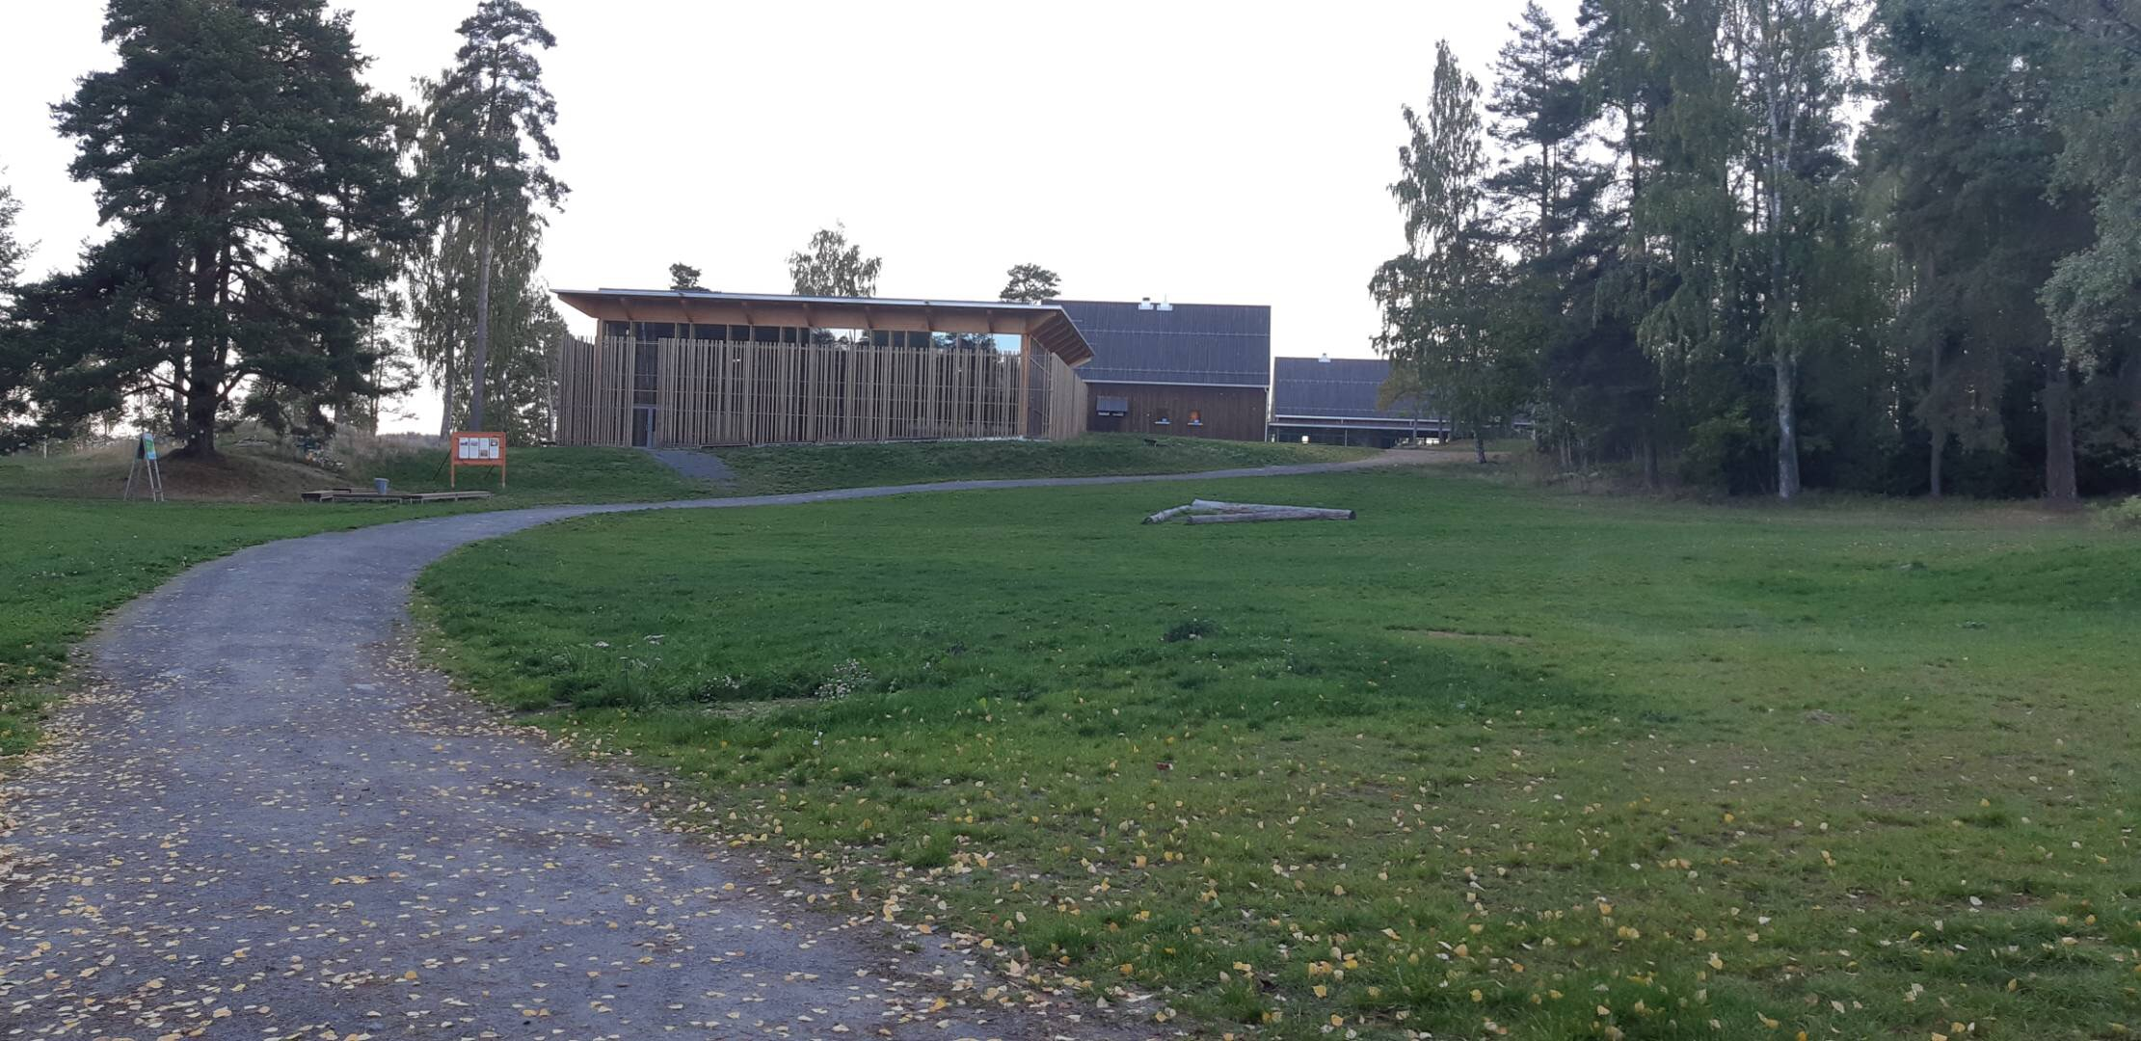
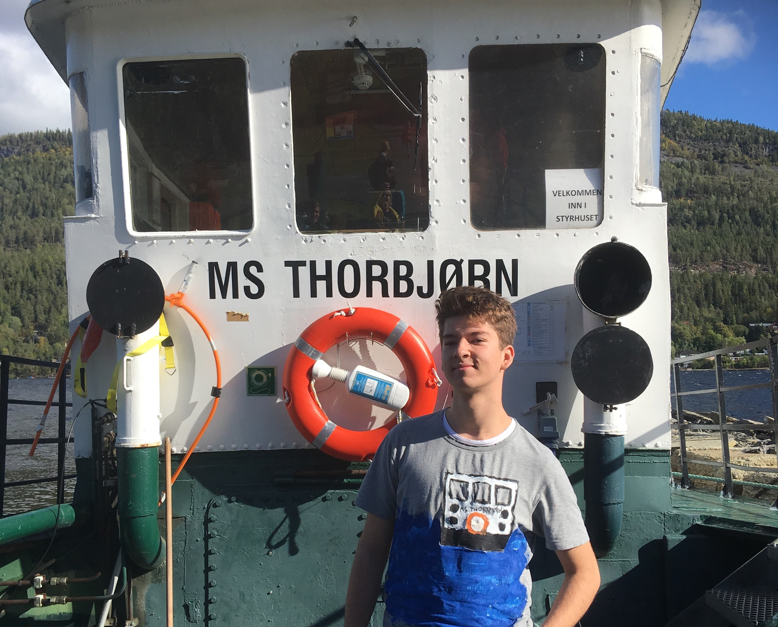
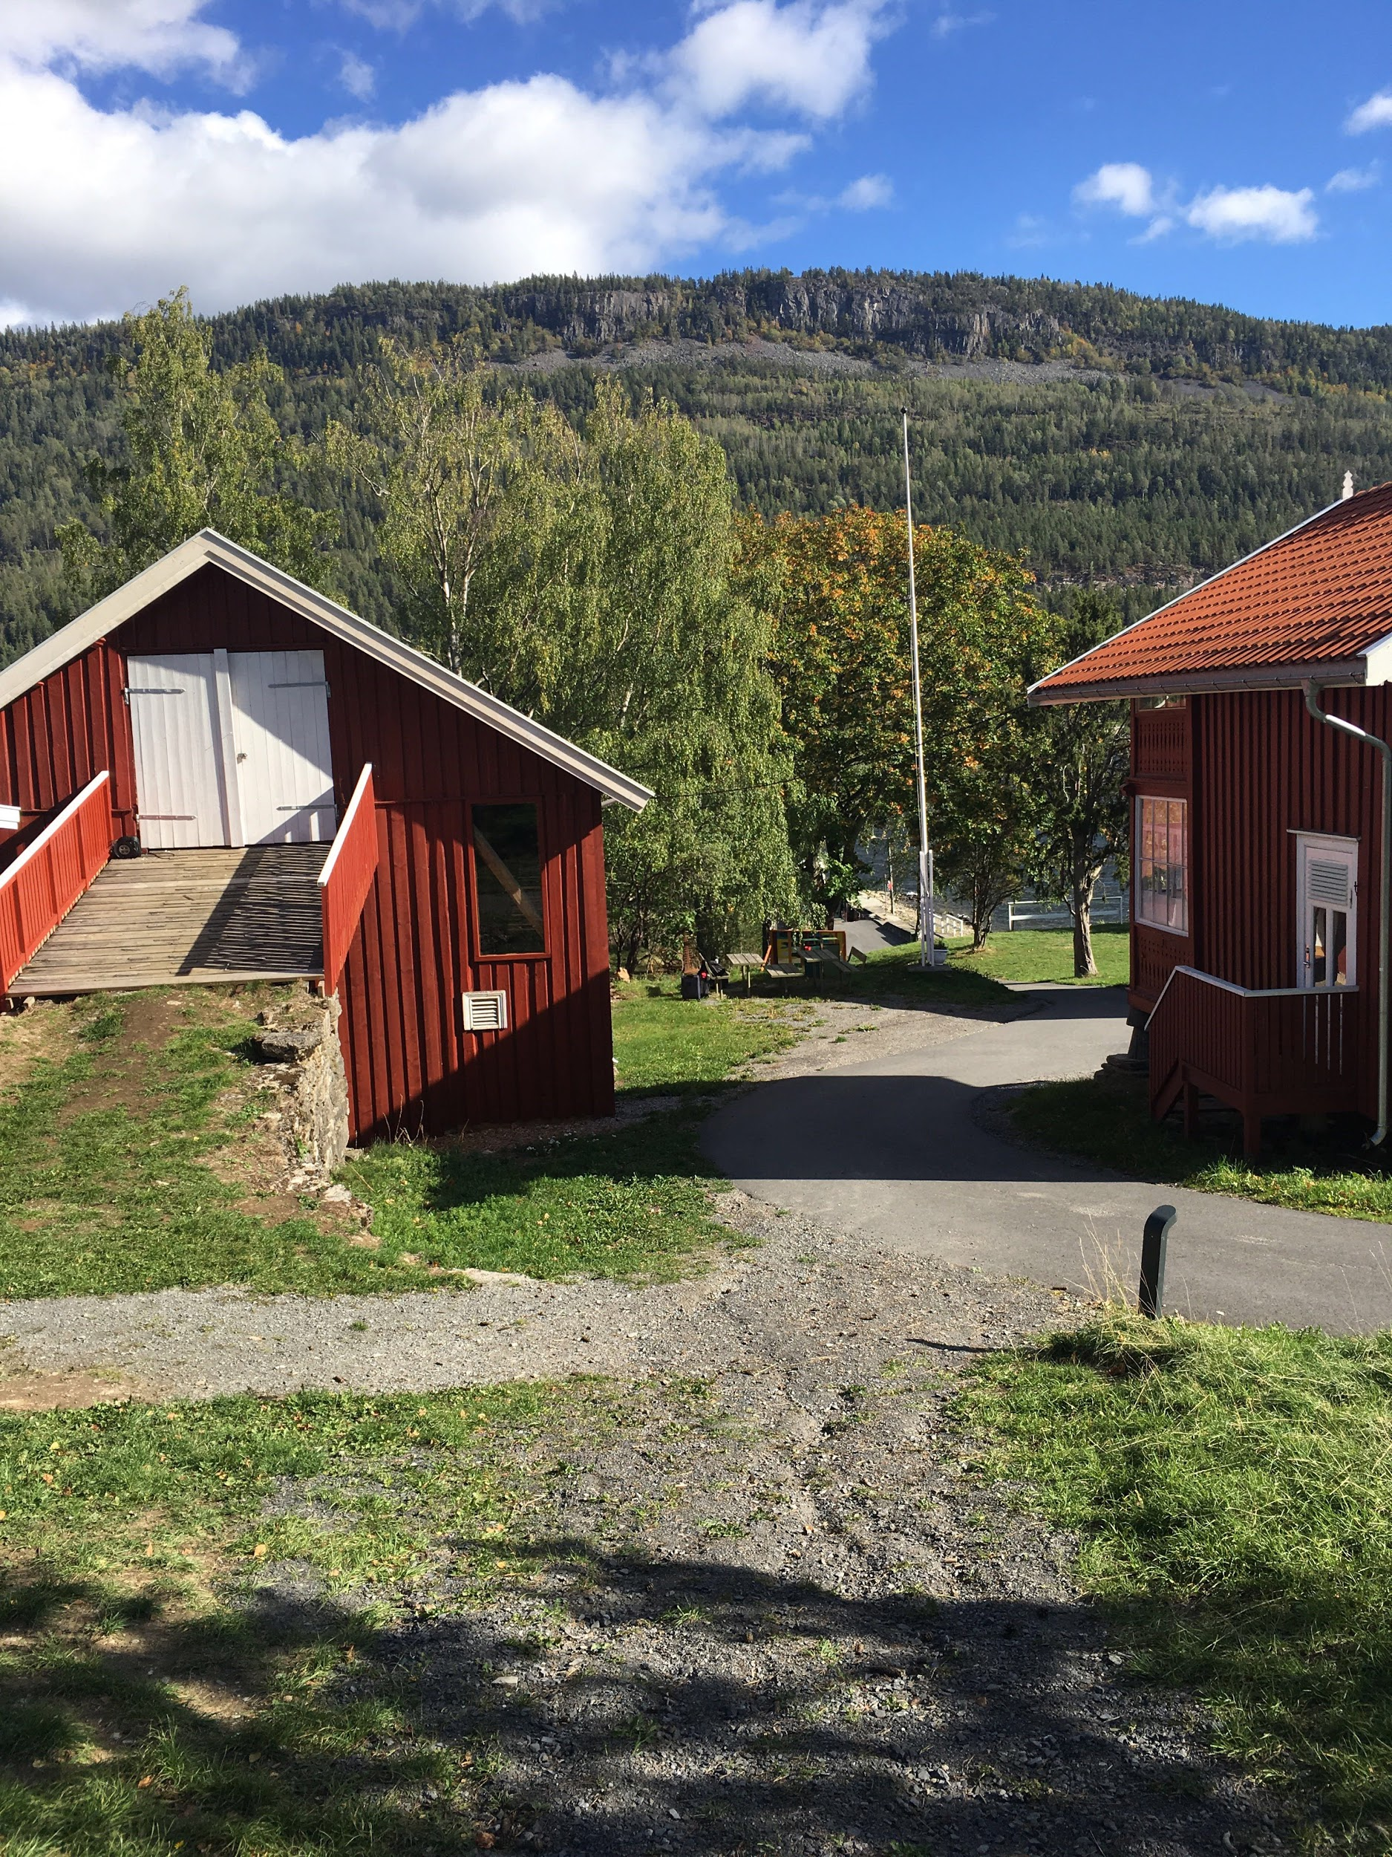
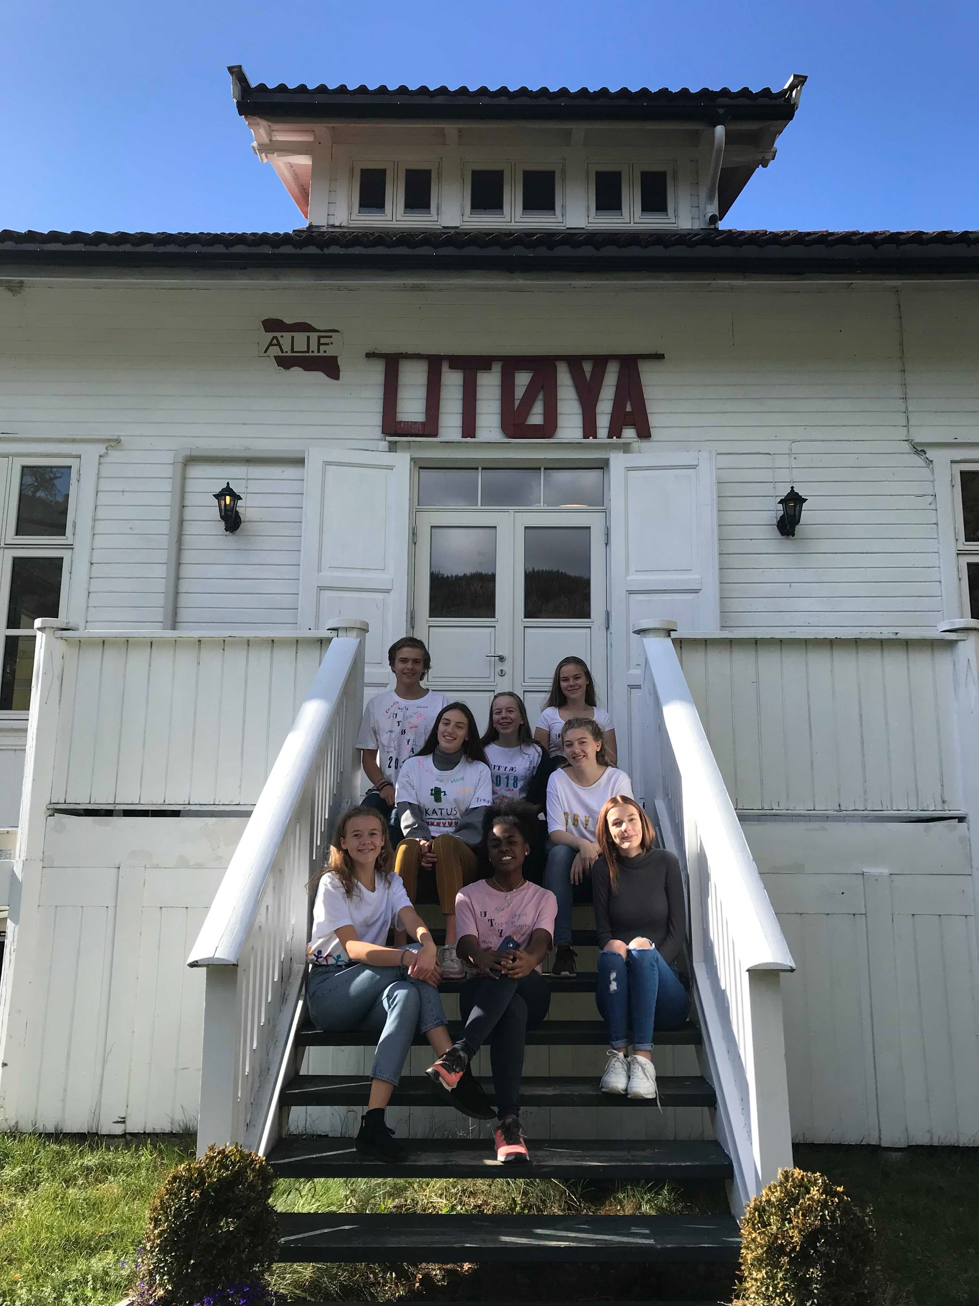
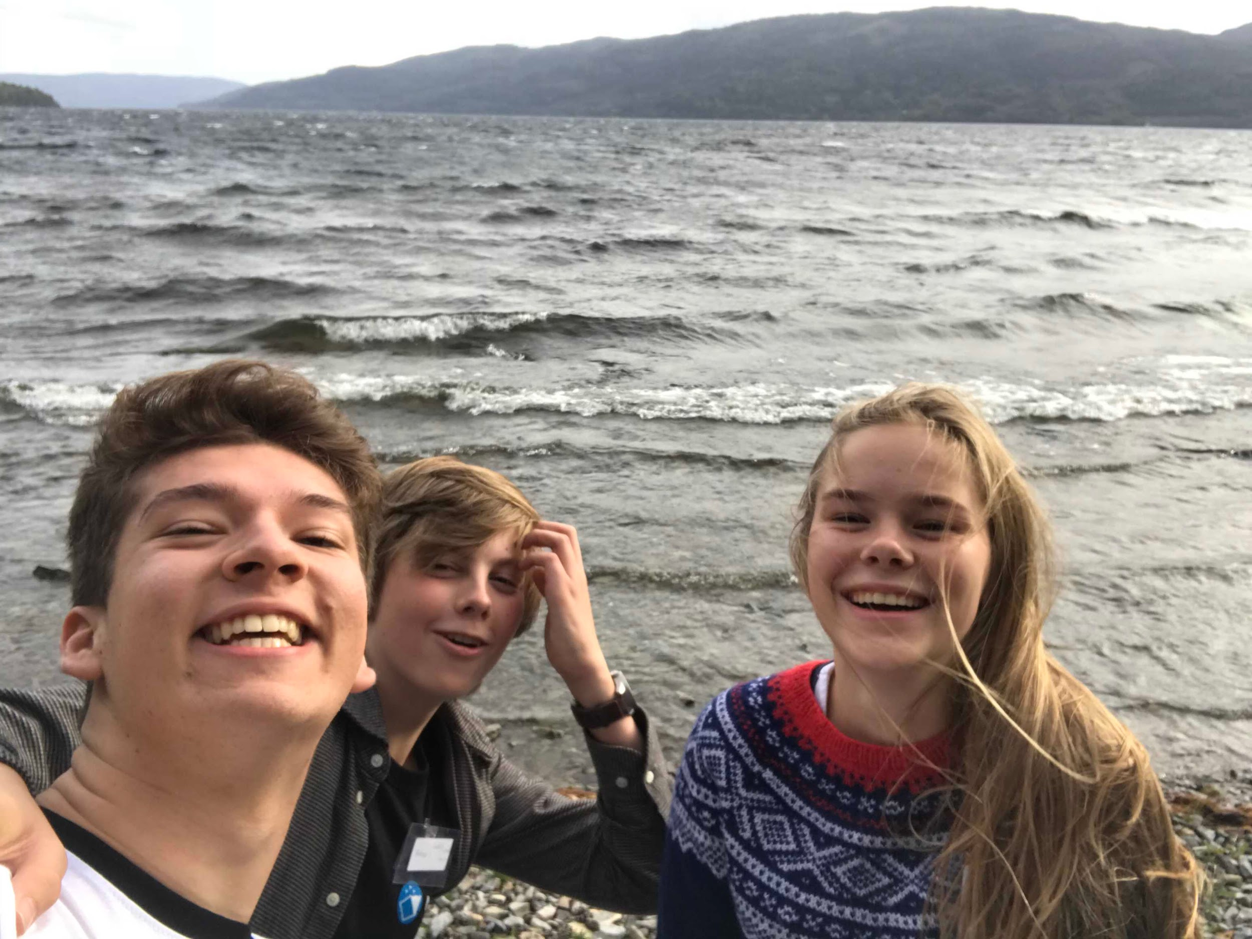

Slide 8
To conclude
“Be the Change” promotes sustainable learning (and teaching?) about sustainability and citizenship by empowering students.
Proof of the matter: Project students taking learning to the next step and former students returning to us as “autonomous social-activists”.
Inspired by our moderator Olena: I firmly believe that education can change the world:)
Happy to highlight the good practice and leave the critical scrutiny to the researchers;)

