Slide 1
museums in hagen

Slide 2
Themes
The names of museums
The History of museums

Slide 3
Hagen Open-air Museum (GERMAN: LWL-Freilichtmuseum Hagen )
LWL-Freilichtmuseum Hagen has many workshops in which the daily craftsmen work and show old craft technologies. In the company you can see how the craftsworker making nails by hand, roll cigarettes and making the ropes.

Slide 4
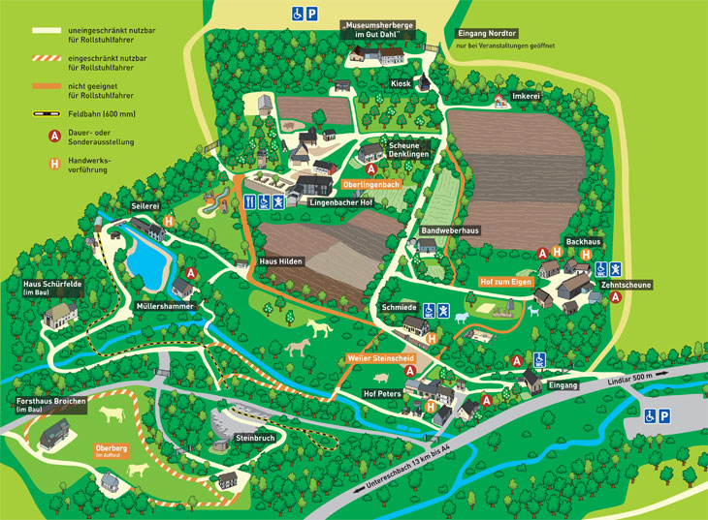
The Card of the LWL-Freilichtmuseum Hagen

Slide 5
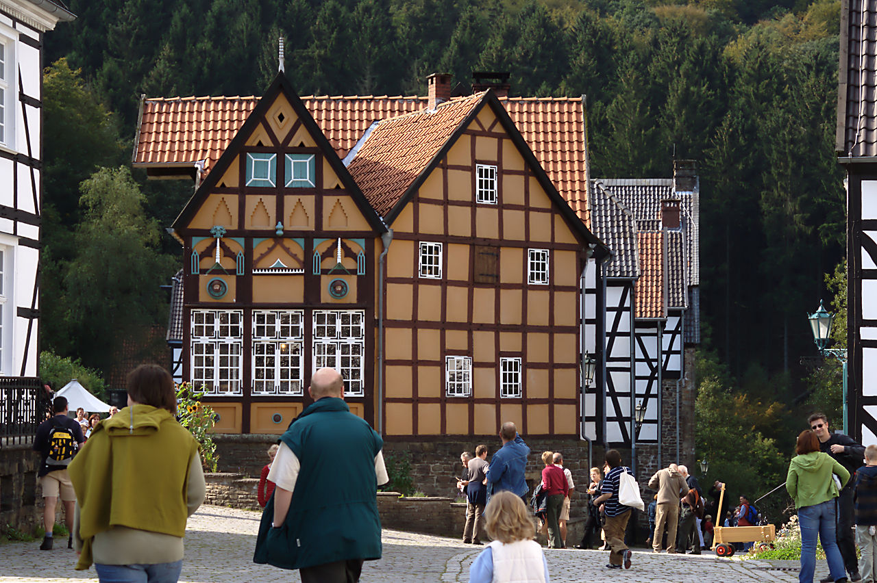
Visitors in front of the old tobacco manufactory

Slide 6
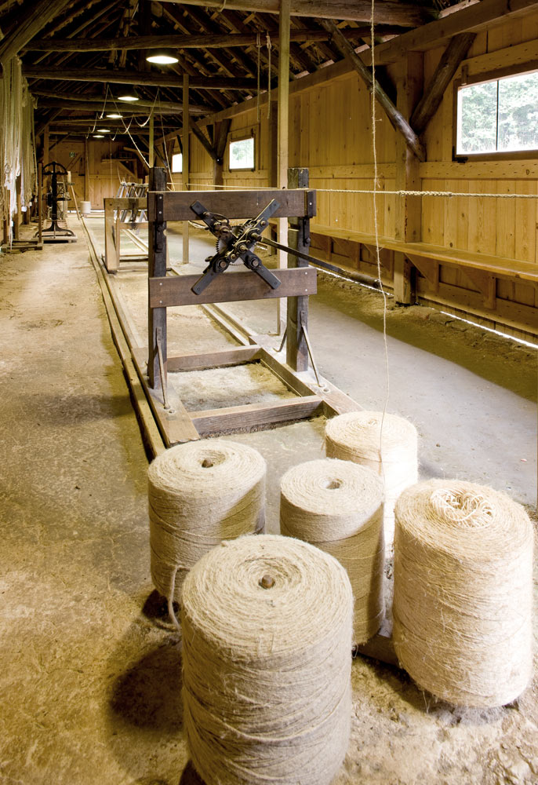
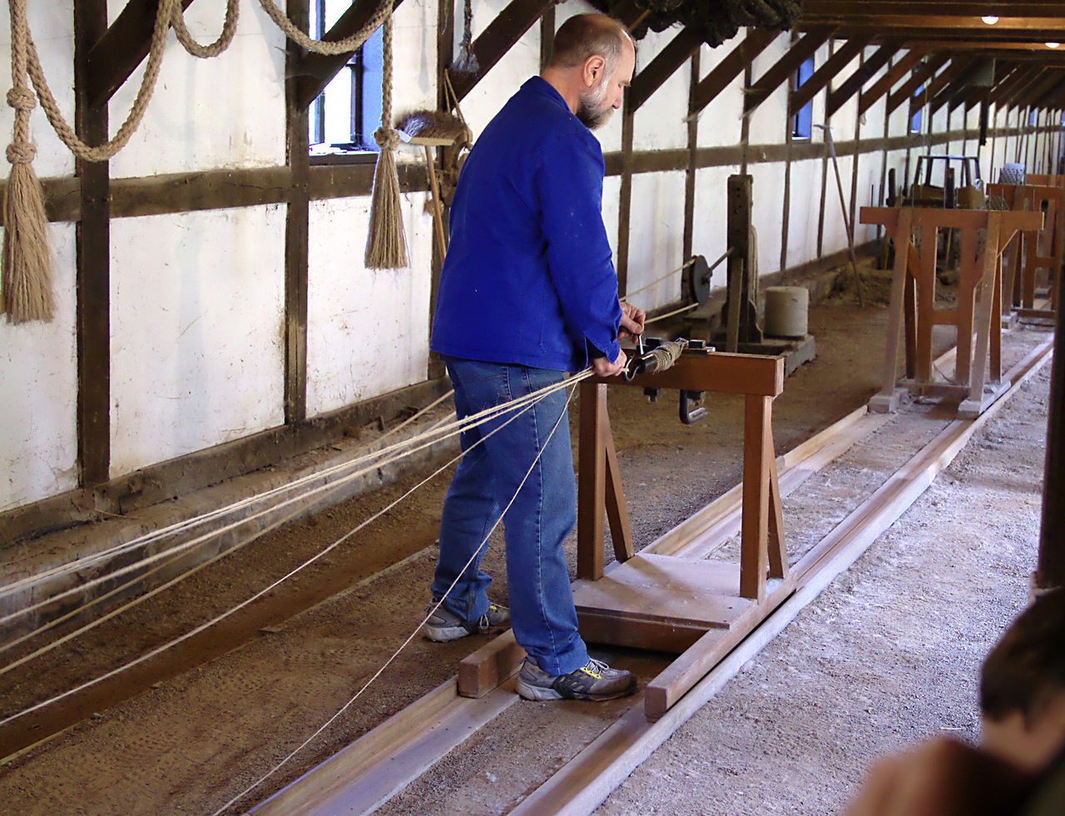
Ropemaking at the ropewalk

Slide 7
In the east house Museum Hagen you can see the collection departments classical modern age and contemporary art, partially with reference to the original Folkwang collection of Karl Ernst. In the historical foyer art is shown about 1900 To see the architecture of the recollection“ from Sigrid Sigurdsson also „ .
Osthaus Museum

Slide 8
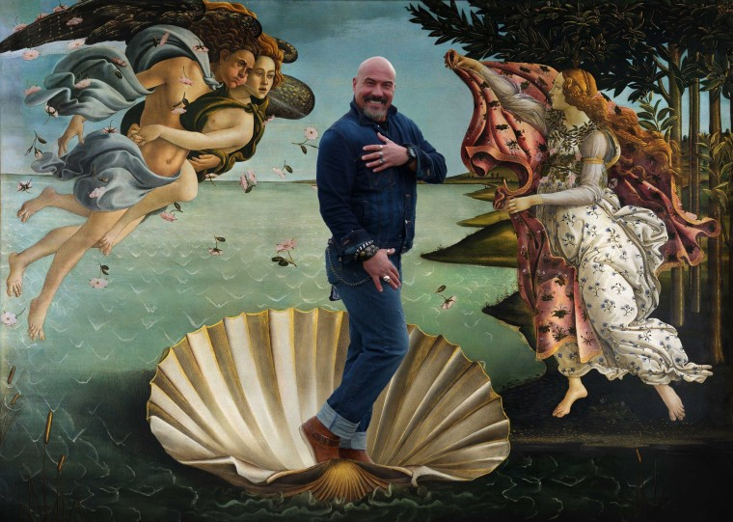
The Osthaus Museum has the 24 different exhibition from 22 January to 4 Juni 2017. There you have a opportunity to be a part of this art.

