Slide 1
LJUBLJANA SLOVENIA
Amela, Lea, Taja, Monika, Sara, Lara, Tajda, Nastja, Nina

Slide 2
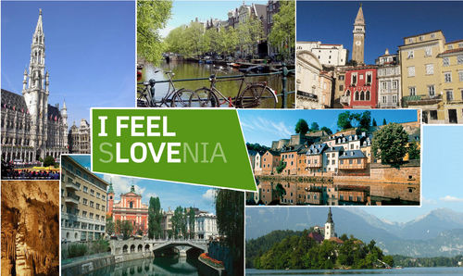
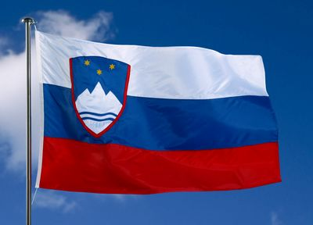
SLOVENIA
Republic of Slovenia is a nation state located in the Central Europe.
It is bordered by Italy to the west, Austria to the north, Hungary to the northeast, Croatia to the south and southeast, and the Adriatic Sea to the southwest.
Population: 2.065.895 (2017).

Slide 3
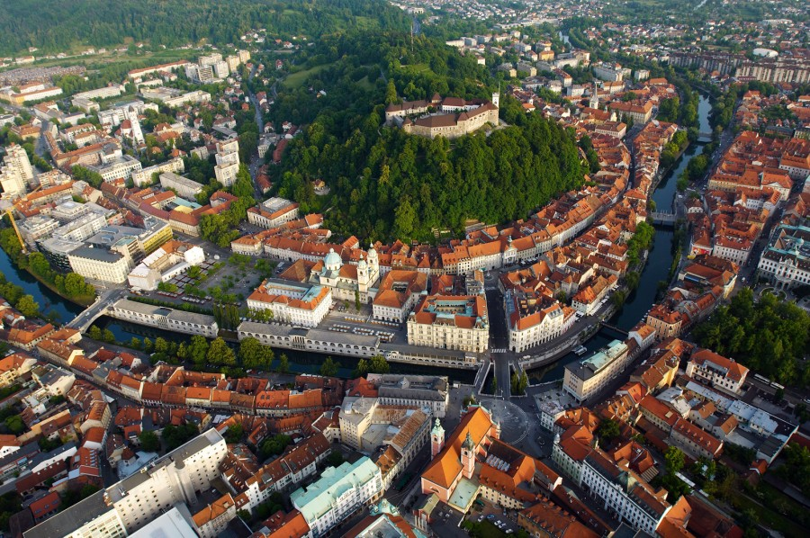
LJUBLJANA
Ljubljana is the capital and largest city of Slovenia.
It has been the cultural, educational, economic, political, and administrative center of independent Slovenia since 1991. Its central geographic location within Slovenia, transport connections, concentration of industry, scientific and research institutions, and cultural tradition are contributing factors to its leading position.
Population: 279.756 (2016)

Slide 4
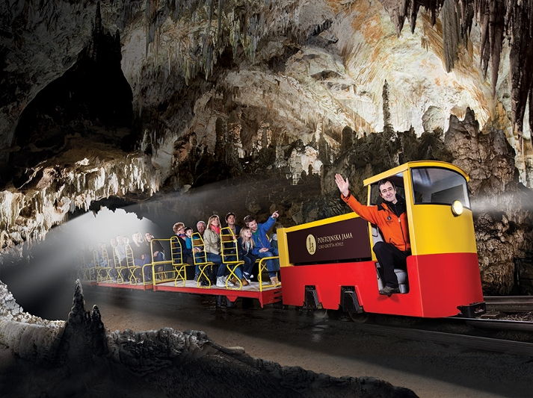
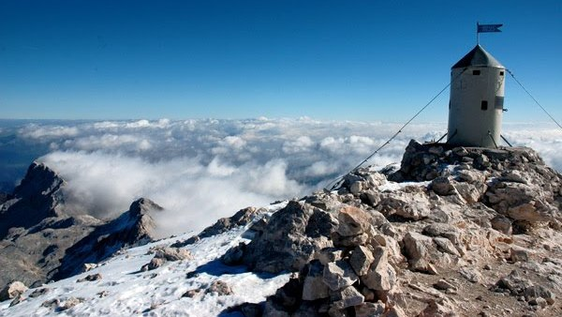
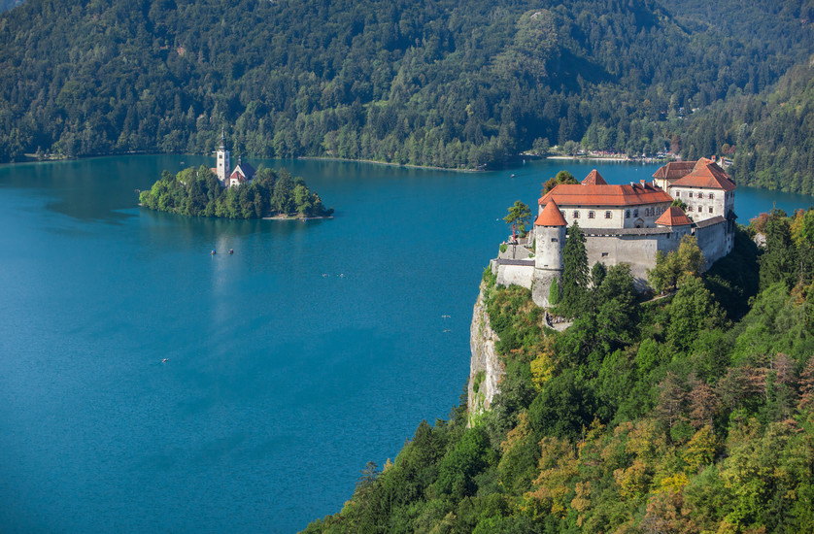
CULTURE - Slovenia
Slovenia has widespread built heritage, including 2.500 churches, 1.000 castles, ruins, and manor houses, farmhouses, and special structures to dry hay, called hayracks.
The most picturesque church is the medieval and Baroque building on Bled Island. The castle above the lake is a museum and restaurant with a view. Near Postojna there is an interesting fortress called the Predjama Castle, half hidden in a cave.
Triglav is the highest mountain in Slovenia and the highest peak of the Julian Alps.

Slide 5
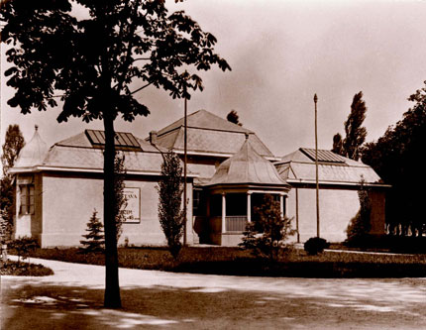
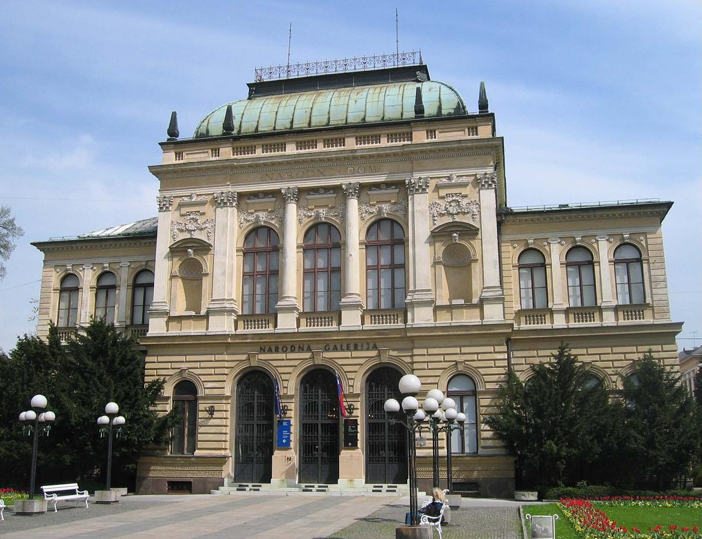
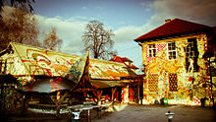
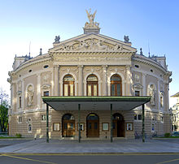
CULTURE - Ljubljana
Ljubljana has numerous art galleries and museums. The first purpose-built art gallery in Ljubljana was the Jakopič Pavilion, which was in the first half of the 20th century the central exhibition venue of Slovene artists.
The Slovenian Philharmonics is the central music institution in Ljubljana and Slovenia. It holds classical music concerts of domestic and foreign performers as well as educates youth.
A Ljubljana equivalent of the Copenhagen's Freetown Christiania, a self-proclaimed autonomous Metelkova neighbourhood, was set up in a former Austro-Hungarian barracks that were built in 1882 (completed in 1911).

Slide 6
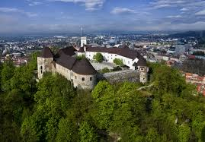
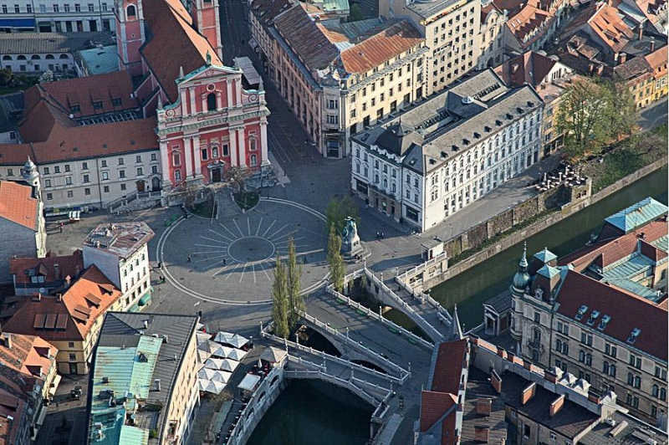
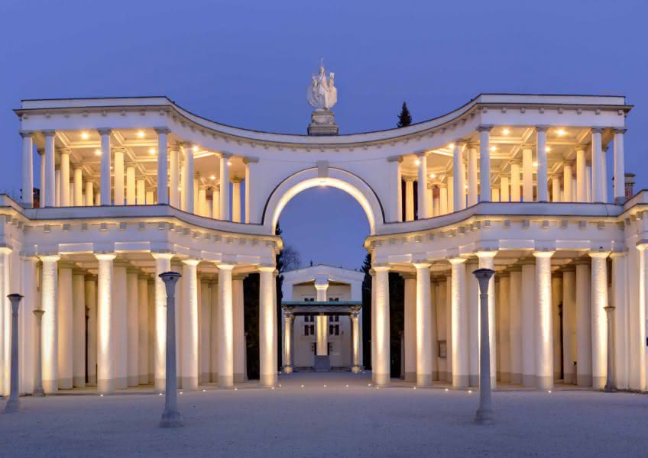
CITYSCAPE
The city's architecture is a mix of styles. Despite the appearance of large buildings, especially at the city's edge, Ljubljana's historic center remains intact. Although the oldest architecture has been preserved from the Roman period, Ljubljana's downtown got its outline in the Middle Ages.
Large sectors built in the inter-war period often include a personal touch by the architects Jože Plečnik and Ivan Vurnik. In the second half of the 20th century, parts of Ljubljana were redesigned by Edvard Ravnikar.
Ljubljana castle is a medieval castle with Romanesque, Gothic, and Renaissance architectural elements, located on the summit of Castle Hill, which dominates the city center.
Skyscraper is a thirteen-story building that rises to a height of 70.35 m.

Slide 7
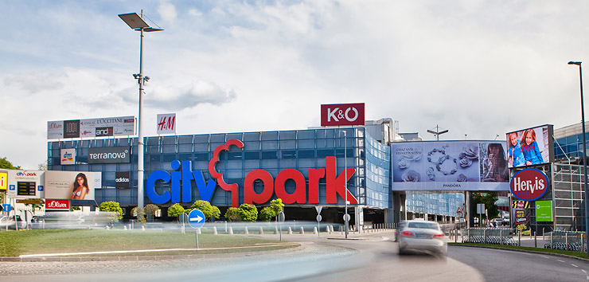
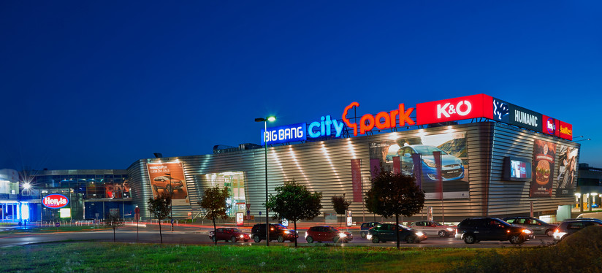
ECONOMY
Industry remains the most important employer, notably in the pharmaceuticals, petrochemicals and food processing. Other fields include banking, finance, transport, construction, skilled trades and services and tourism. The public sector provides jobs in education, culture, health care and local administration.
BTC City is the largest shopping mall, sports, entertainment and business area in Ljubljana.

