Slide 1
School of Economics Ljubljana
Prešernova 6
1000 Ljubljana, Slovenia

Slide 2
School with rich tradition

Slide 3
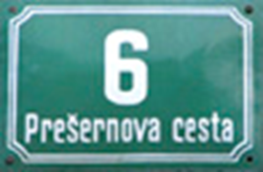
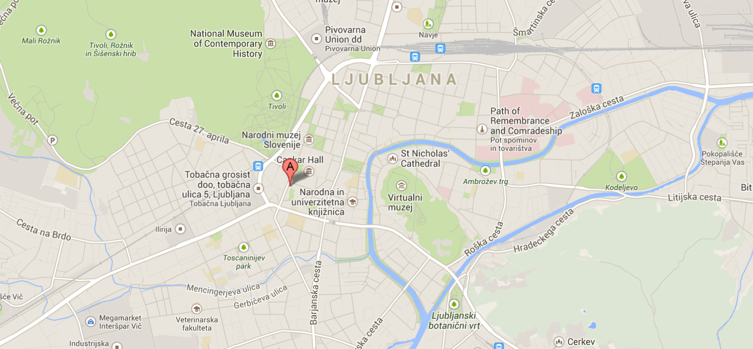
Location
City centre
Opposite of the presidential palace and government

Slide 4
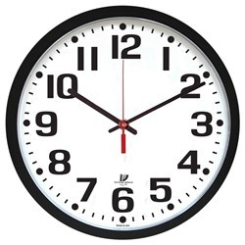
Schedule
Starts at 8:00.
Ends at 14:50.

Slide 5
Programs
Economic vocational school
enrolment: 3 departments
ends with vocational matura
Grammar school
enrolment: 2 departments
ends with matura

Slide 6
Economic technician
SUBJECTS
Slovenian language | 487 | 24
Art | 68 | 3
First foreign language | 417 | 20
Second foreign language | 204 | 10
Mathematics | 383 | 19
History | 102 | 5
Geography | 68 | 3
Sociology | 68 | 3
Psychology | 68 | 3
Chemistry | 105 | 5
Biology | 105 | 5
Gym | 340 | 14
Amount of hours in four years | 2415

Slide 7
MODULS (mandatory)
Business projects | 238 | 12
Business operations | 272 | 14
Business economics | 238 | 14
Introduction to economics | 340 | 21
Finance | 136 | 7
Commerce | 136 | 7
Insurance services | 102 | 6
Banking | 102 | 6
Accounting | 102 | 6
Business communication Business German/Italian Economics geography Matura exam preparations Additional informatics

Slide 8
Grammar school
SUBJECTS | 1. | 2. | 3. | 4. | SUM
Slovenian language | 4 | 4 | 4 | 4 | 560
Mathematics | 4 | 4 | 4 | 4 | 560
First foreign language | 3 | 3 | 3 | 3 | 420
Second foreign language | 3 | 3 | 3 | 3 | 420
Economics | 2 | 2 | 3 | 4 | 385
History | 2 | 2 | 2 |  | 210
Geography | 2 | 2 | 2 |  | 210
Biology | 3 | 2 |  |  | 175
Chemistry | 3 | 2 |  |  | 175
Music/art | 2 |  |  |  | 70
Sociology |  | 2 |  |  | 70
Psychology |  |  | 2 |  | 70
Informatics | 2 | 2 |  |  | 140
Business |  | 2 | 3 | 4 | 140
Gym | 3 | 3 | 3 | 3 | 420

Slide 9
Foreign languages
English (first foreign language)
German (second foreign language)
Italian (second foreign language)
Spanish (second foreign language)

Slide 10
Options for continouing studies
ECONOMIC TEHNICIAN
Higher education and higher education programs
Most university programs
ECONOMIC GRAMMAR SCHOOL
University study programs.
Higher education programs.

