Slide 1
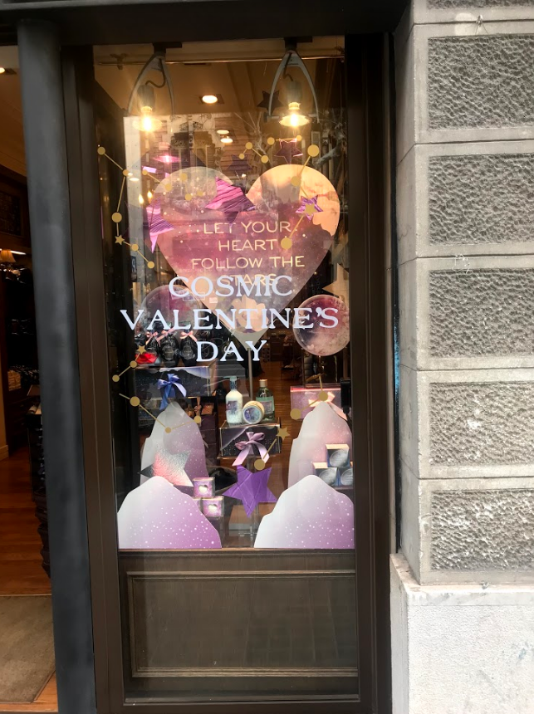
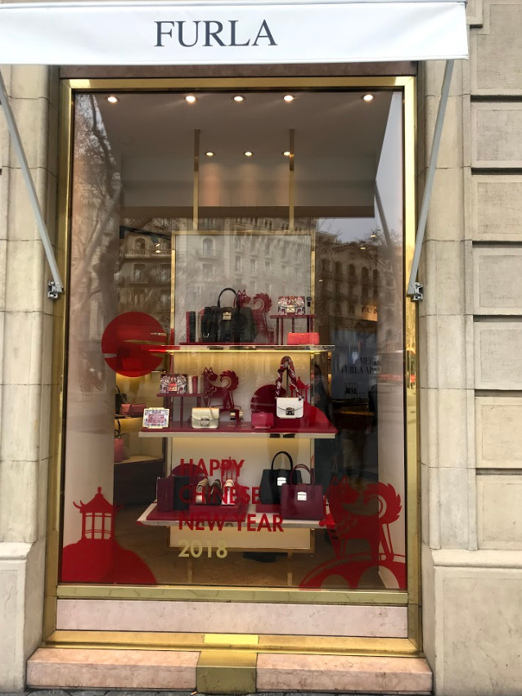
Valentine’s In Barcelona
Valentine’s is present in many shop windows in the center of Barcelona, mostly shops targeting women: jewelleries, clothes shops, chocolate shops...
Most of the signs are in English because it is a touristy area.
Red and pink were the predominant colours.
Many shop windows also included Chinese New Year’s displays.
Ivan + Hector + Jonatan

