Slide 1
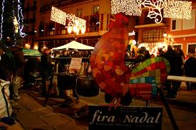
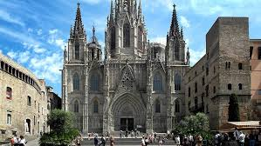
CHRISTMAS MARKETS IN CATALONIA
Emil Tihomirov
Alejandro Aponte

Slide 2
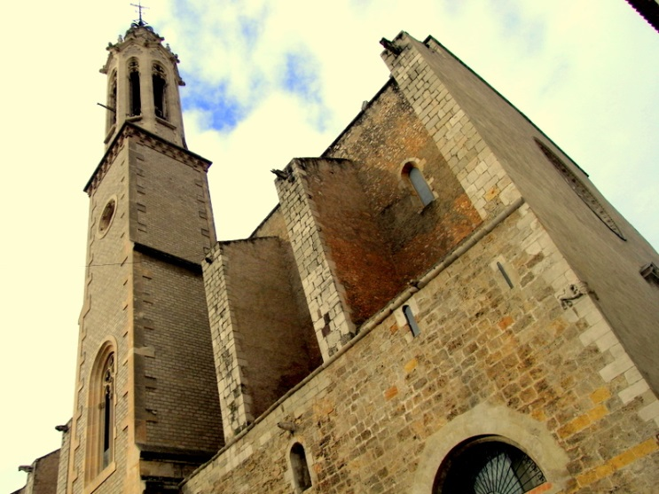
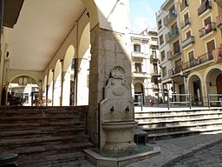
Christmas Market, Fair of capons, birds and Christmas reasons of Vall
This is one of the most typical and busy street markets of the year in the capital of Alt Camp. It has a wide range of live birds, trees and green, crib figures, wines and cavas, honey and sweets, ornamental objects ... It even has an approved slaughter service for those who want to pick up a bird when they want to buy it. dead and plucked -service common in this type of fairs-. It has the center of Valls, specifically the Plaza del Blat and its surroundings, where the main attractions of the city are concentrated.

Slide 3
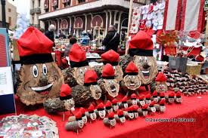
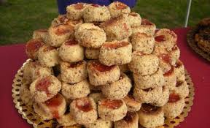
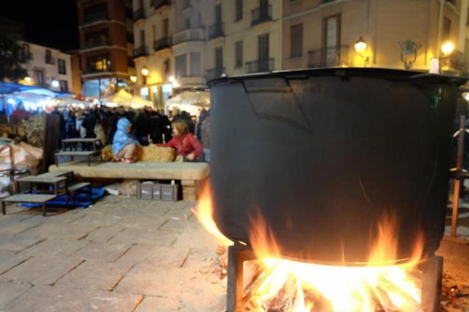
Christmas Fair of Caldes de Montbui
The Caldes de Montbui is the earliest fair. Maybe it does not have as much hype as the markets mentioned below, but we can say that it is at the same height. With 29 years of experience and 160 stops that invade the alleys of the old town, a good number of events accompany the Fair. The most anticipated moment is the popular tasting of the traditional Christmas broth, made with thermal water and cooked over a wood fire in the largest pot in Catalonia. More than 5,000 servings come out! A fact that could very possibly enter the Guinness Book of Records.

Slide 4
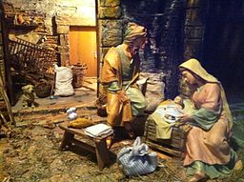
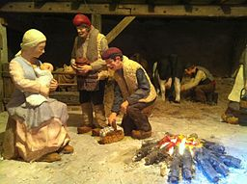
Olot Nativity Fair
During the month of December Olot becomes the capital of the manger. During the first weekend the Crib Fair is held where you can buy the traditional figurines, but also nougat, Christmas trees, handicraft products and objects to decorate the house. Parallel and until the day of Kings in different spaces of the city is celebrated the Sample of Cribs. The modernist architecture stands out among the attractions of Olot, but the visit to the Fair can also be the perfect excuse to visit the sites of the Natural Park of the Garrocha Volcanic Zone.

Slide 5
Barcelona's cathedral
This is one of the most famous markets of Catalonia, it is celebrated in front of the Cathedral of Barcelona.

