Slide 2
Présentation
Black Friday 2017 is already started.
While the date of this day of massive promos in the traditional trade and especially online is set to 24 November, the first discounts are already offered on sites like Groupon. The group shopping site launched its "Black Friday Preview", starting last week with significant discounts
Every year, Americans rush after Thanksgiving in the shops

Slide 3
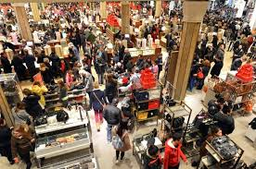
What is the black Friday for?
The principle of this day very popular with Americans? Monster discounts in many stores, giving rise to real human tides, and a bitter commercial battle between signs.

Slide 4
why is it called black Friday?
Black Friday (literally Black Friday, sometimes translated as crazy Friday) 1,2, takes place the day after the Thanksgiving meal. It traditionally marks the start of the end-of-year shopping period. Several traders take advantage of this moment to offer large balances.

Slide 5
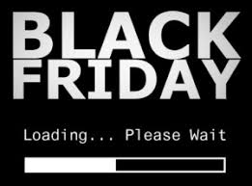
what are the type of discount during black friday
Black Friday, it's great sales before the time that usually mark the launch of Christmas shopping. (up to -70, -80%)

Slide 6
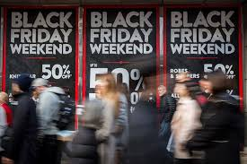
Advertising for black friday

Slide 7
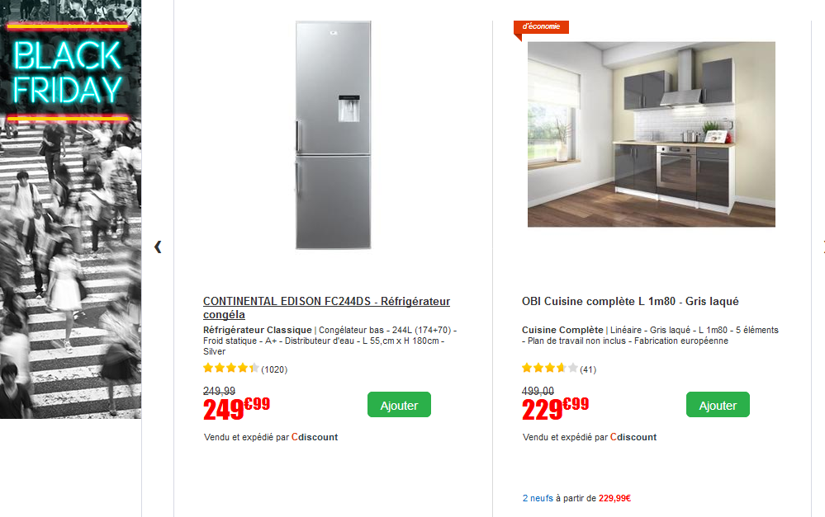
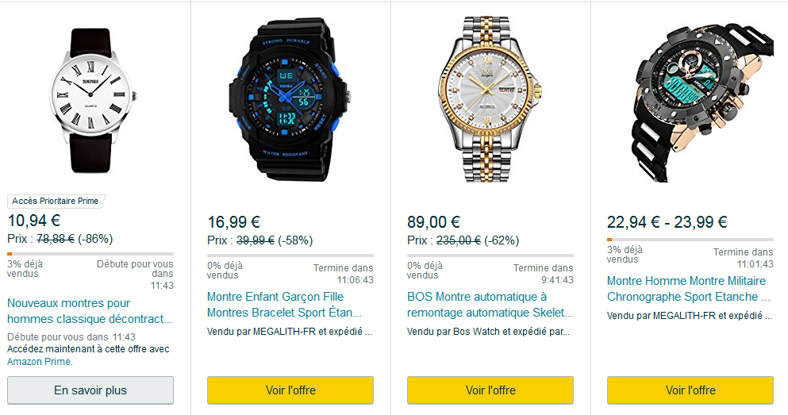
Black Friday in France

Slide 8
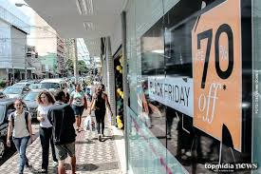
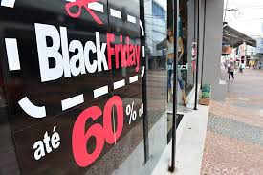
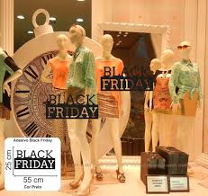
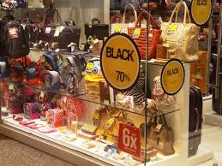
showcase for black friday

